Slide 1
Chapter No-6
HEAT TRANSFER
Marks-16

Slide 2
C404.4-Describe construction and working of nozzle, governors,steam turbine and heat exchanger.

Slide 3
Heat exchanger
A heat exchanger is a piece of equipment built for efficient heat transfer from one medium to another.
The media may be separated by a solid wall to prevent mixing or they may be in direct contact.
They are widely used in space heating, refrigeration, air conditioning, power plants, chemical plants, petrochemical plants, petroleum refineries, natural gas processing, and sewage treatment.
The classic example of a heat exchanger is found in an internal combustion engine in which a circulating fluid known as engine coolant flows through radiator coils and air flows past the coils, which cools the coolant and heats the incoming air.

Slide 4
classification
Classification of Heat Exchangers by Flow Configuration
There are four basic flow configurations:
Counter Flow
Cocurrent Flow
Crossflow
Hybrids such as Cross Counterflow and Multi Pass Flow

Slide 5

Classification of Heat Exchangers by Flow Configuration
Figure 1 illustrates an idealized counter flow exchanger in which the two fluids flow parallel to each other but in opposite directions.
This type of flow arrangement allows the largest change in temperature of both fluids and is therefore most efficient (where efficiency is the amount of actual heat transferred compared with the theoretical maximum amount of heat that can be transferred).

Slide 6
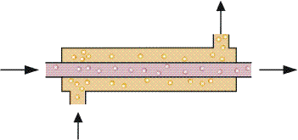
Classification of Heat Exchangers by Flow Configuration
In cocurrent flow heat exchangers, the streams flow parallel to each other and in the same direction as shown in Figure .
This is less efficient than countercurrent flow but does provide more uniform wall temperatures.

Slide 7
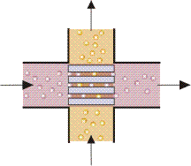
Classification of Heat Exchangers by Flow Configuration
Cross flow heat exchangers are intermediate in efficiency between countercurrent flow and parallel flow exchangers.
In these units, the streams flow at right angles to each other as shown in Fig.

Slide 8
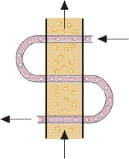
Classification of Heat Exchangers by Flow Configuration
In industrial heat exchangers, hybrids of the above flow types are often found.
Examples of these are combined cross flow/counter flow heat exchangers and multi pass flow heat exchangers.

Slide 9
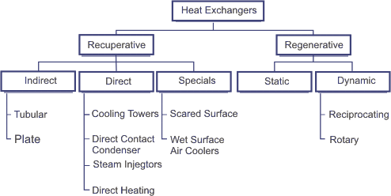
Classification of Heat Exchangers by Construction

Slide 10
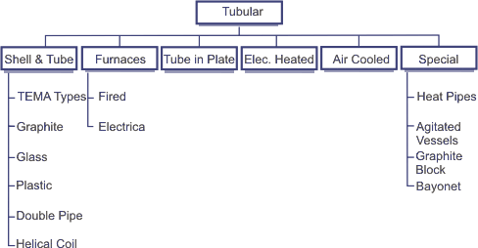
Classification of Heat Exchangers by Construction

Slide 11
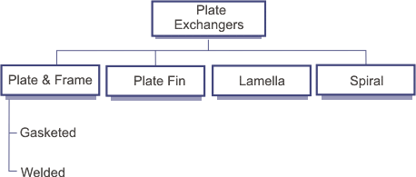
Classification of Heat Exchangers by Construction

Slide 12
Classification of Heat Exchangers by Construction
A Recuperative Heat Exchanger has separate flow paths for each fluid and fluids flow simultaneously through the exchanger exchanging heat across the wall separating the flow paths.
A Regenerative Heat Exchanger has a single flow path, which the hot and cold fluids alternately pass through.
In a regenerative heat exchanger, the flow path normally consists of a matrix, which is heated when the hot fluid passes through it (this is known as the "hot blow"). This heat is then released to the cold fluid when this flows through the matrix (the "cold blow").

Slide 13
Shell and tube heat exchanger
Shell and tube heat exchangers consist of a series of tubes.
One set of these tubes contains the fluid that must be either heated or cooled.
The second fluid runs over the tubes that are being heated or cooled so that it can either provide the heat or absorb the heat required.
A set of tubes is called the tube bundle and can be made up of several types of tubes: plain, longitudinally finned, etc.
Shell and tube heat exchangers are typically used for high-pressure applications (with pressures greater than 30 bar and temperatures greater than 260 °C).
This is because the shell and tube heat exchangers are robust due to their shape.

Slide 14
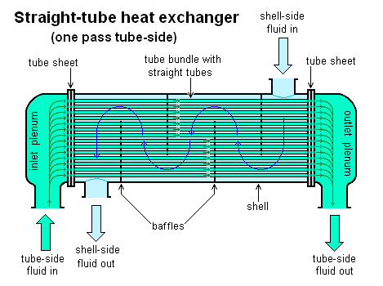
Shell and tube heat exchanger

Slide 15
Applications and uses
The simple design of a shell and tube heat exchanger makes it an ideal cooling solution for a wide variety of applications.
One of the most common applications is the cooling of hydraulic fluid and oil in engines, transmissions and hydraulic power packs.
With the right choice of materials they can also be used to cool or heat other mediums, such as swimming pool water or charge air.
One of the big advantages of using a shell and tube heat exchanger is that they are often easy to service, particularly with models where a floating tube bundle (where the tube plates are not welded to the outer shell) is available.

Slide 16
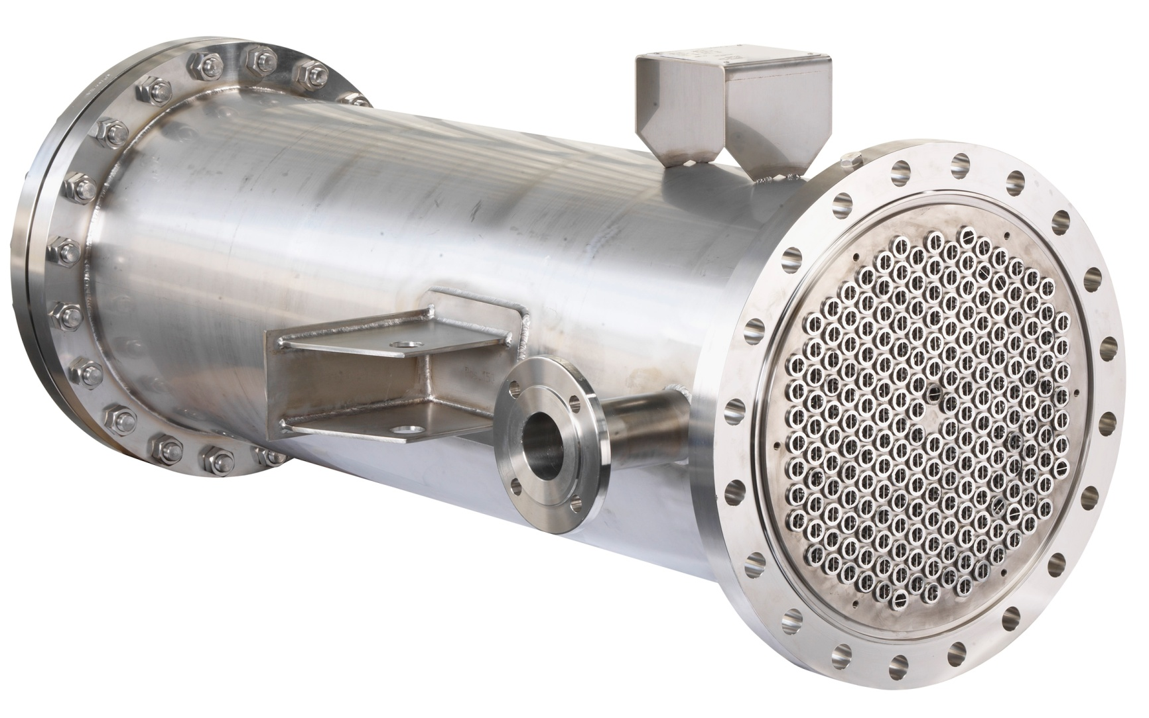
Shell and tube

Slide 17
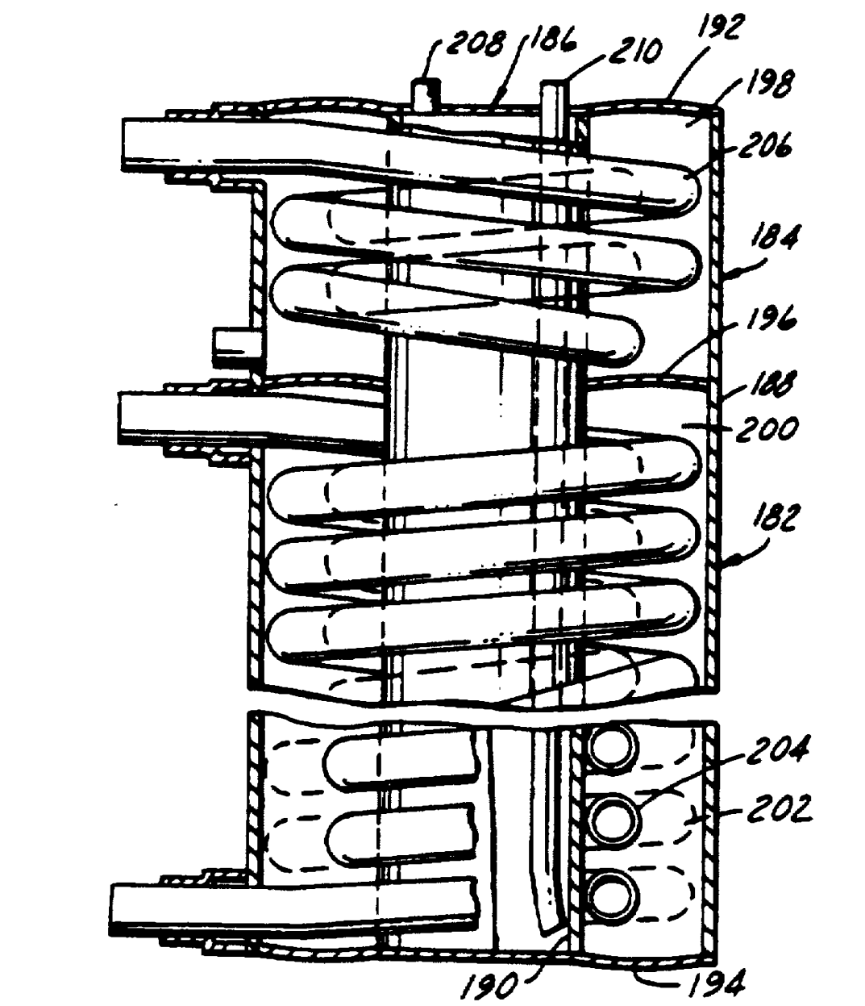
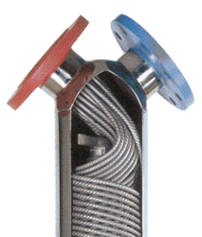
Shell and Coil Heat Exchangers

Slide 18
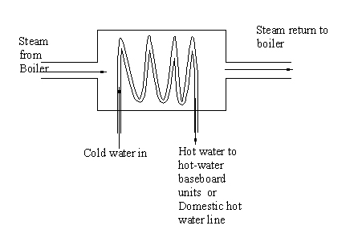
Shell and coil

Slide 19
Shell and Coil Heat Exchangers
The shell and coil heat exchangers are constructed using circular layers of helically corrugated tubes placed inside a light compact shell.
The fluid in each layer flows in the opposite direction to the layer surrounding it, producing a criss-cross pattern.
The large number of closely packed tubes creates a significant heat transfer surface within a light compact shell.
The alternate layers create a swift uniform heating of fluids increasing the total heat transfer coefficient.
The corrugated tubes produce a turbulent flow where the desired feature of fluctuating velocities is achieved.

Slide 20
Advantages of the shell and coil heat exchangers:
The shell and coil design is the perfect choice whenever high heat transfer rates, compact design and low maintenance costs are high priorities. Other benefits include:
High Performance: the unique coil arrangement has a large heat transfer area meaning high heat transfer coefficients.
Compact and Lightweight: closely packed tubes makes our shell and coil exchangers compact and lightweight. Small footprint makes it easy to install where space is limited and hard to access.
Low Maintenance Costs: corrugated tube design produces a high turbulent flow, which reduces deposit build-up and fouling. This means longer operating cycles between scheduled cleaning intervals.
Low Installation Costs: vertical installation makes it ideal for hydronic heating and cooling systems where space is an issue.

Slide 21
Advantages of the shell and coil heat exchangers:
Higher Temperature Differentials: helical design allows for higher temperatures and extreme temperature differentials without high stress levels and costly expansion joints.
Flexible Designs: variety of model types and configurations allow shell and coil heat exchangers to be used with a wide range of pressures, temperatures, and flows.
Low Pressure Drop:
Easy selection based on sub-station space requirements and heat or cooling load.

Slide 22
Shell and Coil Heat Exchangers
Shell and Coil Applications:
The shell and coil design were designed specifically for the hydronic markets including:
Heating Systems:
Chilled Water Systems:
Ground Water Systems:
Residential Use:
District Heating Systems: heating systems that distribute heat from one or more heating sources to multiple buildings.
Shell & Coil Heat Exchangers are designed for steam-water, water-water and glycol applications

Slide 23
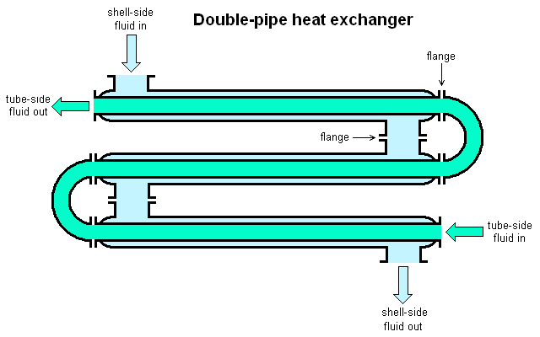
Pipe in Pipe Heat Exchanger

Slide 24
Pipe in Pipe Heat Exchanger
A Double Pipe Heat Exchanger is one of the simplest forms of Shell and Tubular Heat Exchanger.
Here, just one pipe inside another larger pipe. To make a Unit very Compact, The Arrangement is made Multiple Times and Continues Serial and Parallel flow.
One fluid flows through the surrounded by pipe and the other flows through the annulus between the two pipes.
The wall of the inner pipe is the heat transfer surface. This is also called as a hairpin Heat Exchanger.
These are might have only one inside pipe, or it may have multiple inside tubes, but it will forever have the doubling back feature shown.
In some of the Special Cases the Fins also Used in Tube side

Slide 25
Advantages
A primary advantage of a hairpin or double pipe heat exchanger is to facilitate it can be operated in a true counter flow pattern, which is the a large amount efficient flow pattern.
That is, it will give the highest overall heat transfer coefficient for the double pipe heat exchanger design.
Also, hairpin and double pipe heat exchangers can handle high pressures and temperatures well. When they are operating in true counter flow, they can operate among a temperature cross, that is, where the cold side outlet temperature is higher than the hot side outlet temperature.
The primary advantage of a concentric configuration, as opposed to a plate or shell and tube heat exchanger, is the simplicity of their design.

Slide 26
Advantages
As such, the insides of both surfaces are easy to clean and maintain, making it ideal for fluids that cause fouling.

Slide 27
Disadvantages
There are significant disadvantages however, the two most noticeable being their high cost in proportion to heat transfer area;
and the impractical lengths required for high heat duties.
They also suffer from comparatively high heat losses via their large, outer shells.

Slide 28
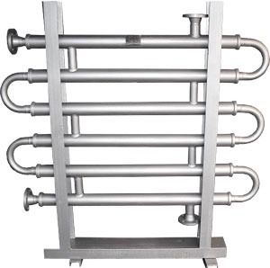
Pipe in pipe

Slide 29
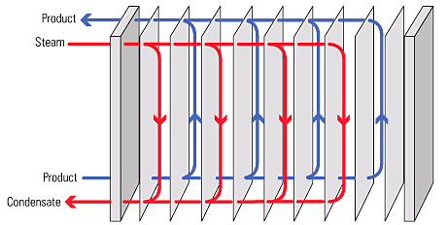
Plate type heat exchanger
A plate heat exchanger consists of a series of thin corrugated metal plates between which a number of channels are formed, with the primary and secondary fluids flowing through alternate channels.
Heat transfer takes place from the primary fluid steam to the secondary process fluid in adjacent channels across the plate. Figure 2.13.3 shows a schematic representation of a plate heat exchanger.

Slide 30
Plate Heat Exchanger
The plate heat exchanger consists of a specific number of plates arranged between the pressure & the fixed frame.
The plates are having corrugations with different designs which increase the total surface area for the heat exchange.
The plates are movable within the frame and rest on the carrying bar on the top and the bottom of the frame.
The plates are arranged in pairs which are opposite of each other forming a honey comb pattern when viewed sideways.
The plate corrugations promote fluid turbulence and increase the heat transfer.
The fixed and the pressure plate are supported by the supporting column.
The plates are fitted with each other with gaskets which seal the material from coming out sideways as well as through the holes on the plates. The alternate arrangement of the gaskets prevents the mixing of the fluids within the channels.

Slide 31
Plate type heat exchanger
The steam heat exchanger market was dominated in the past by the shell and tube heat exchanger, whilst plate heat exchangers have often been favoured in the food processing industry and used water heating.
However, recent design advances mean that plate heat exchangers are now equally suited to steam heating applications.

Slide 32
Plate type heat exchanger
Advantages of Plate Type Heat Exchanger
Low cost of operation
Low cost of maintenance
Easy to clean
Highly efficient heat transfer
Future changes are possible by fitting extra heat transfer plates
Less floor space required
Applications of Plate type Heat Exchanger
Power generation applications
In food, Dairy and brewing industries
Refrigerants in cooling systems

Slide 33
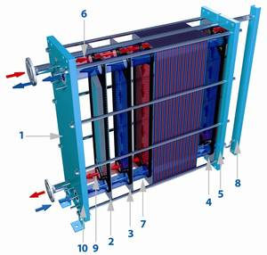
Plate type heat exchanger
fixed pressure plate
start plate
thermoline® heat exchanger channel plate with gasket
end plate
movable pressure plate
upper carrying bar
lower carrying bar
support column
tightening bolt
stud bolt or flanged connection (fluid inlet/outlet ports)

Slide 34
Modes of heat transfer
Heat transfer is broadly defined as the transmission of heat energy from one region to another due to the difference between these two region.
There are three modes of heat transfer from one region to another
1)by conduction
2)by convection
3)by radiation

Slide 35
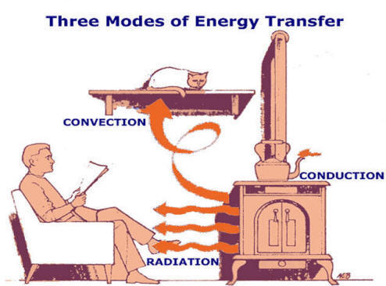

Slide 36
conduction
It is process of heat transfer from one particle of body to another in the direction of fall of temperature.
Heat conduction may takes place through solids, liquids and gases.
Conduction of heat is due to vibration of molecules.
Particle themselves remain in fixed position relative to each other.

Slide 37
convection
It is a process of heat transfer from one particle of the body to another by convection current.
Or
Convection is the process of heat transfer during which heat energy is carried from one part of a fluid to another part of it by the actual movement of heated mass of the fluid.
The motion of the fluid is caused by the differences in density which results from temperature difference.

Slide 38

Radiation
It is a process of heat transfer from a hot body to a cold body, in a straight line, without affecting the intervening medium.
E.g. solar radiation heats the Earth.

Slide 39
Fourier law
According to this law,
Q  A x dT/dX
Q= kA dT/dX
Where,
Q= amount of heat flow through the body in a unit time.
A= surface area of heat flow. it is taken at right angles to the direction of the flow.
dT= temperature difference on the two faces of the body.
dX= thickness of the body through which the heat flows. It is taken along the direction of heat flow.
k= constant of proportionality known as thermal conductivity of the body.

Slide 40
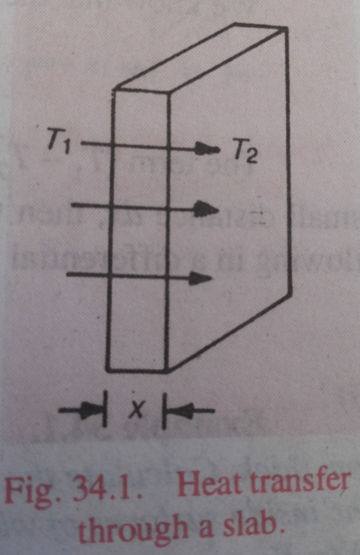
Heat transfer by conduction through a slab
Consider a solid slab having one of its face (say left) at a higher temperature and the other (say right) at a lower temperature as shown in fig.

Slide 41
Heat transfer by conduction through a slab
Let T1= temperature of the left face (i.e. higher temperature) in k.
T2= temperature of the right face (i.e. lower temperature) in k.
X= thickness of the slab.
A= area of the slab
k= thermal conductivity of the body.
t= time through which the heat flow has taken place.

Slide 42
As per the fourier law of heat conduction, the heat flow (assuming no loss of heat from the sides) through the slab.
Q= kA dT/dx
=kA (T1-T2)/dx
Now the total amount of heat flow in time t may be found out by the equation
Q= kA (T1-T2)t/x
Since temperature of the slab decreases as x increases, therefore sometimes negtive sign is put on the right hand side of the above equation.

Slide 43
Thermal conductivity
We discussed in previous article that the amount of heat flow through a body
Q= kA (T1-T2)t/x
In above equation, if we put A= 1m2
(T1-T2)= 1 K
t= 1s
X=1m,
Then Q=k.
It is thus oblivious, that the thermal conductivity of a material is numerically equal to the quantity of heat (in joules) which flows in one second through a slab of the material of area 1m2 and thickness 1m when its faces differ in temperature by 1 K.

Slide 44
Thermal conductivity
It may also be defined as quantity of heat in joules that flows in one second through 1 m cube of material when opposite faces are maintained at a temperature difference of 1 k.
Unit
=W/mK

Slide 45
Thermal resistance
Rate of heat flow
Q= kA (T1-T2)/x
The above equation can be written as,
Q= (T1-T2)/(x/kA)
The term x/kA is known as thermal resistance.

Slide 46
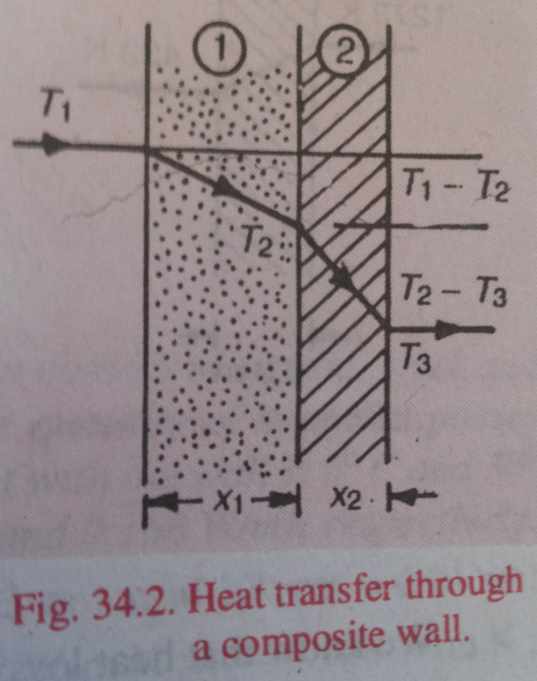
Heat transfer by conduction through a composite wall
Consider a composite wall consisting of two different materials through which the heat is being transferred by conduction, as shown in fig.

Slide 47
Heat transfer by conduction through a composite wall
Let x1= thickness of first material .
k1 thermal conductivity of first material.
x2, k2 = corresponding values for second material ,
T1, T3 = temperature of the two outer surfaces,
T2 = temperature at the junction point
A= surface area of the wall.

Slide 48
Heat transfer by conduction through a composite wall
Now assuming T1 is higher than T2 , the heat will flow from left to right as shown in the figure.
Under steady condition , the rate of heat flow through section 1 is equal to that through section 2.
We know that heat flowing through section 1,
Q= k1 A (T1-T2)/x1
(T1-T2) = Q x1 / A k1

Slide 49
Heat transfer by conduction through a composite wall
Similarly for section 2
(T2-T3) = Q x2 / A k2
Adding above two equation
(T1-T3)= (Q/A) ((x1/k1)+(x2/k2))
Q= A(T1-T3)/((x1/k1)+(x2/k2))

Slide 50
Radiation
The radiation energy received by a body is called incident radiation energy.
The radiation energy is distributed as follows:
Some of the radiation energy may be absorbed by body.
Some of the radiation energy may be reflected by body.
The remaining radiation energy may be transmitted by body.

Slide 51
Radiation
Let,
Qi = incident radiation energy.
Qa = radiation energy absorbed by body.
Qr = radiation energy reflected by body.
Qt = radiation energy transmitted by the body.
Qi = Qa+Qr+Qt
Dividing both sides of the above eqn by Qi, we get
1= (Qa/Qi) + (Qr/Qi) + (Qt/Qi)

Slide 52
Radiation
The term Qa/Qi is called absorptivity.
So, absorptivity of a body is the ratio of the radiation heat absorbed by the body to the total radiation heat received by the body.
The term Qr/Qi is called reflectivity of the body.
Reflectivity of a body is the ratio of the radiation heat reflected by the body to the body to the total radiation heat received by the body.
The term Qt/Qi is called transmissivity of the body.
Transmissivity of a body is the ratio of the radiation heat transmitted by the body to the total heat received by the body.

Slide 53
Radiation
Let ,
 = (Qa/ Qi) = absorptivity of a body,
β = (Qr/ Qi) = reflectivity of a body, and
γ = (Qt/ Qi) = Transmissivity of a body.
So we can write,
 + β + γ = 1

Slide 54

emissivity
To account for a body's outgoing radiation (or its emissive power, defined as the heat flux per unit time), one makes a comparison to a perfect body who emits as much thermal radiation as possible.
Such an object is known as a blackbody, and the ratio of the actual emissive power E to the emissive power of a blackbody is defined as the surface emissivity .
The emissivity depends on the wavelength of the radiciación, the surface temperature, surface finish (polished, oxidized, clean, dirty, new, weathered, etc..) and angle of emission.

Slide 55
Black body
Black body absorbs all the radiation heat energy received by it.
So , β = o, = 1, γ = 0.
So absorptivity of a black body = 1.
The perfect black body does not exit in nature. But it may be conceived of as a spherical cavity of very small dia.
See in fig. which of course has been drawn with large dia. To show that physical model of a black body.
The inner surface of the hollow sphere being coated with lamp black.

Slide 56
Black body
An incident ray on entering in to the hollow sphere is reflected many times within the sphere and negligible amount of radiation heat energy is left to go outside through the hole of the sphere.
In this way, about 95% of the radiation heat energy is absorbed within hollow sphere.

Slide 57
Gray body

Slide 58
Stefan–Boltzmann law
Stefan–Boltzmann law, statement that the total radiant heat energy emitted from a surface is proportional to the fourth power of its absolute temperature.
if E is the radiant heat energy emitted from a unit area in one second and T is the absolute temperature (in degrees Kelvin),
then E = σT⁴,
the Greek letter sigma (σ) representing the constant of proportionality, called the Stefan–Boltzmann constant.
This constant has the value 5.6704 × 10⁻⁸ watt per metre²∙K⁴.
The law applies only to blackbodies, theoretical surfaces that absorb all incident heat radiation.

