Slide 1
Chapter No- 02
IDEAL GASES
Marks-12

Slide 2
C404.2-Calculate values of thermodynamic properties by using thermodynamic processes.

Slide 3
A perfect gas or ideal gas is defined as a state of a substance, whose evaporation from its liquid is complete, and strictly obeys all the gas laws under all condition of temperature and pressure.
In actual practice , there is no real or actual gas which strictly obeys the gas laws over entire range of temperature and pressure.
Laws of perfect gas
Boyles law
Charles law
Gay-Lussac law

Slide 4
BOYLE’S LAW
“The absolute pressure of a given mass of a perfect gas varries inversely as its volume, when the temperature remains constant”
Mathematically,
p  1/v or pv = constant.
P1v1=p2v2=p3v3=……..= constant.

Slide 5
Charles law
“The volume of given mass of perfect gas varies directly as its absolute temperature, when absolute pressure remains constant”.
Mathematically,
v  T or v/T=constant
Or v1/t1 = v2/t2 = v3/t3 =…….constant.
Video showing example(video 1)

Slide 6
Gay –lussac law
“The absolute pressure of a given mass of a perfect gas varies directly as its absolute temperature, when the volume remains constant.”
Mathematically,
P  t or p/T = constant.
or p1/T1 = p2/T2 =………= constant.

Slide 7
General gas equation
In the previous section we have discussed the gas laws which gives us the relation between the two variables when the third variables is constant.
But in actual practice, all the three variables i.e. pressure temperature and volume , changes simultaneously.
in order to deal with all practical cases, the Boyles law and Charles law are combined together, which gives us a general gas equation.

Slide 8
General gas equation
According to Boyles law,
P  1/v or v  1/p …….. (T= constant)
According to Charles law
V  T …………………....(P = constant)
It is thus obvious that
V  T/p
Pv  T
Pv= CT
Where C is a constant , whose value depends upon the mass and properties of the gas concerned.

Slide 9
General gas equation
The more useful form of the general gas equation is
p1v1/T1 =p2v2/T2 =p3v3/T3….. = constant.

Slide 10
Characteristics equation of a gas
It is modified form of general equation .
If the volume (v) in general gas equation is taken as that of 1 kg of gas (known as its specific volume, and denoted by vs)
Then the constant c (in the general gas equation ) Is represented by another constant R (in the characteristics equation of gas).
Thus the general gas equation may be written as :
P vs = RT
Where R is known as characteristics gas constant or simply gas constant.

Slide 11
Characteristics equation of a gas
For any mass m kg of a gas , the characteristics gas equation becomes:
mp vs = mRT
or pv = mRT ……….. Since (m vs = v)
The unit of gas constant R may be obtained as
NM/kg k = J/kg k
The value of R is different for different gases . In S.I. units , its value for atmospheric air is taken 287 j/kg k or 0.287 kJ/ kg k.

Slide 12
Avogadro's law
“ equal volume of all gases, at the same temperature and pressure, contain equal number of molecules”
e.g. 1 m3 of oxygen (O2) will contain the same number of molecules as 1 m3 of hydrogen (H2) when the temperature and pressure is the same.
Video Avogadro's law(video 2)

Slide 13
Universal gas constant or molar gas constant
The universal gas constant or molar gas constant (generally denoted by Ru) of a gas is the product of the gas constant and the molecular mass of the gas.
Mathematically,
Ru = MR
Where M= molecular mass of the gas expressed in kg-mole and
R = gas constant.
In general , if M1, M2 , M3 etc are the molecular masses of different gases and R1,R2,R3 etc are their gas constants respectively, then

Slide 14
Universal gas constant or molar gas constant
M1R1 = M2R2= M3R3=…… Ru
The value of Ru is same for all gases. The value of Ru is Taken as 8314 j/kg-mol k or 8.314 kJ/kg – mol k

Slide 15
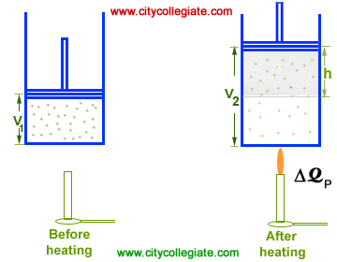
Constant pressure process ( isobaric process)
Consider a cylinder fitted with a frictionless piston. The piston is free to move in the
cylinder. An ideal gas is enclosed in the
cylinder.
Let the initial volume of the
system is V₁ and initial internal energy
is U₁. Let DQ_{P} the gas is heated from T1 K
to T2 K. Addition of heat causes the
following changes in the system: Internal energy increases from U₁ to U₂.

Slide 16
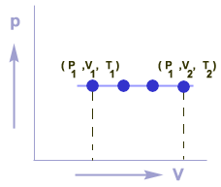
Constant pressure process ( isobaric process)
Volume of the system increases from V₁ to V₂.
Temperature increases from T₁ K to T₂ K.
Work (DW) is done by the gas on the piston.
According to the first law of
thermodynamics: DQ = DU+ DW
But DW = PDV
Thus
DQ_{P} = DU+ PDV
As
DV = (V₂ - V₁)
DQ_{P} = DU+ P (V₂ - V₁)

Slide 17
1) From general gas equation,
PV=C
T
P1=P2
V1 = V2
T1 T2
2) HEAT SUPPLIED TO SYSTEM
DQ= MCp (T2-T1)
3) WORK OUTPUT OF SYSTEM
DW= P(V2-V1)

Slide 18
CHANGE IN ENTHALPY
DH=DQ= mCp (T2-T1)
CHANGE IN ENTROPY
DS= mCp loge(T2/T1)

Slide 19
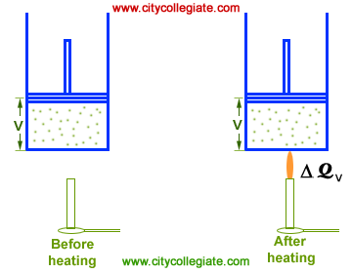
ISOCHORIC PROCESS
A thermodynamic process in
which the volume of the system
remains constant during the supply
of heat is called an ISOCHORIC
PROCESS.
EXPLANATION
Consider a cylinder fitted with a
frictionless piston. An ideal gas is
enclosed in the cylinder. The piston is
fixed at a particular position so that the
volume of cylinder remains constant during
the supply of heat. Let DQ amount of heat is added to the system. Addition of heat causes the following changes in the system:

Slide 20
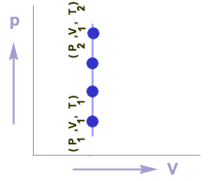
Internal energy increases from U₁ to U₂.
Volume of the system remains unchanged.
Temperature increases from T₁ K to T₂ K.
Pressure increases from P₁ to P₂.
No work is performed.
According to the first law of thermodynamics:
DQ = DU+ DW
But DW = PDV
Thus
DQ = DU+ PDV
As
DV = 0
DQ = DU+ P (0)
DQ = DU
This expression indicates that the heat supplied under isochoric process is consumed in increasing the internal energy of the system but no work is performed.
GRAPHICAL REPRESENTATION
Graph between P & V for an isochoric process is a straight line which is parallel to P-axis.

Slide 21
From general gas equation
PV=C
T
V1= V2
P1 = P2
T1 T2
HEAT SUPPLIED TO SYSTEM
DQ= mCv (T2-T1)
WORK OUTPUT OF SYSTEM
DW=0
CHANGE IN INTERNAL ENERGY
DU = DQ= mCv (T2-T1)
CHANGE IN ENTROPY
DS = mCv loge (T2/T1)

Slide 22
Isothermal process
A process in which the temperature of the working substance remains constant during its expansion or compression , is called constant temperature process or isothermal process.
It is obvious that in an isothermal process:
1) There is no change in temperature.
2) There is no change in internal energy.
3) There is no change in enthalpy.
Now consider a m kg of gas being heated or a constant temperature from an initial state 1 to final state 2.

Slide 23
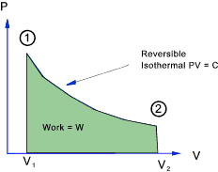
Let P1v1T1= pressure , volume
And temperature at the initial state
P2v2 and T2= pressure, volume and
temperature at the final state 2.
We know that general gas equation is
P1v1 = P2v2
T1 T2
Since gas is heated at constant temp. T1=T2
P1v1=P2v2

Slide 24
Heat supplied to system= work transferred by system
DQ=DW= P1V1 loge(V2-V1) = P1V1 loge(P1/P2)
CHANGE IN INTERNAL ENERGY, DU=O
CHANGE IN ENTROPY
DS= m R loge (V2/V1)= m R loge (P1/P2)

Slide 25
Adiabatic process or isentropic process
A process in which the working substance neither gives out heat to its surroundings, during its expansion or compression, is called an adiabatic process.
This will happen when the working substance remains thermally insulated, so that no heat enters or leaves it during the process .
It is thus obvious that in an adiabatic or isentropic process
1) No heat leaves or enters the gas.
2) Change in internal energy is equal to the work done.

Slide 26
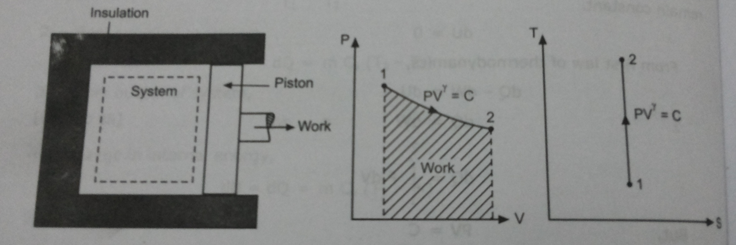
Let P1v1T1= pressure , volume
And temperature at the initial state
P2v2 and T2= pressure, volume and
temperature at the final state 2.

Slide 27
DW= -DU= mCv (T2-T1)
From general eqn
(Pv)γ = c γ= (Cp/Cv)
P1 = (V2/V1)γ
P2
T1 = (V2/V1)(γ-1)
T2
T1 = (P2/P1)((γ-1)/ γ)
T2
HEAT TRANSFERRED = DQ= 0
WORK OUTPUT DW= P1V1-P2V2
γ-1
Change in entropy,
DS= 0

Slide 28
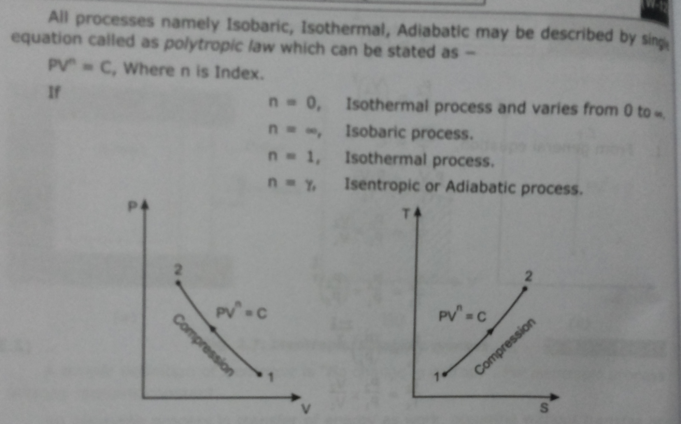
Polytropic process

Slide 29
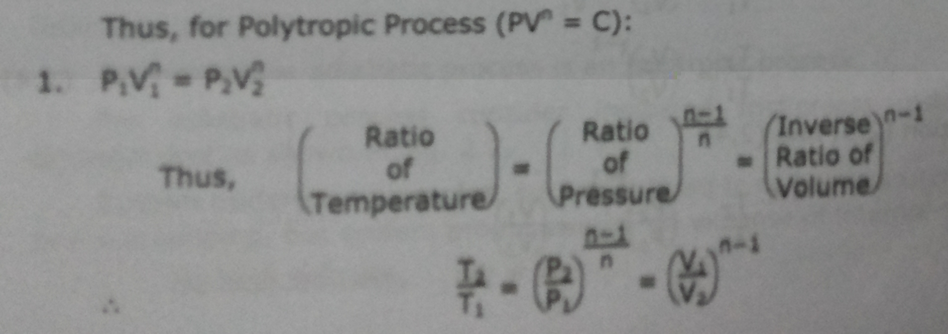
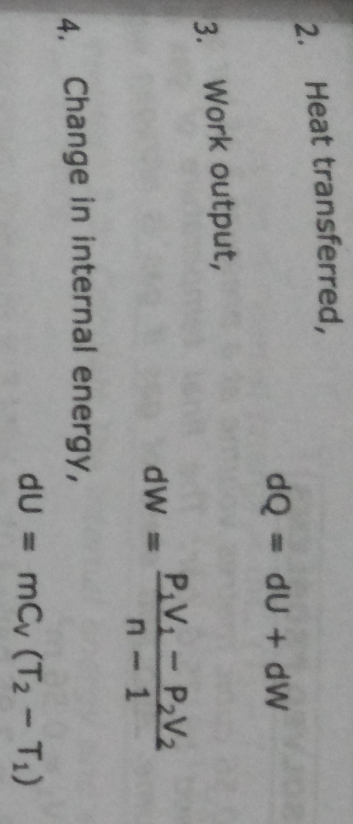

Slide 30
