Slide 1
Chapter No1
FUNDAMENTALS OF THERMODYNAMICS
Marks-20

Slide 2
C404.1- Describe basic concepts, laws of thermodynamics and apply Steady Flow Energy Equations to thermodynamic devices

Slide 3
Thermal engineering
No. of chapter : 06
Total marks :150
Theory paper: 100
External 0ral : 25
Internal marks (submission): 25
No. of practical's : 09

Slide 4
Thermal engineering
Reference books:
A text book of thermal engineering (R.S. Khurmi, J.K. Gupta)
Engineering thermodynamics (P.K. Nag)

Slide 5
Thermal engineering
What is thermodynamics ?
The field of science , which deals with the energies possessed by gases and vapours is known as Thermodynamics.
What is Thermal Engineering ?
The field of engineering science, which deals with the application of thermodynamics and its laws to work producing and work absorbing devices.

Slide 6
Thermal engineering
What is thermodynamics ?
The field of science , which deals with the energies possessed by gases and vapours is known as Thermodynamics.
What is Thermal Engineering ?
The field of engineering science, which deals with the application of thermodynamics and its laws to work producing and work absorbing devices.

Slide 7
UNIT 1 : (20 MARKS)
Fundamental of thermodynamics
Concept of pure substance
“ a pure substance is defined as one that is homogeneous and invariable in chemical composition throughout its mass.”
Atmospheric air, steam –water mixture and combustion products of fuel are regarded as pure substance
But the mixture of air and liquid air is not a pure substance, since the relative proportion of oxygen and nitrogen differ in the gas and liquid phases in equilibrium.

Slide 8
Fundamental of thermodynamics
Thermodynamic system (system)
A definite area or a space where some thermodynamic processes is taking place.
It is a region where our attention is focused for studying thermodynamic processes.
A little observation will show that a thermodynamic system has its boundaries and any thing outside the boundaries is called as surrounding.
boundary
system
surrounding

Slide 9
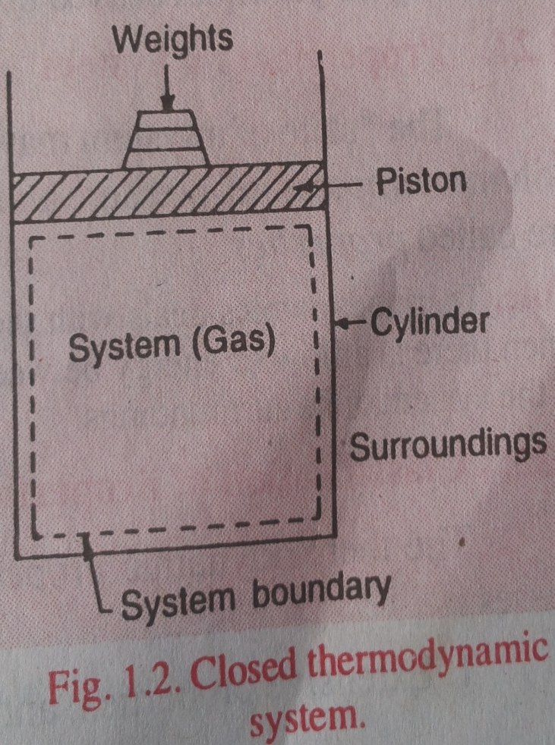
Fundamental of thermodynamics
Types of systems:
1)Closed system
2)Open system
3)Isolated system
1)Closed system:
Closed system is a system
of fixed mass.
There is no mass transfer
across the system boundary.
There may be energy
transfer in to or out of the
system.

Slide 10
Fundamental of thermodynamics
A closed system is shown in fig.
The gas in the cylinder is considered as system.
If heat is supplied to the cylinder from external source, the temperature of the gas will increases and piston will rise.
As piston rises , the boundary of the system moves. In other words the heat and work energy crosses the boundary of the system during this process.
But there is no addition or loss of original mass of the working substance, which compromise the system ,is fixed.
Thus a closed system does not permits any mass transfers across its boundary, but it permits transfer of energy .(heat and work)

Slide 11
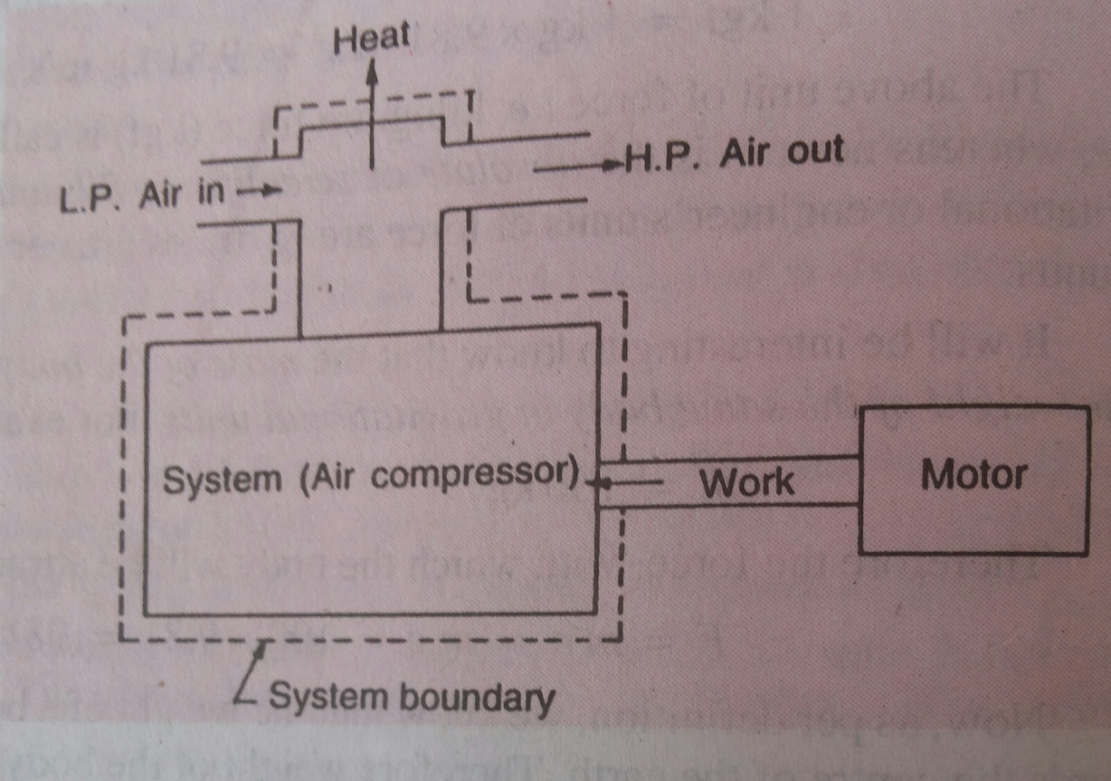
Fundamental of thermodynamics
Open system :
In this system the mass of the working substances crosses boundary of the system.
Heat and work also cross boundary.

Slide 12
Fundamental of thermodynamics
Fig shows dia. Of an air compressor which illustrates an open system.
The working substance crosses the boundary of the system as low pressure (L.P.) air enters the compressor and leaves the high pressure (H.P.) air.
The work crosses the boundary of the system through the driving shaft .
And heat transferred across the boundary from cylinder walls.
Thus ,an open system permits both the mass and energy (heat and work) transfer across the boundaries and the mass within system may not be constant.

Slide 13
Fundamental of thermodynamics
Isolated system:
A system which is completely uninfluenced by the surrounding is called an isolated system.
It is a system of fixed mass and no heat or work energy cross its boundary.
In other words, an isolated system does not have transfer of either mass or energy(heat or work) with the surrounding.
A open system with its surroundings (known as universe) is an example of an isolated system.

Slide 14
Fundamental of thermodynamics
Properties of system:
Every system has certain characteristics by which its physical condition may be described, e.g. volume, temp. pressure etc. such characteristics are called as properties of system.
Properties may be of two types
1)Intensive properties
The properties which are independent on mass of the system is called as intensive properties.
e.g. pressure, temperature, density etc
The properties of the system ,whose value for the entire system is not equal to the sum of their values for individual parts of the system.

Slide 15
Fundamental of thermodynamics
2) Extensive properties:
The properties of system which depend on mass of the system is called as extensive properties.
e.g. total volume, total mass , total energy, enthalpy, entropy, weight etc.
The properties of the system , whose value for the entire system is equal to the sum of their values for the individual parts of the systems are called as extensive properties.

Slide 16
Fundamental of thermodynamics
State of system
The state of a system is the condition of the system at any particular moment which can be identified by the statement of its properties , such as pressure ,volume, temperature etc.
Consider a system enclosed in a cylinder and piston arrangement as shown in fig.
Let the system is initially in equilibrium when the piston is at position 1, represented by its properties p1,v1,t1.
When the system expands , the piston moves towards right and occupies the final position at 2.

Slide 17
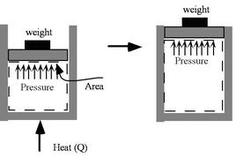
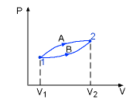
Fundamental of thermodynamics
At this, the system is finally in the equilibrium state represented by the properties p2,v2,t2.

Slide 18
Fundamental of thermodynamics
Processes
When a system changes its state from 1 equilibrium state to another equilibrium state , then the path of successive states through which a
System has pass is known as thermodynamic processes.

Slide 19
Fundamental of thermodynamics
Thermodynamic cycle or cyclic processes
When a process or processes are perform on a system in such a way that the final state is identical with the initial state it is then known as thermodynamic cycle or cyclic process.
In fig.1-A-2 and 2-B-1 are processes whereas 1-A-2-B-1 is a thermodynamic cycle or cyclic process.

Slide 20
Thermodynamic equilibrium
Fundamental of thermodynamics
The two systems are said to be in thermodynamic equilibrium with each other when they are in mechanical, chemical and thermal equilibrium with each other.
1) Mechanical equilibrium: When there are no unbalanced forces within the system and between the system and the surrounding, the system is said to be under mechanical equilibrium. The system is also said to be in mechanical equilibrium when the pressure throughout the system and between the system and surrounding is same.
Two systems are said to be in mechanical equilibrium with each other when their pressures are same.

Slide 21
Fundamental of thermodynamics
Chemical equilibrium: The system is said to be in chemical equilibrium when there are no chemical reactions going on within the system or there is no transfer of matter from one part of the system to other due to diffusion. Two systems are said to be in chemical equilibrium with each other when their chemical potentials are same.
Thermal equilibrium: When the system is in mechanical and chemical equilibrium and there is no spontaneous change in any of its properties, the system is said to be in thermal equilibrium. When the temperature of the system is uniform and not changing throughout the system and also in the surroundings, the system is said to be thermal equilibrium. Two systems are said to be thermal equilibrium with each other if their temperatures are same.

Slide 22
Fundamental of thermodynamics
E.g. Let us suppose that there are two bodies at different temperatures, one hot and one cold. When these two bodies are brought in physical contact with each other, temperature of both the bodies will change. The hot body will tend to become colder while the cold body will tend to become hotter. Eventually both the bodies will achieve the same temperatures and they are said to be in thermodynamic equilibrium with each other.
hot
cold
heat
26 °C
26 °C

Slide 23
Fundamental of thermodynamics
Quasi-static process or quasi equilibrium process
When a process is carried out in such a way that ,at every instant, the system deviation form the thermodynamic equilibrium is infinitesimal then the process is known as Quasi-static process or quasi equilibrium processes.
Let us consider a system of gas contained in cylinder. The gas held by a moving piston. A weight W is placed over the piston. Due to the weight , the gas in cylinder is compressed. After the gas reaches equilibrium, the properties of gas are denoted by p₁, v₁, t₁.

Slide 24
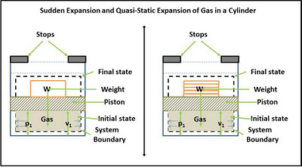
Fundamental of thermodynamics

Slide 25
Fundamental of thermodynamics
The weight placed over the piston is balanced by upward force exerted by the gas. If the weight is removed, then there will be unbalanced force between the system and the surroundings. The gas under pressure will expand and push the piston upward till it touches the stops. The properties at this state after reaching equilibrium are p₂,v₂,t₂. But the intermediate states passed through by the system are non-equilibrium states which cannot be described by thermodynamic coordinates. In this case we only have initial and final states and do not have a path connecting them.

Slide 26
Fundamental of thermodynamics
Suppose, the weight is made of large numbers of small weights. And one by one each of these small weights are removed and allowed the system to reach an equilibrium state. Then we have intermediate equilibrium states and the path described by these sates will not deviate much from the thermodynamic equilibrium state. Such a process, which is the locus of all the intermediate points passed by the system is known as Quasi-static process. It means, this process is almost near to the thermodynamically equilibrium process. Infinite slowness is the characteristic feature of quasi-static process.

Slide 27
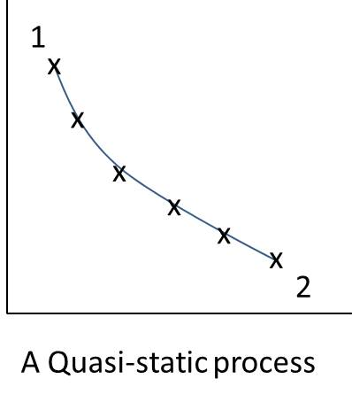
Fundamental of thermodynamics

Slide 28
Flow and non flow process
Fundamental of thermodynamics
Non Flow process
The processes occurring in closed system which do not permit the transfer of mass to and from the system , are known as flow processes.
It may be noted that in non flow processes , the energy crosses the system boundary in the form of heat and work , but there is no mass flow in to or out of the system.

Slide 29
Fundamental of thermodynamics
Flow process
The processes occurring in open system which permits the transfer of mass to and from the system. Are known as flow processes.
It may be noted that in a flow process, the mass enters the system and leaves after enhancing energy.
The flow processes may be steady flow or non steady flow processes.
Steady flow processes e.g. flow through nozzles, turbines compressors etc.
Non steady flow processes are filling or evacuation of vessels.

Slide 30
Fundamental of thermodynamics
Path Function and Point Function
Path function and Point function are introduced to identify the variables of thermodynamics.
Path function: Their magnitudes depend on the path followed during a process as well as the end states. Work (W), heat (Q) are path functions.
Process A: W_{A} = 10 kJ
Process b: W_{B} = 7 kJ
Point Function: They depend
on the state only, and not on
how a system reaches that state.
All properties are point functions.
Process A: V₂ - V₁ = 3 m³
Process B: V₂ - V₁ = 3 m³

Slide 31
Fundamental of thermodynamics
Work
Work is defined as the product of force (F) and distance moved (x) in the direction of force.
Mathematically ,
W= F . X
In SI system unit of work is N-m.
1N-m = 1 Joule (J).
In thermodynamics ,
Work is defined as the energy transferred (without transfer of mass) across the boundary of the system because of an intensive property difference other than temp. That exist between temp. and surrounding.

Slide 32
example of thermodynamic work
Fundamental of thermodynamics
So consider a battery which we take as our system. The battery terminals are connected to a resistor through a switch:
When the switch is shut for a time,
current flows through the resistor
and it becomes "Warmer". Is this a
work interaction? Of course from
mechanics we would say NO!
(since no force has moved its point of
application). But now let us image that

Slide 33
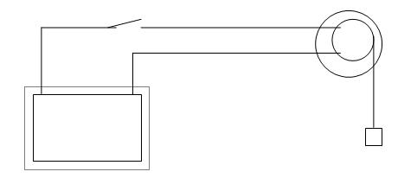
example of thermodynamic work
Fundamental of thermodynamics
That is we have
imagined a practical
arrangement which
includes a pulley and
an electric motor. If we again
close the
switch, the electric current
will drive the electric motor
which winds up a string
attached to a weight. That is
the sole effect external to the
system could be the rise of a
weight.

Slide 34
heat
Fundamental of thermodynamics
The heat is defined as the energy transferred , without transfer of mass, across the boundary of a system because of a temperature difference between a system and surroundings.
It is usually represented by “Q” and is expressed in joule (J) or kilo-joule(kJ) .

Slide 35
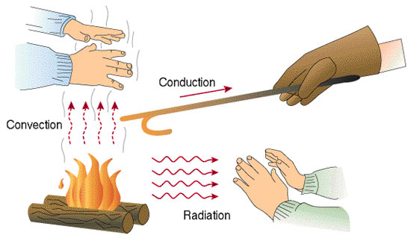
Modes of heat transfer
Fundamental of thermodynamics
Conduction: Heat transferred between two bodies in direct contact.
Convection: Heat transfer
between a solid surface
and an adjacent gas
or liquid.
Radiation: The energy
emitted by matter in
the form of electromagnetic
waves as a result of the
changes in the electronic
configurations of the atoms
or molecules.

Slide 36
Heat and work
Fundamental of thermodynamics
What is the difference between Heat and Work?
- Heat is the random motion of molecules, while work is the ordered motion in one direction.
- It can be proven that work can be totally converted to heat, but heat cannot be 100% converted to work.
- Heat is a function of state, while work is a function of path.
- Heat is a form of energy, while work is a method of transferring energy

Slide 37
energy
Fundamental of thermodynamics
The energy is defined as capacity to do work.
The energy possessed by a system is of following two types:
1)Stored energy: the stored energy is the energy possessed by a system within its boundaries.
e.g. potential energy, kinetic energy and internal energy.
2) Transit energy: the transit energy is the energy possessed by a system which is capable of crossing its boundaries.
e.g. heat, work , electrical energy.

Slide 38
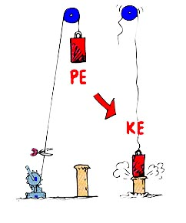
energy
Fundamental of thermodynamics
Potential energy: it is the energy possessed by body or a system for doing work, by virtue of its position above the ground level.
e.g. a body raised to some height above the ground level possesses potential energy because it can do work by falling on earths surface.
Let w= weight of the body
m= mass of the body
z= distance through which body falls
g= acceleration due to gravity= 9.81 m/s2.
Therefore potential energy,
P.E.= wz = mgz
Unit = N-m

Slide 39
energy
Fundamental of thermodynamics
Potential energy: it is the energy possessed by body or a system for doing work, by virtue of its position above the ground level.
e.g. a body raised to some height above the ground level possesses potential energy because it can do work by falling on earths surface.
Let w= weight of the body
m= mass of the body
z= distance through which body falls
g= acceleration due to gravity= 9.81 m/s2.
Therefore potential energy,
P.E.= wz = mgz
Unit = N-m

Slide 40
energy
Fundamental of thermodynamics
Kinetic energy:
It is energy possessed by body or a system, for doing work, by virtue of its mass and velocity of motion .
Let m= mass of the body
V= velocity of body.
Kinetic energy (K.E.)= ½ x mv2
Unit N-m.
Internal energy:
It is energy possessed by a body or system due to its molecular arrangement and motion of the molecules.
It is usually represented by “U”

Slide 41
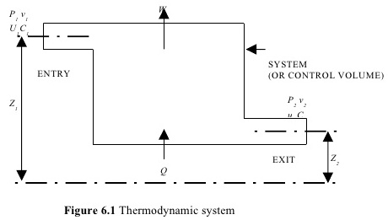
Flow Work (or Flow Energy)
Fundamental of thermodynamics
when substance is flowing through some steady flow system, some work is required to be done to push the mass in to the system against inside and outside of the system against pressure of surrounding.

Slide 42
Fundamental of thermodynamics
Work done required to push the mass through the distance across the boundary of the system against the inside pressure at the inlet is flow work at inlet (p1v1).
Similarly, work done for forcing out the mass against surrounding pressure through particular distance is flow at outlet(p2v2)
Therefore,
Total flow work=flow work at outlet-flow work at inlet.
=(p2v2)-(p1v1)

Slide 43
enthalpy
Fundamental of thermodynamics
In thermodynamics one of the basic quantities most frequently recurring is the sum of internal energy (U) and product of pressure and volume (pv). This sum is known as enthalpy.
It is mathematically represented as
H= U+pv
For unit mass, specific enthalpy,
h= U+P Vs
U= specific internal energy
Vs=specific volume.
Units (SI) is the joule
British thermal unit is calorie

Slide 44
entropy
Fundamental of thermodynamics

Slide 45
Zeroth law
Fundamental of thermodynamics
“ when two system are each in thermal equilibrium with a third system then two systems are also in thermal equilibrium with one another.”

Slide 46
Zeroth law
Fundamental of thermodynamics
Suppose some firewood is brought in from the cold and an apple pie(one type of food) is removed from a hot oven. Both are placed in the same room. With time the firewood and the room with reach thermal equilibrium, as will the pie and the room. This means the firewood and the room are at the same temp. The pie and room are at the same temp too. Therefore, by the zeroth law, the firewood and pie are at the same temp, meaning they too are in thermal equilibrium.
Video 3

Slide 47
First law of thermodynamics
Fundamental of thermodynamics
“The heat and mechanical work are mutually convertible.”
According to this law ,when a closed system undergoes a thermodynamic cycle, the net heat transfer is equal to the net work transfer.
Q=ΔU+W
ΔU=Q-W

Slide 48
First law of thermodynamics
Fundamental of thermodynamics
“The energy can neither be created nor be destroyed , it can be transformed from one form to another.”
According to this law , when a system undergoes a change of state (or a thermodynamic process), then both heat transfer and work transfer takes place.
The net energy transfer is stored within the system and is known as stored energy or total energy of the system.

Slide 49
First law of thermodynamics
Fundamental of thermodynamics
A simple example can be of water stored in a dam. This water has a potential energy due to its height. now when this water falls down, this potential energy is converted into kinetic energy. This kinetic energy then rotates the turbines and electricity is produced. So the potential energy gets converted to kinetic energy which in turn helps us to produce electricity and thereby the total energy remains constant.
Video 1
Video 2

Slide 50
Limitation of first law
Fundamental of thermodynamics
1)When a closed system undergoes a thermodynamic cycle, the net heat transfer is equal to the net work transfer.
This statement does not specify the direction of flow of heat and work(i.e. whether the heat flows from a hot body to cold body or from cold body to hot body). It also does not give any condition under which these transfer takes place.
2) “the heat energy and mechanical work are mutually convertible”
Though the mechanical work can be fully converted in to heat energy, but only a part of heat energy can be converted in to mechanical work.
This means that the heat energy and mechanical work are not fully mutually convertible. It other words, there is a limitation on conversion of one form of energy in to another form.

Slide 51
Pmm-I (perpetual motion machine)
Fundamental of thermodynamics
A machine which violets the first law of thermodynamics is known as perpetual motion machine of the first kind(PMM-I).
It is defined as a machine which produces work energy without consuming an equivalent of energy from other source. Such a machine ,is impossible to obtain in actual practice, because no machine can produce energy of its own without consuming any other form of energy.
PMM-I
WORK

Slide 52
Second law of thermodynamics
Fundamental of thermodynamics
“Kelvin Planck's statement”
1) “ it is impossible to construct an engine working on a cyclic process, whose sole purpose is to convert heat energy from single thermal reservoir in to an equivalent amount of work”.

Slide 53
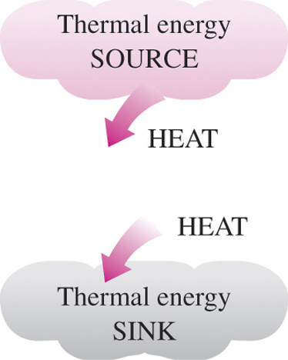
Second law of thermodynamics
Fundamental of thermodynamics
A reservoir that:
Supplies heat is a source
Absorbs heat is a sink
Converting heat to work
requires the use of a device
called a heat engine
Heat engines come in many
forms, pure heat engines
(steam power plants) and
semi heat engines (gas turbines)
All have a working fluid

Slide 54
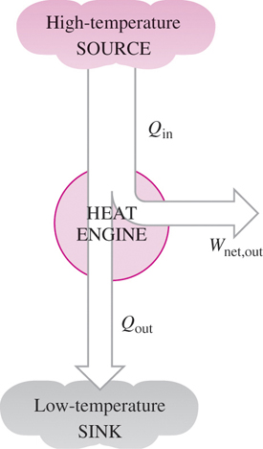
Heat engine
Fundamental of thermodynamics
  Receive heat from high
  temperature source
  Convert part of the heat
  to work (usually a rotating
  shaft)
  Reject remaining waste
  heat to a low-temperature
  sink
  Operate on a cycle

Slide 55
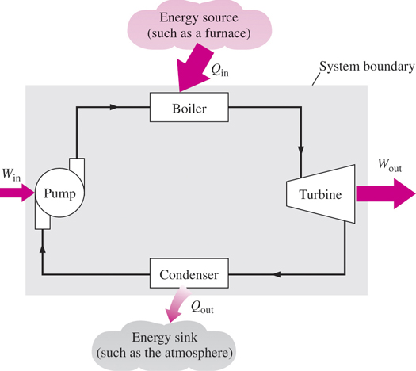
e.g. of steam engine
Fundamental of thermodynamics
Q_{in}=amount of heat
supplies to steam in boiler from
high temperature source (furnace)
Q_{out}=amount of heat
rejected from steam in
condenser to a low-
temperature sink
W_{out}=amount of work
delivered by steam as it
expands in turbine
W_{in} = amount of work required
to compress water to boiler pressure
W_{net,out}= W_{out}-W_{in} (kJ)
W_{net,out}= Q_{in}-Q_{out} (kJ)

Slide 56
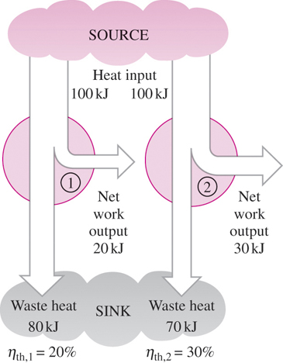
e.g. of heat engine
Fundamental of thermodynamics
Thermal efficiency, η_{th}
η_{th}= net work output
total heat input
η_{th} = 1 – (heat out /total heat in)
VIDEO 4B

Slide 57
Second law of thermodynamics
Fundamental of thermodynamics
“Clausius statement”
“It is impossible for a machine , working in a cyclic process, to transfer heat from a body at a lower temperature to a body at a higher temperature without the aid of an external agency.”
In other word heat can not flow itself from a cold body to a hot body without the help of an external agency(without expenditure of mechanical work).

Slide 58
Second law of thermodynamics
Fundamental of thermodynamics
Heat moves in nature from high temperatures to lower temperatures, no devices required
The reverse process, heat from low temp to high temp, required special devices called refrigerators or heat pumps
VIDEO 4A

Slide 59
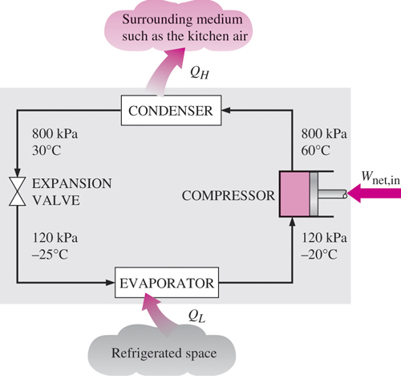
refrigerator
Fundamental of thermodynamics
Vapor-compression refrigeration cycle
Compressor
Condenser
Expansion valve
Evaporator

Slide 60
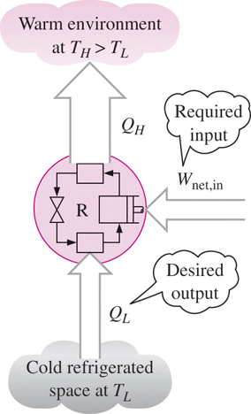
refrigerator
Fundamental of thermodynamics
The performance of refrigerator is
measured in terms of coefficient of
performance which is defined as ratio
of the maximum heat transferred
(i.e. heat taken from the cold body)
to the amount of work required to
produce the desired effect.
COP = Desired output/Required input
C.o.p.= QL/w net = QL/(QH-QL)
= TL/(TH-TL)

Slide 61
refrigerator
Fundamental of thermodynamics
The performance of refrigerator is
measured in terms of coefficient of
performance which is defined as ratio
of the maximum heat transferred
(i.e. heat taken from the cold body)
to the amount of work required to
produce the desired effect.
COP = Desired output/Required input
C.o.p.= QL/w net = QL/(QH-QL)
= TL/(TH-TL)
VIDEO -4D

Slide 62
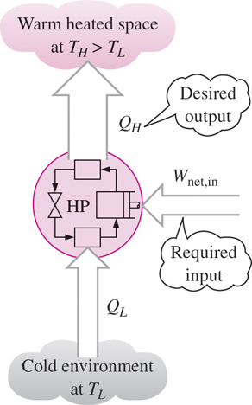
Heat pump
Fundamental of thermodynamics
Transfers heat from low temperature
area to higher temperature area
COP_{HP} = Desired op /Required ip
= Q_{H}/W_{net,in}
COP_{HP} = Q_{H}/(Q_{H}–Q_{L})
= 1/(1-(Q_{L}/Q_{H}))
VIDEO-4C

Slide 63
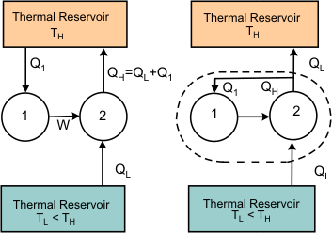
Equivalence of kelvin-Plancks and Clausius statements
Fundamental of thermodynamics

Slide 64
Violation of kelvin plancks statement
Fundamental of thermodynamics
Refer to Figure 17.3 that is, it is possible to construct a device I which, working cyclically, absorbs energy a heat(Q1) from a source at temperature(Th) and performs an equivalent amount of work (w=Q1).
Next consider a device II which absorbs(Ql) amount of energy from a low temperature (Tl)body at and delivers energy as heat (QH)to a high temperature reservoir at(Th) . To accomplish this, work(W) is done on the device.
The device II does not violate the Clausius statement. For device II, we can write(Qh=Ql+w) . Now combine I and II. The work delivered by device I is used by device, II.
Then
W=Q1
Qh=Ql+W
=Ql+Q1

Slide 65
Violation of kelvin plancks statement
Fundamental of thermodynamics
(17.1) (17.2)
This combined device (which is no more aided by any external agency) working cyclically, is not producing any effect other than the transfer of energy as heat (QL)from the low temperature reservoir to the high temperature reservoir. This is in violation of the Clausius statement.

Slide 66
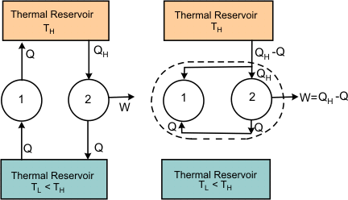
Violation of kelvin plancks statement
Fundamental of thermodynamics

Slide 67
Violation of clausis statement
Fundamental of thermodynamics
To prove that violation of the Clausius' statement leads to violation of Kelvin Planck statement, let us assume that the Clausius' statement is incorrect. That is, it is possible to constructs a device I (refer to Figure 17.4) such that it transfers energyas heat(Q) from a body at lower temperature to a body at higher temperature unaided by any external agency. Consider another device II which receives energy as heat(QH) from a body at higher temperature, delivers work(W) and rejects energy as heat (Q)to the body at a low temperature. Device II does not violent Kelvin Planck statement. Application of the first law of thermodynamics to device II gives,
QH=QL+w (17.3)

Slide 68
Violation of clausis statement
Fundamental of thermodynamics
Now consider the combination of devices I and II as a single device. This combined device, working cyclically, absorbs(QH-Q) amount of energy as heat from the thermal reservoir at temperature (TH)and delivers work (W=QH-Q), leaving the thermal (TL)reservoir at temperature unaffected. That is, the resulting device is a PMM-II(perpetual motion machine-II), which is in violation of the Kelvin Planck statement. Thus the Kelvin Planck statement and the Clausius' statement are equivalent.

Slide 69

Fundamental of thermodynamics

Slide 70
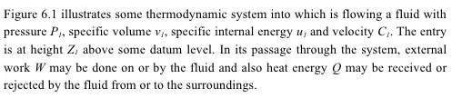
Fundamental of thermodynamics

Slide 71
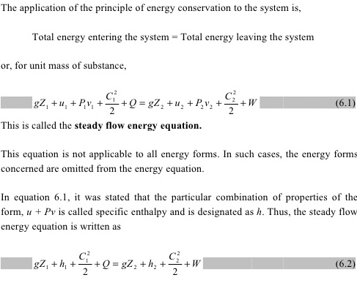

Slide 72
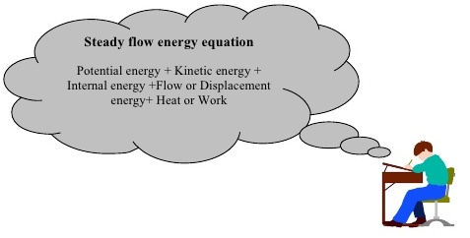
Fundamental of thermodynamics
VIDEO 5

Slide 73
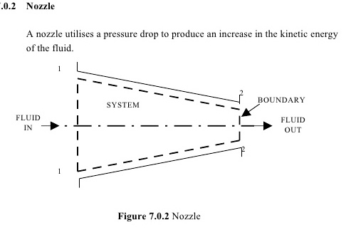
Fundamental of thermodynamics

Slide 74
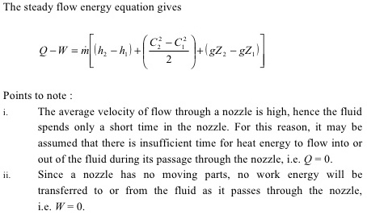

Slide 75
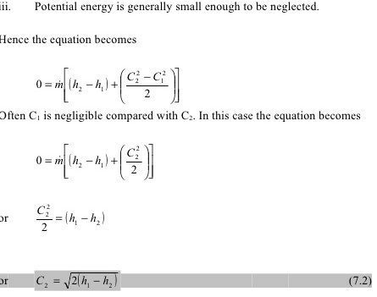

Slide 76
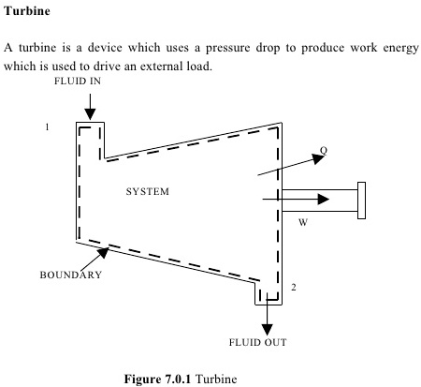

Slide 77
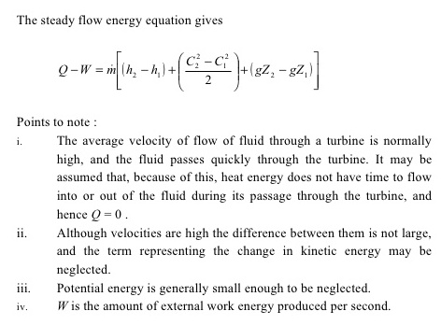

Slide 78
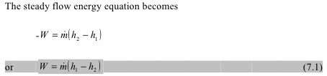
Fundamental of thermodynamics

Slide 79
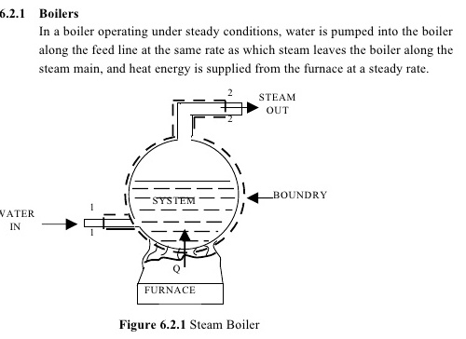

Slide 80
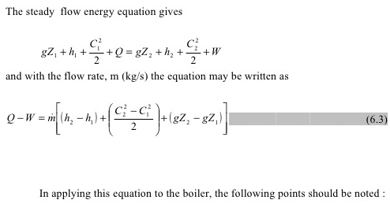
Fundamental of thermodynamics

Slide 81
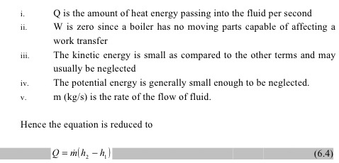
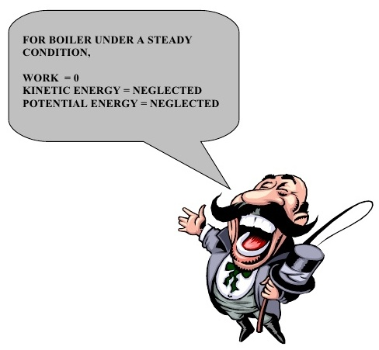

Slide 82
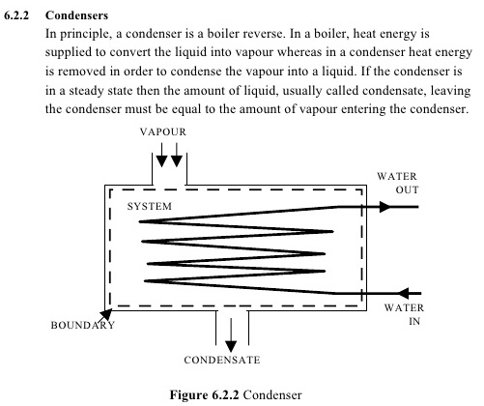

Slide 83

- Q= m(h2-h1) or Q=m(h1-h2)
The –ve sign with Q is taken because the heat is lost by the coolant while passing through the condenser.

Slide 84
compressor
Fundamental of thermodynamics
Compressor is a device which compresses air and supplies the same at moderate pressure and in large quantities.
Heat (q)=0
Change in kinetic and potential energy =o
Applying first law of thermodynamics…

Slide 85
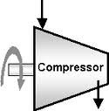
compressor
Fundamental of thermodynamics
-(-w)=h2-h1
-ve sign indicates that work is done on system.
W=(h2-h1)

Slide 86
Application of second law of thermodynamic for refrigerator, heat pump, heat engine
Another important application of second law of thermodynamics is found in refrigerators and heat pumps, which are based on the principle of reversed Carnot cycle or reversed Carnot theorem. The second law of thermodynamics says that heat can flow from high temperature reservoir to low temperature reservoir only, however, if you want to move the heat from low temperature to high temperature reservoir, then the external work has be supplied.
The original Carnot cycle corresponds to the heat engines in which work is produced. In this cycle heat is absorbed from the high temperature reservoir and released to the low temperature reservoir and the work is produced. In the reversed Carnot cycle, the work is supplied to the cycle, and the heat is transferred from low temperature reservoir to the high temperature reservoir. This is what exactly the second law of thermodynamics says.

Slide 87
Application of second law of thermodynamic for refrigerator, heat pump, heat engine
In our refrigerator, the freezer is maintained at low temperature by removing the heat from it and throwing it to the atmosphere which is at higher temperature. This does not happen automatically, we have to supply electricity which is used to run the compressor of the refrigerator.
The same principle is applied to the air-conditioner and heat pump also. The air-conditioner helps to keep the room cool when outside temperature is very high by removing heat from the room maintained at low temperature. The heat pump is used to keep the room hot when outside temperature is very low by absorbing the heat from atmosphere and supplying to the room

Slide 88
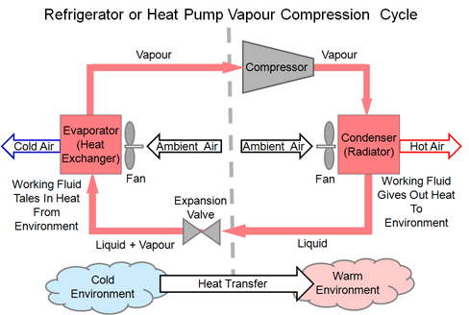
Application of second law of thermodynamic for refrigerator, heat pump, heat engine

