Slide 1
Chapter No.2……Principal planes and stresses……..08 Marks

Slide 2
CO RELATED TO CHAPTER
C304.2
Calculate the hoop stresses & principal stresses.

Slide 3
Principal planes and stresses
Group A:
Concept of principal planes and stresses
Group B:
Thin cylindrical shell

Slide 4
Group A: Concept of principal planes and stresses
Simple definition:
Principal plane: A plane which carries only normal stress and no shear stress is called…
Principal stress: The magnitude of normal stress acting on the principal plane is called…
Major Principal Stress: The maximum value of normal stress acting on the principal plane is called…
Minor Principal Stress: The minimum value of normal stress acting on the principal plane is called…
Major Principal Plane: A plane which carries a major principal stress is called….
Minor principal plane: A plane which carries a minor principal stress is called….

Slide 5
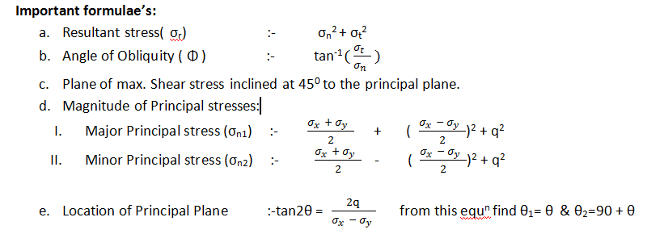
Formulae’s related to Concept of principal planes and stresses

Slide 6
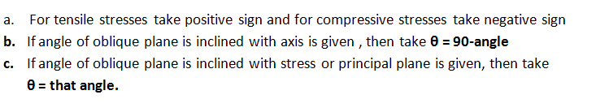
Important note:

Slide 7
Group B:- THIN CYLINDRICAL SHELL…………..4 Marks
When ≤ 20, then cylindrical shell is thin , where t= thickness & d= diameter
e.g.: tanks, boilers, steam pipes, gas or water pipes
Basic definition:
Hoop stress or circumferential stress (σ_{c}):-
The stresses which act in the tangential direction to the circumference of the cylinder are called……..
Longitudinal stress (σ_{L}):-
The stresses which act parallel to the longitudinal axis of the cylinder are called……..

Slide 8
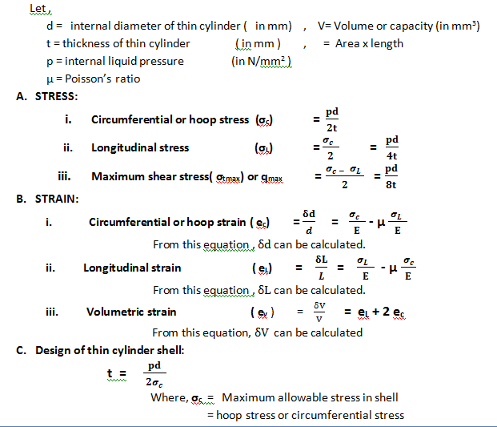
FORMULAES RELATED TO Thin cylindrical shell

