Slide 1
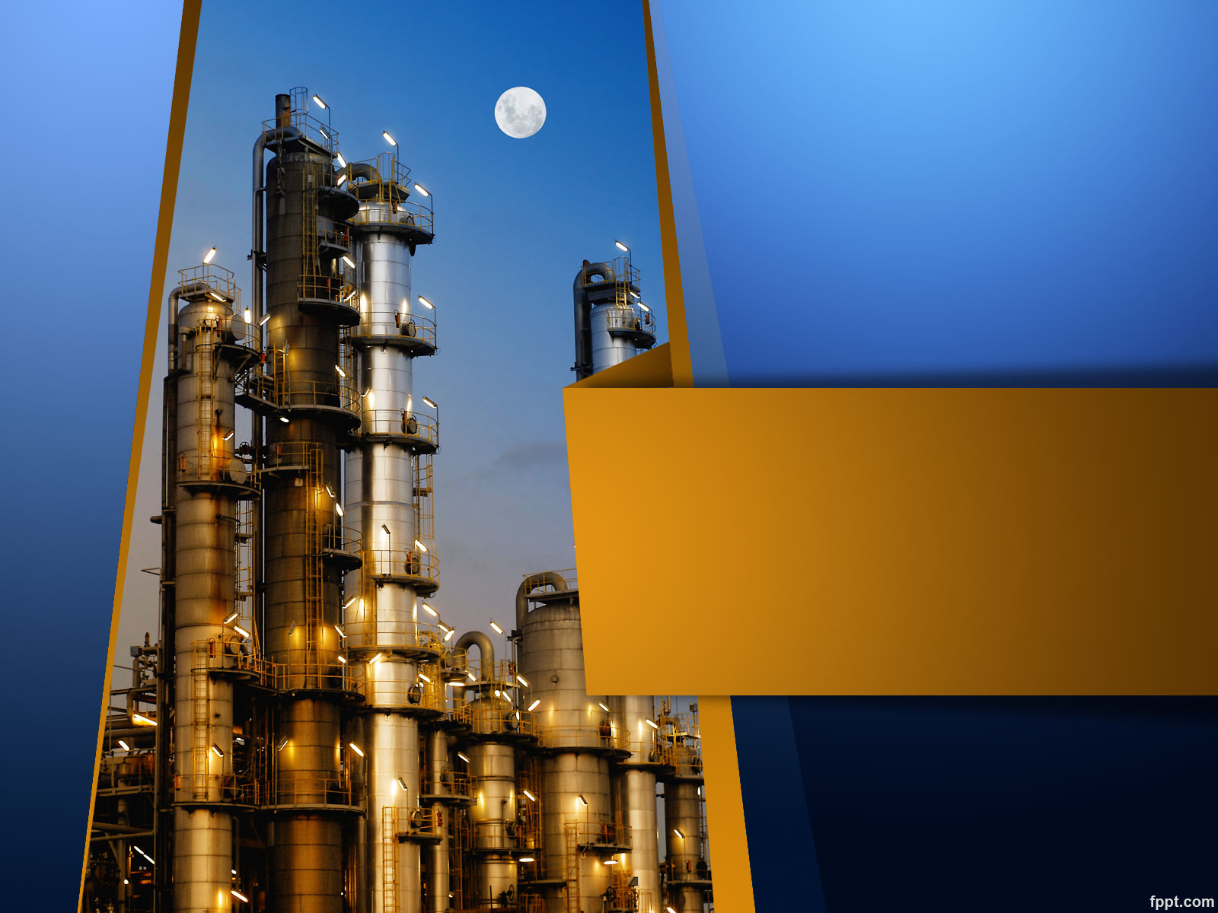
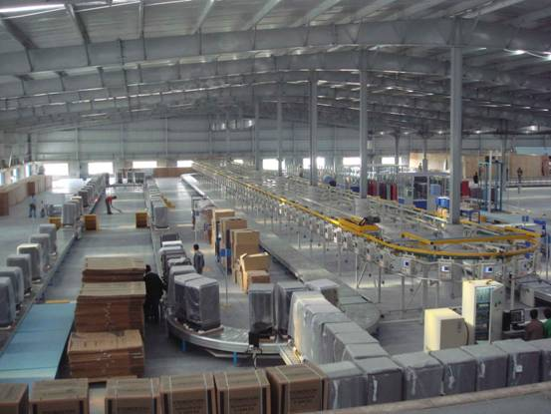
PLANT LAYOUT
PLANT LAYOUT

Slide 2
Plant Layout
Meaning :
Arrangement of –
Machinery
Equipment
Other industrial facilities
Achieving Quick production at least cost.

Slide 3
Scope for Plant Layout:
Related to material
✓ Less material handling and minimum transportation cost
✓ Less waiting time for in-process inventory

Slide 4
Related to work place
✓ Safe working conditions from the point of ventilation, lighting, etc.
✓ Minimum movement of workers
✓ Least chances of accidents, fire, etc.
✓ Proper space for machines, worker, tools, etc.

Slide 5
Objectives of a Good Plant layout/Characteristics :
Utilize available space
Increase employee moral
Reduce hazards to personnel/reduce accidents
Reduce material handling cost
Provide enough production capacity
Provide ease of production
Provide ease of maintenance
Provide ease of supervision
Improve productivity
Allow high machine utilization

Slide 6
Design Principles of Layout:
Principle of minimum travel
Principle of sequences
Principle of usage
Principle of compactness
Principle of safety and satisfaction
Principle of flexibility
Principle of minimum investment

Slide 7
Factors affecting Plant Layout
Plant location and building
Nature of Product
Type of Industry
Plant Environment
Spatial Requirements
Repairs and Maintenance
Balance
Management Policy
Human Needs
Types of machinery and equipment

Slide 8
Principles For Ideal Layout
Ideal
Layout
Minimum Travel
Sequence
Usage and Flexibility
Safety and Satisfaction
Compactness and Minimum investment

Slide 9
Types of Layouts
Product Layout
Process Layout
Fixed Position Layout
Combined Layout

Slide 10
1. Product Layout
This type of layout is generally used in systems where a product has to be manufactured or assembled in large quantities. In product layout the machinery and auxiliary services are located according to the processing sequence of the product without any buffer storage within the line itself.

Slide 11
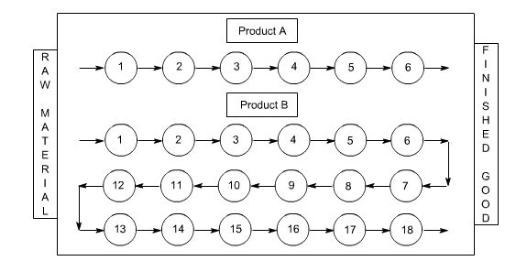

Slide 12
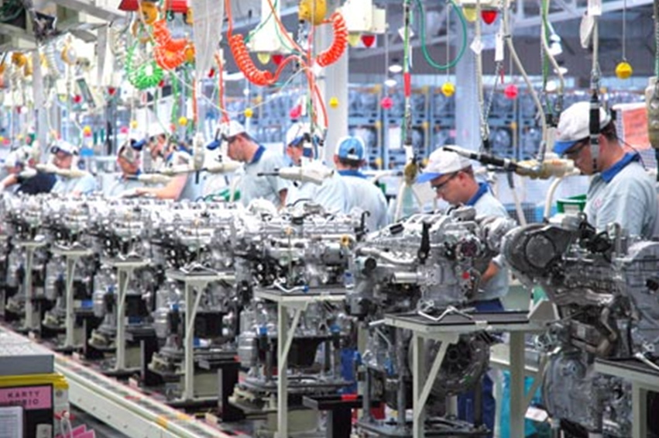

Slide 13
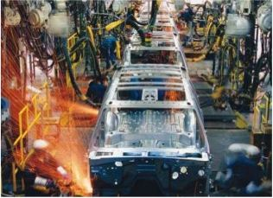

Slide 14
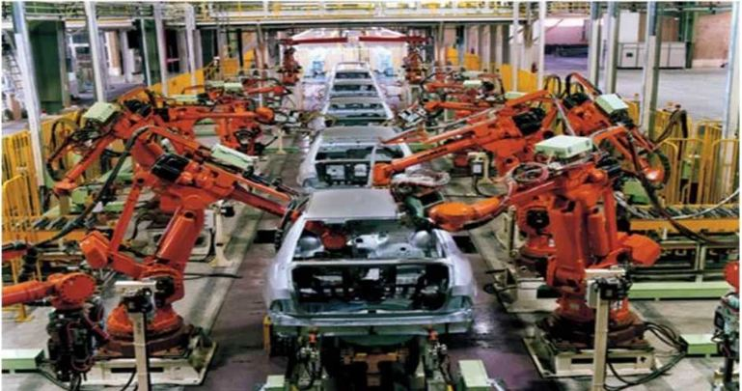

Slide 15
Advantages:
Low material handling cost per unit
Less work in process
Total production time per unit is short
Low unit cost due to high volume
Less skill is required for personnel
Smooth, simple, logical, and direct flow
Inspection can be reduced
Delays are reduced
Effective supervision and control

Slide 16
Disadvantages:
Machine stoppage stops the line
Product design change or process change causes the layout to become obsolete
Slowest station paces the line
Higher equipment investment usually results
Less machine utilization
Less flexible

Slide 17
2. Process Layout
In a process layout, (also referred to as a job shop layout) similar machines and services are located together. Therefore, in a process type of layout all drills are located in one area of the layout and all milling machines are located in another area.

Slide 18
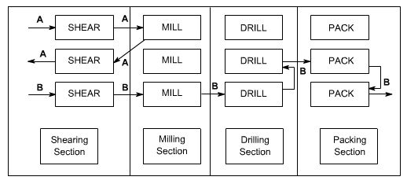

Slide 19
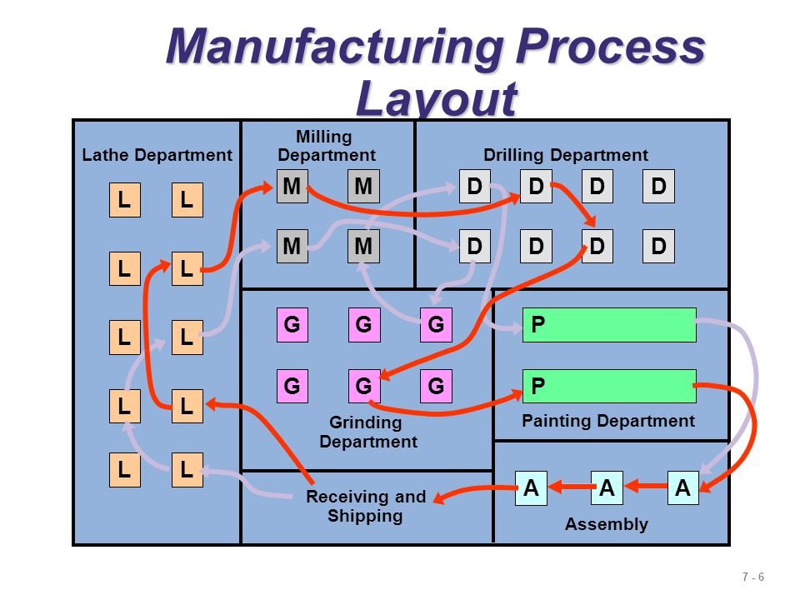

Slide 20
Advantages:
Better machine utilization
Highly flexible in allocating personnel and equipment because general purpose machines are used.
Diversity of tasks for personnel
Greater incentives to individual worker
Change in Product design and process design can be incorporated easily
More continuity of production in unforeseen conditions like breakdown, shortages, absenteeism

Slide 21
Disadvantages:
Increased material handling
Increased work in process
Longer production lines
Critical delays can occur if the part obtained from previous operation is faulty
Routing and scheduling pose continual challenges

Slide 22
3. Fixed Position layout
In this type of layout, the product is kept at a fixed position and all other material; components, tools, machines, workers, etc. are brought and arranged around it. Then assembly or fabrication is carried out. The layout of the fixed material location department involves the sequencing and placement of workstations around the material or product. It is used in aircraft assembly, shipbuilding, and most construction projects.

Slide 23
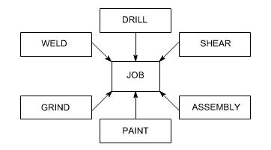

Slide 24
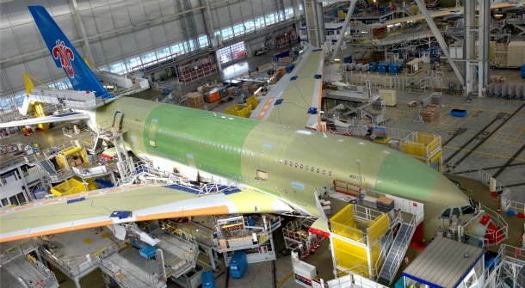

Slide 25
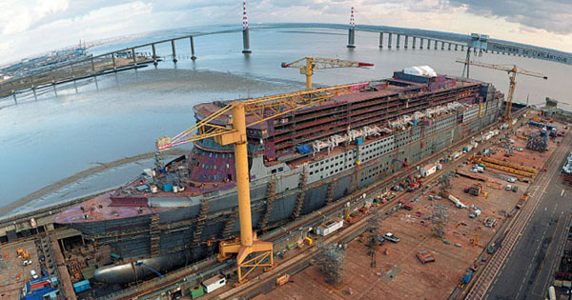

Slide 26
Advantages:
Material movement is reduced
Promotes pride and quality because an individual can complete the whole job
Highly flexible; can accommodate changes in product design, product mix, and production volume

Slide 27
Disadvantages:
May result in increase space and greater work in process
Requires greater skill for personnel
Personnel and equipment movement is increased
Requires close control and coordination in production and personnel scheduling

Slide 28
4. Combination layout
A combination of process and product layouts combines the advantages of both types of layouts.
A combination layout is possible where an item is being made in different types and sizes. Here machinery is arranged in a process layout but the process grouping is then arranged in a sequence to manufacture various types and sizes of products.
It is to be noted that the sequence of operations remains same with the variety of products and sizes.

Slide 29
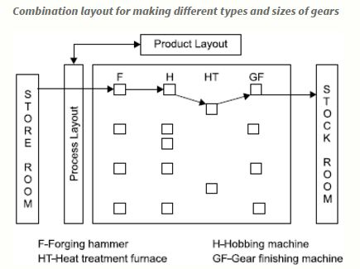

Slide 30
Group Technology
“A manufacturing philosophy in which similar parts are identified and grouped together to take advantage of their similarities in design and production”

Slide 31
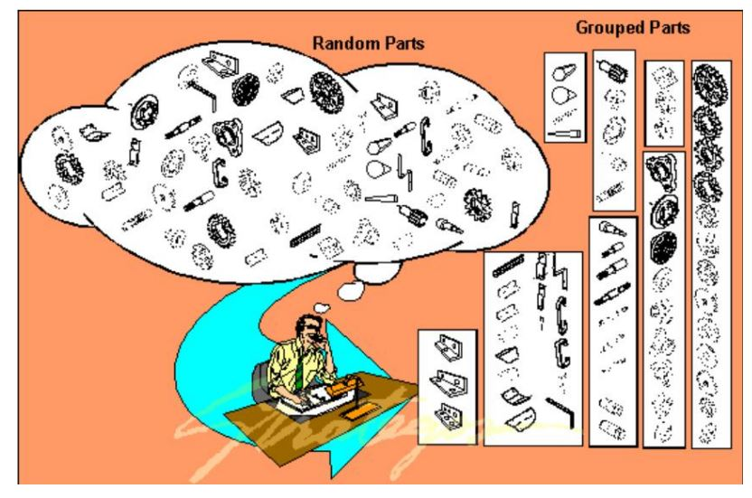

Slide 32
Similarities among parts permit them to be classified into part families.
In each part family, processing steps are similar.
The improvement is typically achieved by organizing the production facilities into manufacturing cells that specialize in production of certain part families.
Machines are grouped into cells, each cell specializing in the production of a part family called cellular manufacturing.

Slide 33
Cellular manufacturing can be implemented by manual or automated methods. When automated, the term flexible manufacturing system is often applied.

Slide 34
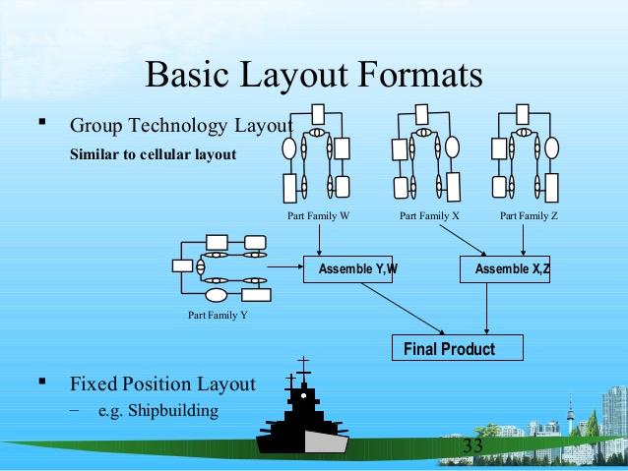

Slide 35
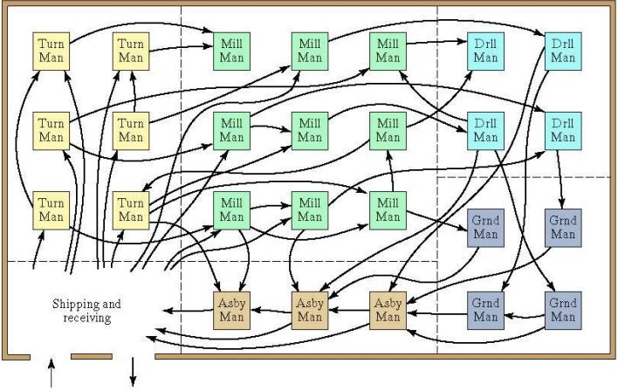
Traditional process layout

Slide 36
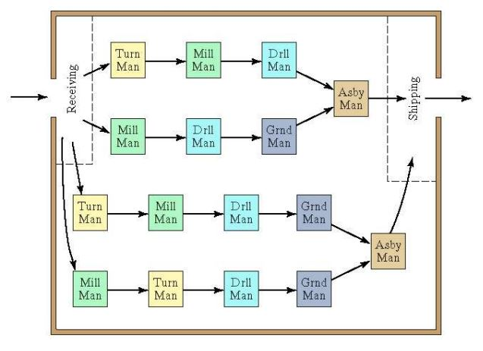
Cellular layout based on GT
Each cell specializes in producing one or a limited number of part families

Slide 37
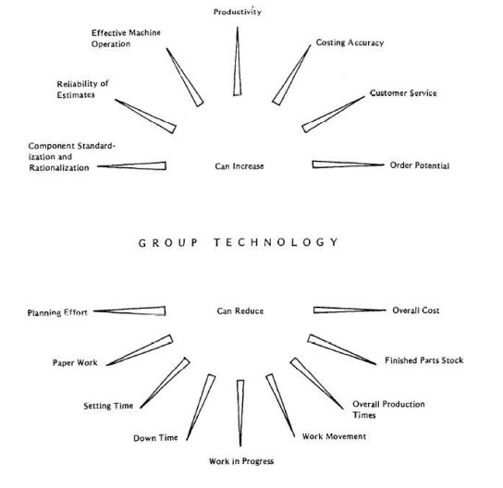
General achievements of GT

Slide 38
Advantages
Faster Processing Time
Manufacturing Time is Less
Less Material Handling
Workers Able To Attend Every Machine
Improved Efficiency Of Workers
Less Work-in Process Inventory
Boredom Factor Is Less For Workers

Slide 39
Disadvantages
Require More Time For Grouping
More Initial Investment
Require More Analysis Of Data
More Supervising Is Needed

Slide 40
Material Handling
“Material handling is the movement, protection, storage and control of materials and products throughout manufacturing, warehousing, distribution, consumption and disposal.”

Slide 41
Movement and Storage of material at the lowest possible cost through the use of proper methods and Equipments.
As it adds cost of Product, it is important to minimize the handling of material & to eliminate unnecessary movement of material.
Product has to be travelled number of times till it becomes finished Product.
Proper Scheduling, Proper selection of materials & proper material handling devices are needed for cost reduction.

Slide 42
Importance Of Materials HANDLING
For efficient space utilization.
To reduce costs by improving material handling.
To improve working conditions.
To improve customer service.
It helps to increase productivity & thereby increases profitability of an industry.
Reduce physical strain on workers.

Slide 43
Objectives of Material Handling
To reduce material handling costs.
Reduction in manufacturing times using faster movements.
To improve working conditions & greater safety in movements of materials.
To utilize properly storage capacity and storage area.
Higher productivity at lower manufacturing costs.
To minimize fatigue of the worker.

Slide 44
Principles of material handling
Planning Principle: All handling devices should be planned.
Systems Principle: Plan a system integrating as many handling activities as possible & co - ordinating the full scope of operations (receiving, storage, production, inspection, packaging, warehousing, supply & transportation.
Space utilization principle: Make optimum utilization of cubic space.
Material flow principle: Plan an operation sequence and equipment arrangement to optimise material flow.
Simplification principle: Reduce, combine or eliminate unnecessary movements or equipment.

Slide 45
Safety Principle: Provide for safe handling methods and equipment.
Mechanisation Principle: Use mechanical or automated material handling equipment.
Flexibility Principle: Use methods and equipment's that can perform a variety of task and application.
Equipment selection principle: Consider all aspects of materials, move and methods to be utilised.
Maintenance principle: Plan for preventive maintenance or scheduled repair of all handling equipment.

Slide 46
Types of material handling
Lifting and Lowering devices
(Vertical Motion)
Transporting devices
(Horizontal Motion)
Combination devices
( Lifting and Lowering Plus Transportation)

Slide 47
Lifting and lowering devices
These devices are used for movement of material in vertical direction only.
Chain hoist
Electric hoist
Pillar crane
Jib crane
Elevators
Gantry cranes
Bridge cranes

Slide 48
Transportation devices
These devices are used for movement of material in horizontal direction only.
Hand truck
Pipelines
Railway equipment's
Skids
Wheel barrow
Tractors and trailers
Aerial Trainways

Slide 49
Combination devices
These devices are used when movement of material in both horizontal and vertical direction in required.
Conveyors
Lift trucks
Slides and Chutes
Overhead crane

Slide 50
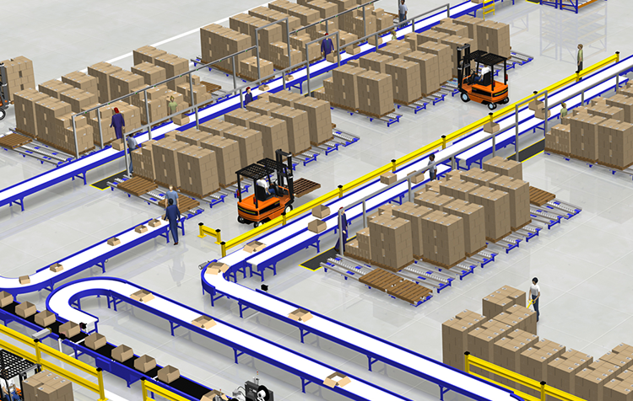
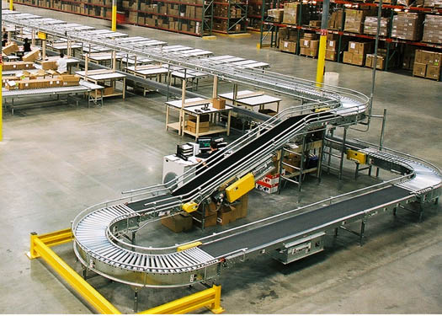
Conveyor
A conveyor system is a common piece of mechanical handling equipment that moves materials from one location to another.
It is especially useful in applications involving the transportation of heavy or bulky materials
It may be in horizontal, inclined or vertical.
The movement may be either continually or intermittently.

Slide 51
ADVANTAGE:
Moves the material without the use of labour.
DISADVANTAGE:
It occupies space even when it is not in operation.

Slide 52
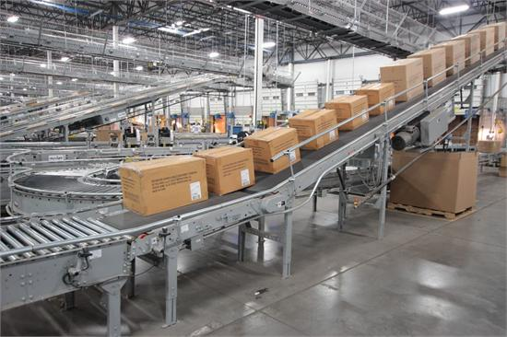
TYPES Of Conveyor
Belt conveyor
Roller conveyor
Screw conveyor
Bucket conveyor

Slide 53
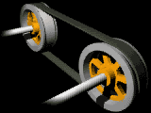
BELT Conveyor
It Consists of a belt mounted over a frame and the belt is driven by rolls at both ends.
One of the roll is power operated while other is idler roll.
Half part of the belt which is at the top surface of the frame is used for carry material and the other half is the return belt.
The belt is made of rubber, Leather or Steel material.
It is used to deliver material over a short as well as long distance used for transportation of cement, coal and other similar material.
It can operate in horizontal direction only.
Main Components:
Idler Roll
Support Ladder
Return Loop
Drive Roll

Slide 54
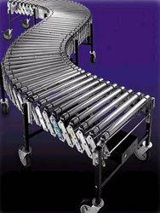
Roller conveyor
It consists of rollers supported in frame over which material are allowed to move.
The material must posses a flat bottom surface of sufficient area to span several adjacent rollers.
The frame is mounted above the floor level at certain height.
Roller conveyor may be gravity operated or power operated.
It can move the material along straight or curved path.
It can operate in horizontal direction only.

Slide 55
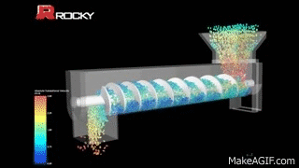
SCREW CONVEYOR
Can operate in horizontal,vertical and inclined direction
videos\Vertical Screw Conveyor test for Nestle - powdered sugar - YouTube (360p).mp4`

Slide 56
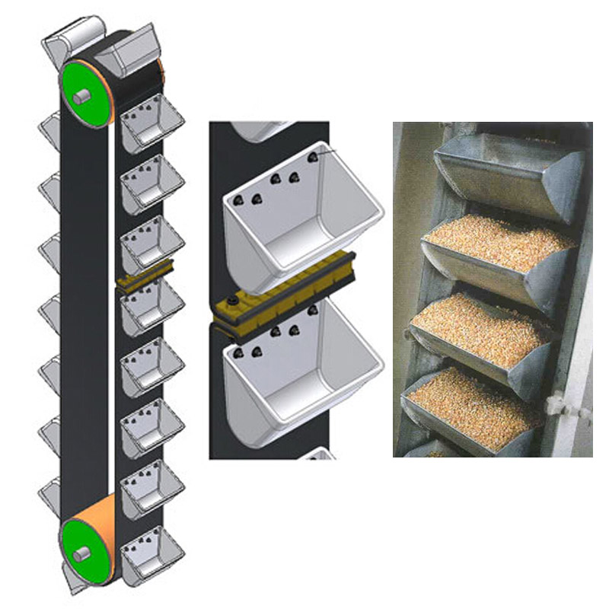
Bucket conveyor
It uses buckets arranged at regular intervals for movement of materials.
It is used to operate in vertical or in horizontal direction.
Material is fed at the bottom and is delivered either by gravity or by centrifugal action as the buckets invert after passing over the head
of the elevator.
A bucket conveyor moves the granular or powdered material or liquid.

Slide 57
BUCKET CONVEYOR
Uses buckets arranged at regular intervals for the movement of material
Operated in vertical or in inclined direction
videos\Gough Engineering Swinglink Bucket Elevator conveying wrapped confectionery - YouTube (360p).mp4

Slide 58
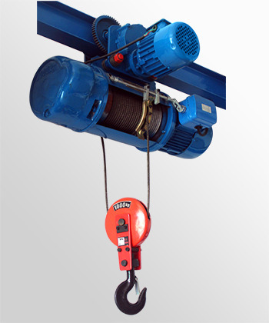
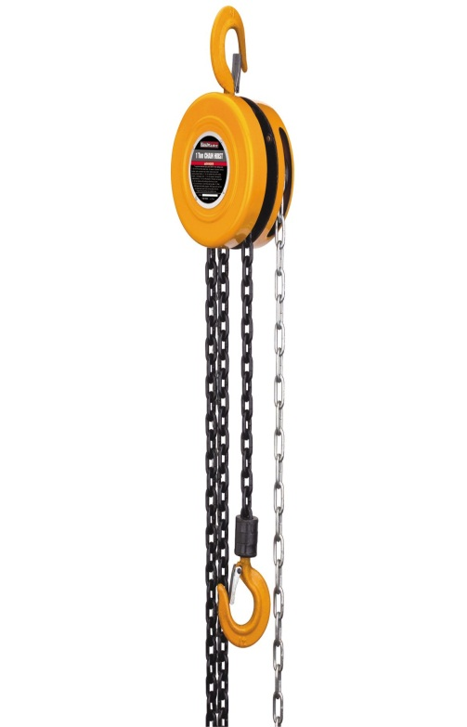
Hoist
It is a mechanical device that can be used to raise and lower loads.
Depending upon capacities of loads to be carried, hoists are available.

Slide 59
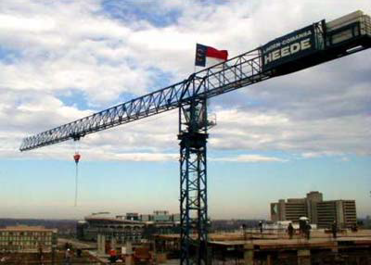
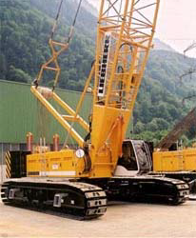
CRANES
Lifting and moving heavy loads using one or more overhead beams for support.
Hoist is mounted in a crane to a trolley which allows horizontal movement of material

Slide 60
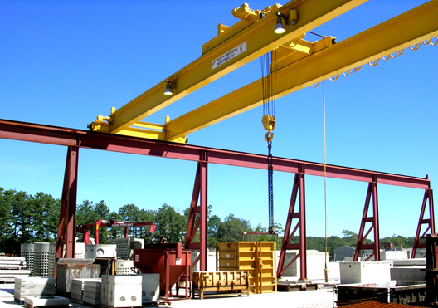
Principal types of cranes
Bridge crane
Gantry crane
Jib crane

Slide 61
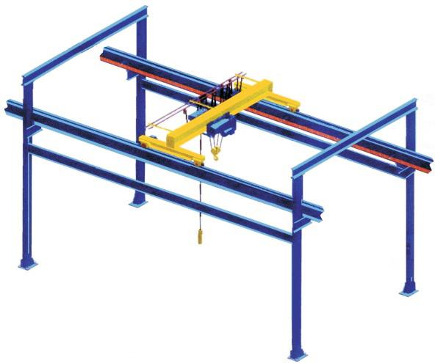
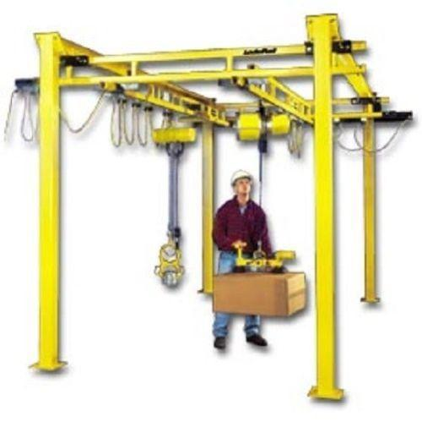
Bridge crane
It is also called as electric overhead travel (EOT) crane.
Consists of two horizontal girders suspended between fixed rails on either end to form a rectangle.
Entire unit is connected to the structure of the building.

Slide 62
GANTRY CRANE
Similar to bridge crane
Crane structure is mounted on wheels and can be moved at the place of use
Vertical lifting is accomplished by hoist.

Slide 63
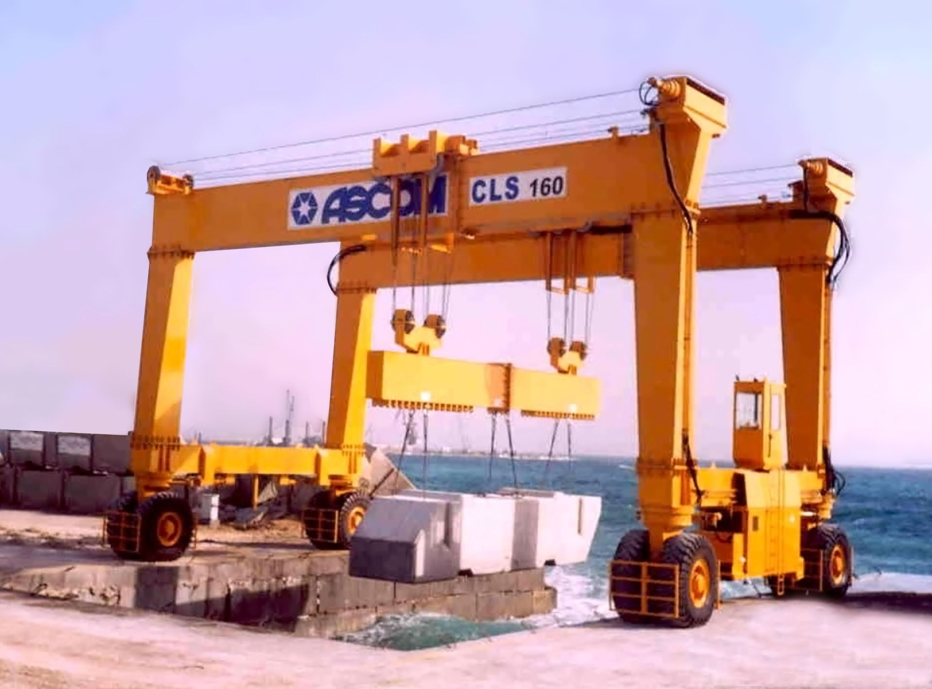

Slide 64
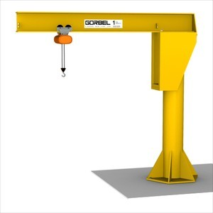
Jib crane
Also called as Pillar crane.
Consist of horizontal beam that comes out from a vertical pillar or wall support.

Slide 65
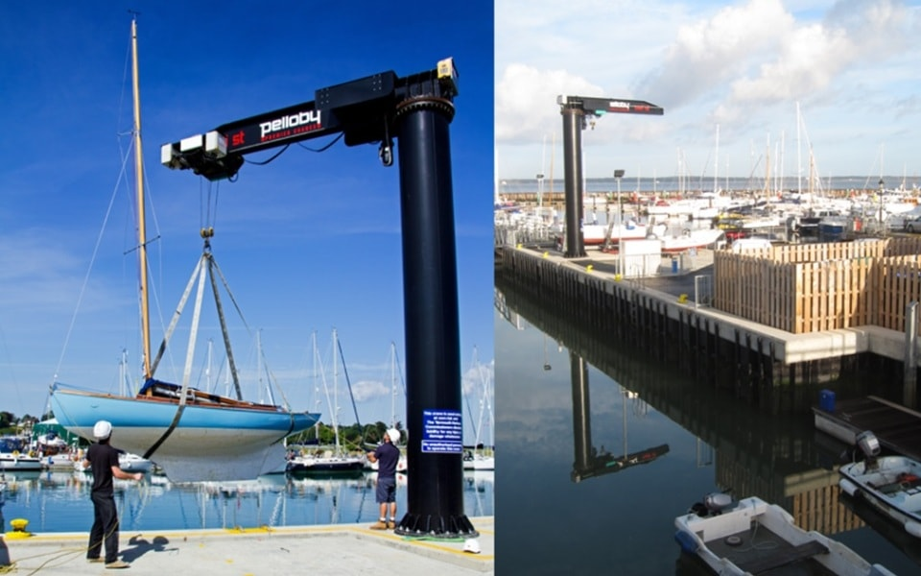
PER_DEEPIKA\videos\jib cranes video.mp4

Slide 66
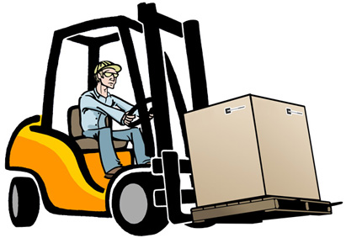
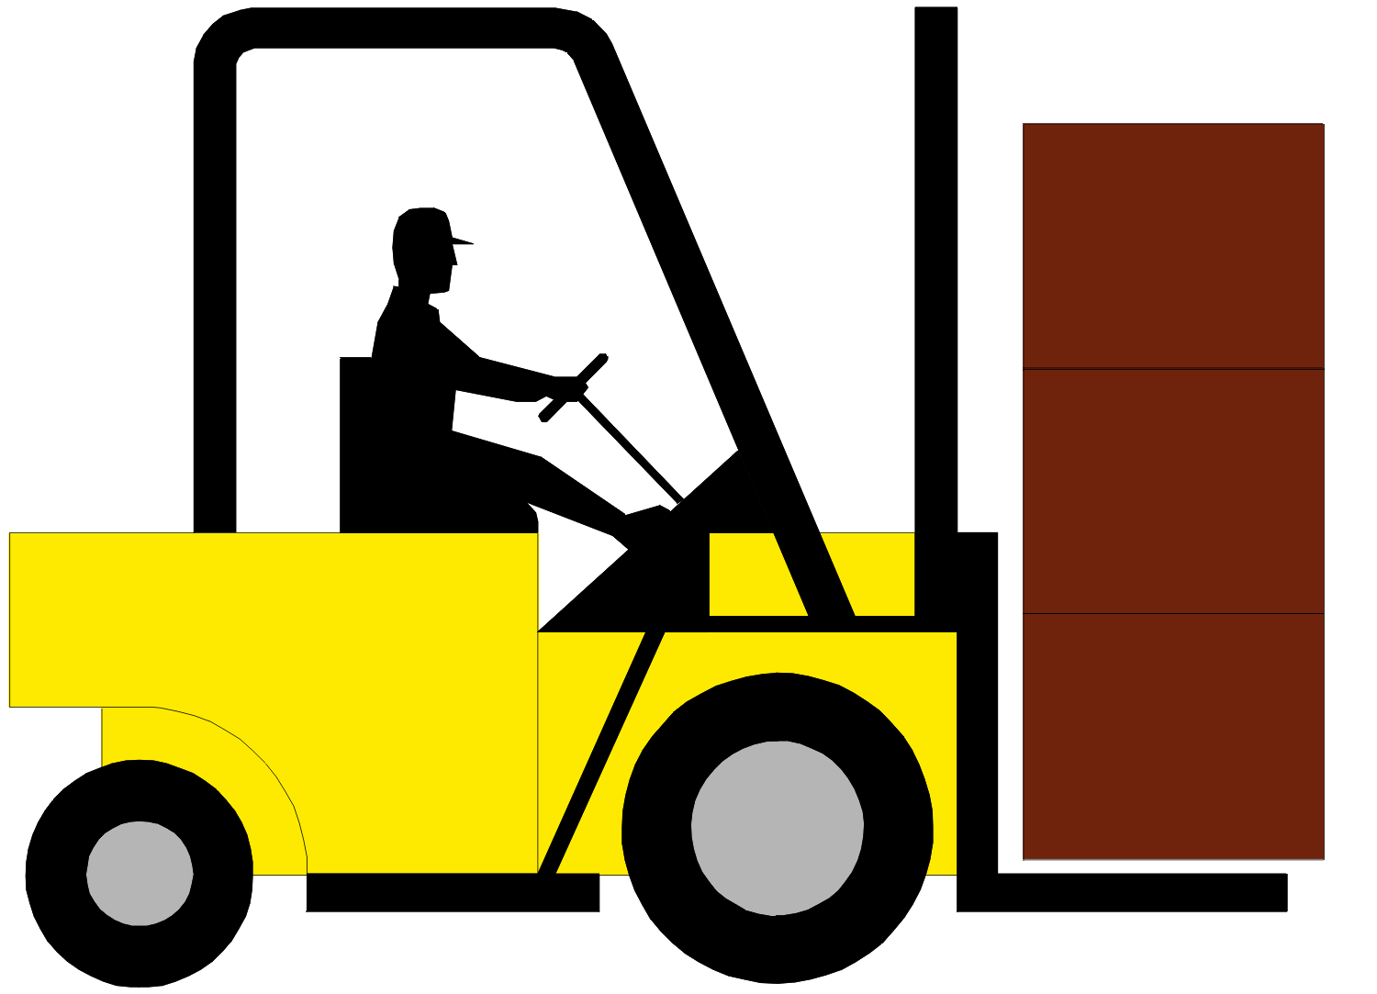
Fork lift trucks
It is an industrial truck of small capacity.
Used for transporting material at a distance inside a factory.
Also used to stack material at a height.
Operator can lower or raise the fork by the use of control levers.
Can be battery operated or use fuel for its running.

Slide 67
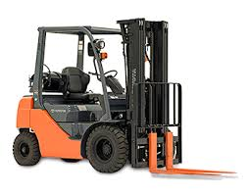

Slide 68
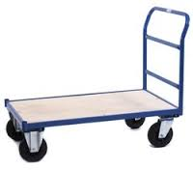
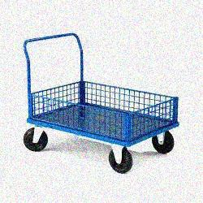
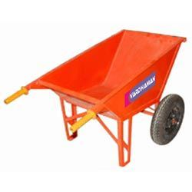
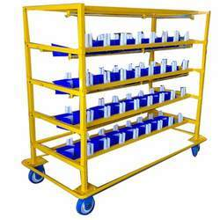
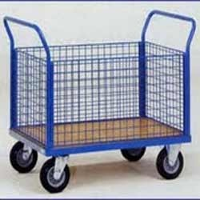
TROLLEY

Slide 69
Criteria for the Selection of material handling equipment
Material to be moved
Plant buildings and layout
Type of production machines
Type of material flow pattern
Type of production
Cost of material handling equipment
Handling cost
List of the equipment
Amount of care & maintenance require for the material handling

Slide 70
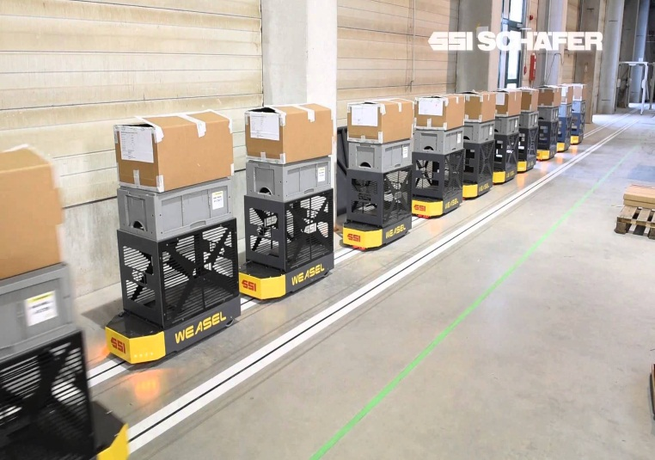
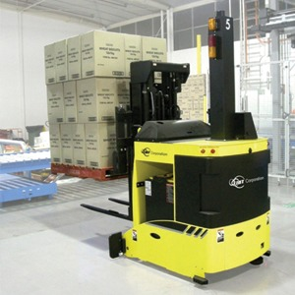
Automated guided vehicles
AGV is a material handling device that uses independently operated, self- guided vehicles, along defined pathways.
AGVs can increase efficiency and productivity as well as reduce product damage and labor costs.
“A driverless vehicle used to move materials efficiently in a facility”

Slide 71
Types of agv
Driverless Trains
Pallet Trucks
Unit Load Carriers

Slide 72
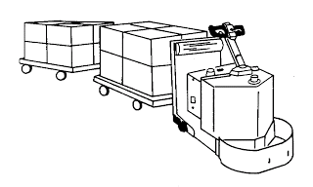
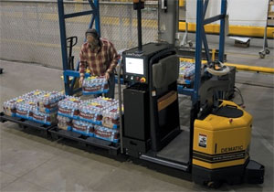
Driverless automated guided train
A driverless train pulls one or more trailers to form a train.
This type is applicable in moving heavy pay loads over large distances in warehouses.
It consists of 5-10 trailers and is an efficient transport system.

Slide 73
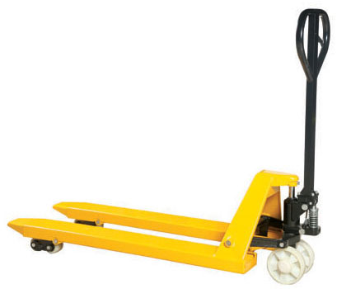
Pallet trucks
Pallet trucks are used to move palletized loads along predetermined routes.
A pallet is loaded by a human worker who steers the truck and uses its fork to elevate the load slightly then the worker drives the pallet truck to the guide path, programs its destination, and the vehicle proceeds automatically to the destination for unloading.

Slide 74
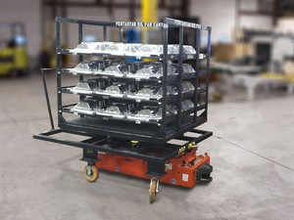
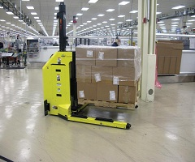
Unit load carriers
AGV unit load carriers are used to move loads from one station to another
It is also used for automatic loading and unloading of pallets by means of rollers
Load capacity ranges 250 kg or less.
Especially these vehicles are designed to move small loads

Slide 75


