Slide 1
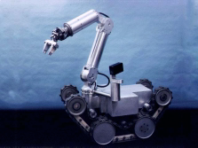
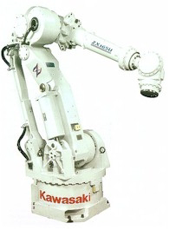
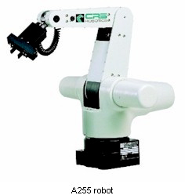
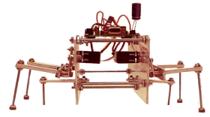
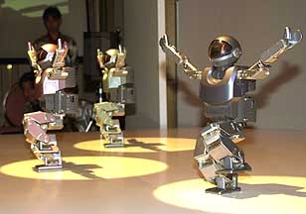
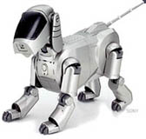
ROBOTICS

Slide 2
Definition of Robot:
“A robot is a reprogrammable, multifunctional manipulator designed to move material, parts, tools or specialized devices through variable programmed motions for the performance of a variety of tasks”
Statement by : Robotics institute of America
OR
A mechanical device with joints and links, guided by sensors and driven by actuators, controlled by a programme,that handle and manipulate parts,material,tools and devices for performing different tasks in various work conditions…..

Slide 3

LAWS OF ROBOTICS
Isaac Asimov proposed three “Laws of Robotics” and later added the “zeroth law”
• Law 0: A robot may not injur humanity or through inaction, allow humanity to come to harm
• Law 1: A robot may not injure a human being or through inaction, allow a human being to come to harm, unless this would violate a higher order law
• Law 2: A robot must obey orders given to it by human beings, except where such orders would conflict with a higher order law
• Law 3: A robot must protect its own existence as long as such protection does not conflict with a higher order law

Slide 4
DEGREE OF FREEDOM
Each plane in which a robot can move.
Ability of the robot arm to move forward, backward, up down and to the left and right.
For each DOF, a joint is required
A robot requires 6 DOF to be completely versatile.

Slide 5
6 DOF
Rotational movement
Vertical movement
Radial movement
Pitch
Yaw
Roll

Slide 6
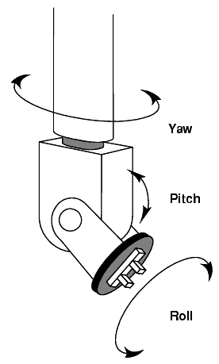
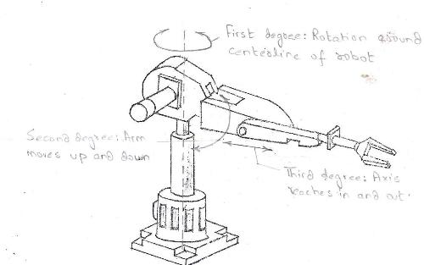
6 dof robot arm animation.mp4

Slide 7
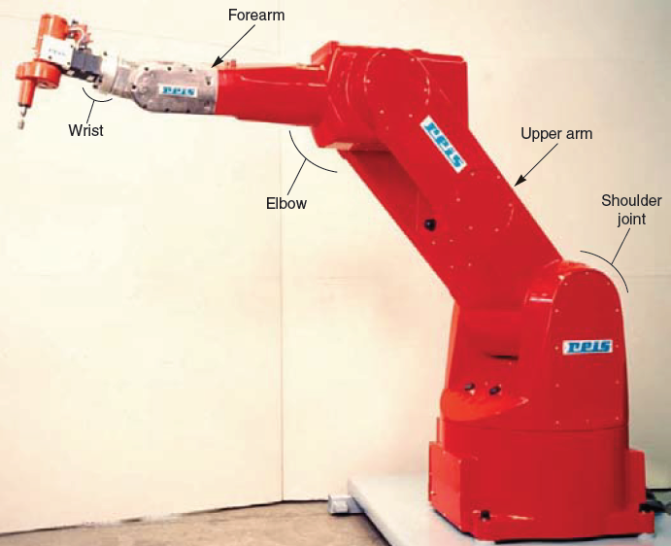
BASIC COMPONENTS OF ROBOT
1. Arm
2. End Effectors
3. Actuators
4. Sensors
5. Controllers
6. Drive
7. Software

Slide 8
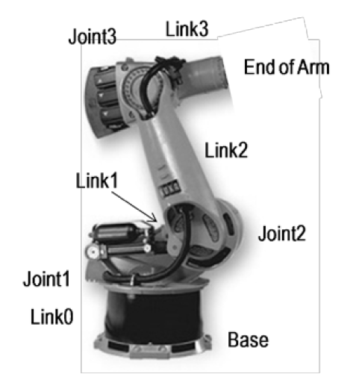
JOINTS AND LINKS
The manipulator of an industrial robot consists of a series of joints and links.
Each joint is connected to two links, an input link and an output link
A robotic link is the rigid component of the robot manipulator.

Slide 9
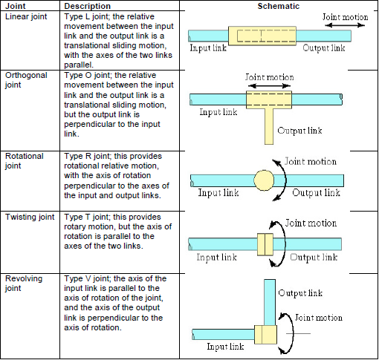
TYPES OF MECHANICAL JOINTS

Slide 10
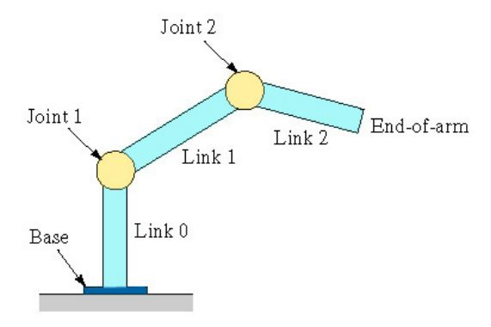
ROBOT ANATOMY
The manipulator of an industrial robot consists of a series of joints and links.
Different joints and links comprise the study of robot anatomy,
Means assembling of outer components of a robot such as wrist, arm and body
Robotic manipulator consists of 2 sections:
Body and arm assembly (3 DOF)
Wrist assembly (3 DOF)

Slide 11
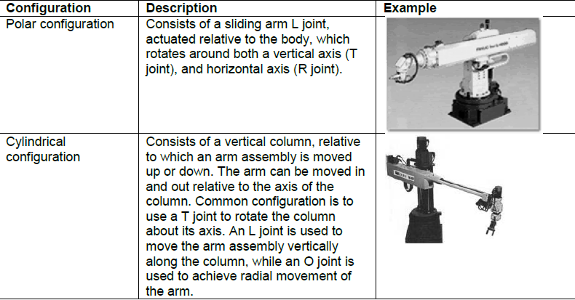
BODY AND ARM CONFIGURATIONS

Slide 12
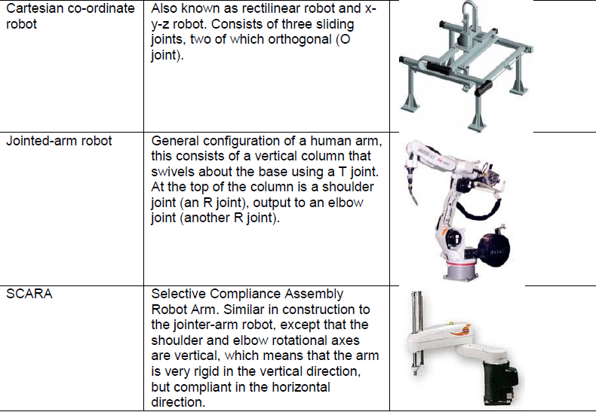

Slide 13
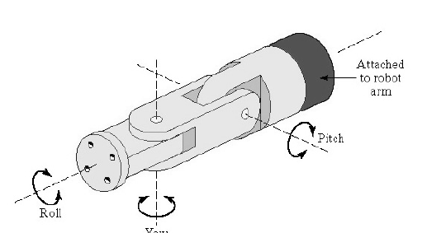
ROBOT WRIST ASSEMBLY
The roll joint is accomplished by use of a T joint;
The pitch joint is achieved by recourse to an R joint; and
The yaw joint, a right-and-left motion, is gained by deploying a second R joint.

Slide 14
END EFFECTORS:
An end effector is usually attached to the robot’s wrist, and it allows the robot to accomplish a specific task.
This means that end effectors are generally custom-engineered and fabricated for each different operation.
The two general categories of end effectors are grippers and tools.

Slide 15
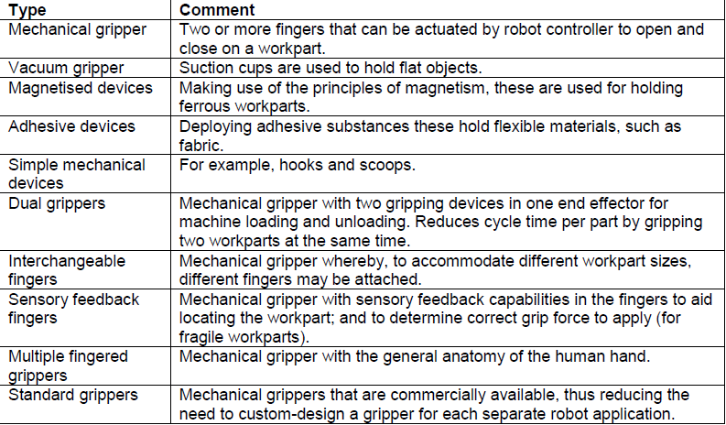
GRIPPERS
Grippers grasp and manipulate objects during the work cycle.
Typically the objects grasped are work parts that need to be loaded or unloaded from one station to another.

Slide 16
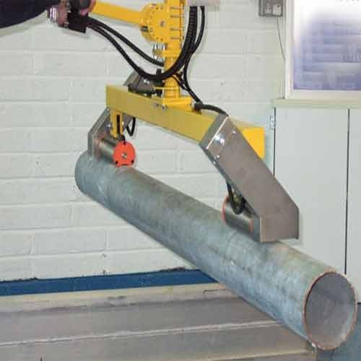
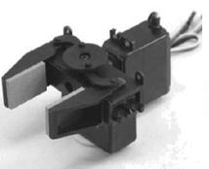
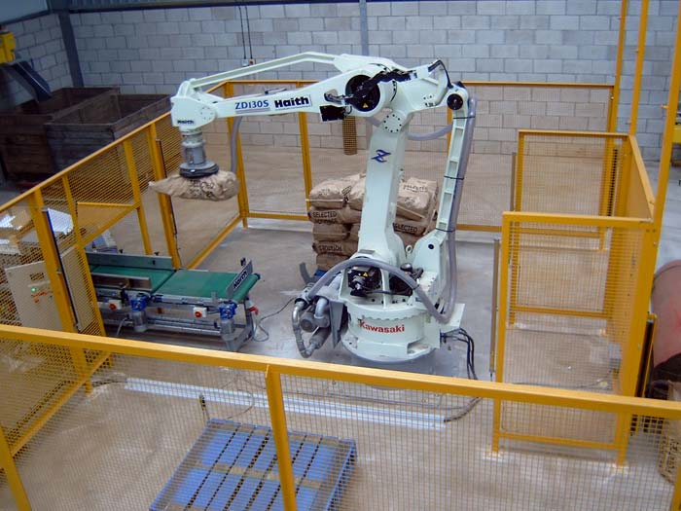
Magnetised gripper
Vacuum gripper
Mechanical gripper

Slide 17
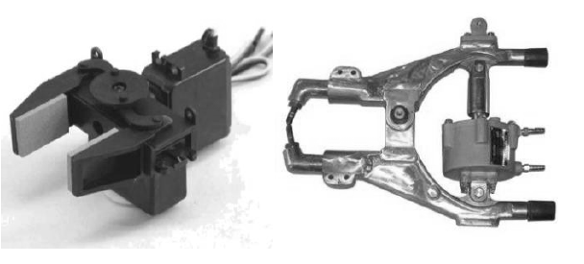

Slide 18
TOOLS
Tools are used to perform processing operations on the work part.
Typically the robot uses the tool relative to a stationary or slowly-moving object
For example, spot welding, arc welding, and spray painting—which all use a tool for processing the operation—may all be carried-out in this way.

Slide 19
GRIPPER AND TOOL (SPOT WELDING)

Slide 20
ACTUATORS
Actuators convert the energy into mechanical form
Classification:
Hydraulic actuators
Pneumatic actuators
Electrical actuators

Slide 21
ELECTRICAL ACTUATORS
Converts electrical signal commands into mechanical motions.
Commonly used are servo motor and stepper motor
DC MOTORS
AC MOTORS
STEPPER MOTOR

Slide 22
HYDRAULIC/PNEUMATIC ACTUATORS
LINEAR – converts hydraulic energy into linear motion
ROTARY – converts hydraulic energy into rotary motion
ACTUATORS TO OPERATE FLOW CONTROL VALVES – used to control the flow and pressure of fluids such as gases, steam or liquid

Slide 23
SENSORS
SENSORS
CONTACTING
NON CONTACTING
TOUCH SENSORS
FORCE SENSORS
OPTICAL SENSORS
PROXIMITY SENSORS
MACHINE VISION
MISCELLANOUS TYPE

Slide 24
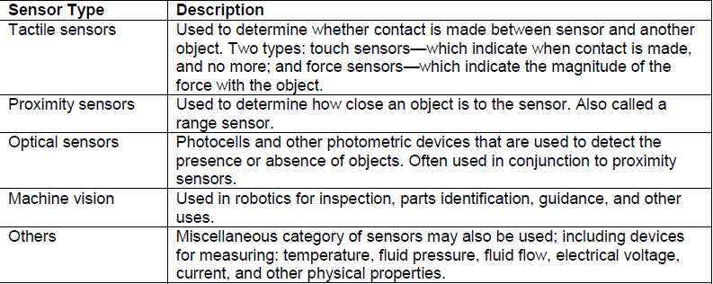
ADVANCED SENSOR TECHNOLOGIES IN ROBOTICS

Slide 25
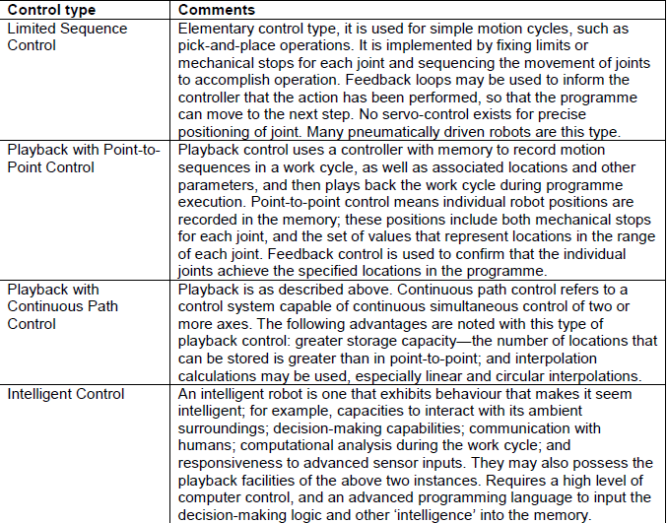
CONTROL SYSTEM
Joint movements must be controlled if the robot is to perform as desired.

Slide 26
ROBOT PROGRAMMING
A robot program is a path in space to be followed by the manipulator, combined with peripheral actions that support the work cycle.
To programme a robot, specific commands are entered into the robot’s controller memory, and this action may be performed in a number of ways.

Slide 27
PROGRAMMING METHODS
Lead through programming -work cycle is taught to robot by moving the manipulator through the required motion cycle and simultaneously entering the program into controller memory for later playback
Robot programming languages -uses textual programming language to enter commands into robot controller
Simulation and off-line programming –program is prepared at a remote computer terminal and downloaded to robot controller for execution without need for leadthrough methods

Slide 28
INDUSTRIAL ROBOT APPLICATIONS
Material handling
Processing operations
Assembly and inspection.

Slide 29
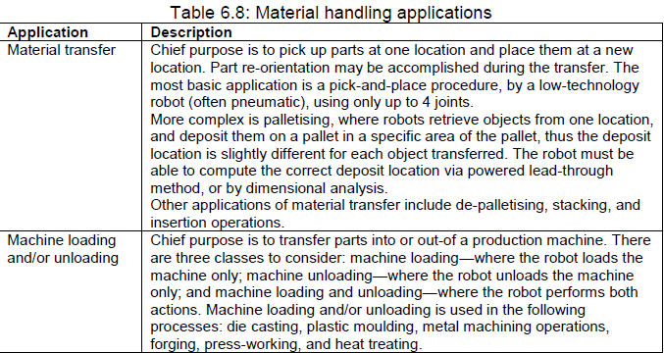
MATERIAL HANDLING APPLICATIONS

Slide 30

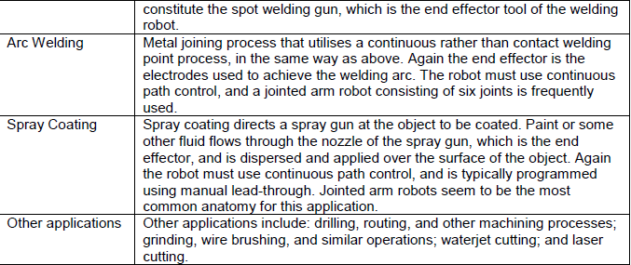
PROCESSING OPERATIONS

Slide 31
ASSEMBLY AND INSPECTION
In assembly and inspection robots can be used for material handling applications, and for processing applications, so it is in effect a hybrid of the previous two application categories.
Owing to difficulties in both assembly and inspection, the application of robots to these tasks has been found to be somewhat difficult.

Slide 32
