Slide 1
CHAPTER 5 WORK STUDY
(12 MARKS)

Slide 2
DEFINITION of METHOD STUDY
“Method study is the systematic recording and critical examination of existing and proposed ways of doing work as a means of developing and applying easier and more effective methods and reducing cost”

Slide 3
OBJECTIVES OF METHOD STUDY
To present and analyze true facts concerning the situation.
To examine those facts critically
To develop the best answer possible under given circumstances based on critical examination of facts.

Slide 4
PROCEDURE OF WORK STUDY/STEPS INVOLVED
SELECT
The job is analyzed
RECORD
All relevant facts about present method
EXAMINE
The recorded facts critically
DEVELOP
The most efficient,practical and economic method
DEFINE
The new method
INSTALL
The method as a standard practise
MAINTAIN
That standard practise

Slide 5
SELECTION OF JOB BASED ON THE FOLLOWING CONSIDERATIONS:
ECONOMIC ASPECT
The method study involves cost and time.
Guidelines for selecting a job:
Bottlenecks operations
Operations involving excessive labor
Operations producing lot of scrap or defectives
Operations having poor utilisation of resources
Backtracking of materials and excessive movement of materials

Slide 6
TECHNICAL ASPECT
The method study man should be careful enough to select a job in which he has the technical knowledge and expertise.
HUMAN CONSIDERATION
Method study means a change as it is going to affect the way in which the job is done presently and is not fully accepted by the workman and union.

Slide 7
RECORDING TECHNIQUES
Recording techniques are designed to simplify and standardize the recording work.

Slide 8
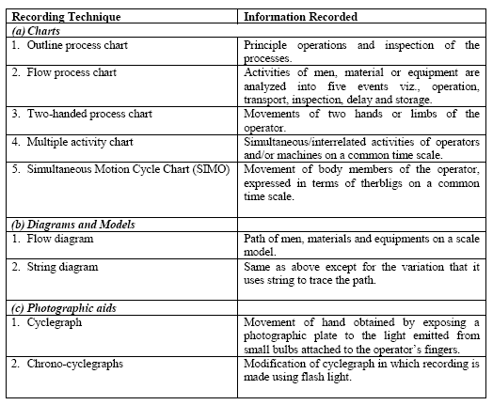

Slide 9
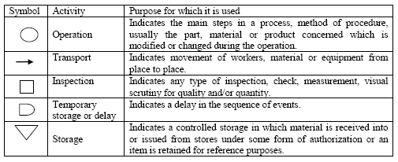
METHOD STUDY SYMBOLS:

Slide 10
RECORDING TECHNIQUES
CHARTS
DIAGRAMS AND MODELS
PHOTOGRAPHIC AIDS

Slide 11
CHARTS
OPERATION PROCESS CHART (outline process chart)
FLOW PROCESS CHART
MULTIPLE ACTIVITY CHART
TWO HANDED PROCESS CHART
TRAVEL CHART
SIMO CHART

Slide 12
OUTLINE PROCESS CHART
It surveys and records an overall picture of the process and states only main events sequence wise.
It considers only main operations and inspections.

Slide 13
Task : Changing refill of a ball pen
1
Unscrew cap
2
Unscrew Neck
3
Remove the old refill
4
Assemble the spring on new refill
5
Place the refill in the barrel
6
1
7
Screw the neck
Check if the pen writes
Screw the cap

Slide 14
FLOW PROCESS CHARTS
It’s a detailed version of outline process chart and it records all the events.
It :
Sets out sequence of flow
Records all the events in sequence using process chart symbols
Marks distances travelled and time taken for completing an activity
Mentions other important points,if any.

Slide 15
TYPES OF FLOW PROCESS CHARTS
Man type
Records the activities of an operator i.e what an operator does
Equipment type
Records the manner in which the equipment is used
Material type
Records what happens to the material i.e the changes in material undergoes in location or condition

Slide 16
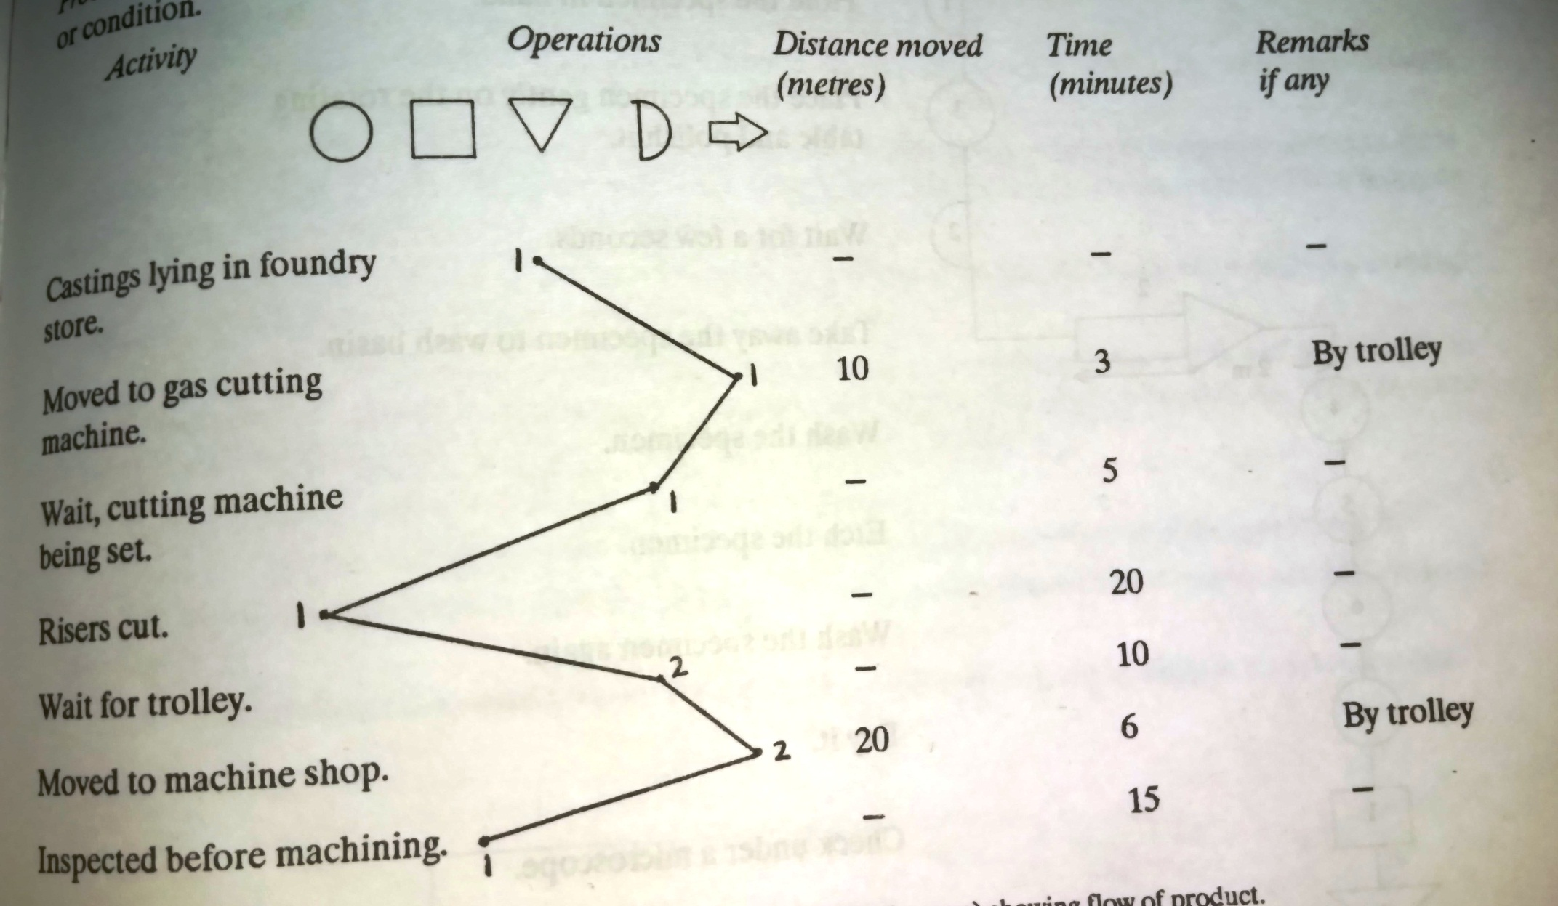
Material type flow process chart

Slide 17
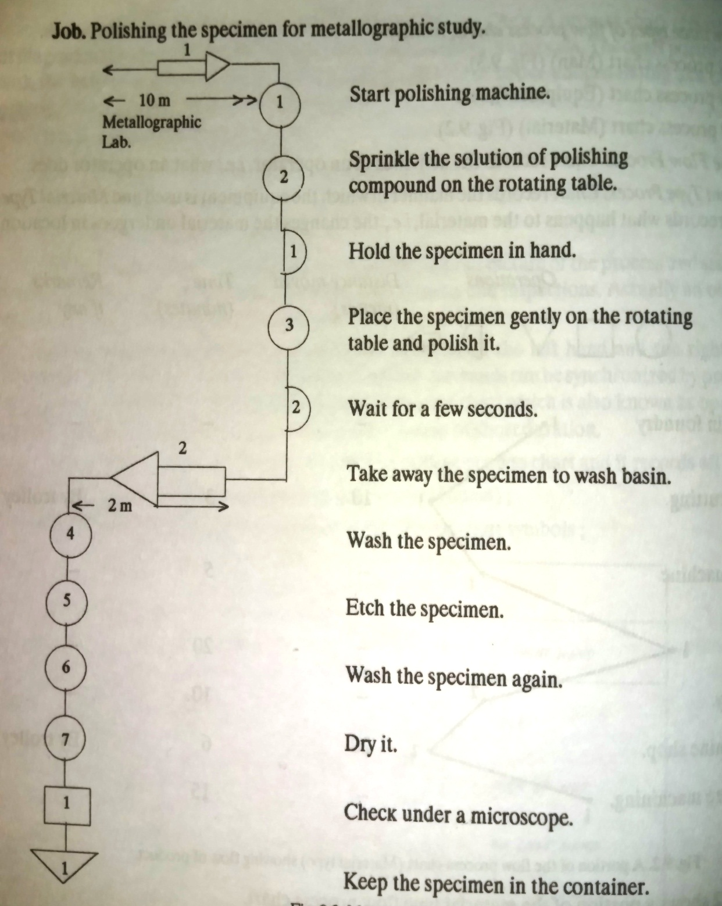
Man type flow process chart

Slide 18
TWO HANDED PROCESS CHART
Records the activities of the left hand and the right hand (of an operator) as related to each other.
The activities of the two hands can be synchronized by providing a time scale on the chart.
It is also called as operator activity chart
It is generally used for repetitive works of short duration

Slide 19
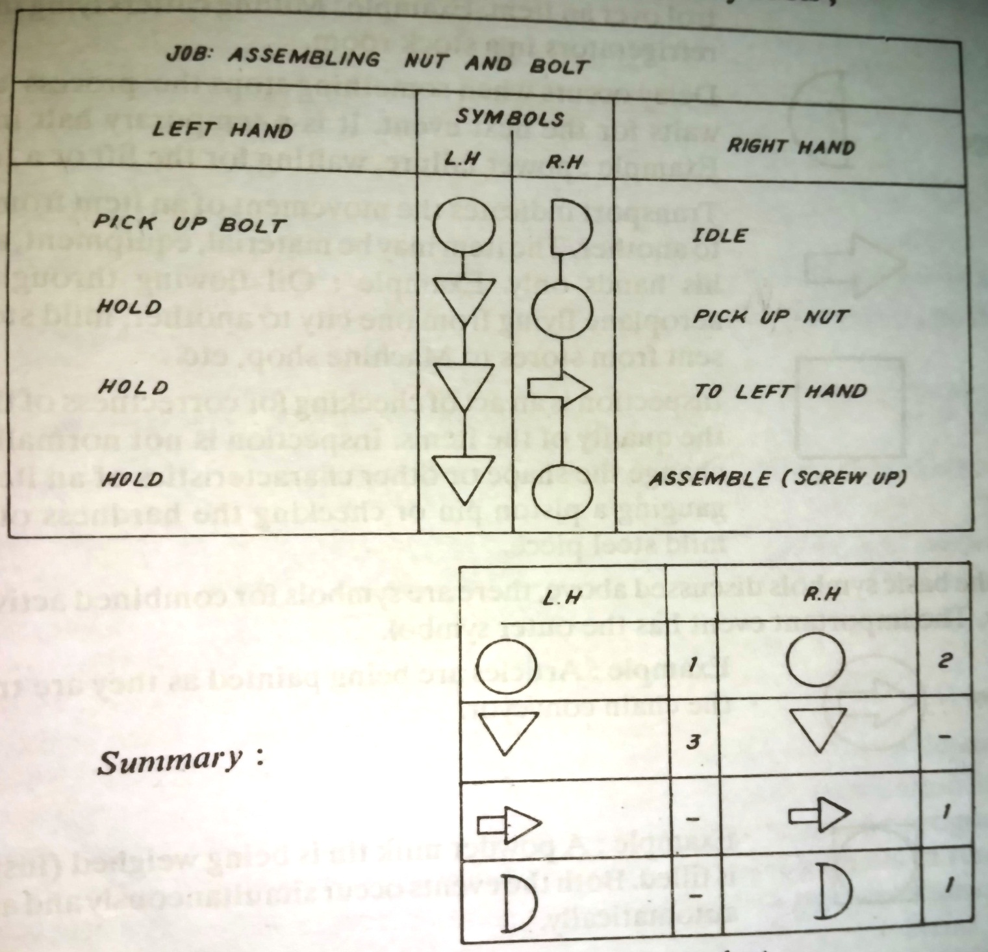

Slide 20
MULTIPLE ACTIVITY CHART
It is a chart where activities of more than subject (worker or equipment) are each recorded on a common time scale to show their inter relationship.
It is made to
Study idle time of the man and machine
Determine number of machines handled by one operator
Determine number of operators required in team work to perform the given job

Slide 21
It consist of a series of bar(columns) placed against a common time scale.
Each subject is allocated one bar and the activities related to the subjects are represented in this bar.
The columns are placed against a common time scale which starts at zero and ends at the cycle time of the job.
The task to be recorded is broken into smaller elements and time for each element is measured with the help of a stop watch.
The activities are then recorded in the chart in their respective columns.

Slide 22
SYMBOLS USED IN MULTIPLE ACTIVITY CHART:
IDLE
WORKING

Slide 23
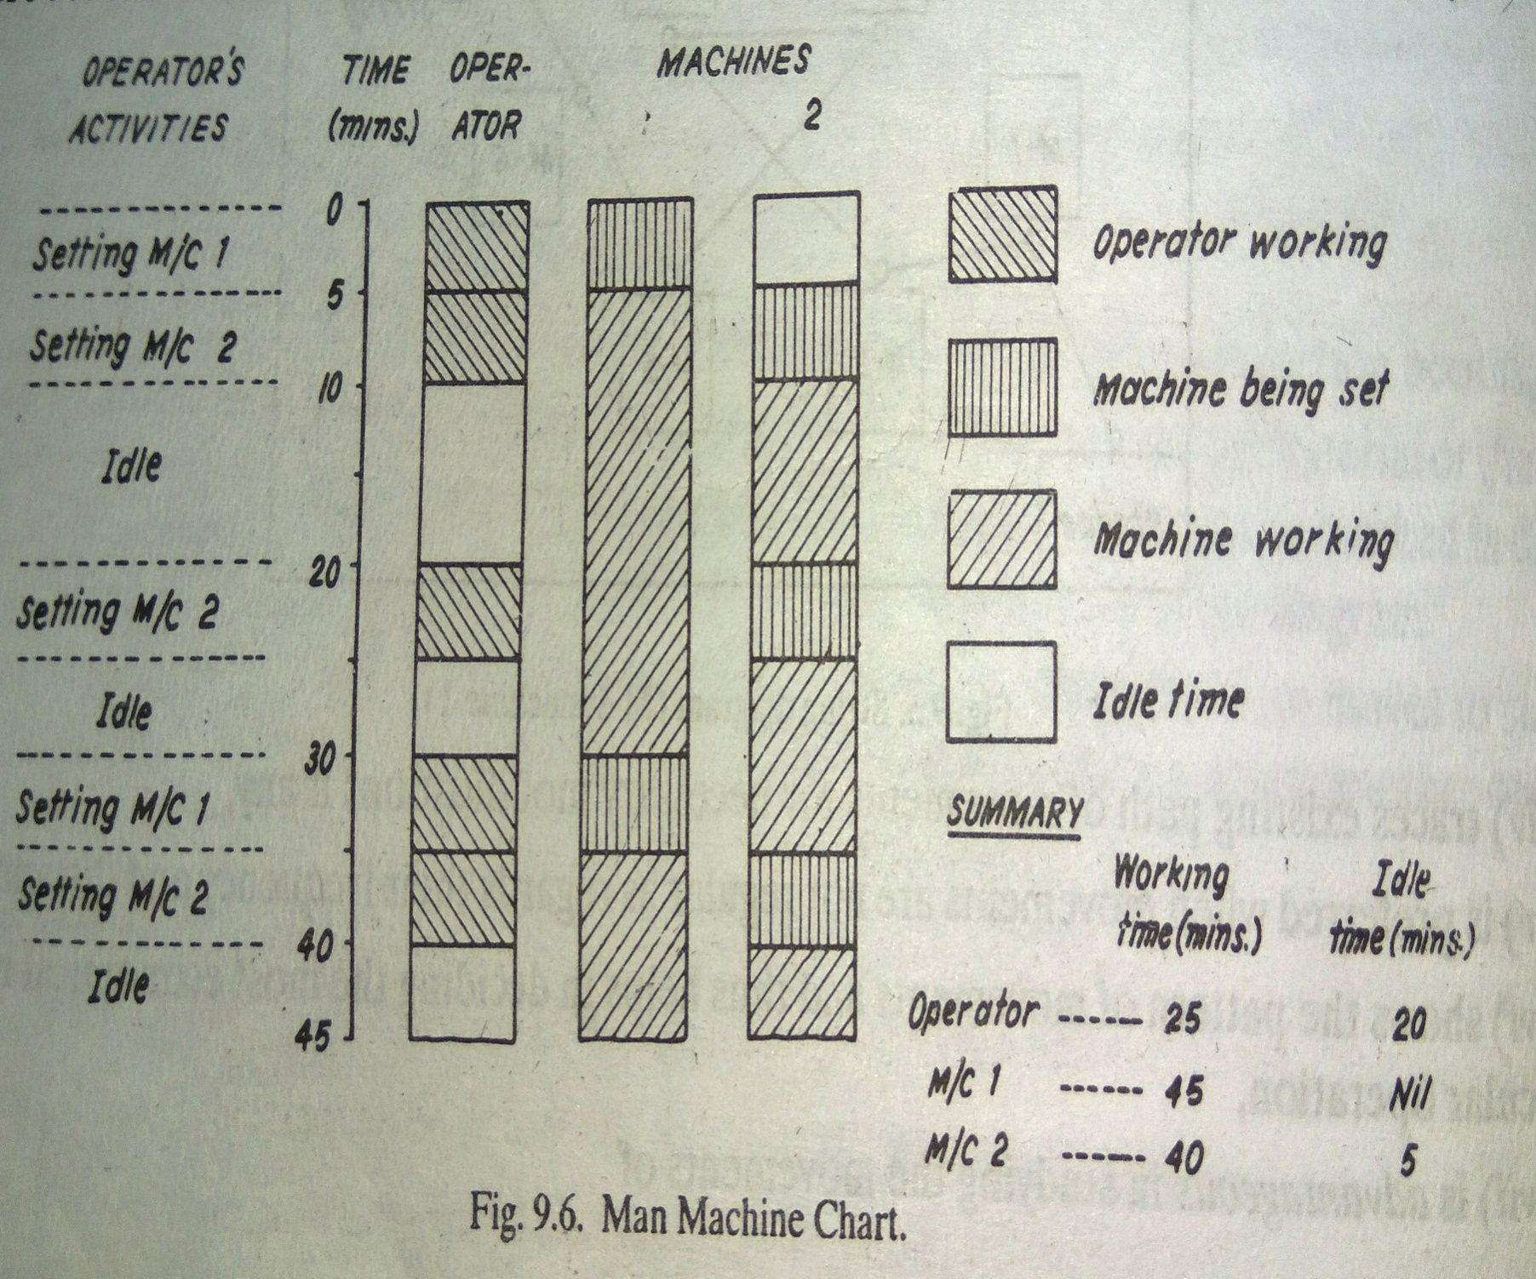

Slide 24
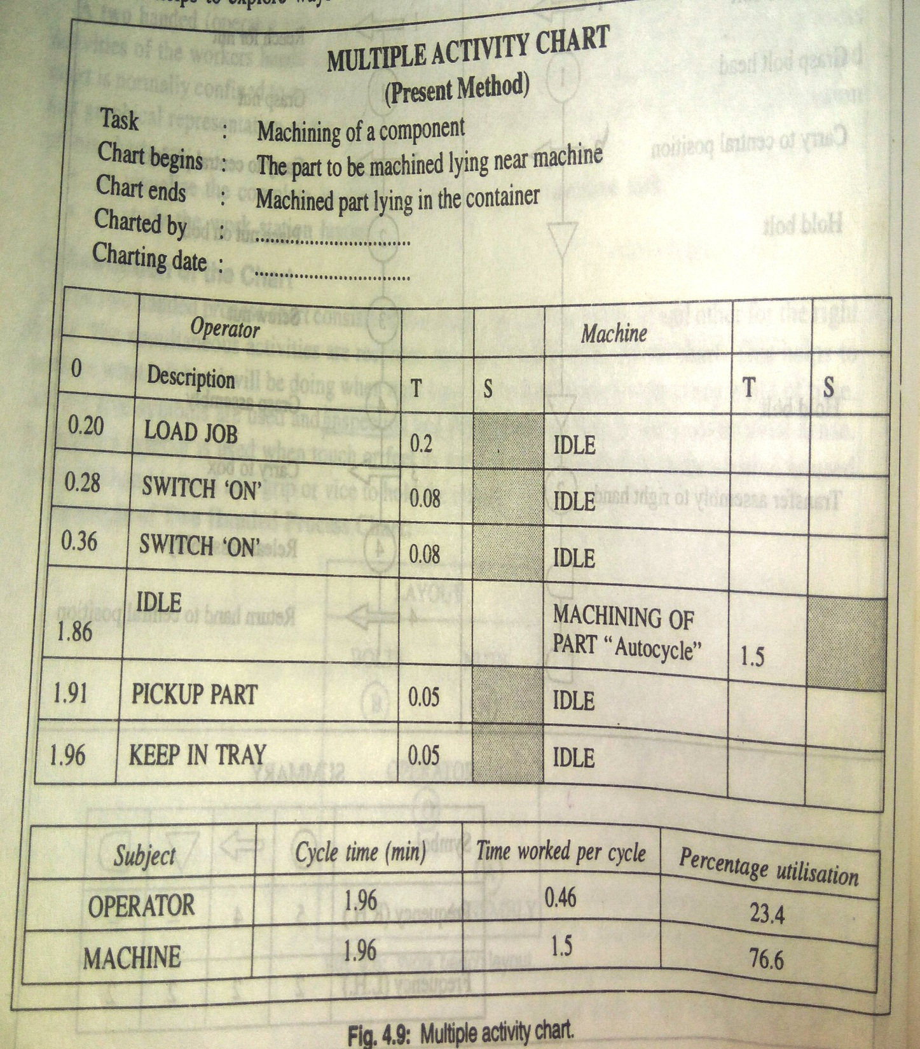
ILLUSTRATION:
The operator engaged on the machine performs the following operations
Pick up the job,place it between the jaws of a hydraulic vice (.2 min)
Make the sw ON to tightly hold the part (.08 min)
Make the sw ON start automatic cycle of the operation (.08 min)
Machining of the part on auto cycle (1.5 min)
Wait till the vice opens automatically (.08)
Pickup the machined job from the vice (.05)
Keep in the tray(.05)

Slide 25
DIAGRAMS
The flow process charts shows the sequence and nature of movement but it does not clearly show the path of movements.
In the path of movements there are undesirable features such as congestion,back tracking and unnecessary long movements.
To record these unnecessary features, representation can be in the form of flow diagrams, string diagrams.

Slide 26
DIAGRAMS
FLOW DIAGRAM
STRING DIAGRAM

Slide 27
FLOW DIAGRAM
It is a drawing,substantially to scale,of the working area,showing the location of the various activities identified by their numbered symbols and are associated with particular flow process chart either man type or material type.

Slide 28
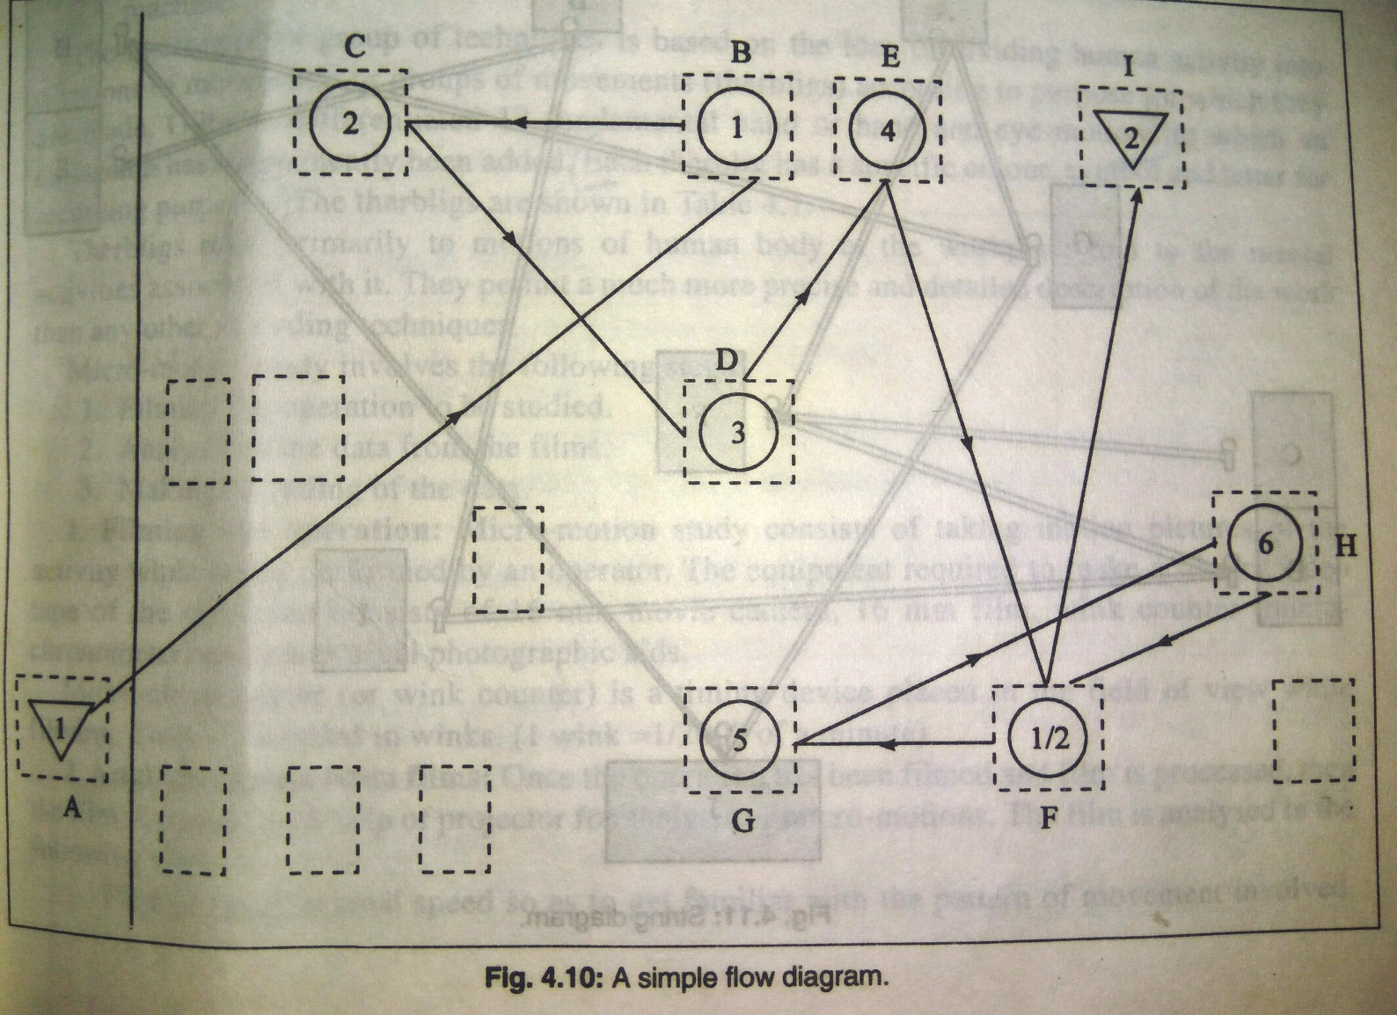

Slide 29
STRING DIAGRAM
The string diagram is a scale layout drawing on which length of a string is used to record the extent as well as the pattern of movement of a worker within a limited area during certain period of time.
It enables the actual distance travelled during the period of study to be calculated by relating the length of the thread used to the scale of the drawing.

Slide 30
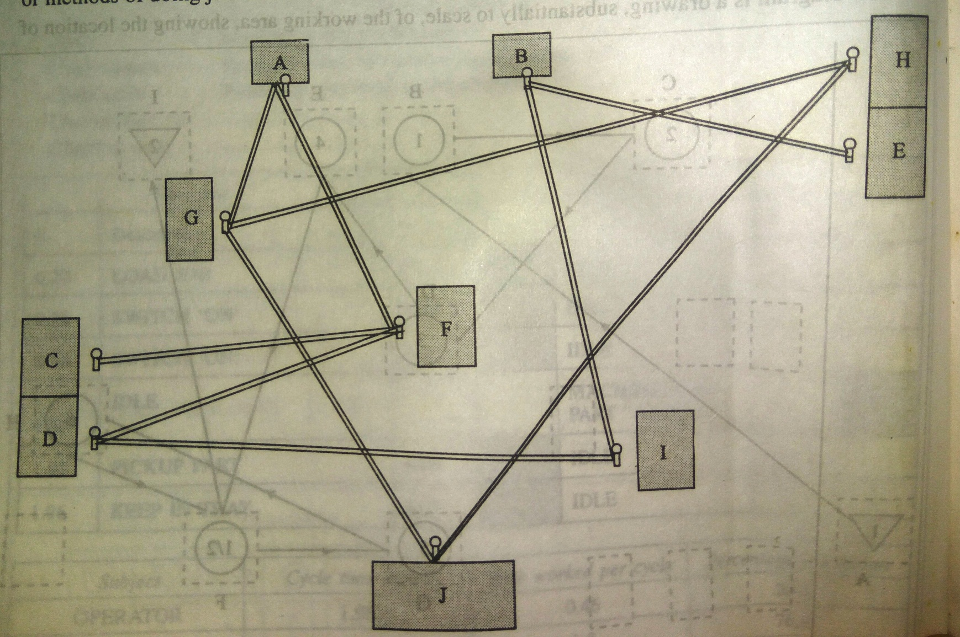

Slide 31
TRAVEL CHART
When the movement patterns are complex, the travel chart is a quicker and more manageable recording technique.
A travel chart is a tabular record for presenting quantitative data about the movements of workers, materials or equipment between any number of places over any given period of time

Slide 32
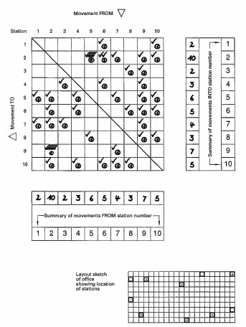

Slide 33
WORK MEASUREMENT

Slide 34
DEFINITION
Can be termed as WORK MEASUREMENT
Can also be termed as TIME STUDY
Can be defined as “The application of techniques designed to establish the time for a qualified worker to carry out a specified job at a defined level of performance”

Slide 35
OBJECTIVES OF WORK STUDY:
Comparing alternative methods
Assessing the correct initial manning (Manpower requirement planning)
Planning and control
Realistic costing
Financial incentive schemes
Delivery date of goods
Cost reduction and cost control
Identifying substandard workers
Training new employees

Slide 36
TECHNIQUES OF WORK MEASUREMENT
Time study
Synthesis
Work sampling
Analytical estimating
Predetermined motion and time study

Slide 37
TIME STUDY
A work measurement technique for recording the time and rates of working for the elements of a specified job carried out under specified conditions and for analyzing the data so as to determine the time necessary for carrying out the job at the defined level of performance.

Slide 38
STEPS IN TIME STUDY
SELECT
The job to be timed
OBTAIN & RECORD
details regarding method,operator,job and working conditions
DEFINE
The elements, break the job into elements convenient for timing
MEASURE
Time duration for each element and assess the rating
EXTEND
Observed time into normal time
DETERMINE
Relaxation and personal allowances
COMPUTE
Standard time for the operation for defined job or operation

Slide 39
TIME STUDY EQUIPMENTS
TIME STUDY EQUIPMENTS
TIME STUDY BOARD
STOP WATCH
TIME STUDY FORMS
CUMULATIVE STOOP WATCH
FLY BACK STOP WATCH

Slide 40
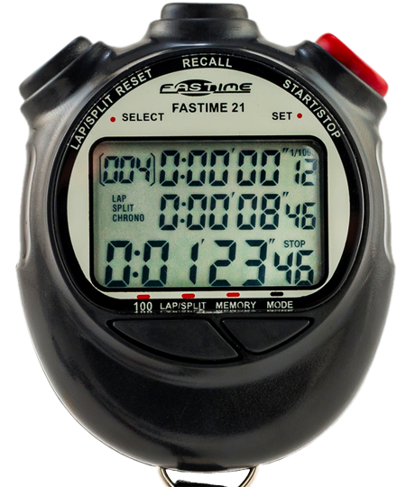
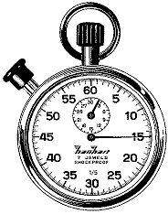
CUMULATIVE STOP WATCH
FLYBACK STOP WATCH

Slide 41
ALLOWANCES
The normal time for an operation does not contain any allowance for the worker
It is impossible to work throughout the day even though the most practicable effective method has been developed
Even under the best working method situation, the job will still demand the expenditure of human effort and some allowance must therefore be made for recovery from fatigue and for relaxation

Slide 42
CATEGORY OF ALLOWANCES:
ALLOWANCE
RELAXATION ALOWANCE
INTERFERENCE ALLOWANCE
CONTINGENCY ALLOWANCE
FIXED
VARIABLE

Slide 43
ALLOWANCE TO BUILD STANDARD TIME

