Slide 1
PRODUCTION SYSTEM
Rashmi P. Khobragade

Slide 2
Introduction
Production is the process of converting resources into products or services.
It is usually measured in terms of output per time period (e.g. boxes per hour, tones per day, bookings per month) or cost per unit of output (e.g. $10 per box, $20 per ton, etc).
The objective of production operations is to meet the forecasted needs of the market in which they perform at the lowest possible cost.

Slide 3
Meaning of production
Production can be explained as an act of either manufacturing or mining or growing of goods (commodities) generally in bulk for trade.
Production is a method employed for making or providing essential goods and services for consumers. It is a process that puts intangible inputs like ideas, creativity, research, knowledge, wisdom, etc. in use or action. It is a way that transforms (convert) tangible inputs like raw-materials, semi-finished goods and unassembled goods into finished goods or commodities.

Slide 4
Meaning of system
System is an arrangement or assembly of inter-dependent processes (activities) that are based on some logic and function. It operates as a whole and is designed (build) with an intension to achieve (fulfill) some objective or do some work. Huge systems are often a collection (assembly) of smaller sub-systems.

Slide 5
Definition of production system
Production system may be defined as,
Production system utilizes materials, funds, infrastructure, and labour to produce the required output in form of goods.
"The methods, procedure or arrangement which includes all functions required to accumulate (gather) the inputs, process or reprocess the inputs, and deliver the marketable output (goods)."

Slide 6
Meaning of production system
Production system consists of three main components viz., Inputs, Conversion Process and Output.
Inputs include raw-materials, machines, man-hours, components or parts, drawing, instructions and other paper works.

Slide 7
Conversion process includes operations (actual production process). Operations may be either manual or mechanical or chemical. Operations convert inputs into output. Conversion process also includes supporting activities, which help the process of conversion. The supporting activities include; Production planning and control, purchase of raw-materials, receipt, storage and issue of materials, inspection of parts and work-in-progress, testing of products, quality control, warehousing of finished products, etc.
Output includes finished products, finished goods (parts), and services.

Slide 8
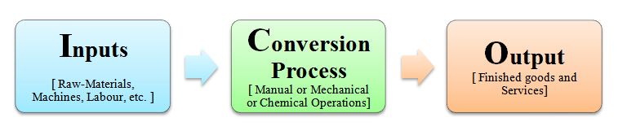
The three components of a production system are depicted in this diagram.

Slide 9
Examples
Tangible goods : Consider an example of a manufacturing industry like a Sugar Industry. Here, sugarcane is first used as an input, then the juice of sugarcane is processed through a conversion process, finally to get an output known as a refined sugar (used for mass consumption).
Intangible goods : Consider an example from a service industry that of a software-development firm or company. Here, initially, written program codes are used as an inputs. These codes are then integrated in some database and are provided with a user-friendly interface through a conversion process. Finally, an output is made available in form of an executable application program.

Slide 10
Productivity
Productivity describes various measures of the efficiency of production.
A productivity measure is expressed as the ratio of output to inputs used in a production process, i.e. output per unit of input.
Productivity is an index that measures output (goods and services) relative to the input (capital, labor, materials, energy, and other resources) used to produce them.

Slide 11
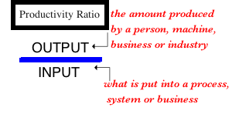
PRODUCTIVITY = OUTPUTS / INPUTS

Slide 12
Productivity
Productivity is simply a measure of the ratio between the output of a process and the input of resources needed for it. It is usually expressed as output divided by input.
Output can be expressed in terms of units or volume (e.g. tones, liters, boxes, etc) and these units have usually been already determined for production planning purposes. In cases where outputs cannot be individually defined a monetary total can be used (e.g. $s of production, $s of sales, etc).
Inputs are usually separated into Manpower, Machinery and Materials. In cases where inputs cannot be segregated a monetary value can be substituted (e.g. £s of material).

Slide 13
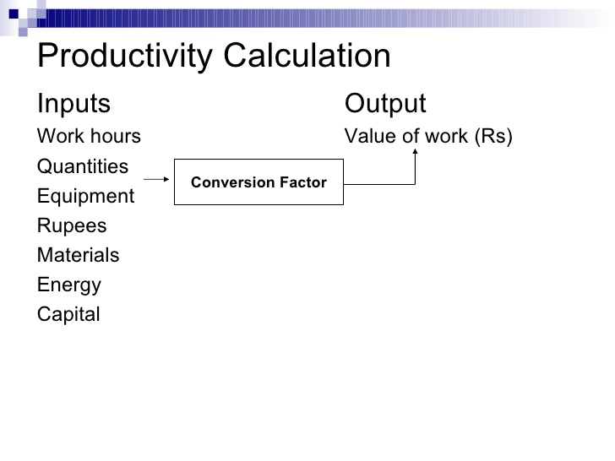

Slide 14
Why Productivity Matters
High productivity is linked to higher standards of living
As an economy replaces manufacturing jobs with lower productivity service jobs, it is more difficult to maintain high standards of living.
Higher productivity relative to the competition leads to competitive advantage in the marketplace
Pricing and profit effects
For an industry, high relative productivity makes it less likely it will be supplanted by foreign industry

Slide 15
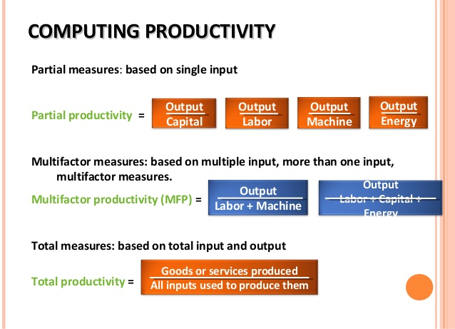
Measures of Productivity

Slide 16
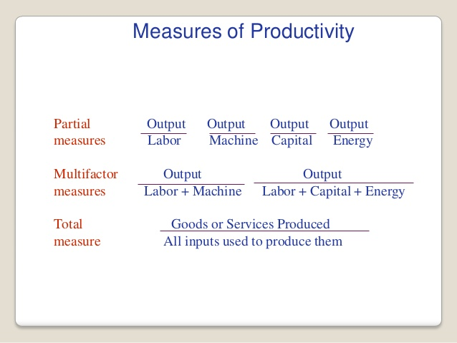

Slide 17
Examples of Partial Productivity Measures
Labor Productivity | Units of output per labor hour Units of output per shift Value-added per labor hour
Machine Productivity | Units of output per machine hour machine hour
Capital Productivity | Units of output per dollar input Dollar value of output per dollar input
Energy Productivity | Units of output per kilowatt-hour Dollar value of output per kilowatt-hour

Slide 18
Productivity Growth
Productivity Growth is a key factor in a country’s rate of inflation and the standard of living of its people

Slide 19
Productivity improves when firms:
Become more efficient
Downsize
Expand
Retrench
Achieve breakthroughs

Slide 20
Ways to Increase Productivity
Increase output by using the same or a lesser amount of (input) resource.
Reduce amount of (input) resource used while keeping output constant or increasing it.
Use more resource as long as output increases at a greater rate.
Decrease output as long as resource use decreases at a greater rate.
Production is concerned with the activity of producing goods and services.
Productivity is concerned with the efficiency and effectiveness with which these goods and services are produced.

Slide 21
THANK YOU

