Slide 1
CHAPTER NO.4
FLOW MEASUREMENT

Slide 2
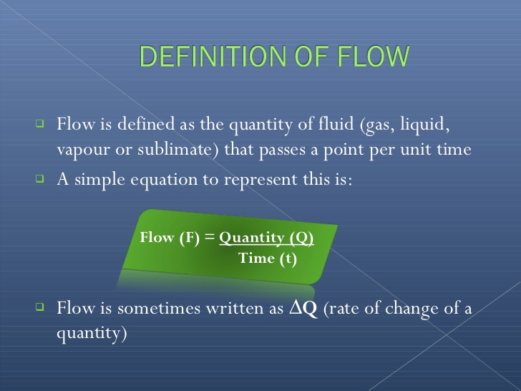

Slide 3
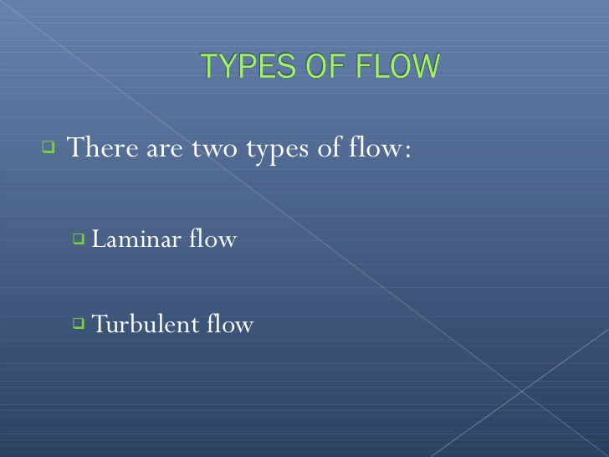

Slide 4
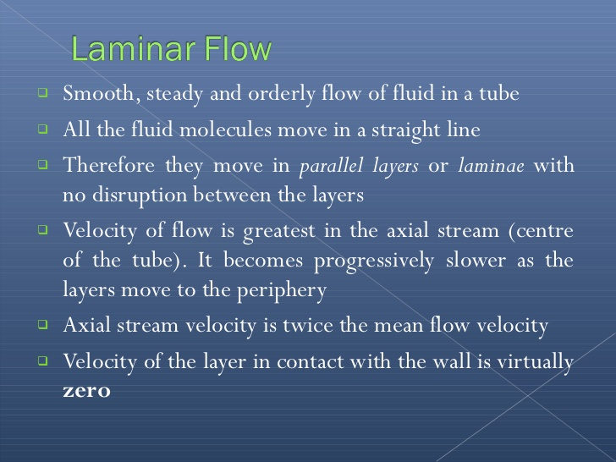

Slide 5
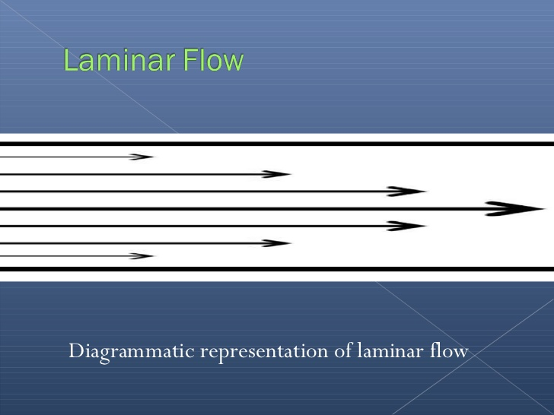

Slide 6
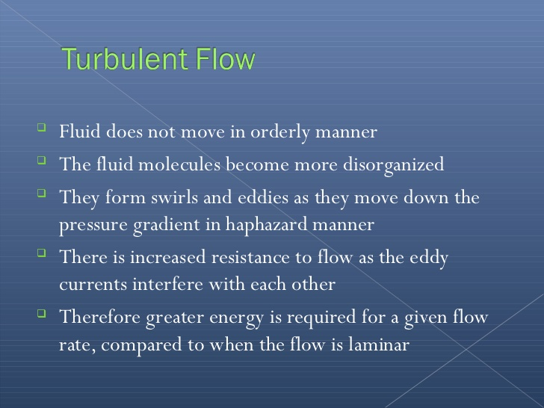

Slide 7
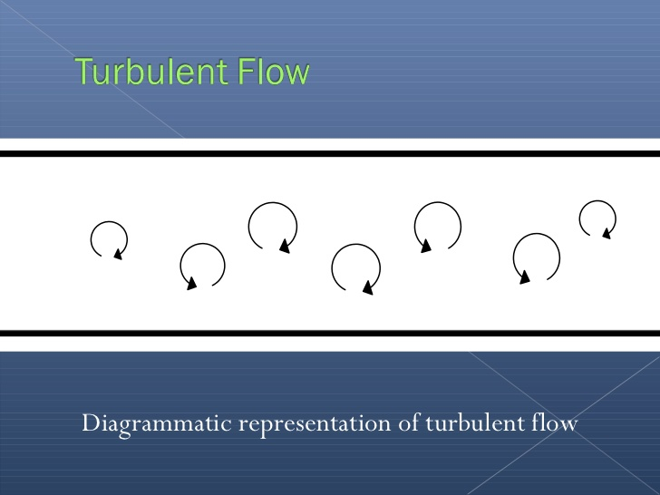

Slide 8
STEADY AND NON STEADY
Steady flow is defined as, the fluid in which the fluid characteristics like velocity, pressure, density etc. at a point does not change with time.
Unsteady flow is that flow in which characteristics like velocity, pressure , density etc . Changes with respect to time.

Slide 9
Uniform and non uniform
Uniform flow is type of flow in which velocity at any given time does not change with respect to space (I.e. along length of direction of flow).
Non uniform is type of flow in which velocity at any given time change with respect to space.

Slide 10
Compressible and non compressible flow
Compressible flow is that type of flow in which the density of fluid changes from point to point or in other words density is not constant for fluid.
Incompressible flow is that type of flow in which the density is constant for the fluid flow.

Slide 11
Rotational and Irrotational
Rotational flow Is the type of flow in which the fluid particles while moving along stream lines also rotate about their own axis.
The type of flow in which the fluid particles while flowing in stream line do not rotate about their own axis is called irrotational flow.

Slide 12
Flow measurement technique.
Inferential type flow meter
In this method flow is not directly measured but it is inferred from measurements of other parameter related to flow. Such as pressure, temperature, force, displacement, velocity etc.
1)variable head or differential method
2) variable area meter or rotameter
3) Magnetic Meter
4) Turbine Meter
5) Thermal flow meter
6) swirl Meter
Positive displacement method

Slide 13
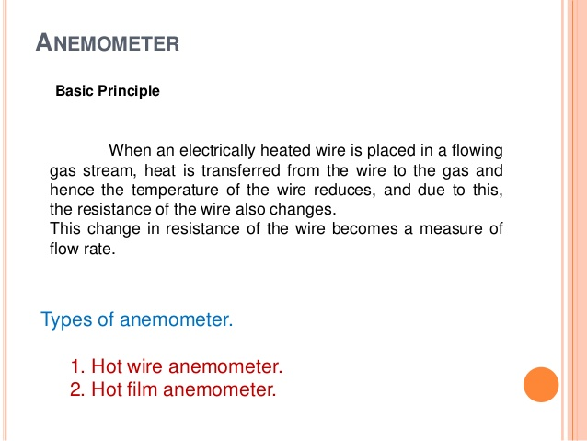

Slide 14
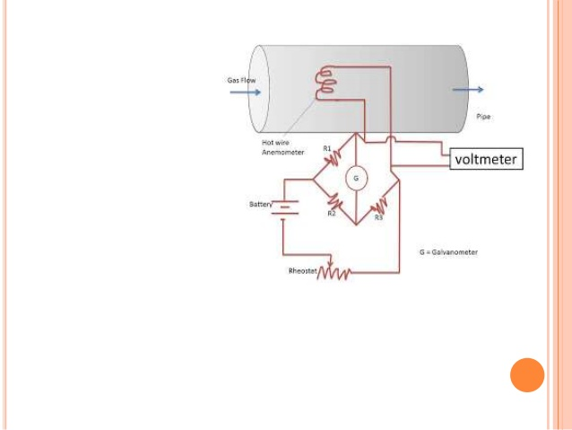

Slide 15
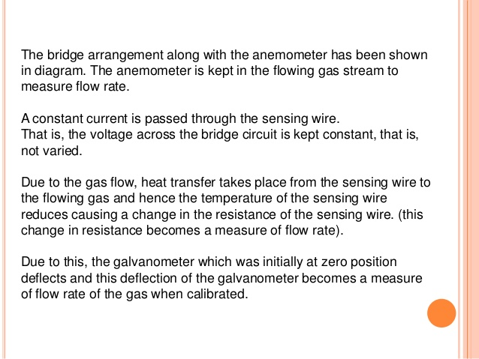

Slide 16
Advantages and disadvantages
Main application of hot wire anemometer is for measurement of rapidly fluctuating velocity.
Majority of application is in gas flow meter.
Fine wire has limited physical strength.
Due to dirt accumulation calibration of instrument changes.

Slide 17
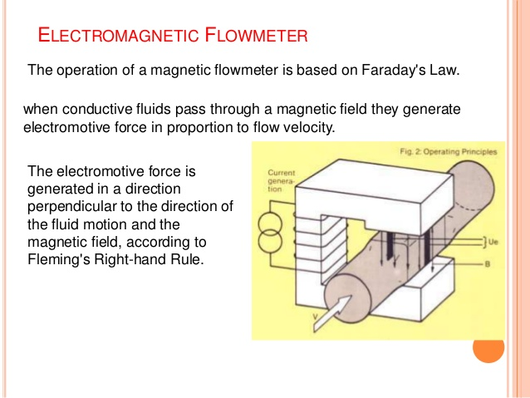

Slide 18
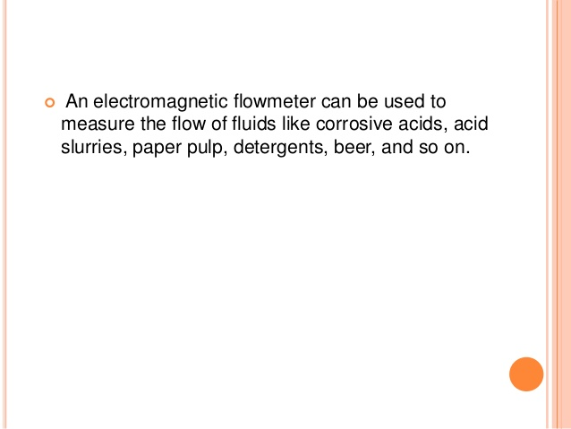

Slide 19
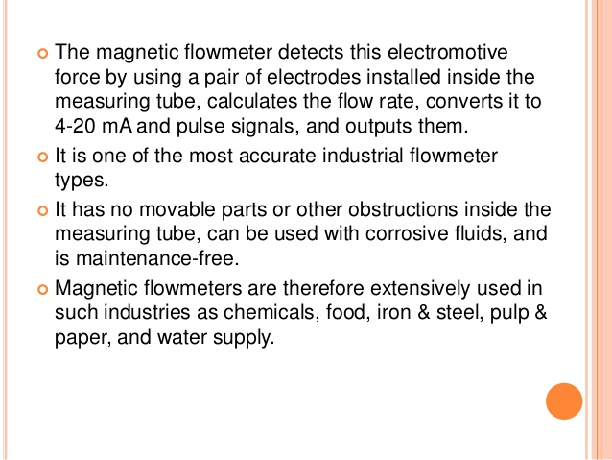
Advantages

Slide 20
Disadvantages
Relatively expensive
Works only with fluids, which are electrical conductors.
Relatively heavy, especially in large size.
Must be explosion proof when installed in electrical hazard area.

Slide 21
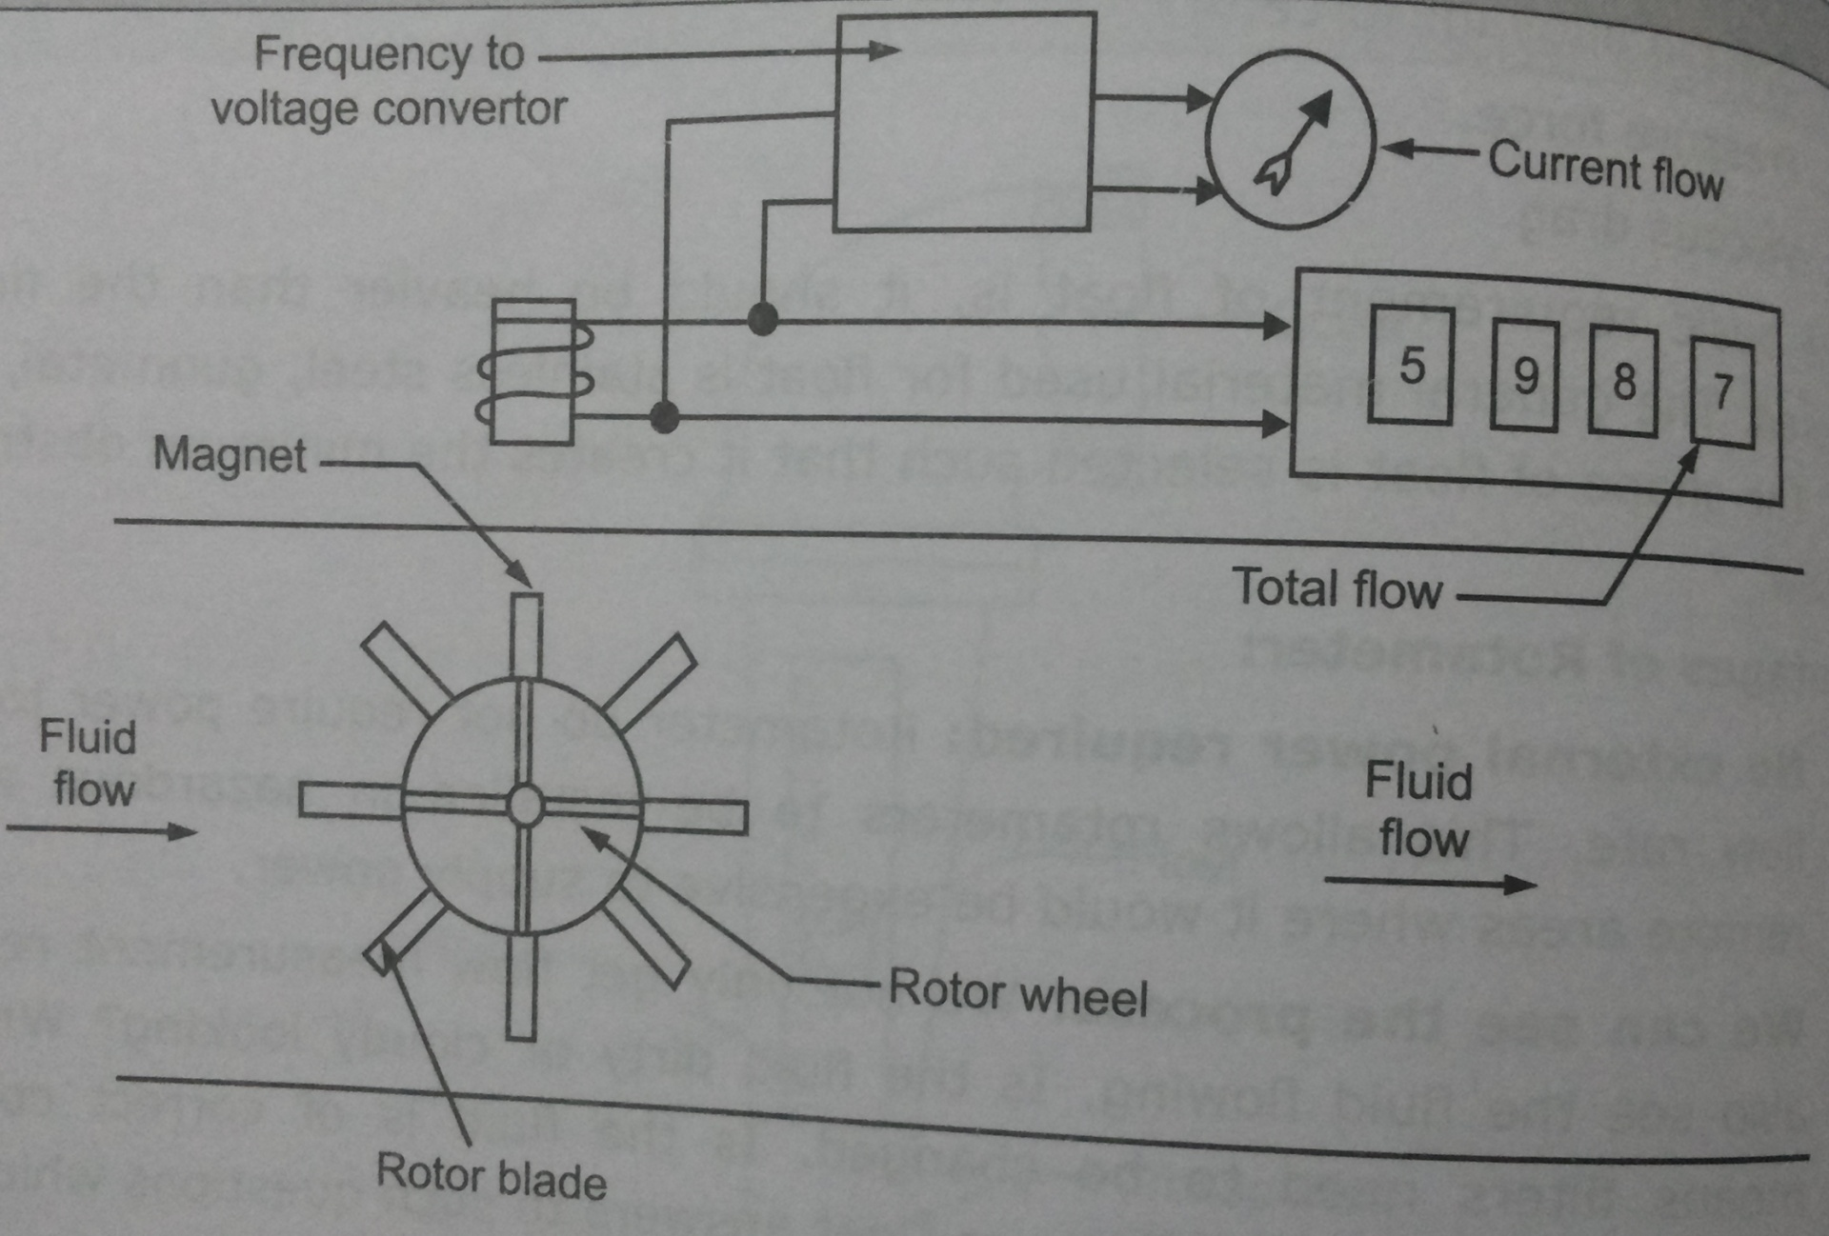
Turbine meter

Slide 22
The rotor is placed in path of moving stream directly.
The rotor spins freely at the rate proportional to flow velocity.
A permanent magnet sealed inside the rotor body is polarized at 90° to the axis of rotation.
As rotor rotates, along with it magnet also rotates and produces rotating magnetic field.
This produces an A.C. voltages pulse in the pick up coil located external to the meter housing.
The frequency of this voltage is directly proportional to the rate of flow.
This voltages pulses are counted by means of electronic digital counter to give total flow.
Alternatively, the frequency is converted in to voltage and is feed to an analogue/digital voltmeter to give the rate of flow.

Slide 23
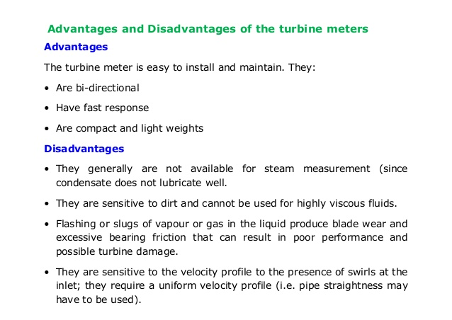

Slide 24
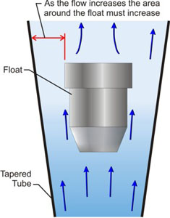
Rotameter
Rotameters are simple industrial flow meters that measure the flow rate of liquid or gas in a closed tube.
Rotameters are popular because they have linear scales, a relatively large measurement range, low pressure drop, and are simple to install and maintain.
Rotameters are a subset of meters called variable area flow meters that measure the flow rate by allowing the fluid to travel through a tapered tube where the cross sectional area of the tube gradually becomes greater as the fluid travels through the tube.
The flow rate inside the rotameter is measured using a float that is lifted by the fluid flow based on the buoyancy and velocity of the fluid opposing gravity pulling the float down.

Slide 25
Rotameter
For gasses the float responds to the velocity alone, buoyancy is negligible.
The float moves up and down inside the rotameter tapered tube proportionally to the flow rate of the fluid.
It reaches a constant position once the fluid and gravitational forces have equalized.
Changes in the flow rate cause rotameter's float to change position inside the tube.
Since the float position is based on gravity it is important that all rotameters be mounted vertically and oriented with the widest end of the taper at the top.
It is also important to remember that if there is no flow the float will sink to the bottom of the rotameter due to its own weight.

Slide 26
Advantages and Disadvantages of a Rotameter
Rotameter Advantages:
A rotameter doesn't require power, so it is safer to use with flammable fluids than a flow meter that does use electrical power.
A rotameter is flexible in the type of applications it is suited for. It can be used for clean and relatively dirty liquids and gases.
The cost of a rotameter is low in comparison with most other types of pipe flow meter.
Rotameter Disadvantages:
Typical accuracy for a rotameter is 1% to 10% of full scale. Several other types of flow meter have typical accuracy better than this.
As noted above the rotameter doesn't work well for machine reading or continuous recording of flow rate.

Slide 27
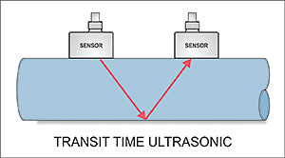
Ultrasonic Flow meters
Transit Time flow meters must have a pair of transducers, each containing a Piezo-electric crystal.
One transducer transmits sound while the other acts as a receiver.
As the name suggests, Transit Time flow meters measure the time it takes for an ultrasonic signal transmitted from one sensor, to cross a pipe and be received by a second sensor.
Upstream and downstream time measurements are compared

Slide 28
Ultrasonic Flow meters
With no flow, the transit time would be equal in both directions.
With flow, sound will travel faster in the direction of flow and slower against the flow.
Because the ultrasonic signal must cross the pipe to a receiving transducer, the fluid must not contain a significant concentration of bubbles or solids.
Otherwise the high frequency sound will be attenuated and too weak to traverse the pipe.

Slide 29
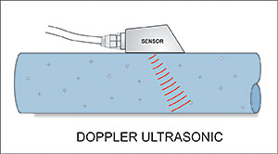
Doppler flow meters
Doppler flow meters manufactured by Greyline Instruments use a single-head sensor design allowing fast, simple mounting on the outside of pipes.
The single-head transducer includes both transmit and receive piezo-electric crystals in the same housing.

Slide 30
Doppler flow meters
Doppler flow meters use the principal that sound waves will be returned to a transmitter at an altered frequency if reflectors in the liquid are in motion.
This frequency shift is in direct proportion to the velocity of the liquid.
It is precisely measured by the instrument to calculate the flow rate.
So the liquid must contain gas bubbles or solids for the Doppler measurement to work.

Slide 31
Benefits with Ultrasonic Flowmeters As A Whole
Obstruction less flow
Unaffected by changes in temperature, density or viscosity
Bi-directional flow capability
Low flow cutoff
Accuracy about 1% of flow rate
Relative low power consumption

Slide 32
Limitations with Ultrasonic Flowmeters as A Whole
The operating principle for the ultrasonic flowmeter requires reliability high frequency sound transmitted across the pipe. Liquid slurries with excess solids or with entrained gases may block the ultrasonic pulses.
Ultrasonic flowmeters are not recommended for primary sludge, mixed liquor, aerobically digested sludge, dissolved air flotation thickened sludge and its liquid phase, septic sludge and activated carbon sludge.
Liquids with entrained gases cannot be measured reliably.

Slide 33
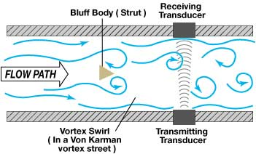
Vortex Shedding Flow Meter
A blunt, non-streamline body is placed in the stream of the flow through a pipe.
When the flow stream hits the body, a series of alternating vortices are produced, which causes the fluid to swirl as it flows downstream.
The number of vortices formed is directly proportional to the flow velocity and hence the flow rate

Slide 34
Vortex Shedding Flow Meter
The vortices are detected downstream from the blunt body using an ultrasonic beam that is transmitted perpendicular to the direction of flow.
As the vortices cross the beam, they alter the carrier wave as the signal is processed electronically, using a frequency-to-voltage circuit.
The following diagram shows the basic principle of the vortex-shedding flow meter:

