Slide 1

COURSE: MEASUREMENT AND CONTROL (17528)
Subject Teacher: Ms. Nilesha U. Patil
Pimpri Chinchwad polytechnics

Slide 2
FHH
Chapter No.-03
Temperature Measurement
Co-Know the different temperature measuring instrument with their construction and working

Slide 3
Temperature measurement
Temperature is measure of thermal energy in a body.
It is the hotness or coldness of a medium
Hotness or coldness is indication of heat and is compared by giving some reference of unit

Slide 4
Temperature scale
A) Fahrenheit scale:
  Abbreviated as (°F)
  First to gain acceptance
  Proposed in the early 1700s by Fahrenheit (Dutch)
  Freezing point- 32 °C, Boiling point- 212 °C

Slide 5
….
B) Centigrade or Celsius scale:
  Abbreviated as (°C)
  Proposed in the mid 1700s by Celsius (Sweden)
  Freezing point- 0 °C, Boiling point- 100 °C

Slide 6
….
C) Rankine scale:
  Abbreviated as (°R)
  Proposed in the mid 1800s by Rankine
  Freezing point- 491.6 °C, Boiling point- 671 °C
  Based on Fahrenheit scale

Slide 7
….
C) Kelvin scale:
  Abbreviated as (°K)
  Proposed in the late 1800s by Lord Kelvin
  Freezing point- 273.15 °C, Boiling point- 373.15 °C
  Based on Celsius scale

Slide 8
Classification of Temperature Measuring Devices
Based on nature of change produced:
i) Glass thermometer:- Work on the principle of
expansion of liquid like mercury, alcohol, pentane etc.
Pressure guage thermometer:- produce pressure O/P on a/c of vapour or liquid. a) liquid filled b) vapour filled c) gas filled
Bimetallic thermometer or differential thermometer:- O/P is on a/c of differential expansion of dissimilar metals produced by temp.

Slide 9
….
Electrical resistance thermometer:- temperature is measured by resistance o electrical wire
Thermocouples:- Temperature is indicated by production of emf
Optical pyrometer:- Temperature is determined by luminosity of hot body that of a calibrated source
Radiation Pyrometer:- Measures temp by absorbing radiation
Fusion pyrometer :- Temp. is determined by which of a series of material with graduated fusion material melt or soften due to temp.

Slide 10
….
ix) Calorimetric pyrometer:- Temp. is determined by measuring quantity of heat removed when temp. of body brought from unknown to known level.
x) Electrical and non electrical type:- Those which are electrical or electronic in nature and those which are not.
xi) Temperature range:- Range for which different types of temp measuring devices are used along with their accuracies.
xii) Thermister:- It measures temp by relating change in resistance with change in temp

Slide 11
Non electrical methods
Expansion thermometer
  a) Expansion of solid
    Bimetallic thermometer
  b) Expansion of liquid
    Liquid in gas thermometer
    Liquid in metal thermometer
  c) Expansion of gas
Filled system thermometer
  Gas filled thermometer
  Liquid filled thermometer
  Mercury filled thermometer
  Vapour filled thermometer
Pyrometer

Slide 12
LIQUID IN GLASS THERMOMETER
Construction
The unit consists of glass envelope, a responsive liquid and an indicating scale
The envelope comprises a thick walled glass tube with capillary bore and cylindrical bulb filled with liquid
Size of capillary depends on the sensing bulb, responsive liquid and desired temp range.

Slide 13
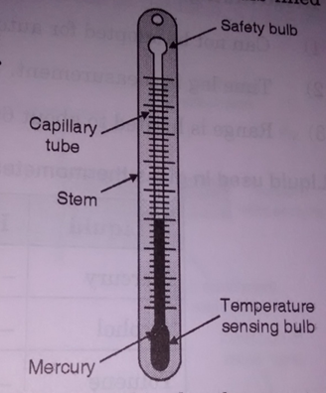
Diagram

Slide 14
....
Working
Changes in temp will cause the fluid to expand and rise up the stem
Since the area of stem is much less than bulb, relatively small changes of fluid volume will result in significant fluid will rise in the stem
Length of the movement of free surface of fluid column serves, by prior calibration to indicate temp of bulb

Slide 15
Advantages
Simple to use
Low cost
Easily portable
Ease of checking for physical damage
No need of auxiliary power
No need of additional indicating instruments
Good accuracy

Slide 16
Disadvantages
Fragile construction
Can not be adopted for remote reading
Time lag
Limited range (about 600 °C)

Slide 17
Bimetallic Thermometer

Slide 18
Bimetallic thermometer
Construction
A metallic thermometer consists of two pieces of different pieces of different metals having different coefficient expansion firmly bonded together by welding
Bimetallic elements can be arranged in the flat, spiral, single helix configuration
One end of helix is anchored permanently to the casing and the other end is secured to the pointer

Slide 19
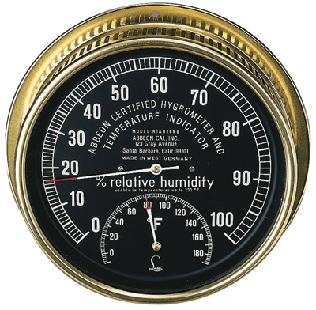
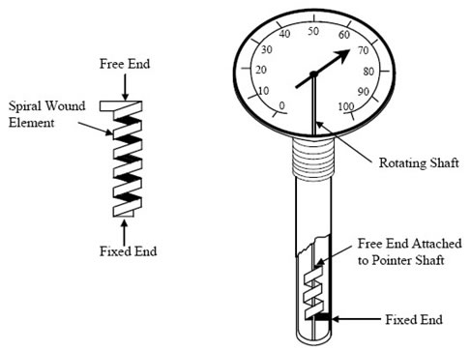
Bimetallic Thermometer

Slide 20
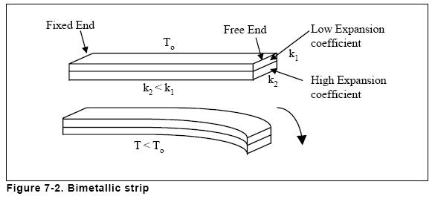
Working
In response to temperature change, the bimetal expands and the helical bimetal rotates at its free end
When free end of bimetallic strip is heated ,it bends in the direction of material having low thermal coefficient of expansion
This movement is connected to pointer which moves over calibrated scale
The curvature of bimetal spiral strip varies with temp and causes a pointer to deflect

Slide 21
Advantages
Low cost
Simple in design
Compact and robust in construction
No maintenance is required
Overloading can be tolerated

Slide 22
Disadvantages
Low speed of response
Creep at high temperature

Slide 23
Pressure Thermometer
A pressure thermometer operates by expansion of gas or liquid.
A pressure thermometer measures temperature indirectly by measuring pressure.
The gauge is a pressure gauge, but is typically calibrated in units of temperature instead.

Slide 24
Pressure Thermometer
Construction
A thermal system partially filled with a volatile liquid and operating on vapour pressure that depends on temperature at the free surface of liquid.
The bulb is partially filled with a volatile liquid and rest of system contains vapour

Slide 25
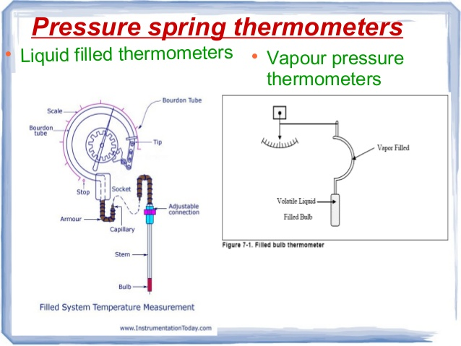
Types of Pressure Thermometer
Liquid pressure thermometers.
Vapour pressure thermometers.

Slide 26
LIQUID PRESSURE THERMOMETER
It is temperature measuring device whose operation is based on thermal expansion of a liquid.
These are also called as fluid-expansion thermometers.
Liquid filled thermometers have range from -30° C to 250° C.
The measurement accuracy depends on the depth of immersion of the thermometer in the medium to be measured.

Slide 27
….
Working
An increase in the temp. at the bulb causes vapourization of volatile liquid
The resulting increase in vapour pressure is measured by a pressure spring and instrument is calibrated in terms of temp.
For cross ambient temp. measurement ,dual fill system is used. In this two different liquids vapourizing and non vapourizing are used

Slide 28
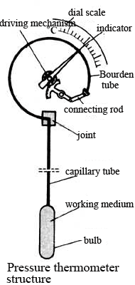
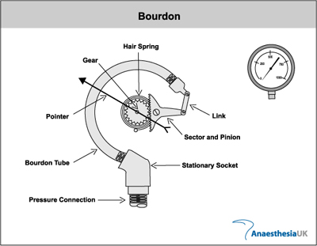
LIQUID PRESSURE THERMOMETER

Slide 29
Construction and Working :
A bulb containing a liquid is immersed in the environment.
The bulb is connected by means of capillary tube to a pressure measuring device, like a bourdon tube pressure gauge.
An increase in temperature causes the liquid to expand, which causes increase in pressure on gauge.
The liquid filled tube are also temperature sensitive so it may cause error.
Error can be reduced by increasing bulb size, but it may increase the response time of system.
The system with bulb, tube, and a pressure gauge can be calibrated directly.

Slide 30
VAPOUR PRESSURE THERMOMETER
These are similar to liquid filled thermometers, but contain only partially filled bulbs.
Vapour pressure thermometer have range of 20°C to 350°C.
The saturated vapour pressure of volatile liquid is used as a measure of temperature.

Slide 31
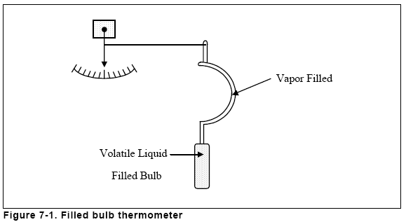

Slide 32
Construction and Working:
They use the principle that the vapour pressure of a liquid depends on the temperature, and most fluids partially filled in an enclosed chamber will create a definite vapour pressure.
When the fluid reach the boiling point, the vapour pressure will be equal to the total pressure above the liquid surface and can be used as the measure of temperature.
Further when the partially filled bulb senses the temperature vapour will be formed in the remaining space of the bulb and is passed through a capillary tube to the indicator with a bourdon tube.

Slide 33
Advantages
Simple and inexpensive
Rugged construction
Ease of installation and use
Fairly good response, accuracy and sensitive
Self operated system
Remote indication (upto 100 m)

Slide 34
Disadvantages
Large time lag
Compensation required for ambient temp.
Upper limit for measurement is low as compared to electrical system

Slide 35
Range:
Liquid Range (°C)
Argon down to -253 °C
Ethyl 90-170
Methyl chloride 0-50
Water 120-220

Slide 36
Applications :
Dairy and Food Industries.
Suitable for Heating and Ventilation application.

Slide 37
Electrical Methods: resistance thermometer
Can be called as Resistance temperature detector
Resistance-Temperature relationship
R= Ro(1+α θ) here, α-temp coeff. Of resistance
θ-Temp. relative to 0 °C
If change in temp. from θ1 & θ2 is considered
R1= Ro(1+α θ1)
R2= Ro(1+α θ2)
Rearrangement gives: θ2= θ1+(R2-R1/ αR0)
R2-R1/ θ2-θ1= αR0
Thus change in resistance is directly proportional to change in temp.

Slide 38
RTD
RTD can also be called a resistance thermometer as the temperature measurement will be a measure of the output resistance.
The main principle of operation of an RTD is that when the temperature of an object increases or decreases, the resistance also increases or decreases proportionally.
ie. positive temperature coefficient

Slide 39
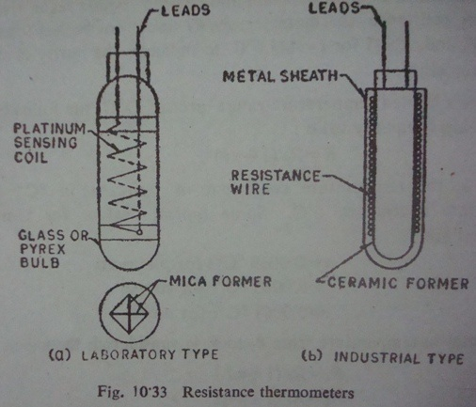
Construction :
It comprises a bulb or resistance element ,suitable electrical leads and an indicating-recording instrument
Bulb is in the form of coil of very fine platinum, nickel wound onto an insulating ceramic former
Ceramic former is protected by metal sheath
Industrial resistance thermometer, often referred to as RTD are usually made with elements of platinum, nickel and copper

Slide 40
….
Working:
Change in temp will cause change in resistance of the coil
Leads are taken out of the thermometer for the measurement of changes in resistance
Range:
Upto 1200 °C

Slide 41
Advantages:
Simplicity in operation
Easy installation
Replacement of sensitive bulb
Average temp can be measured
Very high accuracy
Excellent stability and reproducibility
Ability to be matched to close tolerances for temperature difference measurements.
Ability to measure narrow spans
Suitability for remote measurement

Slide 42
Disadvantages:
More time lag due to protective sheath
Possibility of current leakage
Susceptibility to mechanical damage
Need for lead wire resistance compensation
Sometimes expensive
Susceptibility to self-heating error
Susceptibility to signal noise
Unsuitability for bare use in electrically conducting substance
Generally not repairable
Need for power supply

Slide 43
Thermistor
Principle:
Thermistors are semiconductor having negative temp coeff.
As temp increases, resistance goes down and as the temp decreases ,resistance goes up
Temp-resistance relationship is given by-
Rt= RoB(1/T-t/To)

Slide 44
….
Construction
Thermistors are composed of mixture of metallic oxides such as manganese, nickel, cobalt, copper, iron and uranium
These metallic oxides are mixed in appropriate properties and are pressed into desired shape with appropriate binders and finally sintered
Thermistors may be shaped in the forms of beads, disks, washers, rods
Glass and metal probes are used for temp measurement

Slide 45
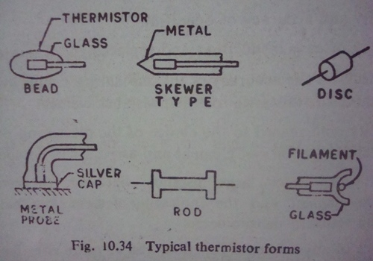
THERMISTOR

Slide 46
….
Working:
Temp change will cause change in resistance
This change in resistance is measured by using circuitary similar to that of metal conductor
Range
Approximately : -100 °C to 300 °C

Slide 47
….
Advantages :
High sensitivity
Availability in very small size
Fast thermal response
Low cost

Slide 48
Thermoelectric measurement
Thermocouple
Radiation pyrometer
Optical pyrometer

Slide 49
Definition-
-Pyro is a greak word which means fire.
-Pyrometer is a non contact type instrument
Which is used to measure temperature.

Slide 50
WORKING PRINCIPLE
Pyrometer
Optical system & detector
Optical system-
Thermal radiation
detector
Output→ thermal radiation
Temperature is sensed

Slide 51
Radiation Pyrometer
Principle
Radiation pyrometer works on the Stefan-Boltzman law
Stefan-Boltzman law applied to non black body is stated below:
E=ЄбoT E-emmisive power. Є-emmisivity
For two bodies at temp T1 & T2(T2>T1), the energy transfer relation is given by: E=Єбo(T2-T1)
It is basis for temp measurement

Slide 52
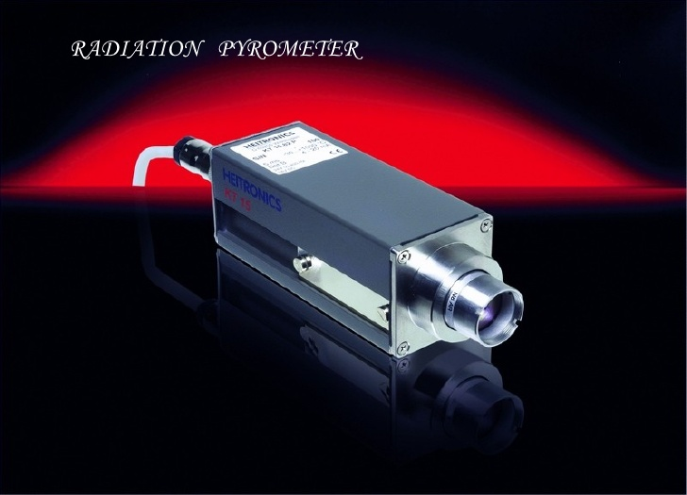
RADIATION PYROMETER

Slide 53
….
Construction
The pyrometer is designed to collect the radiations from radiating object and focus it by means of mirrors or lens onto detector (thermocouple)
The emf generated by thermocouple circuit is measured by suitable milivoltmeter or potentiometer
Suitable calibration of this milivoltmeter or potentiometer becomes a measure of temp of radiating object

Slide 54
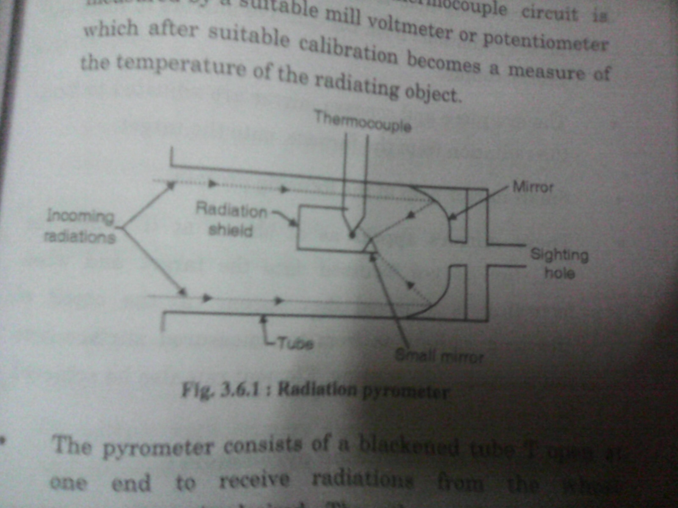
Working of radiation pyrometer-

Slide 55
….
Working:
The eye piece and concave mirror are adjusted to focus the radiation from furnace onto the target i.e. thermocouple hot junction
This will generate emf ,which is used to measure the temp of radiation
Range:700-2000 ºC

Slide 56
….
Advantages:
High speed of response
No direct contact with object
Can be used to measure the temp of moving object
Can be used for sensing the temp at long distance

Slide 57
….
Disadvantage
The effect of dust and dirt on mirror is cause the instrument to read too low
Cooling is required

Slide 58
Optical pyrometer
Principle
When the surface is heated, it emits radiations of different wavelength. By measuring this wavelength we can measure the temp.
Optical pyrometer compare the energy emitted by body at a given wavelength with that of black body calibrated lamp

Slide 59
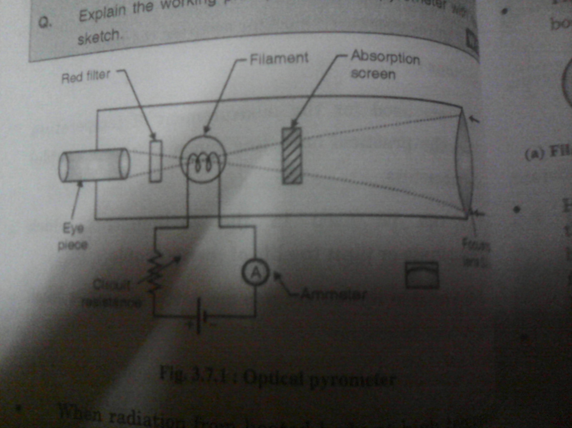
Working of optical pyrometer-

Slide 60
….
Construction
Radiation from the target surface are focused by an objective lens upon the plane filament of an electric light bulb
Red filter is placed between the eyepiece and filament
Eyepiece is provided to observe the filament
Brightness of lamp filament can be varied by adjusting current through standard lamp

Slide 61
….
Working:
When the filament is different in terms of brightness from target surface, then it is radiating at same intensity as the target surface
When filament is colder than the target surface it appears as a wire
When filament is hotter than the object it appears brighter than target surface
The current through the filament is then reduced provide correct merging of filament & object
Thus current through filament will be basis for temp measurement
Range: 700-3000 ºC

Slide 62
….
Advantages:
No direct contact required
Excellent accuracy
Measurement is independent of distance between target and instrument
Has been accepted as standard means for determining temp on international temp scale

Slide 63
….
Disadvantages:
Require operator, hence not suitable for automatic control applications
Lower measuring temp is limited to 700 ºC

Slide 64
Applications-
1.)They can be used in the environment which
Contaminate or limit the life of thermocouple.
2.)They are used for targets not easily accessible
Such as furnace indicators.
3.)they are used for measurement of average
Temperature of large surface areas.
4.)they are used for the measurement of
Temperature above practical operating
Range of thermometer.

Slide 65
Difference between radiation and optical pyrometer
Property | Radiation pyrometer | Optical pyrometer
Temperature range | More than 550 degree centigrade | More than 750 degree centigrade
accuracy | 10 degree centigrade | 10 degree centigrade
stability | good | Very good
sensitivity | fair | good
caliberation | By comparison with standard optical pyrometer | Against standard tungsten strip lamp.

Slide 66
Thermocouple
The most common electrical method of temperature measurement uses the thermo-electric sensors also known as Thermocouple (TC).
Thermocouple is active transducer which generates e.m.f by its own

Slide 67
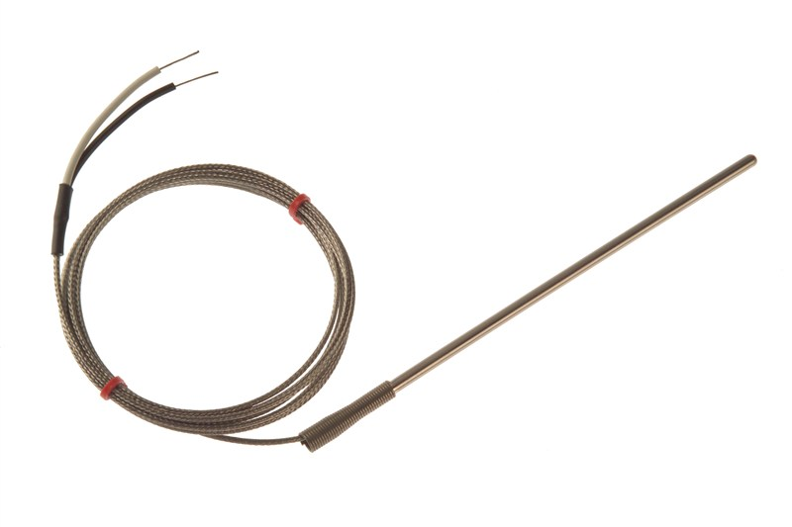
Thermocouple

Slide 68
What are thermocouples?
Thermocouples operate under the principle that a circuit made by connecting two dissimilar metals produces a measurable voltage (emf-electromotive force) when a temperature gradient is imposed between one end and the other.

Slide 69
Construction of Thermocouple
The thermocouple conductors must be insulated from the hot junction to the indicating instrument.
The two wires also should not touch each other except hot junction.
Therefore suitable insulating materials should be used according to temperature ranges.

Slide 70
Seeback effect
The Seebeck effect is a phenomenon in which a temperature difference between two dissimilar electrical conductors or semiconductors produces a voltage difference between the two substances.
An electric current flows from hot junction to cold junction, this produces voltage proportional to temperature at the junction.

Slide 71
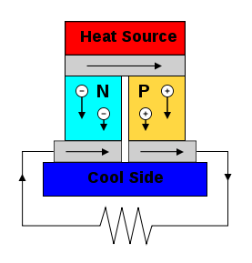
Seeback effect

Slide 72
Peltiers effect
When a loop is formed of two dissimilar metals and if externally current is forced to flow through the circuit, one of the junction is heated while the other is cooled.
The Peltier effect is a temperature difference created by applying a voltage between two electrodes connected to a sample of semiconductor material. This phenomenon can be useful when it is necessary to transfer heat from one medium to another on a small scale.
Amount of heat absorbed when unit current passes from a unit time is called peltier effect

Slide 73
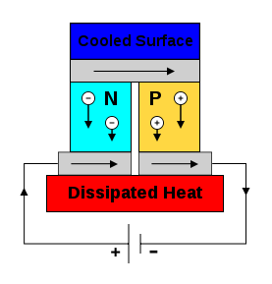
Peltier effect

Slide 74
Thomson effect
When current flows along a wire whose temperature varies from point to point , heat is liberated at any point P when current at P is in same direction as heat flow. Heat is absorbed at P if current is in opposite direction to heat flow.

Slide 75
Thermocouple
Principle
Seeback effect :when two conductor of dissimilar metals M1 & M2 are joined together to form a loop and two unequal temp T1 & T2 are imposed at two interface connection. An electric current flows through the loop
Laws of thermocouple
1. Law of homogeneous circuit:
An electric current cannot be sustained in a circuit of a homogenous metal by application of heat alone

Slide 76
….
2. Law of succesive or intermediate temp:
The emf generated in a thermocouple with junctions at temp T1& T3 is equal to sum of emf generated by similar thermocouples, one acting between temp T1 & T2 and the other acting between T2 & T3 where T2 lies between T1 & T3.
3. Law of intermediate metals:
if the thermal emf’s of any two metals with respect to reference metal are known ,the emf of the combination of two metals is the algebric sum of their emf’s against the reference metal

Slide 77
….
Construction:
Two dissimilar conductors eletrically insulated except at the hot junction ,where conductors may be either be welded together.
A refractory and a metal sheath is provided to protect the thermocouple
Compensating leads are taken for measuring the temp

Slide 78
….
Working:
Temp temp at hot junction will emf in circuit
The emf is used to measure the chang in temp
Range:
Thermocouple Range (ºC)
Copper-constanton -200 to 400
Iron-constanton -200 to 800
Chromel-alumel -200 to 1200

Slide 79
….
Advantages:
Sensing element can be installed easily
Have a better speed of response
Higher range of temp
Disadvantage:
Poor sensitivity
Change in ambient temp affect accuracy
Measure temp indirectly

Slide 80
Disadvantages
Cold junction, cable and lead compensation is essential for measurements.
Needs signal amplifications.
They exhibit non-linearity in emf vs. temperature characteristics.
Stray voltage pickup is possible.

Slide 81
Applications.
To monitor temperature of liquids and gases in storage and flowing pipes and dusts.
In industrial furnaces.
For temperature measurements in cryogenic range.

Slide 82
Difference between RTD and THERMISTER.
RTD | THERMISTER
Material used is platinum , copper , nickel as resistance wire. Large in size. Having more cost. Less sensitive. High temperature range. | Mixture of metallic oxides such as nickel , cobalt , manganese used. Small in size . These are cheap. Higher sensitivity. Small temperature range.

Slide 83
Difference between RTD and THERMOCOUPLE.
RTD | THERMOCOUPLE.
It measure low range of temperature -200 to 1000°C. RTD is more sensitivity. Ambient condition do not affect the temperature measurement. It has slow response. | It measure high range of temperature. It is less sensitivity. Ambient condition affect the temperature measurement. It has better response.

Slide 84
Difference between
RESISTANCE THERMOMETER and THERMISTER
Resistance thermometer | Thermister
Made of metals which are good conductor of electricity e.g copper , platinum, nickel. Works in temperature range of -200 to 1000°C. They have better reproducibility and low hysteresis. Relatively bigger in size. | Made of metallic oxide such as cobalt, manganese , nickel , iron . Works in temperature range of -100 to 300°C. They have less reproducibility and more hysteresis. Small in size.

Slide 85
THANK YOU..

