Slide 1

COURSE: MEASUREMENT AND CONTROL (17528)
Sub. Teacher-Ms.Nilesha Patil
Pimpri Chinchwad polytechnics

Slide 2
CO: Know concept of measurement , errors in measurement, static and dynamic characteristics and Transducers.
Chapter-01
INTRODUCTION AND SIGNIFICANCE OF MEASUREMENT

Slide 3

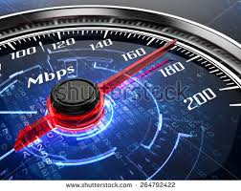


Slide 4
Measurement
Measurement is actually the process of estimating the values that is the physical quantities like; time, temperature, weight, length etc.
Each measurement value is represented in the form of some standard units.
The estimated values by these measurements are actually compared against the standard quantities that are of same type.

Slide 5

Significance of Measurements
We require measuring quantities for performance in our day to day activities.
Fundamental requirement of any process is the measurement.
i.e. input is fed to the system it undergoes a process output is indicated.
i.e. output is compared with input-measurement
Measurement provides the fundamental basis for research & development as it involves measurement of various quantities and parameters.
Measurement is also considered as a method of inspection

Slide 6
Significance of Measurements
Establish the cost of products on the basis of amount of material, power, time & labor, etc.
Place/give realistic tolerance for each of the measured values.

Slide 7
Application of Measurements
1. Design of manufactured goods
2. Design of machinery to perform manufacturing operations
3. Design of power sources
4. Design of roads, waterways and other system.
5. To study the operation features, limitation and difficulties that are inherent in the systems.
6. For proper maintenance of the equipment.
7. To determine the system response(Reply of the systems to given input)
8. For correct recording of the output data(weather forecasting, experimental values, interpretation etc.)

Slide 8
Fundamental methods of Measurement
Two basic methods are commonly employed for measurement.
(a) Direct comparison with primary or secondary standard.
(b) Indirect comparison through the use of calibrated system.
Direct comparison
In this method, measurement is made directly by comparing the unknown magnitude with a standard & the result is expressed by a number.
The simplest example for this would be, length measurement using a meter scale.

Slide 9
Fundamental methods of Measurement
Direct comparison methods are quite common for measurement of physical quantities like length, mass, etc.
It is easy and quick.
Drawbacks of Direct comparison methods
The main drawback of this method is, the method is not always accurate and reliable.
Also, human senses are not equipped to make direct comparison of all quantities with equal facility all the times.
Also, measurement by direct methods are not always possible, feasible and practicable.

Slide 10
Indirect comparison
Most of the measurement systems use indirect method of measurement.
In this method a chain of devices which is together called as measuring system is employed.
The chain of devices transform the sensed signal into a more convenient form & indicate this transformed signal either on an indicator or a recorder or fed to a controller.
i.e. it makes use of a transducing device/element which convert the basic form of input into an analogous form, which it then processes and presents as a known function of input.
For example, to measure strain in a machine member, a component senses the strain, another component transforms the sensed signal into an electrical quantity which is then processed suitably before being fed to a meter or recorder.

Slide 11
Measurement system
A general template for a measurement system is illustrated in fig.
Basically such a system consists of part or all of four general stages:
(1) Sensor-transducer stage
(2) Signal -conditioning stage
(3) Output stage
(4) Feedback -control stage

Slide 12
Measurement system
sensor –stage
transducer stage
Signal conditioning stage
Output stage
control stage

Slide 13
Measurement system
The sensor is a physical element that employs some natural phenomenon by which it senses the variable being measured.
. The transducer converts this sensed information into a detectable signal, which might be electrical, mechanical, optical, or otherwise.
Signal conditioning equipment takes the transducer signal and modifies it to a desired magnitude.
output stage indicates or records the value measured.
control stage, contains a controller that interprets the measured signal and makes a decision regarding the control of the process.

Slide 14
Types of instrument
Mode of measurement:- The instrument can be classified into three types
Primary Instrument:
  Direct Comparison with reference standard.
  For example the length measurement by ruler
  Secondary Instrument:
  indirect comparison by converting it into some other form.
  For example temperature measurement by mercury in glass thermometer
Tertiary Instrument:
two conversion of parameter are involved.
For example measuring of shaft speed by electrical tachometer

Slide 15
Nature of Contact
-The instruments can be classified into two types
  Contact type:
  when initial sensing element comes in direct contact with the medium whose parameter are to be measured.
  Temperature measurement by thermometer
  Non Contact type:
  when the initial sensing element does not comes in contact with the medium whose parameter are to be measured.
  Temperature Measurement by radiation pyrometer.

Slide 16
Condition of Pointer:-
The Classification is as
a. Null Type:
The pointer is maintained at a fixed position and measurement is done by balancing
b. Deflection type:
The pointer is deflected with respect to origin to get the measured quantity

Slide 17
Power Source Required
:-The classification is as follows:
a. Self sufficient Instrument (Active ):
do not need external power
Thermometer
b. Power operated instrument (Passive): need external source of power
Tachometer

Slide 18
Nature of output signal
Analog instrument
It is a continuous and step less function .
Voltmeter, wrist watch, fuel gauge.
Digital instrument
It is in the form of discrete pulse or steps utilizing a coding system and involves a counting process.
Digital temperature indicator, digital weight mater, odometer.

Slide 19
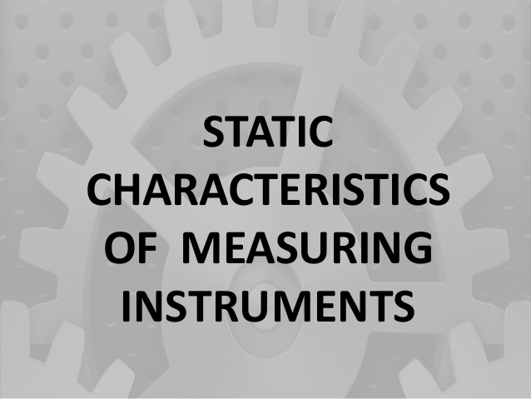

Slide 20
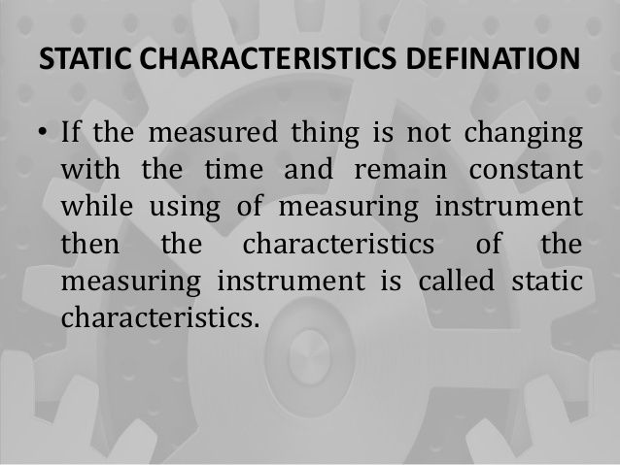

Slide 21
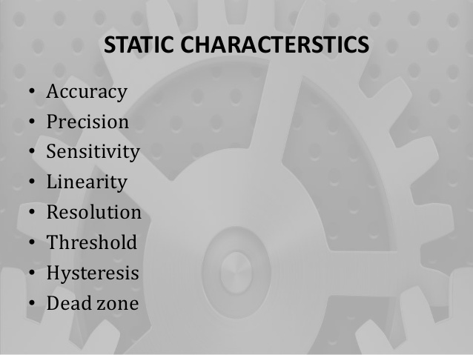
RANGE
SPAN
RELIABILITY
CALIBRATION
DRIFT
REPEATABILITY
REPRODUCIBILITY

Slide 22

Range and spam.

Slide 23
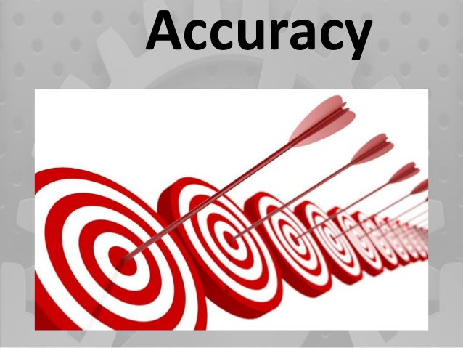

Slide 24
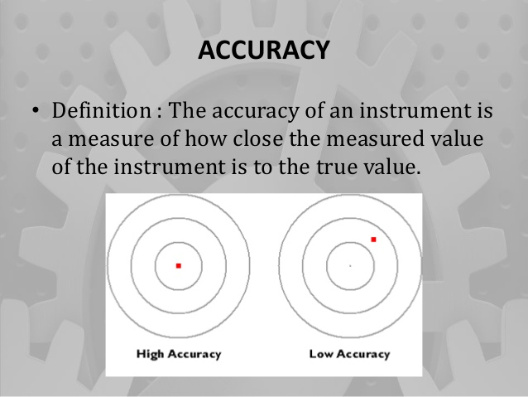

Slide 25
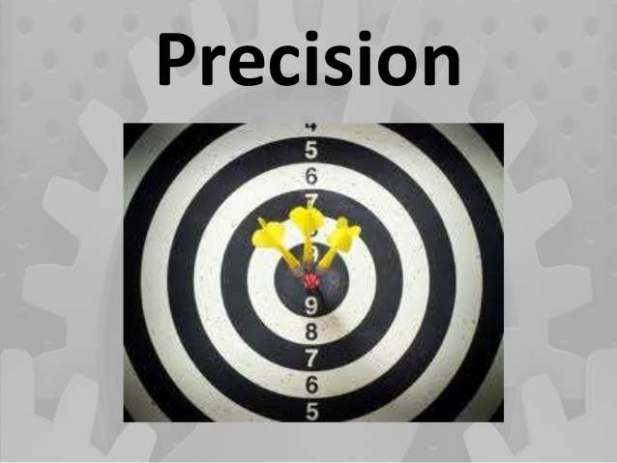

Slide 26
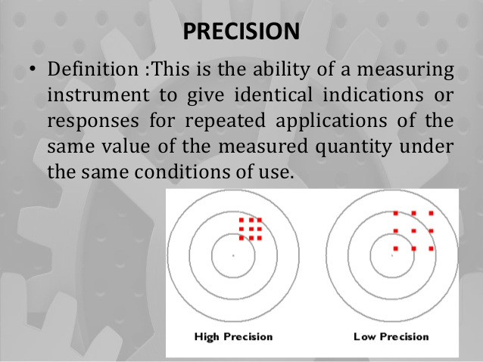

Slide 27
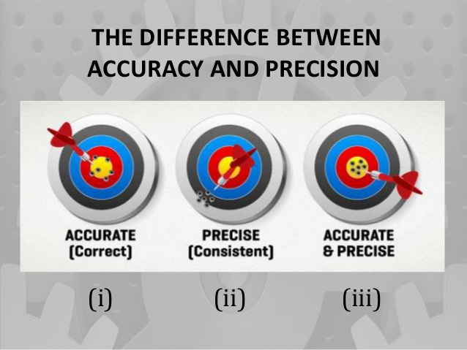

Slide 28
Accuracy and Precision
1) It is the closeness with the true value of the quantity being measured.
It is a measure of reproducibility of the measurements
2) Accuracy can be improved
Precision cannot be improved
3) Accuracy depends upon simple techniques of analysis
Precision depends upon many factors and requires many sophisticated techniques of analysis
4) Accuracy is necessary but not sufficient condition for precision
Precision is necessary but not a sufficient condition for accuracy

Slide 29
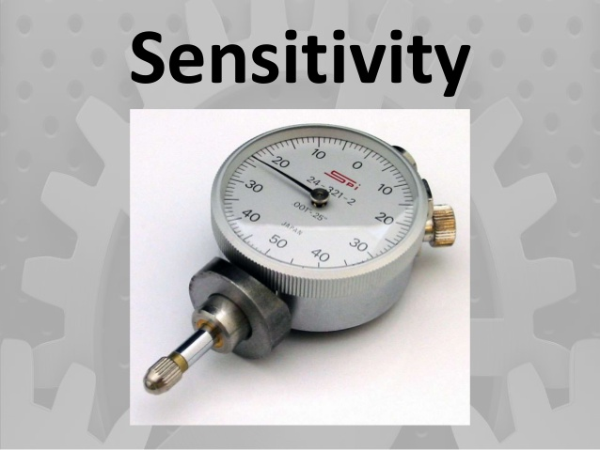

Slide 30
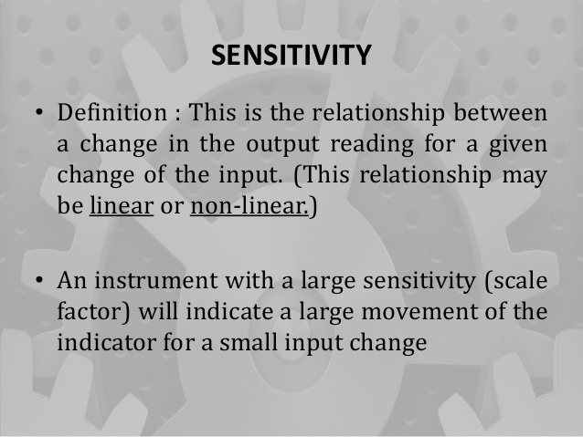

Slide 31
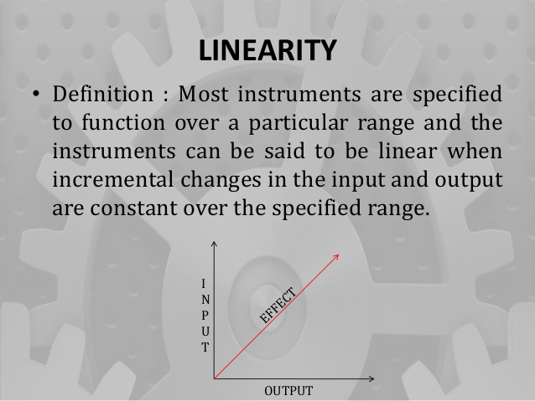

Slide 32


Slide 33
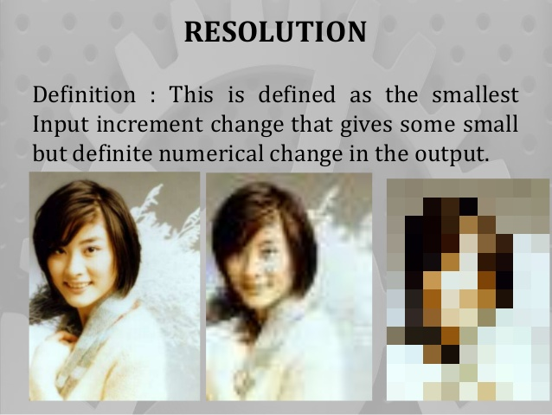

Slide 34



Slide 35
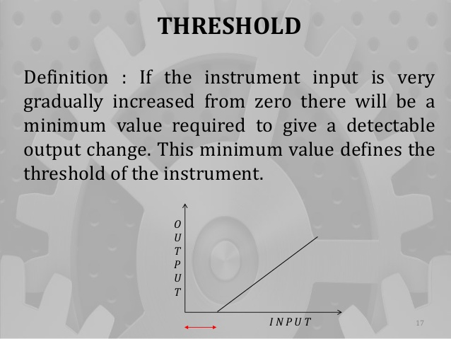

Slide 36
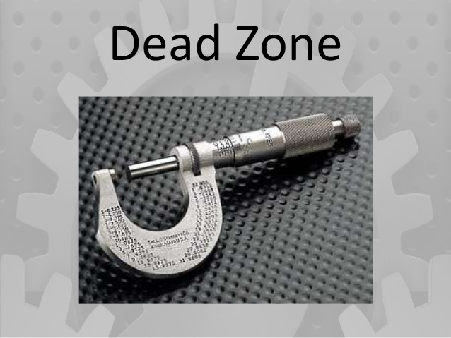

Slide 37
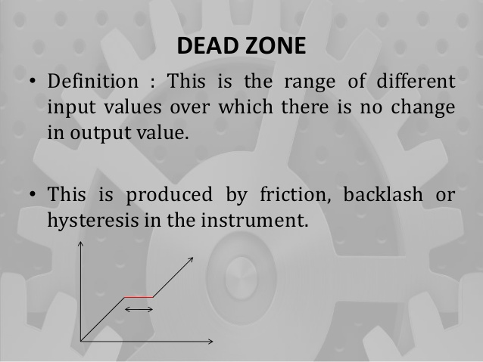

Slide 38
Reliability
It is defined as the possibility that can an instrument will perform its assigned function for given specific period of time under given conditions.
The reliability of a device is affected not only the choice of parts in it but also manufacturing methods, quality of maintenance and the type of user.

Slide 39
Standards
Primary, Secondary, Tertiary & Working Standards:
Primary standard:
It is only one material standard and is preserved under the most careful conditions and is used only for comparison with Secondary standard.
Secondary standard:
It is similar to Primary standard as nearly as possible and is distributed to a number of places for safe custody and is used for occasional comparison with Tertiary standards.

Slide 40
Standards
Tertiary standard:
It is used for reference purposes in laboratories and workshops and is used for comparison with working standard.
Working standard:
It is used daily in laboratories and workshops.
Low grades of materials may be used.

Slide 41
calibration
Calibration is the process of establishing the reliability of a measuring instrument.
This involves the comparison of the instruments to be calibrated with, either a primary standard, secondary standard or a known input source.

Slide 42
Methods of calibration
Primary calibration
When a measuring system is calibrated using primary standards, it is called primary calibration.
E.g. standard resistor , standard cell etc.
Secondary calibration
When a system that has been calibrated using primary standards is used to calibrate another device, then it is called secondary calibration.
E.g. general purpose lab and industries.

Slide 43
Methods of calibration
Direct calibration
Direct calibration is the process of calibrating a system with a known input source.

Slide 44
Repeatability
Repeatability describes the closeness of output reading when the same input is applied repetitively over a short period of time with same measurement condition.
Same instrument and observer, same location and same conditions of use maintained throughout .
It is ability of measuring instrument to give same value every time the measurement of given quantity is repeated.

Slide 45
Reproducability
Reproducability describes the closeness of out put readings for the same input when there are changes in method of measurement, observer, measuring instrument, location, condition of use and time of measurement.

Slide 46
Drift
It is an undesired gradual departure of the instrument output over a period of time that is unrelated to change in inputs operating conditions or load.
0r
Drift: - The gradual shift in the indication or record of the instrument over an extended period of time, during which the true value of the variable does not change is referred to as drift.

Slide 47
47
Output
Output
sensitivity drift
zero drift
input
input
Output
sensitivity drift
zero drift
input

Slide 48
Zero Drift:- if the whole calibration is shifted by the same amount due to slippage or due to undue warming up of tube of electronic tube circuits, zero drift sets in.
zero setting can prevent this.
Span Drift or Sensitivity Drift: - If there is proportional change in the indication all along upward scale, the drift is called span drift or sensitivity drift.
Hence higher calibrations get shifted more than lower calibrations.

Slide 49
Dynamic terms and characteristics
Speed of response
In measuring instruments the speed of response is defined as the value of the rapidity with which an instrument responds to a change in the value of quantity being measured.

Slide 50
Fidelity
Fidelity is the ability of the measuring instrument to reproduce the output in the same form as the input.
E.g. if the input provided is sine wave then output should be sine wave.

Slide 51
Dynamic error
The difference between the indicated quantity and the true value of the time varying quantity is the dynamic error, here static error of an instrument is assumed to be zero.

Slide 52
overshoot
Because of mass and inertia a moving part i.e. the pointer of the instrument does not immediately come to rest in the final deflected position.
The pointer goes beyond the steady state i.e. overshoot.
The overshoot is defined as the maximum amount by which the pointer moves beyond the steady state.

Slide 53
Errors
Difference between true value of the size being measured and the value found by measurement.
Classification of errors
Single transmission errors
environmental error
Observation error
Operational errors

Slide 54
Classification of error
Gross error or Human error
Operational error
B) personal error.
2) Systematic error
Instrumental error
B)environmental error.
3)Random error.

Slide 55
Operational error
A different type of flow meter will read inaccurately if it is placed immediately after valve or a bend.
A thermometer not read properly if its sensitive portion is not properly installed.
A pressure gauge will correctly indicate pressure only when it is exposed only to the pressure which is to be measured.

Slide 56
Personal error
This type of error mainly covers human mistake in reading instruments and recording and calculating measurement results.
For e.g. he may read as 31.5 c instead of 21.5 c due to oversight.
He may change reading while recording.
Cause of this error may be
1)Individual limitation of human being.
2)Lack of experience.
3)Observational error.

Slide 57
Observational errors
As the name suggests these types of errors are due wrong observations.
parallax: due to the line of vision is not normal to the scale.
Unit conversion: inaccurate conversion of units
Personal bias: a tendency to read high or low readings.
Wrong scale reading and wrong recording data.

Slide 58
Instrumental error
These errors are inherent in instrument because of their mechanical structure.
They may be due to construction , calibration or operation of measuring instrument.
E.g. if the spring of a permanent magnet instrument has become weak, the instrument will always read high.
To minimize such type of error instrument may be recalibrated.

Slide 59
Translation and signal transmission error
Instrumental error may arise due to error in translation and transmission of signal.
The instrument may not sense or translate the measured effect with complete fidelity.
The error are remedied by calibration and by monitoring the signal at one or more point along transmission path.

Slide 60
Environmental (Ambient /Atmospheric Condition) Errors:
International agreement has been reached on ambient condition which is at 200C temperature, 760 mm of Hg pressure and 10 mm of Hg humidity.
Instruments are calibrated at these conditions. If there is any variation in the ambient condition, errors may creep into final results. Of the three, temperature effect is most considerable.

Slide 61
Environmental errors
This type of error arises due to conditions external to instrument.
External condition includes temperature, pressure, humidity or it may include external magnetic field.
Following are the steps that one must follow in order to minimize the environmental errors:
(A)Try to maintain the temperature and humidity of the laboratory constant by making some arrangements.
(B)Ensure that there should not be any external magnetic or electrostatic field around the instrument.

Slide 62
Random error/residue error
The disturbance about which we are unaware are lumped together and called random or residual, error caused by these causes are called random or residual errors.
Reading shown by a hand tachometer would vary with the pressure with which it is pressed against the shaft.
In well designed experiments, few random errors usually occur but they become important In high accuracy work.
Some of the reasons of the appearance of these errors are known but still some reasons are unknown.
Hence we cannot fully eliminate these kinds of error.

Slide 63
Sources of errors
(1) Noise: It is defined as any signal that does not convey useful information.
(2) Design limitations: These are certain inevitable factors such as friction & resolving power which lead to uncertainty in measurements.
(3) Response time: It is the time lag between the application of input signal & output measurement
(4) Environmental effects: The change in atmospheric temperature may alter the elastic constant of a spring, the dimensions of a linkage, electrical resistance etc. similarly other factors such as humidity, pressure etc. also affect measurements.
(5) Errors in observation & Interpretation: It is the mistake of operators in observing, interpreting & recording the data.
(6) Poor maintenance of the system

Slide 64
Transducer
It detects and transforms the sensed signal into a more useful form.
Classification of transducer
1) Mechanical
A) elastic member e.g. springs and bourdon tube.
B) Thermal e.g. thermometer.
C) Hydro-pneumatic transducer e.g. venturi, orifice plate.
2) Electrical
A)passive B) Active
a) resistance a) thermocouple
b) capacitive b) photo voltaic
c) inductive c) piezoelectric pick
d) voltage

Slide 65
Active & Passive Transducers
Active transducers
Also known as self generating type transducers Develop their own voltage or current.
Energy required for production of output signal is obtained by quantity being measured.
Ex, Electronic & Piezo electric transducers.
Passive Transducers:
Also known as externally powered transducer
Derive the power for energy conversion from an external power source
Ex: Bonded electrical resistance strain gauges

Slide 66
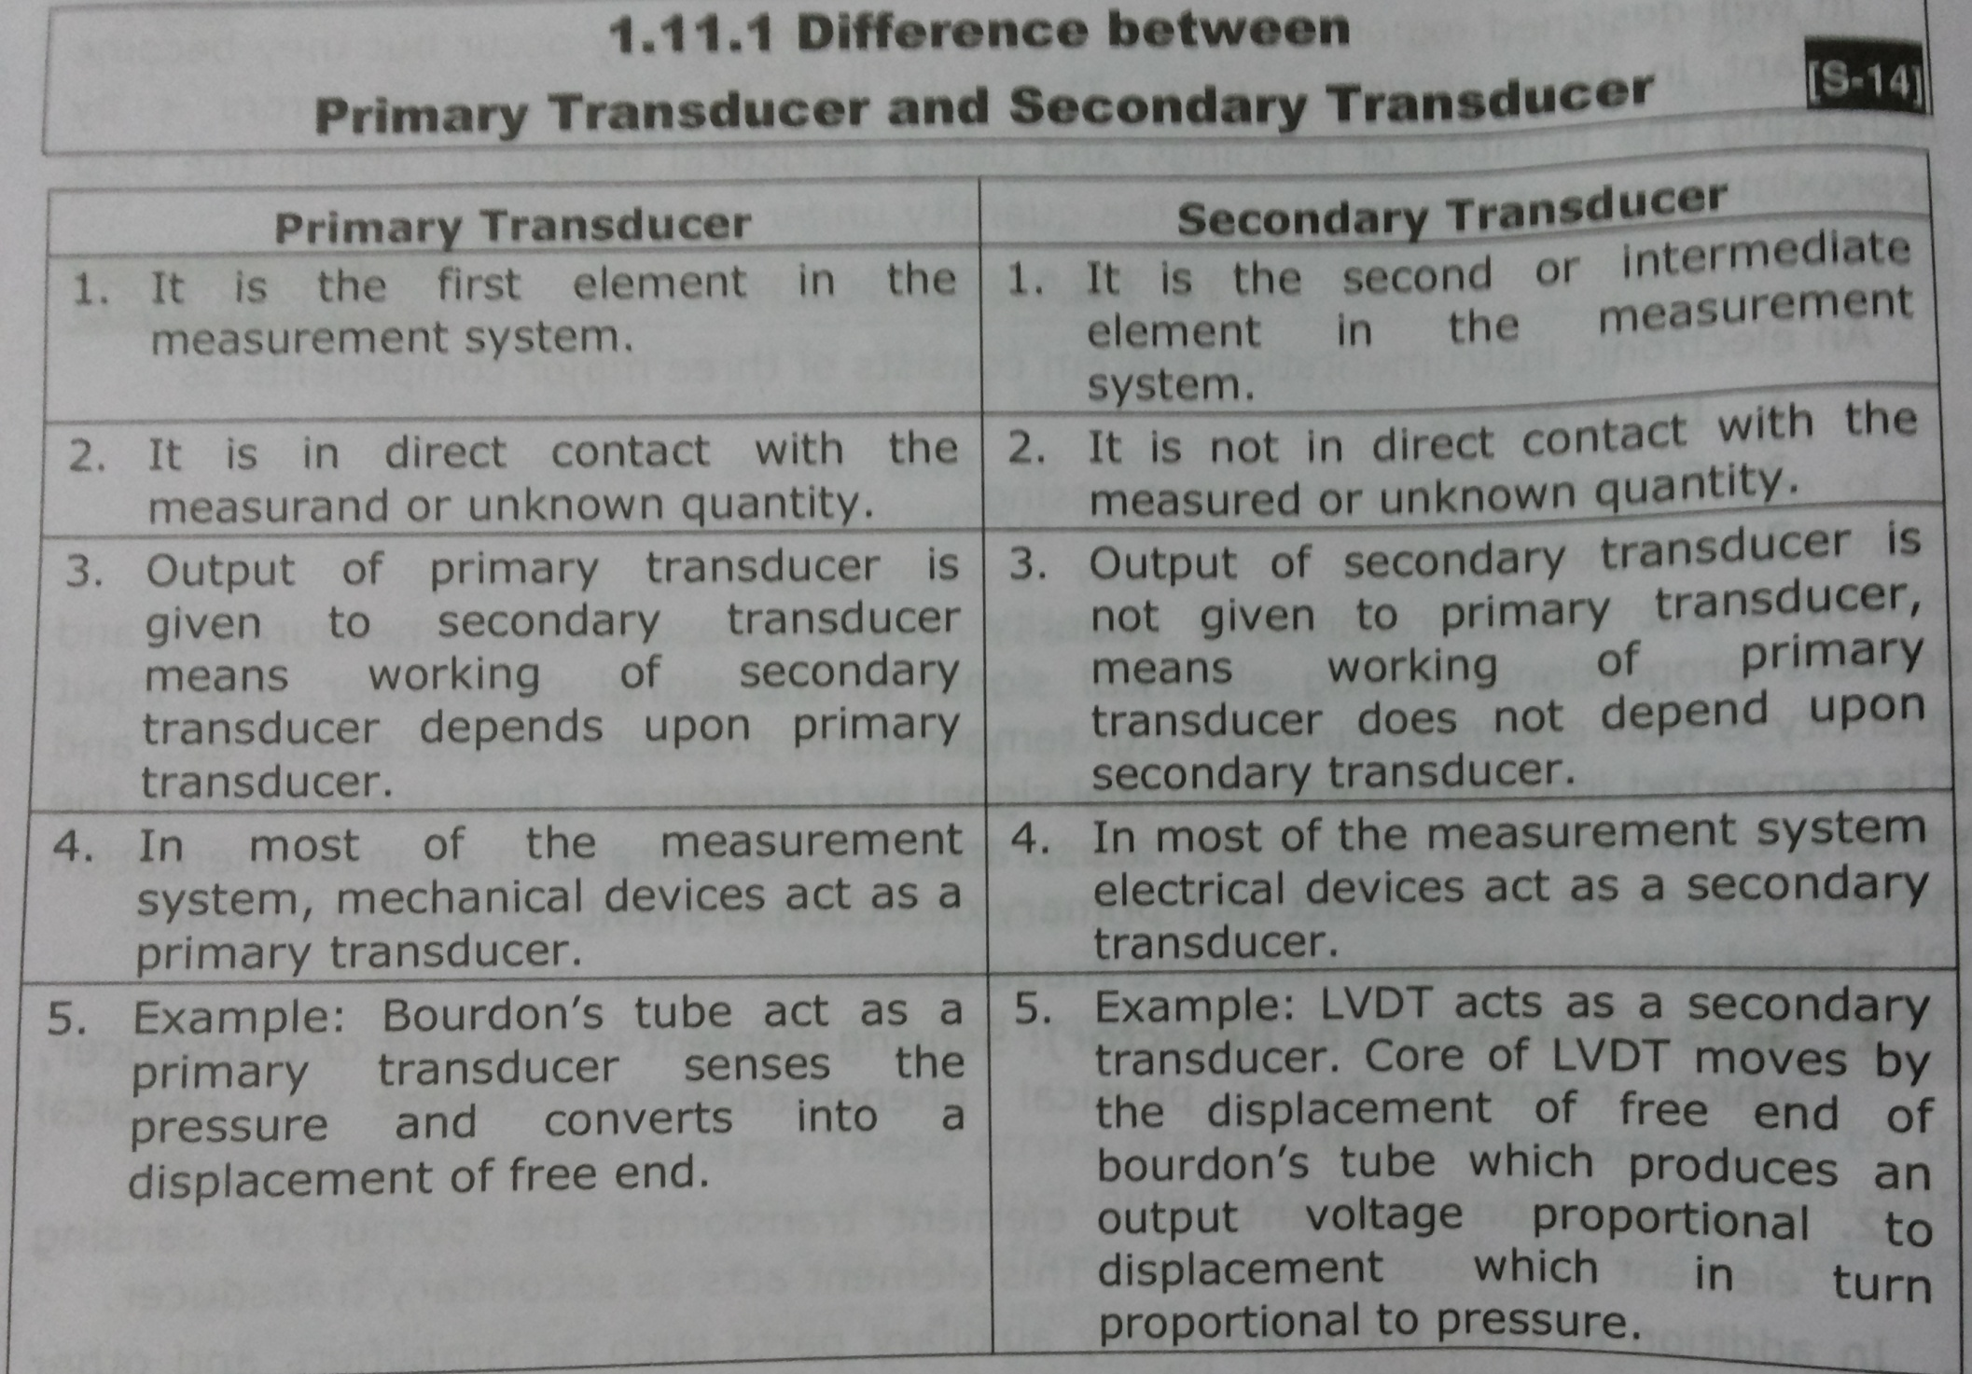

Slide 67
Resistive transducer
Resistive transducer are those in which the resistance changes due to change in some physical phenomenon.
The resistance of an electrical conductor is given by,
R=ρL/A
R=resistance in ohm.
L=length of the conductor in cm
A=cross sectional area of the conductor in cm2
ρ= resistivity of material in ohm-cm.

Slide 68
Resistive transducer
The electrical resistance thus can be varied by varying
1)Length 2) cross-sectional area 3) resistivity
Or a combination of these.
Any phenomenon or a physical variable which can vary any one of the above parameters can be transduced as change of resistance.
E.g. resistivity changes with temperature used for temperature measurement by device Thermistors, RTD etc.

Slide 69
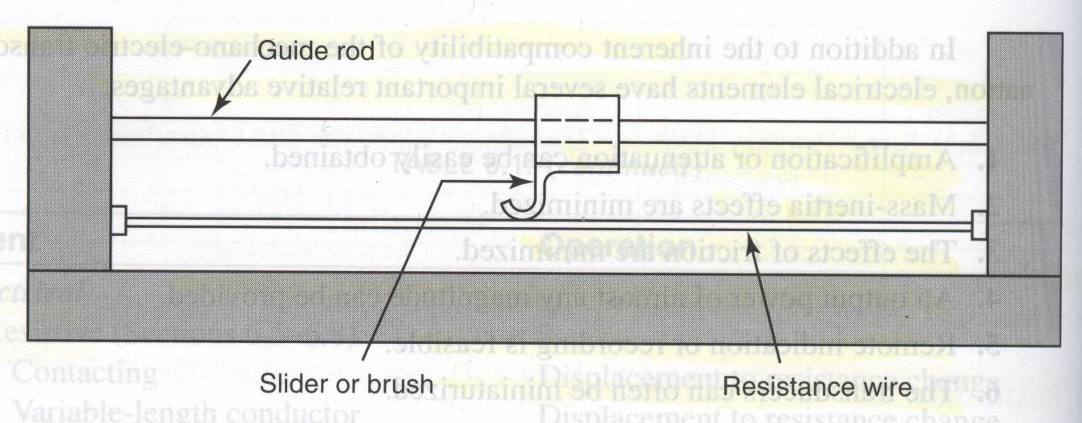

Slide 70
example
1) Sliding contact devices: In the sliding contact type of variable resistance transducers there is a long conductor whose effective length is variable.
One end of the conductor is fixed, while the position of the other end is decided by the slider or the brush that can move along the whole length of the conductor.
The slider is connected to the body whose displacement is to be measured.
When the body moves the slider also moves along the conductor so its effective length changes, due to which it resistance also changes.

Slide 71
example
The effective resistance is measured as the resistance between the fixed position of the conductor and the position of the sliding contact.
The value of the resistance is calibrated against the input quantity, whose value can be measured directly.
One of most popular sliding contact type of variable resistance transducer is the potentiometer.
These devices can be used to measured linear as well as angular displacement.

Slide 72
Capacitive Transducer
Capacitance is the ability of a body to store an electrical charge.
The capacitive transducer or sensor is nothing but the capacitor with variable capacitance.
The capacitive transducer comprises of two parallel metal plates that are separated by the material such as air, which is called as the dielectric material.

Slide 73
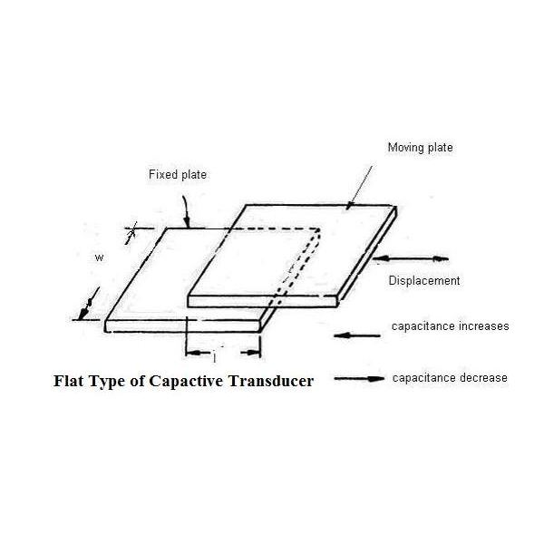

Slide 74
Capacitive Transducer
In the typical capacitor the distance between the two plates is fixed, but in variable capacitance transducers the distance between the two plates is variable.
In the instruments using capacitance transducers the value of the capacitance changes due to change in the value of the input quantity that is to be measured.
This change in capacitance can be measured easily and it is calibrated against the input quantity, thus the value if the input quantity can be measured directly.

Slide 75
Capacitive Transducer
The capacitance C between the two plates of capacitive transducers is given by:
C = ε_{o} x ε_{r} x A/ D
Where C is the capacitance of the capacitor or the variable capacitance transducer
ε_{o} is the absolute permittivity
ε_{r} is the relative permittivity
The product of ε_{o} & ε_{r} is also called as the dielectric constant of the capacitive transducer.
A is the area of the plates
D is the distance between the plates

Slide 76
Capacitive Transducer
It is clear from the above formula that capacitance of the capacitive transducer depends on the area of the plates and the distance between the plates.
The capacitance of the capacitive transducer also changes with the dielectric constant of the dielectric material used in it.

Slide 77
piezoelectric transducers
There are certain materials that generate electric potential or voltage when mechanical strain is applied to them or conversely when the voltage is applied to them, they tend to change the dimensions along certain plane. This effect is called as the piezoelectric effect.
The piezoelectric transducers work on the principle of piezoelectric effect.
When mechanical stress or forces are applied to some materials along certain planes, they produce electric voltage.
This electric voltage can be measured easily by the voltage measuring instruments, which can be used to measure the stress or force.

Slide 78
piezoelectric transducers
The voltage output obtained from the materials due to piezoelectric effect is very small and it has high impedance.
To measure the output some amplifiers, auxiliary circuit and the connecting cables are required.
Some of the materials that exhibit piezoelectric effect are quartz, Rochelle salt, polarized barium titanate, ammonium dihydrogen, ordinary sugar etc.

Slide 79
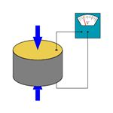

Slide 80
advantages as mentioned below:
1) High frequency response: They offer very high frequency response that means the parameter changing at very high speeds can be sensed easily.
2) High transient response: The piezoelectric transducers can detect the events of microseconds and also give the linear output.
3) The piezoelectric transducers are small in size and have rugged construction.
Limitations of Piezoelectric Transducers
Some of the limitations of piezoelectric transducers are:
1) Output is low: The output obtained from the piezoelectric transducers is low, so external electronic circuit has to be connected.
3) Forming into shape: It is very difficult to give the desired shape to the crystals with sufficient strength.

Slide 81
Inductive Transducers
The inductive transducers work on the principle of the magnetic induction of magnetic material.
The process by which a substance, such as iron or steel, becomes magnetized by a magnetic field.
Just as the resistance of the electric conductor depends on number of factors, the induction of the magnetic material depends on a number of variables like the number of turns of the coil on the material, the size of the magnetic material, and the permeability (is the measure of the ability of a material to support the formation of a magnetic field within itself) of the flux path(The direction and flow of the magnetic forces of attraction created by a magnet)

Slide 82
In the inductive transducers the magnetic materials are used in the flux path and there are one or more air gaps.
The change in the air gap also results in change in the inductance of the circuit and in most of the inductive transducers it is used for the working of the instrument.

Slide 83
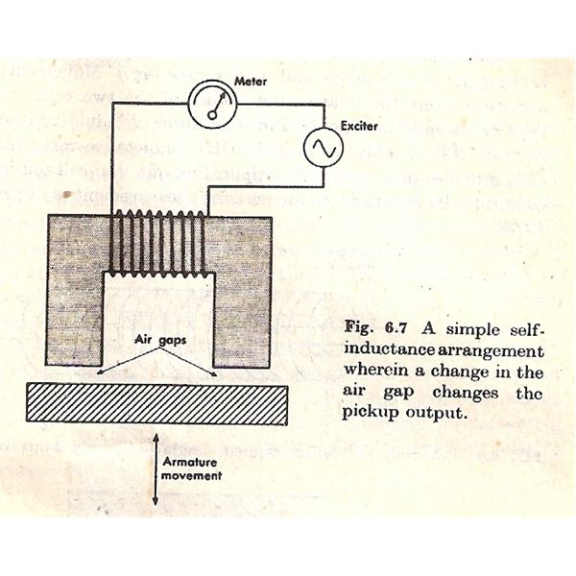

Slide 84
The figure 1 below shows the single coil inductive circuit.
Here the magnetic material is connected to the electric circuit and it is excited by the alternating current.
At the bottom there is another magnetic material that acts as the armature.
As the armature is moved, the air gap between the two magnetic material changes and the permeance of the flux generated by the circuit changes that changes the inductance of the circuit and its output.
The output meter directly gives the valve of the input mechanical quantity.

Slide 85
THANK YOU

