Slide 1
RLC Parallel circuit

Slide 2
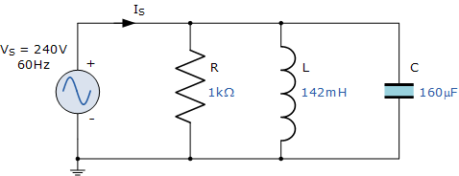
Example 1
In an AC circuit, calculate impedance and supply current?

Slide 3
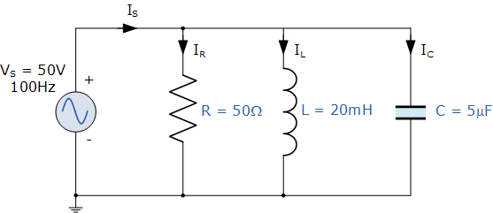
Example 2 A 50Ω resistor, a 20mH coil and a 5uF capacitor are all connected in parallel across a 50V, 100Hz supply. Calculate the total current drawn from the supply, the current for each branch, the total impedance of the circuit and the phase angle. Also construct the current and admittance triangles representing the circuit.

Slide 4
Example 3
A parallel RLC circuit with a 16 Ω resistor, 8 Ω inductor, 20 Ω capacitor, and a 120-V power supply what are the following values?
Current through the resistor (I_{R}).
Current through the inductor (I_{L}).
Current through the capacitor (I_{C}).
Net reactive current (I_{X}).
Total line current (I_{T}).

Slide 5
Example 5
For a RC parallel circuit with a supply voltage of 120-V and total watt of 9604 no value for the resistor and a capacitor valued at 1500µF, determine the following:
a. The amount of current through the resistor.
b. The capacitive reactance of the capacitor.
c. The amount of current flow through the capacitor.
d. The line current
e. Apparent power
f. PF

Slide 6
Example 5
A voltage of 200 V is applied to a pure resistor (R), a pure capacitor, C and a lossy inductor coil, all of them connected in parallel. The total current is 2.4 A, while the component currents are 1.5, 2.0 and 1.2 A respectively. Find the total power factor and Draw the phasor diagram.

