Slide 1
Introduction to Passive Circuit Elements
Marks 8
Visit for more Learning Resources

Slide 2
Introduction
In all electronics circuits we have to use different electronics components such as Resistors, Capacitors, Inductors Transformers and Semiconductor devices such as Diodes, Transistors etc.…
In this chapter we are going to discuss about
  various materials used to manufacture these devices
  Types
  Construction
  Properties of devices and components

Slide 3
Application of Electronics
Communication and Entertainment
Defense Application
Industrial Applications
Medical Science
Instrumentation

Slide 4
Types of Electronics Components
Active Components: Diodes, Transistors, FET
2. Passive Components: Resistors, Capacitors, Inductors

Slide 5
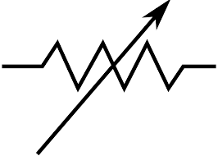

Resistor
Definition: Resistor is an electronics component which provides the specifies amount of opposition (resistance) to the flow of current.
It can be a fixed value or a variable resistor.
Unit: The value of resistor is called resistance. It is denoted by R and the unit of resistance is Ohms (Ω).
Symbol:
Fixed Resistor
Variable Resistor

Slide 6
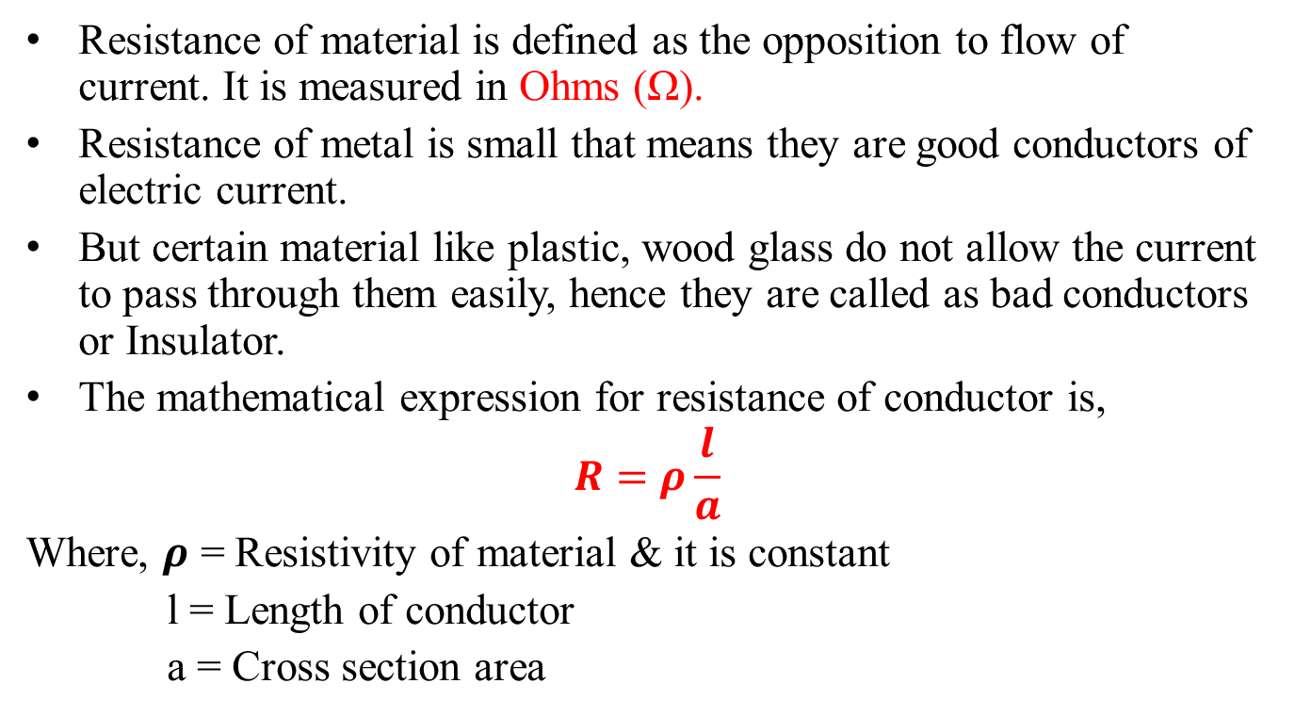
Resistance
Resistance of material is defined as the opposition to flow of current. It is measured in Ohms (Ω).
Resistance of metal is small that means they are good conductors of electric current.
But certain material like plastic, wood glass do not allow the current to pass through them easily, hence they are called as bad conductors or Insulator.
The mathematical expression for resistance of conductor is,
$$R=ρ\frac{l}{a}$$
Where, 𝝆 = Resistivity of material & it is constant
l = Length of conductor
a = Cross section area

Slide 7
Classification of Resistors
Resistors
  Linear
    Fixed
    Variable
  Non Linear
    Thermistor (TDR)
    LDR
    VDR
For more detail contact us

