Slide 1
Hashing
Visit for more Learning Resources

Slide 2
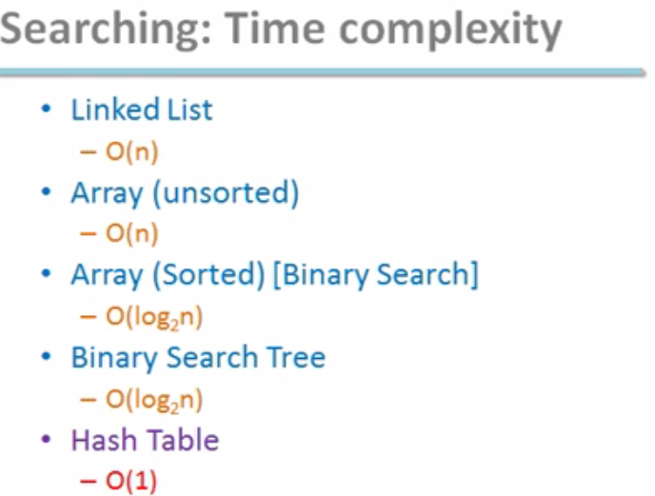

Slide 3
Hashing:
Hashing is a technique used to compute memory address for performing insertion, deletion and searching of an element using hash function. It gives O (1) time complexity in searching. Hash function maps the dataset to specific memory locations in hash table.Hash table is array structure where data is stored.

Slide 4
Significance of Hashing:-
1. Fast retrieval of information.
2. Element can be placed at appropriate position.
3. Collision can be avoided.

Slide 5
Different types of Hashing Functions:
Division Method
Mid square Methods
Folding Method
Digit Analysis
Length Dependent Method
Algebraic Method
Multiplicative Hashing

Slide 6
Collision:
A situation where resultant hashes for two or more data sets maps to a same memory locations in a hash table, is called hash collision

Slide 7
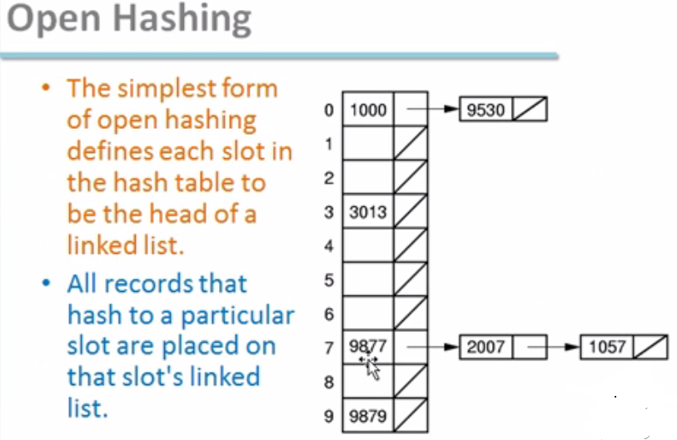

Slide 9
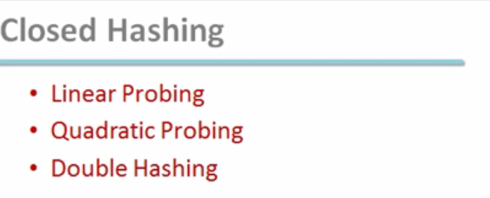
For more detail contact us

