Slide 1
Chapter 6 Testing Tools and Measurements
Visit to more Learning Resources

Slide 2
Manual Testing :
In Manual Testing , Testers manually execute test cases without using any automation tools.
It requires a tester to play the role of an end user.
Any new application must be manually tested before its testing can be automated.
Manual testing requires more effort, but is necessary to check automation feasibility.
Manual Testing does not require knowledge of any testing tool.
One of the Software Testing Fundamental is "100% Automation is not possible". This makes Manual Testing imperative.

Slide 3
Advantages of manual testing:
It is preferable for products with short life cycles.
It is preferable for products that have GUIs that constantly change
It requires less time and expense to begin productive manual testing.
Automation can not replace human intuition, inference, and inductive reasoning
Automation can not change course in the middle of a test run to examine something that had not been previously considered.
Automation tests are more easily fooled than human testers.

Slide 4
Disadvantages of manual testing:
Requires more time or more resources, some times both
Performance testing is impractical in manual testing.
Less Accuracy
Executing same tests again and again time taking process as well as Tedious.
Not Suitable for Large scale projects and time bounded projects.

Slide 5
Continued…
6. Batch Testing is not possible, for each and every test execution Human user interaction is mandatory.
7. Manual Test Case scope is very limited.
8. Comparing large amount of data is impractical.
9. Checking relevance of search of operation is difficult
10. Processing change requests during software maintenance takes more time.

Slide 6
Comparison between Automation Testing and Manual testing
Automation Testing | Manual Testing
Perform the same operation each time | Test execution is not accurate all the time. Hence not reliable.
Useful to execute the set of test cases frequently. | Useful when the test case only needs to run once or twice.
Fewer testers required to execute the test cases. | Large number of tester required
Platform independent. | It is Platform dependent.
Testers can fetch complicated information from code. | Does not involve in programming task to fetch hidden information.
Faster | Slow
Not Helpful in UI | Helpful in UI
High Cost | Less than automation.

Slide 7
Why Automated Testing?
Difficult to test for multi lingual sites manually
Does not require Human intervention
Increases speed of test execution
Increase Test Coverage
Manual Testing can become boring and hence error prone

Slide 8
Which Test Cases to Automate?
Test cases to be automated can be selected using the following criterion to increase the automation ROI(Return On Investment)
High Risk - Business Critical test cases.
Test cases that are executed repeatedly.
Test Cases that are very tedious or difficult to perform manually
Test Cases which are time consuming
The following category of test cases are not suitable for automation:
Test Cases that are newly designed and not executed manually at least once
Test Cases for which the requirements are changing frequently
Test cases which are executed on ad-hoc basis.

Slide 9
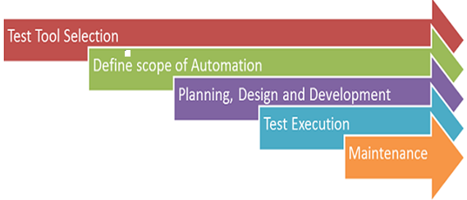
Automation Process
Figure. Automation Processing

Slide 10
1.Test tool selection:
Largely depends on the technology the Application Under Test is built on.
A detailed analysis of various tools must be performed before selecting a tool by assigning a dedicated test team
For example, if we are testing desktop application then we can’t use selenium for that.
Selenium is mainly for web applications.
So first we need to verify which type of application we are using and what appropriate tool we have to choose.

Slide 11
2.Define the scope of Automation:
Identifying which test cases should automate, the following are some points to determine scope:
Run same test cases for cross browser testing.
Major functions of applications which are difficult to test using manual testing.
Scenarios which have many test combinations.
Technical feasibility

Slide 12
3.Planning, Design and Development
In this we plan the resources and tools that we are going to use in the test execution.
we develop the automation scripts (test scripts for automation).
Automation tools selected
In-Scope and Out-of-scope items of automation is decided
Preparation of Schedule and Timeline of scripting and execution
Preparation of Deliverables of automation testing

Slide 13
4.Test Execution:
Scripts are executed during this phase.
The scripts need input test data before they are set to run.
Once executed they provide detailed test reports
Example:
In some scenarios test management tool itself execute scripts by invoking automation tools. We will report the defects to the developers team. And tools prepare test reports after execution.

Slide 14
5.Maintenance:
As new functionalities are added to the System Under Test with successive cycles, Automation Scripts need to be added, reviewed and maintained for each release cycle.
Maintenance becomes necessary to improve effectiveness of Automation Scripts.

Slide 15
Enlist factors considered for selecting a testing tool for test automation
1. Meeting requirements
2. Technology expectations
3. Training/skills
4. Management aspects

Slide 16
1. Meeting requirements-
There are plenty of tools available in the market but rarely do they meet all the requirements of a given product or a given organization.
Evaluating different tools for different requirements involve significant effort, money, and time.
2. Technology expectations
Test tools in general may not allow test developers to extends/modify the functionality of the framework.
So extending the functionality requires going back to the tool vendor and involves additional cost and effort. A good number of test tools require their libraries to be linked with product binaries..

Slide 17
3. Training/skills-
While test tools require plenty of training, very few vendors provide the training to the required level.
Organization level training is needed to deploy the test tools, as the user of the test suite are not only the test team but also the development team and other areas like configuration management.
4. Management aspects-
A test tool increases the system requirement and requires the hardware and software to be upgraded.
This increases the cost of the already- expensive test tool.

Slide 18
Guidelines for selecting a tool:
The tool must match its intended use. Wrong selection of a tool can lead to problems like lower efficiency and effectiveness of testing may be lost.
Different phases of a life cycle have different quality-factor requirements. Tools required at each stage may differ significantly.
Matching a tool with the skills of testers is also essential. If the testers do not have proper training and skill then they may not be able to work effectively.
Select affordable tools. Cost and benefits of various tools must be compared before making final decision.
Backdoor entry of tools must be prevented. Unauthorized entry results into failure of tool and creates a negative environment for new tool introduction.

Slide 19
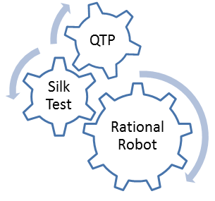
Automation tools:
Following are the most popular test tools :

Slide 20
QTP (Quick Test Professional ):
HP's Quick Test Professional ( now known as HP Functional Test) is the MARKET leader in Functional Testing Tool.
Key word driven testing
Suitable for both client server and web based application
Better error handling mechanism
Excellent data driven testing features

Slide 21
Rational Robot:
Rational Robot is a complete set of components for automating the testing of Microsoft Windows client/server and Internet applications.
The main component of Robot lets you start recording tests in as few as two mouse clicks.
After recording, Robot plays back the tests in a fraction of the time it would take to repeat the actions manually.
Enables defect detection, includes test cases and test management, supports multiple UI technologies

Slide 22
Selenium:
It is a portable software testing framework for web applications.
It provides a record/playback tool for authoring tests without learning a test scripting language (Selenium IDE).
It also provides a test domain-specific language to write tests in a number of popular programming languages, including Java, C#, Groovy, Perl, PHP, Python and Ruby.
The tests can then be run against most modern web browsers.
Selenium deploys on Windows, Linux, and Macintosh platforms.
It is open-source software,.

Slide 23
SilkTest:
SilkTest is a tool for automated function and regression testing of enterprise applications.
It is used for testing e-business applications
It offers test planning, management, direct database access and validation.
Extensions supported by SilkTest: .NET, Java (Swing, SWT), DOM, IE, Firefox, SAP Windows GUI.

Slide 24
WinRunner:
HP WinRunner software was an automated functional GUI testing tool that allowed a user to record and play back user interface (UI) interactions as test scripts.
Functionality testing tool
Supports web technologies such as (VB, VC++, D2K, Java, HTML, Power Builder, Delphe, Cibell (ERP))
It run on Windows only.
This tool developed in C on VC++ environment.

Slide 25
Benefits of Automated Testing
Reliable:
Tests perform precisely the same operations each time they are run, thereby eliminating human error
Repeatable:
You can test how the software reacts under repeated execution of the same operations.
Programmable: You can program sophisticated tests that bring out hidden information from the application. Comprehensive: You can build a suite of tests that covers every feature in your application.

Slide 26
Reusable:
You can reuse tests on different versions of an application, even if the user interface changes.
Better Quality Software:
Because you can run more tests in less time with fewer resources
Fast:
Automated Tools run tests significantly faster than human users. 70% faster than the manual testing
Cost Reduction:
As the number of resources for regression test are reduced

Slide 27
Automated test tool features:
Essential
Highly Desirable
Nice to Have

Slide 28
1.Essential:
The ability to divide the script into a small number (3 or 4) of repeatable modules.
Supports the use of multiple data sheets/tables (up to at least 8).
The ability to store objects names in the data tables and refer to them in the script.
The ability to treat the contents of different cells in the data sheets as input data, output data, windows, objects, functions, commands, URL, executable paths, commands etc.
The ability to access any data sheet from any module.

Slide 29
2.Highly Desirable
The ability to recover from Severity 1(fatal) errors and still continue to the end.
The ability for the user to create User defined functions.
The ability to write directly into the results report.
The ability to write into the data table (by the script).

Slide 30
3. Nice to Have:
Direct interface to the test management system (bi-directional).
The ability to add comments to the data table (rows).
The ability to restrict output to the results file .

Slide 31
Static Test Tools:
These are generally used by developers as part of the development and component testing process.
These tools do not involve actual input and output
Static analysis tools are an extension of compiler technology
Static analysis tools for code can help the developers to understand the structure of the code, and can also be used to enforce coding standards

Slide 32
Which are features for selecting static test tools?
Assessment of the organization’s maturity (e.g. readiness for change);
Identification of the areas within the organization where tool support will help to improve testing processes;
Evaluation of tools against clear requirements and objective criteria;
Evaluation of the vendor (training, support and other commercial aspects) or open-source network of support;
Identifying and planning internal implementation (including coaching and mentoring for
those new to the use of the tool).

Slide 33
Static Test Tools Examples:
Flow analyzers:
They ensure consistency in data flow from input to output.
2) Path tests:
They find unused code and code with contradictions.
3) Coverage analyzers:
It ensures that all logic paths are tested.
4) Interface analyzers:
It examines the effects of passing variables and data between modules.

Slide 34
Dynamic analysis tools
‘dynamic’ because they require the code to be in a running state.
They analyze what is happening ‘behind the scenes’ that is in the code while the software is running.
These tools would typically be used by developers in component testing and component integration testing,
e.g. when testing middleware, when testing security or when looking for robustness defects.

Slide 35
Features of Dynamic test tools:
To detect memory leaks.
To identify pointer arithmetic errors such as null pointers
To identify time dependencies
test the software system with 'live' data

Slide 36
Dynamic test tools examples:
1) Test driver:
It inputs data into a module-under-test (MUT).
2) Test beds:
It simultaneously displays source code along with the program under execution.
3) Emulators:
The response facilities are used to emulate parts of the system not yet developed.
4) Mutation analyzers:
The errors are deliberately 'fed' into the code in order to test fault tolerance of the system

Slide 37
What is a Testing Framework?
testing automation framework is an execution environment for automated tests.
It is the overall system in which the tests will be automated.
It is defined as the set of assumptions, concepts, and practices that constitute a work platform or support for automated testing.
It is application independent.
It is easy to expand, maintain and perpetuate. sting.

Slide 38
Why we need a Testing Framework
If we have a group of testers and suppose if each project implements a unique strategy then the time needed for the tester become productive in the new environment will take long.
To handle this we cannot make changes to the automation environment for each new application that comes along.
For this purpose we use a testing framework that is application independent and has the capability to expand with the requirements of each application.
Also an organized test framework helps in avoiding duplication of test cases automated across the application. In short Test frameworks helps teams organize their test suites and in turn help improve the efficiency of testing.

Slide 39
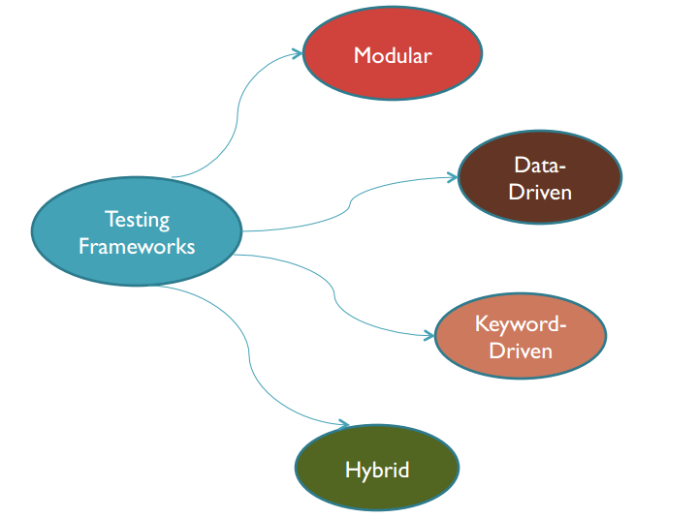
Types Of Testing Frameworks

Slide 40
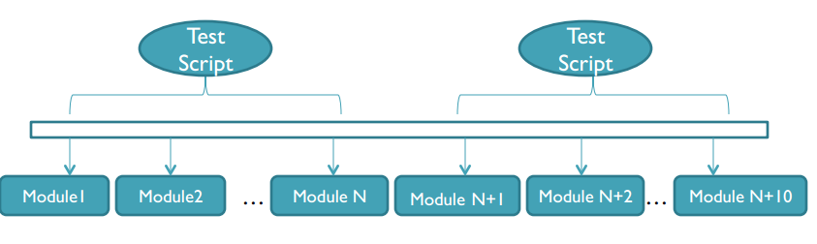
Modular Testing Framework
The Modularity testing framework is built on the concept of abstraction.
This involves the creation of independent scripts that represent the modules of the application under test.

Slide 41
These modules in turn are used in a hierarchical fashion to build large test cases.
• Thus it builds an abstraction layer for a component to hide that component from the rest of the application.
Thus the changes made to the other part of the application do not effect that component.

Slide 42
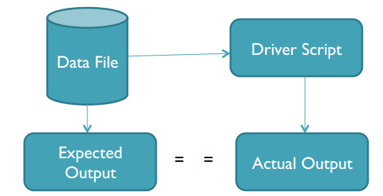
Data-Driven Testing Framework
Data driven testing is where the test input and the expected output results are stored in a separate data file (normally in a tabular format) so that a single driver script can execute all the test cases with multiple sets of data.
The driver script contains navigation through the program, reading of the data files and logging of the test status information.

Slide 43
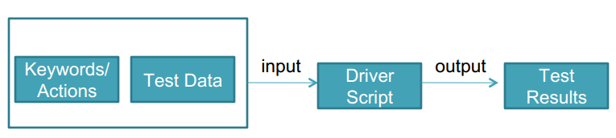
Keyword- Driven Testing Framework
Keyword driven testing is an application independent framework utilizing data tables and self explanatory keywords to explain the actions to be performed on the application under test.
Not only is the test data kept in the file but even the directives telling what to do which is in the test scripts is put in external input data file.
These directives are called keywords.

Slide 44
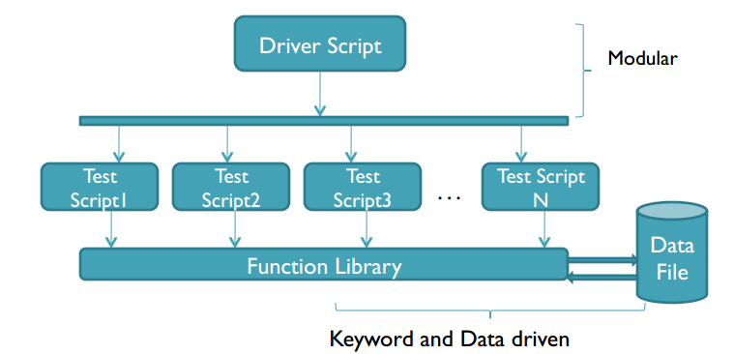
Hybrid Testing Framework
Hybrid testing framework is the combination of modular, data-driven and keyword driven testing frameworks.
This combination of frameworks helps the data driven scripts take advantage of the libraries which usually accompany the keyword driven testing.

Slide 45
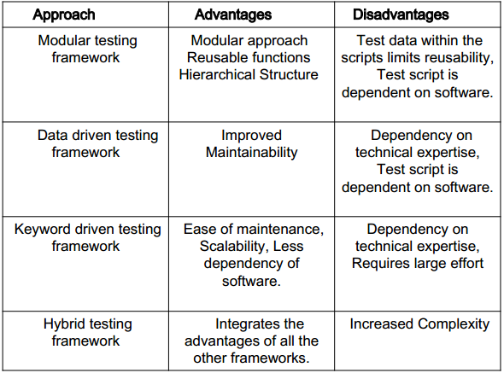
Comparison of Frameworks

Slide 46
Software Test Metrics
Metrics can be defined as “STANDARDS OF MEASUREMENT”.
• Metric is a unit used for describing or measuring an attribute.
• Test metrics are the means by which the software quality can be measured.
• Test provides the visibility into the readiness of the product , and gives clear measurement of the quality and completeness of the product.

Slide 47
Why we Need Metrics?
You cannot improve what you cannot measure.”
“You cannot control what you cannot measure”

Slide 48
TEST METRICS HELPS IN,
Take decision for next phase of activities
Evidence of the claim or prediction
Understand the type of improvement required
Take decision on process or technology change

Slide 49
Type of Testing Metrics
1.Base Metrics (Direct Measure)
Base metrics constitute the raw data gathered by a Test Analyst throughout the testing effort.
These metrics are used to provide project status reports to the Test Lead and Project Manager; they also feed into the formulas used to derive Calculated Metrics.
This data will be tracked throughout the Test Life cycle.
Ex: no. of of Test Cases, no. of of Test Cases

Slide 50
2.Calculated Metrics (Indirect Measure)
Calculated Metrics convert the Base Metrics data into more useful information.
These types of metrics are generally the responsibility of the Test Lead and can be tracked at many different levels (by module, tester, or project).
Ex: % Complete, % Test Coverage

Slide 51
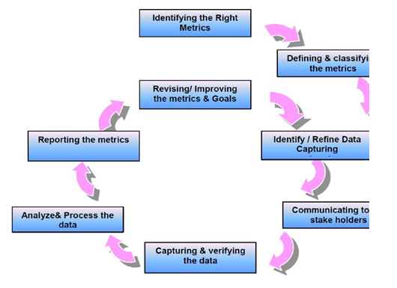
Metrics life Cycle:

Slide 52
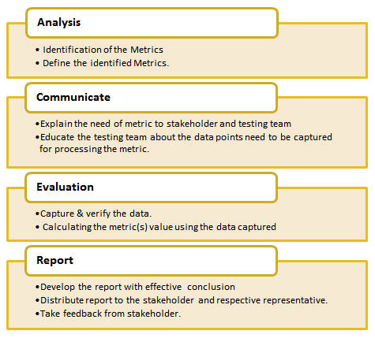

Slide 53
Definitions and Formulas for Calculating Metrics:
1) %ge Test cases Executed:
This metric is used to obtain the execution status of the test cases in terms of %ge.
%ge Test cases Executed = (No. of Test cases executed / Total no. of Test cases written) * 100.

Slide 54
2) %ge Test cases not executed:
This metric is used to obtain the pending execution status of the test cases in terms of %ge.
%ge Test cases not executed = (No. of Test cases not executed / Total no. of Test cases written) * 100.
3) %ge Test cases Passed:
This metric is used to obtain the Pass %ge of the executed test cases.
%ge Test cases Passed = (No. of Test cases Passed / Total no. of Test cases Executed) * 100.

Slide 55
#4) %ge Test cases Failed:
This metric is used to obtain the Fail %ge of the executed test cases.
%ge Test cases Failed = (No. of Test cases Failed / Total no. of Test cases Executed) * 100.
#5) %ge Test cases Blocked:
This metric is used to obtain the blocked %ge of the executed test cases. A detailed report can be submitted by specifying the actual reason of blocking the test cases.
%ge Test cases Blocked = (No. of Test cases Blocked / Total no. of Test cases Executed) * 100.

Slide 56
What is Software Test Measurement?
Measurement is the quantitative indication of extent, amount, dimension, capacity, or size of some attribute of a product or process.
Test measurement example: Total number of defects.

Slide 57
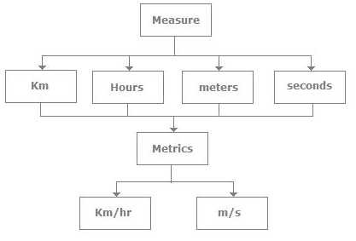
difference between Measurement & Metrics.

Slide 58
Project metrics
A software team can use software project metrics to adapt project workflow and technical activities.
Project metrics are used to avoid development schedule delays, to mitigate potential risks, and to assess product quality on an on-going basis.
Every project should measure its inputs (resources), outputs (deliverables), and results (effectiveness of deliverables).

Slide 59
Project metrics enable project manager to
Assess status of ongoing project
Track potential risks
Uncover problem are before they go critical
Adjust work flow or tasks
Evaluate the project team’s ability to control quality of software work products

Slide 60
Progress Metrics
It is the set of metrics to indicate how different activities of the project are processing.
We used progress metrics to track planned vs. actual over time.
To provide software quality assurance, we want to track progress of such things as a defects , test cases , man hours.

Slide 61
Productivity metrics
Productivity is the measure of the efficiency of a process to consume inputs and produce outputs.
Productivity metrics can be applied to development, enhancement, and support work within IT organizations.
Metric Formula
Development Productivity = Development project size (in FP)
Development effort (in hours)

Slide 62
Development effort is the hours expended doing project work from project inception through to acceptance by the customer or user.
Development project size is the function point size of the functionality created for the project. Included are conversion and test functions
Function points are obtained from the organization´s historical project information.
For more Details Contact Us

