Slide 1
Chapter 4: Test Management
Test Planning
Test Management
Test Process
Test Reporting
Visit to more Learning Resources

Slide 2
Test Planning
Test Plan:
It is a document that describes the scope , approach ,resource and schedule required for conducting test activities.
Following are the activities done as part of test planning
Preparing a Test Plan
Scope Management
Deciding a Test approach
Setting up criteria for testing
Identifying Responsibilities
Staffing and Training needs
Resources requirement
Test Deliverables
Testing task

Slide 3
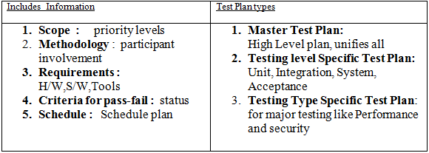
1.Preparation of Test Plan

Slide 4
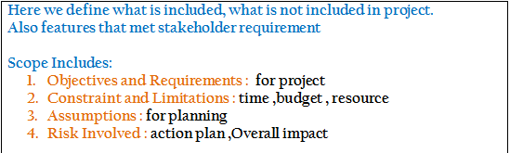
2.Scope Management

Slide 5
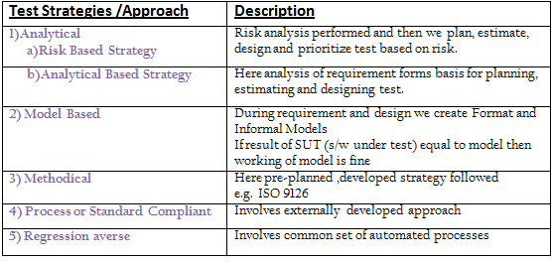
3.Deciding a Test approach

Slide 6
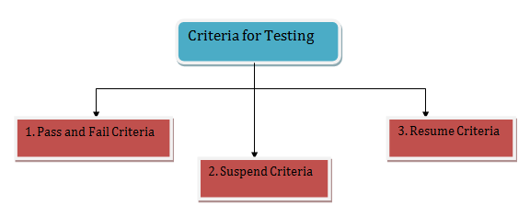
4.Setting up criteria for testing

Slide 7
5.Identifying Responsibilities
Specify no of testing staff and role
Identify people who will responsible for acceptance testing
Identify test team for test environment such as developers ,tester ,Operational staff ,testing services etc..

Slide 8
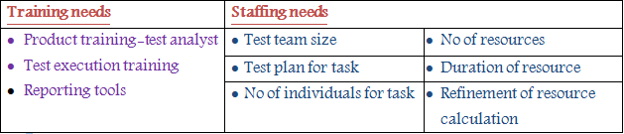
6.Staffing and Training needs
These needs communicate resource requirement and get approval of resources.

Slide 9
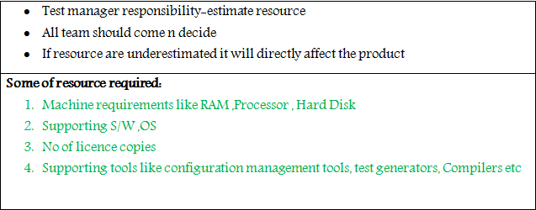
7.Resources requirement

Slide 10
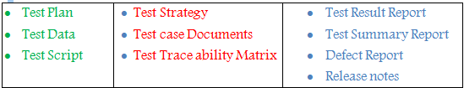
8.Test Deliverables: Test deliverable is any document /Script/Data related to testing which is handover to Client/Stakeholder during or at the end of testing phase. Following are different types of deliverables that are generated at every phase of SDLC:

Slide 11
9.Testing task
Uses work break down structure i.e. first various task are identified and then identify dependency among them.
Identify skills for testing
Determine size estimation for testing:
LOC (Line of Code) or FP (Function Points)
Determine effort estimation for people:
Days/months/years

Slide 12
Test Management
It refers to the activity of managing the S/W testing process
Test management allows different teams to plan , develop , execute and access all testing activities.
Standards:
1.Internal Standards:
2. External standards: Customer,National,International
Test Infrastructure Management
Test People/Team Management

Slide 13
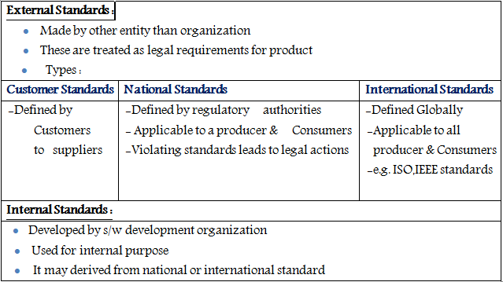
1.Standards It controls the activities under testing

Slide 14
2.Test Infrastructure Management
More stability , Continuity and reliability is provided to automation testing by providing stronger infrastructure .
It is used for supporting automated and manual s/w testing
Testing infrastructure includes:
Test plan document
Test Cases (Planned and Designed)
Test environment (back end and front end)
Defect tracking database
Version control System
Requirement tracing tools
Test Labs

Slide 15
3.Test People Management
Test team is formed with people with various skill and experience level.
So to maximize quality their is need to mange a peoples which can be done by test lead.
Responsibilities of test lead:
Identify how the test team will formed.
Identify scope of testing.
Put out the test plan
Check what skills required for available resources.
Identify tools for test reporting , test management , test automation etc
Provide training for team
Create healthy environment for all resources to gain maximum throughput.

Slide 16
Test team management activities:
Initiate test planning activities
Encourage the team to conduct review meetings
Monitor test progress
Check available resources and reallocate them as required
Check for any delays in schedule
Discuss and resolve issues of testers
Prepare plan to resolve risk
Initiate timely status to the stakeholders and management.
Bridges gap between the testing team and the management.

Slide 17
3.Test Process
Testing is not a single activity instead it’s a set of number of processes.
It includes following activities:
Base Lining a Test Plan
Test Case Specification
Update of Traceability Matrix

Slide 18
1.Base Lining a Test Plan
It is one of the type of non-functional testing.
It refers to the validation of documents and specifications on which test cases would be designed.
The requirement specification validation is baseline testing.
Generally a baseline is defined as a line that forms the base for any construction or for measurement, comparisons or calculations.
It is developed by competent people and and given to higher authorities for approval . If accepted then followed for further all activities
If changes are needed then first it is made into test plan and again approval is needed.
A majority of the issues are solved through baseline testing.

Slide 19
2.Test Case Specification
Test case specification has to be done separately for each unit.
Based on the approach specified in the test plan first determine the feature to be tested for each unit.
Based on these the test cases are specified for testing unit.
Success of product is depending quality of test cases through which it was passed.

Slide 20
3.Update of Traceability Matrix
It act as tool that validate whether every requirement is tested or not
Every test case should associated with requirement and every requirement has one or more associated test cases.
RTM(Requirement Traceability matrix) is created in requirement gathering phase by putting unique id to each one.
When a test case is finished corresponding requirement which is being tested is updated with test specification identifier.
By doing this two way connection between test case and requirement is established.

Slide 21

Testability matrix helps in:
Ensuring 100% test coverage
Showing requirement/document inconsistencies
Displaying the overall defect/execution status with focus on business requirements.
Template for RTM(Requirement Traceability matrix) :

Slide 22
4.Executing Test Cases
Proper execution of test cases is essential which will minimize the work and reduce the time to release s/w product.
Test execution task:
Follow the test procedures to execute test cases.
Do the confirmation testing for the failed test cases.
Log the result for test execution.
Compare actual and expected results. In case of difference defect occurrence is reported.
Update defect database which is used to communicate between developer and tester team.
So the execution of test cases will decide the suspension or resumption of further test cases.

Slide 23
Software Test Metrics
Software Test Metrics is used in decision making.
The test metrics is derived from raw test data.
Because what cannot be measured cannot be managed.
Hence Test Metrics is used in test management.
It helps in showing the progress of testing.

Slide 24
Benefits of Metrics
Provide status visibility.
Form a basis for decision making.
Set realistic expectations.
Focus people’s activities.
Supports process improvement.

Slide 25
Some of the Software Test Metrics are as below
Requirements Volatility
Review Efficiency
Productivity in Test Execution
Defect Rejection Ratio
Defect Fix Rejection Ratio
Delivered Defect Density
Outstanding defect ratio

Slide 26
Requirements Volatility:
Formula =
{(No. of requirements added + No. of requirements deleted + No. of requirements modified) / No. of initial approved requirements} * 100
Unit Of measure =
Percentage

Slide 27
Collecting and Analyzing text Metrics

Slide 28
Review Efficiency
Components -
No. of Critical, Major & Minor review defects
- Effort spent on review in hours
- Weightage Factors for defects:
Critical = 1; Major = 0.4; Minor = 0.1
Formula =
(No. of weighted review defects/ Effort spent on reviews)
Unit Of measure =
Defects per person hour

Slide 29
Productivity in Test Execution
Formula =
(No. of test cases executed / Time spent in test execution)
Unit Of measure =
Test Cases per person per day

Slide 30
Defect Rejection Ratio
Formula =
(No. of defects rejected / Total no. of defects raised) * 100
Unit of Measure =
Percentage

Slide 31
Defect Fix Rejection Ratio
Formula =
(No. of defect fixes rejected / No. of defects fixed) * 100
Unit of Measure =
Percentage

Slide 32
Test summary report
Test summary report is a document which contains summary of test activities and final test results.
After the testing cycle it is very important that you communicate the test results and findings to the project stakeholders so that decisions can be made for the software release. i.e. If further testing is required and we need to delay the release.
Test summary report will be different for different kind of testing.
In addition to test coverage and unresolved defects test summary reports should also contain test strategy, test objectives and overall result of test effort.

Slide 33
Advantages:
All relevant stakeholders of the Project will be able to see the health of AUT (application under test).
It will help them to take necessary steps proactively, if required.
It will to justify the testing effort that testing team is putting in the project.
It will help in building more mature process

Slide 34
Guidelines: Guidelines: Guidelines: Guidelines: Guidelines: Guidelines:
It should be published after every test run cycle
Mention all testing activities
All reports should be maintained in a document repository system

Slide 35
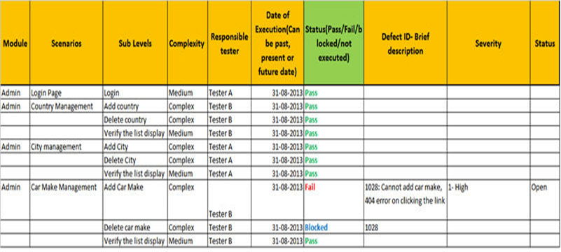
Test summary report Template

Slide 36
Outstanding defect ratio
Formula =
(Total number of open defects/Total number of defects found) * 100
Unit Of measure =
Percentage
For more Details Contact Us

