Slide 1
Baisc Of Software Testing
Visit to more Learning Resources

Slide 2
Software Testing
Software: Software is a set of instructions to perform some task. Software is used in many applications of the real world.
Software Testing: Testing can be defined in simple words as “Performing Verification and Validation of the Software Product” for its correctness and accuracy of working

Slide 3
Error, Fault and Failure
A programmer makes an error (mistake), which results in a defect (fault, bug) in the software source code.
If this defect is executed, in certain situations the system will produce wrong results, causing a failure. Not all defects will necessarily result in failures.
A defect can turn into a failure when the environment is changed. A single defect may result in a wide range of failure symptoms. Not all software defects are caused by coding errors.
A failure occurs when a faulty piece of code is executed leading to incorrect state that f propagates to the program’s output.

Slide 4
Software Testing Objectives
Testing is done to fulfill certain objectives
To discuss the distinctions between validation testing and defect testing
To describe the principles of system and component testing
To describe strategies for generating system test cases
To understand the essential characteristics of tool used for test automation
To find or prevent defects
To determine that software products satisfy specified requirements
Ensuring that a system is ready for use Gaining confidence that it works Providing information about the level of quality
Determining user acceptability Software quality measures how well software is designed (quality of design), and how well the software conforms to that design (quality of conformance).

Slide 5
Software quality
1) Conformance to specification: Quality that is defined as a matter of products and services whose measurable characteristics satisfy a fixed specification – that is, conformance to an in beforehand defined specification.
2) Meeting customer needs: Quality that is identified independent of any measurable characteristics. That is, quality is defined as the products or services capability to meet customer expectations – explicit or not. Software quality is a multidimensional quantity and is measurable. To do this, we need to divide and measure software quality in terms of quality attributes: Static Quality Attributes Dynamic Quality Attributes

Slide 7
When to Start Testing?
An early start to testing reduces the cost and time to rework and produce error-free software that is delivered to the client. However in Software Development Life Cycle (SDLC), testing can be started from the Requirements Gathering phase and continued till the deployment of the software. It also depends on the development model that is being used. For example, in the Waterfall model, formal testing is conducted in the testing phase; but in the incremental model, testing is performed at the end of every increment/iteration and the whole application is tested at the end.
Testing is done in different forms at every phase of SDLC:
During the requirement gathering phase, the analysis and verification of requirements are also considered as testing.
Reviewing the design in the design phase with the intent to improve the design is also considered as testing.
Testing performed by a developer on completion of the code is also categorized as testing.

Slide 8
When to Stop Testing?
It is difficult to determine when to stop testing, as testing is a never-ending process and no one can claim that a software is 100% tested. The following aspects are to be considered for stopping the testing process:
Testing Deadlines
Completion of test case execution
Completion of functional and code coverage to a certain point
Bug rate falls below a certain level and no high-priority bugs are identified
Management decision

Slide 9
Verification & Validation

Slide 10
V model, a software development life cycle methodology, describes the activities to be performed and the results that have to be produced during the life cycle of the product. It is known as verification and validation model Validation answers the question – "Are we developing the product which attempts all that user needs from this software ?" and Verification answers the question– "Are we developing this product by firmly following all design specifications ?"
V-Model Objectives:
Project Risks Minimization
Guaranteed Quality
Total Cost reduction of the Entire Project
Improved Communication between all Parties Involved

Slide 11
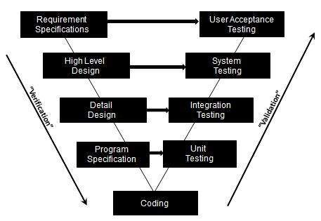

Slide 12
The Requirements phase, a document describing what the software is required to do after the software is gathered and analyzed and the corresponding test activity is user acceptance testing.
The Architectural Design phase, where a software architecture is designed and building the components within the software and the establishing the relationships between the components and the corresponding test activity is System Testing.
The High Level Design phase, breaking the system into subsystems with identified interfaces; then gets translated to a more detailed design and the corresponding test activity is Integration testing.
The Detailed Design phase, where the detailed implementation of each component is specified. The detailed design broken into Data structures, Algorithm used and the corresponding test activity is unit Testing.
Coding in which each component of the software is coded and tested to verify if faithfully implements the detailed design.

Slide 13
Emphasize for verification and validation of the product in early stages of product development.
Each stage is testable
Project management can track progress by milestones
Easy to understand implement and use
Limitations:
Does not easily handle events concurrently.
Does not handle iterations or phases
Does not easily handle dynamic changes in requirements
Does not contain risk analysis or Mitigation activities
For more Details Contact Us

