Slide 1

Tunnel engineering

Slide 2
Definition & necessity
Underground passage which are constructed without disturbing the ground surface
route to be connected by shorter distance
Conveying water for power generation
To avoid acquisition of valuble land
Protection againt landslide, snow fall
Coneveying water,oil,gas

Slide 3
Advantages
The connect terminal station by short route
Less route length result in less transportation cost
They carry railway, road and water, oil, gas
Avoiding holding up of traffic for long time
To avoid acquisition of valuble land
Protection againt landslide, snow fall

Slide 4
Disadvantages
Require skilled labour & supervision
Require Special equipment
Costly in construction
Require more time
May cause suffocation if ventilation not provided properly

Slide 5
Classification
According to purpose
i) Traffic tunnel
Railway
Highway
Navigation
Subway
Pedestrain
ii)Conveyance tunnel
Water supply
Hydropower
Sewage
Tunnel for industrial use
According to type of material
In hard rock
In soft rock
In quick sand
Uder river bed
According to position of alignment
Base tunnel
Spiral tunnel
Slope

Slide 6
Shape tunnel
Shape
Rectangular tunnel
Segmental
Circular
Horse shoe
Egg shape
Elliptical

Slide 7
Tunnel surveying
Involve the following operation
Location center line on the ground
Construction of shaft over center line
Transferring the center line inside the tunnel

Slide 8
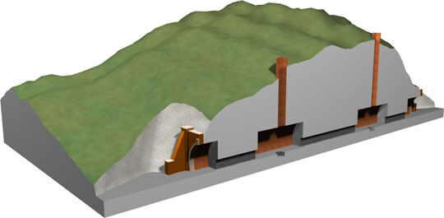
Shaft
When the length of tunnel is small, it can be constructed by excavation
The vertical opening along the alignment

