Slide 1
Vision Of The Institute
One among first top ten Institutions and an autonomous institute in the state of Maharashtra offering demand driven skill development programs and consistent high degree of professional development leading to successful career.
Mission Of The Institute
To educate and train students in engineering and technology.
To prepare them for successful employment in industry/business, self -enterprise, higher education by providing quality system based teaching and learning processes.
To identify themselves as good individuals and responsible citizens.

Slide 2
Vision of Department :
To be one of the best among top ten departments in the field of civil engineering education. Training competent professionals through value based quality education , creativity , and innovation satisfying the increasing demand in the industries.
Mission of Department :
Mission of Department is:
To impart quality based technical education to the students of civil engineering.
To mould them for employability requirement including entrepreneurship.
To provide value based teaching and learning process.
To inculcate good social values so that they become good individuals and responsible
citizens.

Slide 3
Program Out Comes:
1. Basic knowledge: A demonstrates to apply knowledge of basic mathematics, science and engineering to solve the engineering problems.
2. Discipline knowledge: A demonstrates to apply discipline - specific knowledge to solve core and/or applied engineering problems.
3. Experiments and practice: A demonstrates to plan and perform experiments and practices and to use the results to solve engineering problems.
4. Engineering Tools: Apply appropriate technologies and tools with an understanding of the limitations.
5. The engineer and society: Demonstrate knowledge to assess societal, health, safety, legal and cultural issues and the consequent responsibilities relevant to engineering practice.
6. Environment and sustainability: Understand the impact of the engineering solutions in societal and environmental contexts, and demonstrate the knowledge and need for sustainable development.
7. Ethics: Apply ethical principles and commit to professional ethics and responsibilities and norms of the engineering practice.
8. Individual and team work: Function effectively as an individual, and as a member or leader in diverse/multidisciplinary teams.
9. Communication: To communicate effectively.
10. Life-long learning: Recognize the need for, and have the preparation to engage in independent and life-long learning in the context of technological changes.

Slide 4
Program Specific Outcomes
PSO 1:
Basic knowledge: A demonstrates to apply knowledge of basic mathematics, science and engineering to solve the engineering problems.
PSO 2:
Discipline knowledge: A demonstrates to apply discipline - specific knowledge to solve core and/or applied engineering problems.
PSO 3:
Experiments and practice: A demonstrates to plan and perform experiments and practices and to use the results to solve engineering problems.

Slide 6
General Objectives:----
Students will able to
1. Understand various types of solid waste produced with their characteristics
2. Understand different methods of collection, transportation and disposal of solid waste.
3. Apply different method of disposal of solid waste for safe disposal.
4. Understand concept of Bio medical waste, E-waste and Industrial waste.
5. Understand recycling and reuse of solid waste.
6. Understand different transportation equipments with their limitations

Slide 7
Sr NO | Chapter | Marks
01 | Introduction
02 | Storage, Collection and Transportation of Municipal Solid Waste.
03 | Disposal of Solid Waste
04 | Special Types of Solid Wastes
05 | Health aspect and public Involvement in solid waste management
06 | Recycling of Solid Waste

Slide 8
Topic 1: Introduction
Specific objectives :
➢ State meaning of solid waste
➢ List types of solid waste
➢ Write the impact of solid waste
➢ List characteristics of solid waste
➢ List waste management
techniques

Slide 9
Content :---
• Definition of solid waste
• Meaning of different solid waste – Domestic waste, commercial waste, Industrial waste, market waste, agricultural waste, biomedical waste, E waste, hazardous waste, institutional waste, etc.
• Sources of solid waste
• Classification of solid waste – hazardous and non-hazardous waste.
• Physical and Chemical characteristics.
• Impact of solid waste on environment.
• Solid waste management techniques – solid waste management
Hierarchy, waste prevention and waste reduction.
• Factors affecting on solid waste generation.`

Slide 10
Definition of solid waste
--- Solid waste means discarded material including solid, liquid and semi solid resulting from domestic, Industrial, commercial, Agriculture and Mining operation.
Sources of solid waste
Residential:
Commercial:
Institutional:
Municipal:
Industrial:
Agricultural:
Open areas:

Slide 11
Meaning of different solid waste –
Types of waste :--
Residential
Commercial
Institutional
Construction and Demolition
5) Municipal Services
6) Treatment Plant Sites
7) Industrial
8) Agricultural
9)biomedical waste,
10)E waste,
11)hazardous waste,

Slide 12
ii. Residental waste /Domestic waste
The solid wastes that originate from single and multi-family household
units. These wastes are generated from household activities such as cooking, cleaning,
repairs, hobbies, redecoration, empty containers, packaging, clothing, old books,
writing/new paper, and old furnishings
Commercial waste :-- Solid wastes that are originate in offices, wholesale and retail stores, restaurants, hotels, markets, warehouses and other commercial establishments
Institutional waste :--
Construction and Demolition :--
Municipal Services
Treatment Plant Sites
Industrial :-Industrial waste is the waste produced by industrial activity which includes any material that is rendered useless during a manufacturing process such as that of factories, mills, and mining operations. It has existed since the start of the Industrial Revolution .
Agriculture waste
This mainly consists of spoiled food grains and vegetables, agricultural
remains, litter, etc., generated from fields, orchards, vineyards, farms, etc.

Slide 13
9)biomedical waste
Biomedical waste.
In this course, This is medical waste and includes all infectious waste, hazardous (including low-level radioactive wastes), and any other wastes that are generated from all types of health care institutions, including hospitals, clinics, doctor’s (including dental and veterinary) offices and medical laboratories

Slide 14
10)E waste
Define E-Waste
Electronic waste or e-waste describes discarded electrical or electronic devices. Used electronics which are destined for reuse, resale, salvage, recycling or disposal are also considered e-waste
11 ) Hazardous waste
Hazardous wastes may be defined as wastes of industrial, institutional or
consumer origin which, because of their physical, chemical or biological characteristics are potentially dangerous to human and the environment. Typical examples are:solvents, paints and pesticides whose spent containers are frequently mixed withmunicipal wastes and become part of the urban waste stream

Slide 15
Classification of solid waste –
hazardous waste B) non-hazardous waste
Hazardous waste
Hazardous wastes may be defined as wastes of industrial, institutional or consumer origin which, because of their physical, chemical or biological characteristics are potentially dangerous to human and the environment. Typical examples are:solvents, paints and pesticides whose spent containers are frequently mixed with municipal wastes and become part of the urban waste stream

Slide 16
Topic 2: Storage, Collection and Transportation of Municipal Solid Waste. Specific Objectives : 1) State methods of storage of municipal
solid waste. 2) List methods of collection of municipal
solid waste. 3) List various transportation equipment 4) Draw the organization pattern of solid
waste management.

Slide 17
Content s:---
* Storage of municipal waste.
* Collection methods of municipal waste.
* Tools and Equipments - Litter Bin, Broom,
Shovels, Handcarts, Mechanical road sweepers,
Community Bin like movable and stationary Bin.
* Transportation of municipal waste.
* Transportation vehicles with their capacity and
working-Animal carts, Auto vehicles, Tractors or
Trailers, Trucks, Dumper, Compactor vehicles.
*Transfer station- meaning, necessity, location
* Organization pattern of solid waste management

Slide 18
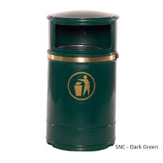
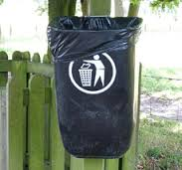
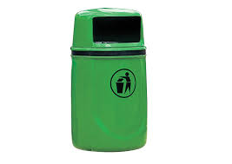
Tools and Equipments - Litter Bin, Broom, Shovels, Handcarts, Mechanical road sweepers, Community Bin like movable and stationary Bin
Litter Bin :--
USE:- for collecting the waste to be thrown by citizens ,public moving on the roads / pavements
Location :-- placed at sides of roads / pavements so that person willingly throw waste can use it
Primary collection device after sweeping .
Capacity :-- 60 ---150lit

Slide 19
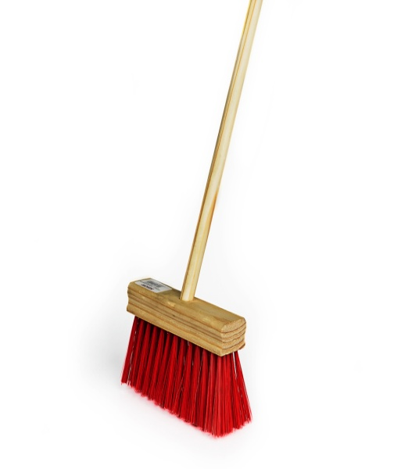
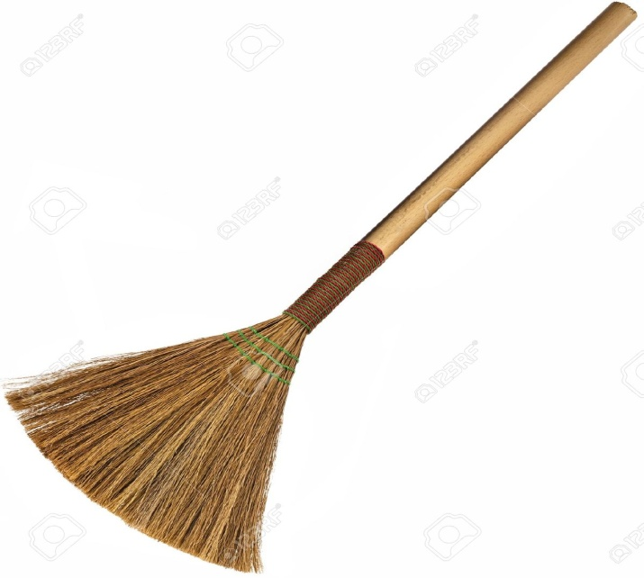
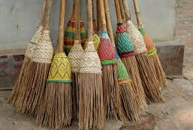
, Broom
A long-handled brush of bristles or twigs, used for sweeping
Length of handle:--135cm
Length of broom :--80—850cm
Wt:--1 kg

Slide 20
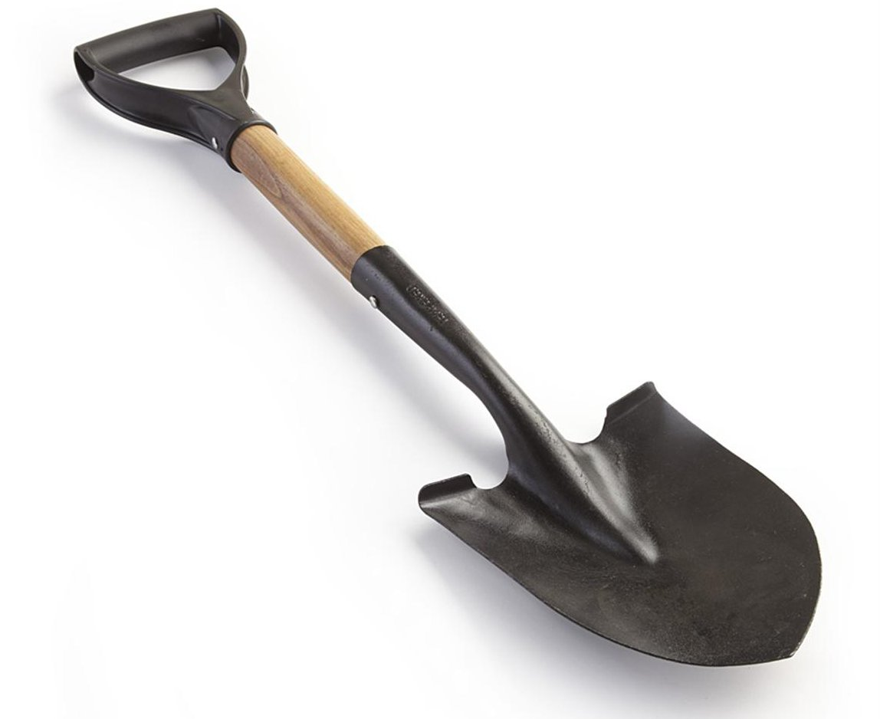
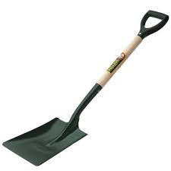
Shovels
a tool used as a spade with a broad blade and typically upturned sides, used for digging , lifting and moving bulk materials, moving coal, earth, snow, or other material,

Slide 21
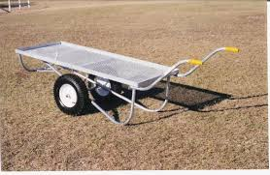
Handcarts
Fabricated out of M S Angle suitable to accommodate 6—8 bins of 25 lit capacity , ideal for solid waste collection

Slide 22
Mechanical road sweepers
A street sweeper or street cleaner may refer to a person's occupation, or a machine that cleans streets. A street sweeper cleans the streets, usually in an urban area.
Street sweepers have been employed in cities since sanitation and waste removal became a priority. A street-sweeping person would use a broom and shovel to clean off litter, animal waste and filth that accumulated on streets. Later, water hoses were used to wash the streets.
Machines were created in the 19th century to do the job more efficiently. Today, modern street sweepers are mounted on truck bodies and can vacuum debris that accumulates in streets.

Slide 23
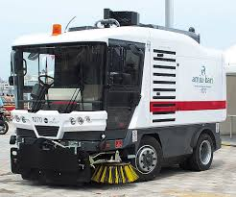

Slide 24
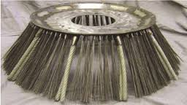
circular broom under road sweepers

Slide 25
Community Bin
Large and meant for use at centrally located pick up points
Tyes :-- Movable
Provided with wheels and handles
2) Stationary :-- without wheels but have handles
Capacity :-- 750—1000 lit

Slide 26
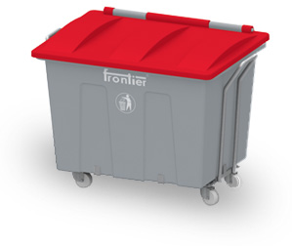

Slide 27
Storage of waste at source
See on next slide

Slide 28
SR NO | Sorce of waste generation | Action to be taken
01 | House holds | 1 Not to throw any solid waste in the neighbourhood , on streets ,on open spaces and vacant lands ,into drains or water bodies 2Keep food waste / biodegradable waste in a non corosive container with a cover 3keep dry / recyclable waste in a bin / bag or a sack .
02 | Multistoried buildings , commercial complexes , private societies | 1 to 4 as above 5. Provide seaperate community bins / bins large enough to hold food / biodegradable waste generated in the building / society 6 direct the members of association / socity to deposit their waste in community bin on day to day basis
03 | Slums | 1 to 4 as above 5 Use community bin provided by local bodies

Slide 29
SR NO | Source of waste generation | Acton to be taken
04 | Shops offices , institutions etc | 1—4 above 5. If situated in commercial complexex ,deposit the wste as per 2 / 3 above in community bin provided by the assosiation
05 | Hotels and restourants | 1---4 above 5. Container used should be strong not more than 100 lit in size ,should have a handle on the top or handles on sides
06 | Vegetables and fruit Market | 1Provide large container which match the transportation system of the body

Slide 30
SR NO | Source of generation of waste | Action to be taken
07 | Meat and fish market | 1 Not to throw any type of waste infront of their shops 2keep a non corrosive container not exceeding 100 lit capacity with lid 3 Transfer the content of this container into a large container
08 | Street food vendors | 1 Not to throw any waste on the streets ,pavements or open spaces 2Keep bin or bag for the storage of the waste 3fix the bin/bags with the hand cart

Slide 31
Solid Waste Collection and Transport
On-site Handling, On-site Storage : Curb Collection, Direct haul, transfer station
Collection services: types and methods
Vehicle and labor requirements
Types of Collection systems (hauled container system, stationary container system)

Slide 32
ON-SITE HANDLING:
- Activities associated with the handling of SW until they are placed in the containers used for storage before collection
ON-SITE STORAGE:
Factors considered:
Types of containers used
Container Locations
Public health
Aesthetics
Methods of Collection

Slide 33
collection of municipal solid waste
Municipal solid waste (MSW), commonly known as trash or garbage in the United States and as refuse or rubbish in Britain, is a waste type consisting of everyday items that are discarded by the public

Slide 34
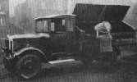
Waste Collection

Slide 35
Lesson Objectives
Understand problems and concerns associated with MSW collection.
Compare and contrast privately and publicly operated systems.
Understand the types of collection systems
Identify the benefits associated with the use of transfer stations
Prepare an economic analysis of transfer stations
Understand the design issues associated with transfer stations

Slide 36
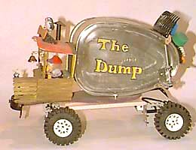
Collection accounts for
70% of a SW budget!

Slide 37
Types of Waste Collection Systems
Refuse Collection Systems (residential)
Commercial Waste Collection
Recyclable Material Collection
179,000 trucks in the US (most diesel powered)

Slide 38
Refuse Collection (Residential)
Stationary container emptied into truck
Manually
High injury rates (heavy containers, broken glass/sharp objects)
Temporary containers that fall apart
Automatic

Slide 39
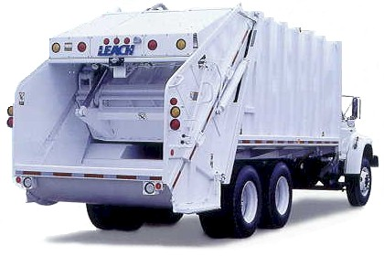
Rear Loading Compactor

Slide 40
Rear Loading Compactor

Slide 41
Maintenance Costs
Collection Method | Annual Maintenance Cost, $
Automated | 35,000
Semi-automated | 15,000
Manual | 8,000
Source: O’Brien, J. K. “The Benchmarking of Residential Solid Waste Collection Services, MSW Management, Sept/Oct 2007, pp 12 – 24.
Notes:
41

Slide 42
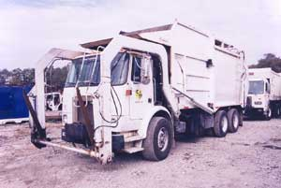
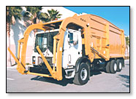
Front Loading Compactor

Slide 43
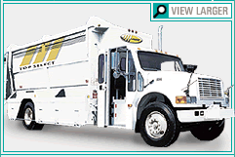
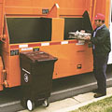
Recycling Hauler

Slide 44
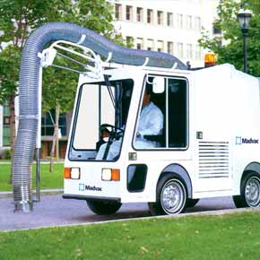
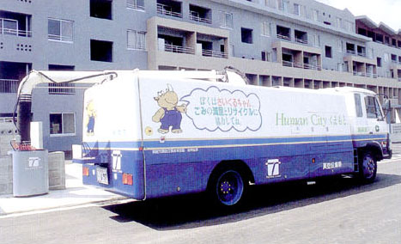
Vacuum Collection

Slide 45
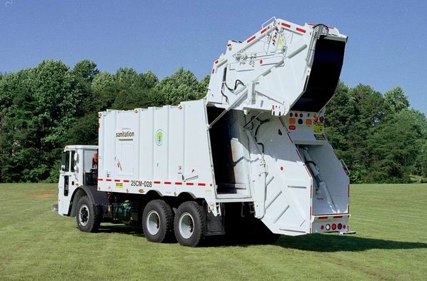
Split Body Rear Loader

Slide 46
Transfer station: meaning necessity, location
These are open or closed structures built by local authority at various locations in city and waste collected by hauling vehicle's is initially transferred to these locations
A transfer station is a building site for the temporary deposition of waste. Transfer stations are often used as places where local waste collection vehicles will deposit their load prior to loading into larger vehicles.
These larger vehicles will transport the waste to the disposal site either in an incinerator,landfill,or hazardous waste faculty, or for recycling.

Slide 47
Transfer station: necessity :--
1 they prevent the scattering of MSW
2 to have ease in proper storage and collection of MSW from different locations
3 to prevent nuisance due to scattered solid waste nearby
4 to reduce the haul distance

Slide 48
FACTORS AFFECTING SITE OF TRANSFER STATION
1.Waste scattering/pollution: It should be selected such that no nuisance should be created in nearby areas.
2.Haul distance: It should be constructed such that haul distance is minimum.
3.Electricity:It should be available.
4.It should be away from heritage place.
Notes:
48

Slide 49
LOCATION
1.it should be centrally located in the city.
2.it should be not far from disposal site.
3.it should be located in area where there is slow traffic.
4.it should be in area where land rates are cheap.
5.it should be not there in thickly populated areas or residential area.

Slide 50
Organizational pattern of solid waste management.
Solid Waste Management activity has been decentralized zone wise.
At the Head Office the Chief Engineer is in charge for establishment of processing and disposal sites.
* The zonal officers look after the collection and transportation of solid waste.
* About 80 % of the MSW activity has been outsourced .
* Small numbers of Self Help Group’s (SHGs) are engaged in door to door collection in some of the new areas.

Slide 52
Topic 3 : Disposal of Solid Waste
Specific objectives :-----
List the types of disposal of solid waste
Describe the process of composting.
Describe the process of land filling.
Describe the process of incineration.

Slide 53
CONTENTS:__
3.1Composting of waste ……………….. 08
Principles of composting process
Factors affecting on composting process
Methods of composting -
A) Manual Composting - Bangalore method, Indore Method
B) Mechanical Composting - Dano Process
C) Vermicomposting- Concept
3.2Land filling technique ………………. 08
Factors for site Selection
Land filling methods-Area method, Trench method and Ramp method
Leachate and its control
Biogas from landfill
Advantages and Disadvantages of landfill method
3.3 Incineration of waste ……………….. 08
Introduction of incineration process.
Types of incinerators-Multiple chamber incinerators and Municipal
incinerators Products of incineration process with their use
Pyrolysis of waste –Definition, methods, Advantages and
Disadvantages of incineration process

Slide 54
3.1 Composting of waste
Composting is the biological decomposition of organic waste such as food or plant material by bacteria, fungi, worms and other organisms under controlled aerobic (occurring in the presence of oxygen) conditions. The end result of composting is an accumulation of partially decayed organic matter called humus.
Principles of composting process :--
Decomposition and stabilization of organic waste matter is a natural phenomenon.
Composting can be carried out in two ways i.e., aerobically and anaerobically.
During aerobic composting aerobic micro-organisms oxidise organic compounds
to Carbon dioxide, Nitrite and Nitrate. Carbon from organic compounds is used as a
source of energy while nitrogen is recycled. Due to exothermic reaction, temperature ofthe mass rises.During anaerobic process, the anaerobic micro organisms, while metabolizing thenutrients, break down the organic compounds through a process of reduction. A verysmall amount of energy is released during the process and the temperature ofcomposting mass does not rise much. The gases evolved are mainly Methane andCarbon dioxide. An anaerobic process is a reduction process and the final product is subjected to some minor oxidation when applied to land.

Slide 55
Methods of composting :--
A) Manual Composting
1) Indore method :---
* Indore method layers of vegetable and night soil is alternative piled into trench,
the depth of pile is 1.5-2m and widths is about 3-8m or above the ground form a
mound called windrow.
Normally windrows are conical in shape and about 50m in length.
*The aeration is achieved by periodically turning the piles. Manual turning is
Adopted for small plants and mechanical turning is adopted for larger plants.
* Refuse should be turn once or twice per week which introduce oxygen and helps
to control temperature.
* Turning continued for about 4-5 weeks during which biodegradable organic are
Consumed. The solid waste is allowed to keep for 2-8 weeks with turning the
Composting in windrow may take 21-28 days for stabilization.
* The composted waste is removed from windrow and allowed to mature in
maturing yards for 1-3 months, after which the compost becomes ready for being
taken out for use.

Slide 56
II) Bangalore method
Bangalore method is commonly used anaerobic method used for biological used anaerobic method used for biological conversion of organic component of municipal solid waste.
In this method underground earthen trench is excavated and alternate layer of waste and soil is filled in trench or pit to control odour.final layer of soil is provide at top.
The soil cover not only prevent odour but also prevents breeding of files.
Within 2-3 days of burial intensive biological action starts taking place and organic matter beings to be destroyed. After 4-5 months complete stabilization of waste takes placed.
➢ During biological action head is evolved which rises temperature of
decomposing mass.

Slide 57
Factors affecting on composting process
1.Particle size
2. Moisture content
3. pH
4. Temperature
5. Carbon Nitrogen ratio
6. Blending and seeding
7. Air circulation

Slide 58
* Temperature
Microorganisms require a certain temperature range known as Mesophiles (20-45ºC or 68-113ºF) and thermophiles (45ºC or 113ºF) for optimal activity. Certaintemperatures promote rapid composting and destroy pathogens and weed seeds. Thermopiles bacteria can turn waste to compost almost 6 months faster than the lower temperature bacteria.
* Moisture Level
Microorganisms living in a compost pile need an adequate amount of moisture to survive Moisture is very important for a composting toilet. Without moisture, no bacteria can perform the processes necessary for composting.
*Air Circulation or Oxygen Level
Aerobic conditions are important for proper composting and odor control. Ifanaerobic (no air present) conditions are allowed to exist, then foul and offensive odors. Providing proper ventilation by designing the composting toilet with a vent pipe.
* Particle size: Smaller particle size increases conversion rate during composting.
*pH: During the composting process, the pH level will fluctuate according to the different reactions produced by the micro-organisms.
* Carbon/Nitrogen Nutrient Ratio
The proper balance of nutrients is vital to the composting process. A good carbon/nitrogen (C/N) ratio for a compost toilet is 20/1 to 35/1. This means far more carbon must be present in the vault to the nitrogen for good composting to proceed. Because of the composition of feces and urine, a lot of carbon in the form of hay, straw ,wood chips, and sawdust have to be added to the compost toilet.

Slide 59
B) Mechanical Composting - Dano Process:---
➢ In the process of stabilization is expiated by mechanical device of turning the compost. It is recommended to use refuse of 1.5cm particle size in this method.The moisture content and aeration of refuse are continually adjusted. Care is taken to see that quantity of air should not exceed 2m3/kg of volatile solid per day.
➢ It requires small area compare to trenching and open windrow
composting.
➢ The stabilization of waste takes 3 – 6 days.
➢ The operation involved are
• Reception of refuse
• Segregation
• Shredding
• Stabilization
• Marketing
See fig on the next slide

Slide 60
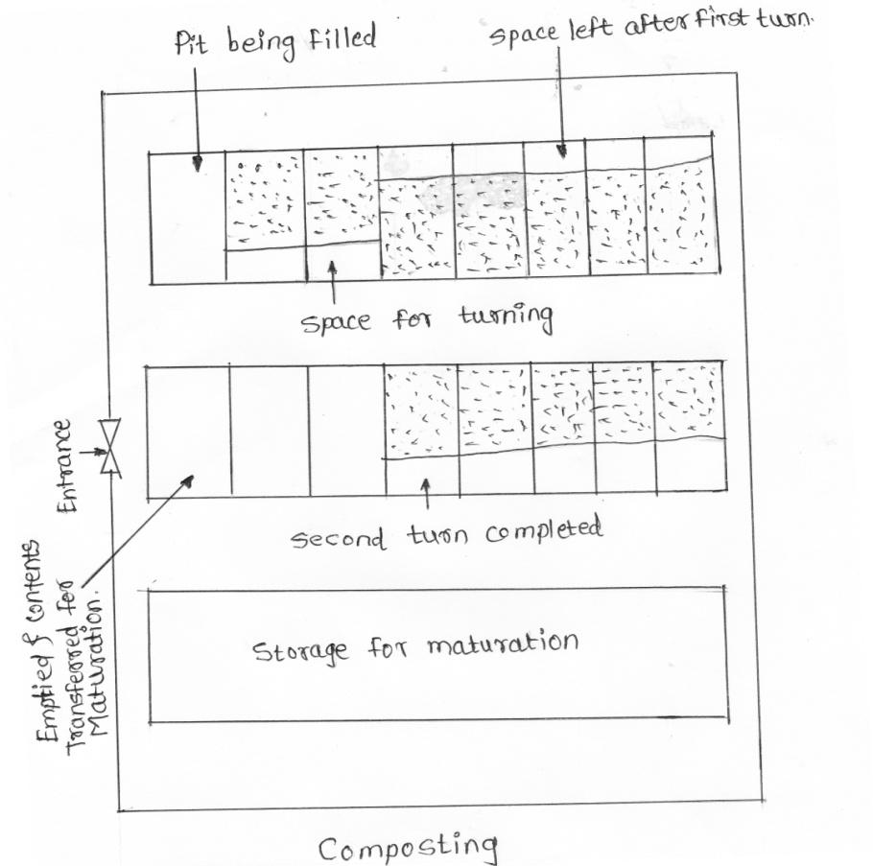

Slide 61
C) Vermicomposting- Concept
Vermicomposting is the breaking down of organic material through the use of worms, bacteria, and fungi. In nature, organic matter is decomposed through these organisms.By managing vermicomposting you are essentially speeding up mother nature's process of breaking down organic matter.
Vermi compost is the product or process of composting using various worms, usually red wigglers, white worms, and other earthworms to create a heterogeneous mixture of decomposing vegetable or food waste, bedding materials, and vermicast.
Concept on next slide

Slide 62
Vermicomposting- Concept
➢ Take a small wooden box or dig a small pit.
➢ Spread a net on your box.
➢ Also spread 1 or 2 cm thick layer of sand.
➢ Put some kitchen wastes such as peels of fruits etc., to cover the sand.
➢ Use green leaves to cover over the sand.
➢ Sprinkle some water to make this layer wet.
➢ Buy some red worms and put them in your pit.
➢ Give them vegetable and fruit wastes as food.
➢ After 3 to 4 weeks you will see loose, soil like material in the pit.
➢ Remove the material from the box, dry it in the sun.
➢ Use this as manure.

Slide 63
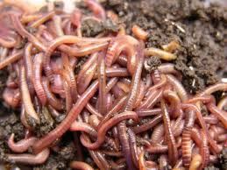
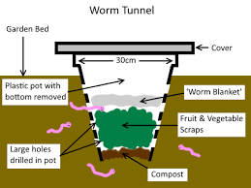

Slide 64
3.2Land filling technique
A landfill site (also known as a tip, dump, rubbish dump, garbage dump or dumping ground and historically as a midden) is a site for the disposal of waste materials by burial and is the oldest form of waste treatment (although the burial part is modern; historically, refuse was just left in piles or thrown into pits).

Slide 65
Factors affecting on site Selection of land filing
1)No Residential area should be located near the boundaries of landfill site.
2) The site should be provided all facilities such as drinking water, Electricity,
Roads for transportation.
3) It should be free from Seismic Zone.
4) Selection of landfill site should be based upon the examination of
environmental issues.
5) Land area and volume should be sufficient enough to provide landfill
capacity.
6) The landfill area having steep gradient (where stability of slope could be
problematic) should not be selected.
7) The water level in ground water table should be sufficient below the base
of any excavation to enable landfill development.
8) There should not be fault lines and significantly fractured geological
structure.
9) Landfill site should be away from airports

Slide 66
Land filling methods
➢ Area method
➢ Trench method
Ramp method
Valley method
1)Area method
➢ The Area Method is used when the terrain is unsuitable for the excavation of trenches in which to place the solid wastes. The filling operation usually is started by building an earthen bund against which wastes are placed in thin layers and compacted as the fill progresses until the thickness of the compacted waste s reaches a height of 2 to 3 m at the end of day’s operation a 150 mm to 300 mm layer of cover material is placed over the compacted fill. The cover material must be hauled in by truck or earth-moving equipment from adjacent land or from borrow-pit areas. A final layer of cover material is used when the fill reaches the
final design height

Slide 67
2) Trench method
Σ The trench method is suited to areas where an adequate depth of cover material is available at the site.
Σ Where the water table is well below the surface.
Σ To start the process, a portion of the trench is dug with a bulldozer and the dirt is stockpiled to form an embankment behind the first trench.
Σ Wastes are then placed in the trench, spread into thin layers and compacted.
Σ The operation continues until the desired height is reached.
Σ Cover material is obtained by excavating an adjacent trench or continuing the trench that is being filled.

Slide 68
3)Slope Method-
In hilly regions it is not possible to find flat ground for landfilling, in such situation waste is placed along the sides of existing hill slope. The wastes are spread on existing slope, compacted & covered. The cover materials usually come from just ahead of the working face.
4) Valley Method-
Σ At locations where natural or artificial depression exists, it is often possible to use them effectively for land filling operations.
Σ Canyons, ravines, fry borrow pits and quarries have all used for this purpose.
Σ The technique to place and compact solid waste in depression landfills vary with the geometry of the site, the characteristics of the cover material, the hydrology
and geology of the site, and the access to the site

Slide 69
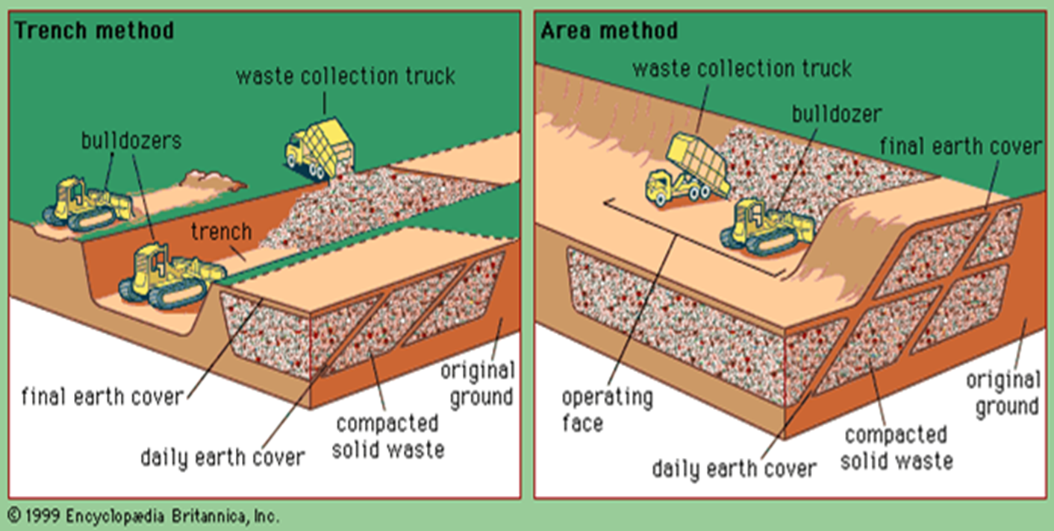

Slide 70
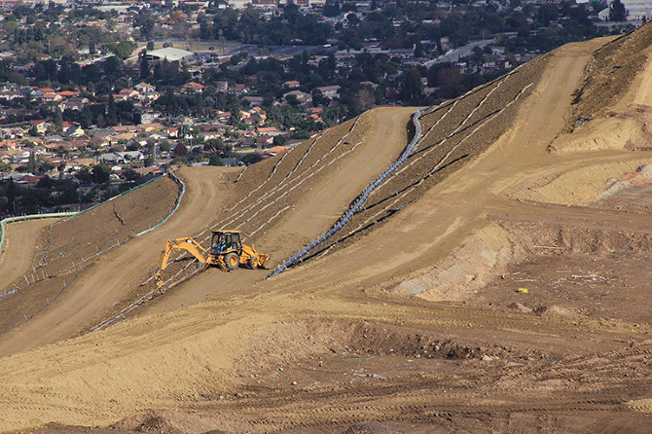

Slide 71
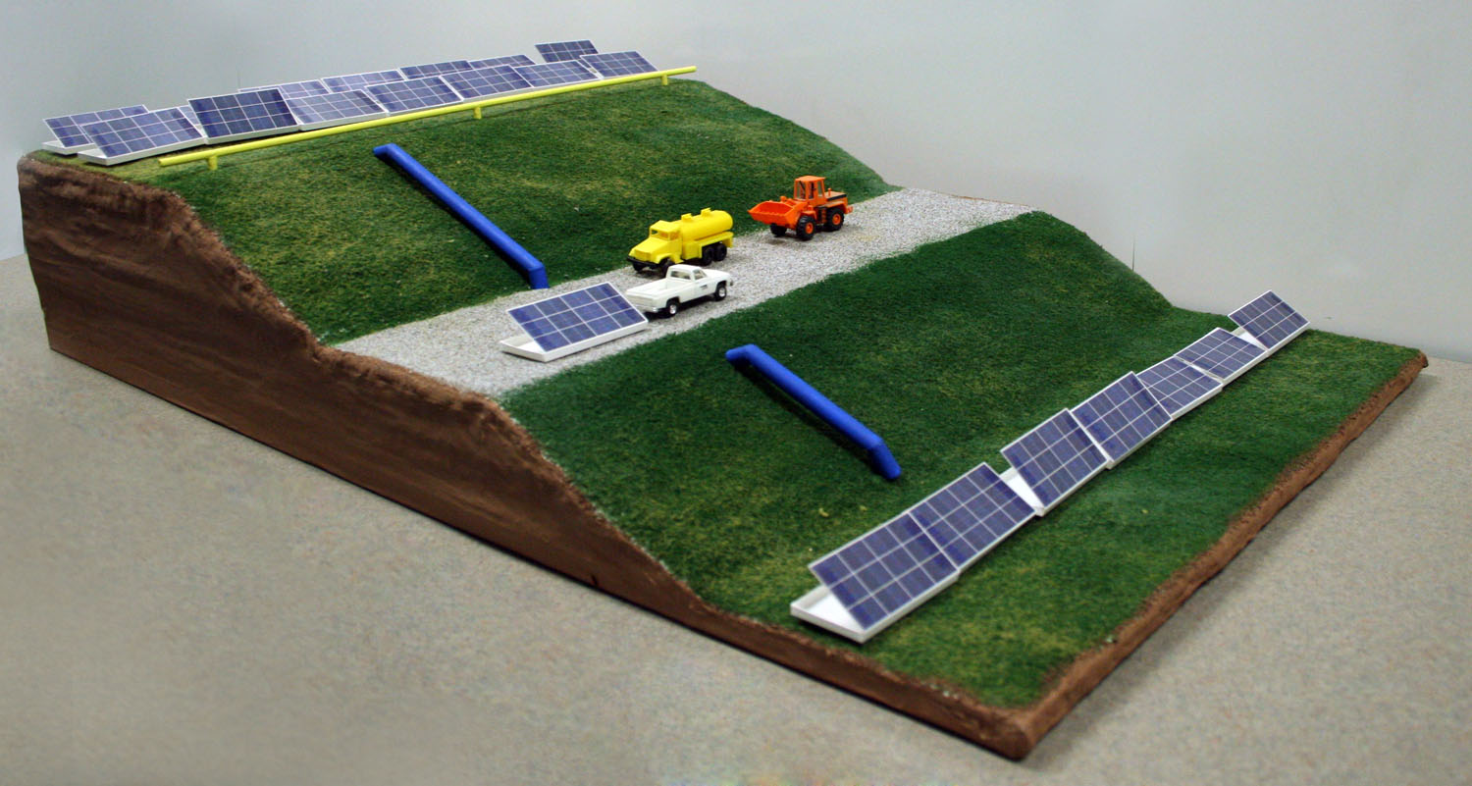

Slide 72
Leachate and its control
A leachate is any liquid that, in the course of time passing through matter, extracts soluble or suspended solids, or any other component of the material through which it has passed.
Leachate is the liquid that drains or ‘leaches’ from a landfill. It varies widely in composition regarding the age of the landfill and the type of waste that it contains. It usually contains both dissolved and suspended material.
Effect of leachate :--

Slide 73
Leachate Control methods :--
1) Single-Liner Systems
2) Composite-Liner Systems
3) Double-Liner Systems
1) Single-Liner Systems
➢ Single liners consist of a clay liner, a geosynthetic clay liner, or a geomembrane (specialized plastic sheeting)
➢ Single liners are sometimes used in landfills designed to hold construction and demolition debris.
➢ Construction and demolition debris results from building and demolition activities and includes concrete, asphalt, shingles, wood, bricks, and glass.
➢ These landfills are not constructed to contain paint, liquid tar, municipal garbage, or treated lumber; consequently, single-liner systems are usually adequate to protect the environment.
➢ It is cheaper to dispose of construction materials in landfill than in a municipal
solid waste landfill because Construction and demolition debris landfills use only a single liner and are therefore cheaper to build and maintain than other landfills.

Slide 74
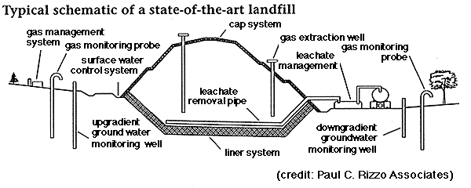

Slide 75
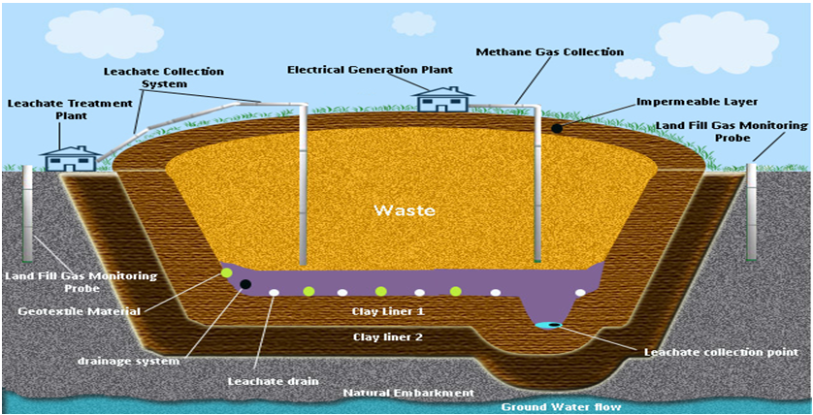

Slide 76
Composite-Liner Systems
➢ A composite liner consists of a geomembrane in combination with a clay liner.
➢ Composite-liner systems are more effective at limiting leachate migration into the subsoil than either a clay liner or a single geomembrane layer.
➢ Composite liners are required in municipal solid waste (MSW) landfills.
Municipal solid waste landfills contain waste collected from residential, commercial, and industrial sources.
These landfills may also accept C&DD debris, but not hazardous waste.
* The minimum requirement for MSW landfills is a composite liner. Frequently,l andfill designers and operators will install a double liner system in MSW landfills to provide additional monitoring capabilities for the environment and the community.

Slide 78
Double-Liner Systems
➢ A double liner consists of either two single liners, two composite liners, or a
single and a composite liner.
➢ The upper (primary) liner usually functions to collect the leachate, while the
lower (secondary) liner acts as a leak-detection system and backup to the primary
liner.
➢ Double-liner systems are used in some municipal solid waste landfills and in all
hazardous waste landfills.
➢ Hazardous waste landfills also referred to as secure landfills are constructed for
the disposal of wastes that once were ignitable, corrosive, reactive, toxic, or are
designated as hazardous.
➢ These wastes can have an adverse effect on human health and the environment, if
improperly managed.
➢ Hazardous wastes are produced by industrial, commercial, and agricultural
activities.
➢ Hazardous wastes must be disposed of in hazardous waste landfills. Hazardous
waste landfills must have a double liner system with a leachate collection system
above the primary composite liner and a leak detection system above the
secondary composite liner.

Slide 80
Advantages of Landfilling:
Σ Volume can increase with little addition of equipment.
Σ Filled land can be reused for other community purposes.
Σ Low cost and ease of application, no high-tech.
Σ Absorb massive amounts of solid wastes.
Σ Replanting the area with trees is possible.
Σ Access to methane.
v Disadvantages of Landfilling:
Σ Leakage of air pollutant gases: methane, carbon dioxide.
Σ Possibility of contamination of water sources by waste water resulting from landfill.
Σ Requires proper planning, design, and operation

Slide 81
Control measures of :--Leachate
➢ Leachate is carefully collected and shall be treated before its release on ground if possible.
➢ Prevention of migration of leachate from landfill sides and landfill base to the sub-soil by a suitable liner system should be provided.
➢ Used leachate treatment method like Natural system, Biological treatment physicochemical treatment.

Slide 82
3.3 Incineration of waste ……………….. 08
Definition :--
Incineration is a waste treatment process that involves the combustion of organic substances contained in waste materials. Incineration and other high-temperature waste treatment systems are described as "thermal treatment". Incineration of waste materials converts the waste into ash, flue gas, and heat. Incineration: It is controlled and complete combustion process, in which the
OR
waste material is burned in specially designed incinerators at a high temperature.
Advantage of incineration of e-waste is the reduction of waste volume and
utilization of the energy content of combustible materials. Disadvantages of
incineration are the emission to air of substances escaping flue gas cleaning and
the large amount of residue from gas cleaning and combustion.

Slide 83
The products of incineration process with their use.
1. After the incineration process the left out products can be used as aggregate for Preparation of low grade concrete or even sometimes it can also be used as Road metal.
2. The incineration ash is used for making bricks or block manufacturing.
3. Also the steam generated during incineration can be used for electricity generation by running the turbines.
4. The products of incineration can also be used as filler material.

Slide 84
Types of incinerators-
1)Mass burner Incinerator
2) RDF (Refuse-Derived fuel) based incinerator
3) Modular Incinerators
4) Fluidized bed incineration

Slide 85
i) Mass burner Incinerator:
Σ This incinerator consists of two or three incineration unit ranging from 50 to 1000 tons per day. These are design to incinerate the municipal solid waste as collected without prior processing. It is flexible and convenient
.
Σ It is continuously fed to a grate system the waste intake are usually includes tipping floor a pit, a crane and sometimes a conveyors. Truck dumps solid waste on floor or directly into a pit.
Σ When waste is dumped on floor bulldozer is used to push them into a pit or conveyor and then it is fed to grate system which moves waste through
combustion chamber

Slide 86
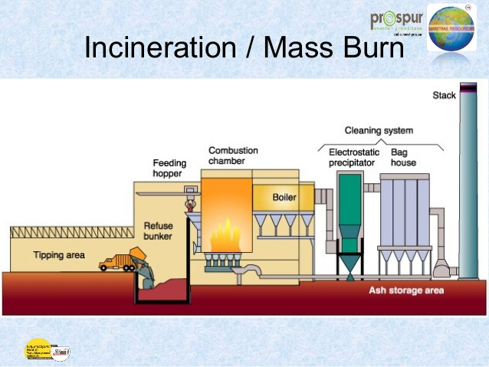

Slide 87
ii) RDF based incinerator:
Σ RDF is homogeneous system and better control on combustion and can recover more energy.
Σ Various components like metal, glass and non-combustible material can be removed to produce RDF.
Σ The combustible waste is shredded into uniform particle size, then pelletisation is done to get RDF pellets.
Σ In this system process solid waste refuse derived fuel is burnt.

Slide 88
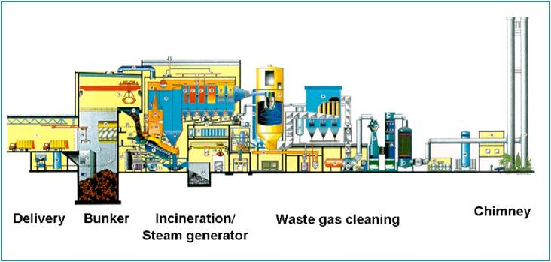

Slide 89
iii) Modular Incinerators:
Σ These are prefabricated units with relatively small capacities.
Σ The capacity range is in between 5 to 120 tones solid day.
Σ The capital cost per ton of capacity is lower than other MSW incineration option.
Σ Modular incinerator includes two combustion chambers, which ensures complete combustion. It has better control of pollution.

Slide 90
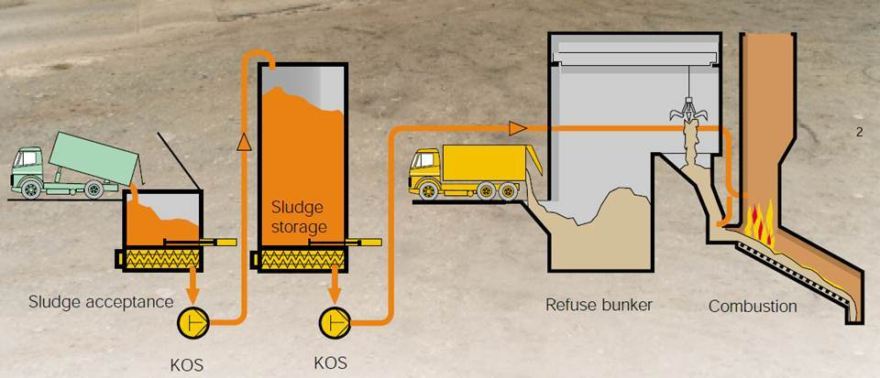

Slide 91
iv) Fluidized bed incineration:
Σ This type of combustion system includes steel vertical cylinder lined from inside with bricks and sand is placed as bed.
Σ Air nozzles are provided to inject air at high pressure.
Σ Solid fuel is injected into chamber along with natural gas or oil initially to
increase temperature of incinerator.
Σ This system is suitable for burning sewage sludge and other chemical waste.

Slide 92
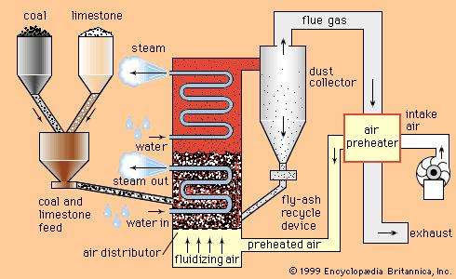

Slide 93
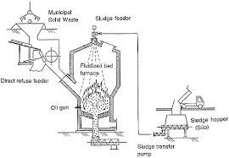
Working of a municipal incinerator.
Incineration is a waste treatment process that involves the combustion of solid waste at 1000°C.
➢ Waste materials are converted into ash, flue gas, and heat.
➢ The ash is mostly formed by the inorganic constituents of the waste and gases due to organic waste.
➢ The heat generated by incineration is used to generate electric power

Slide 94
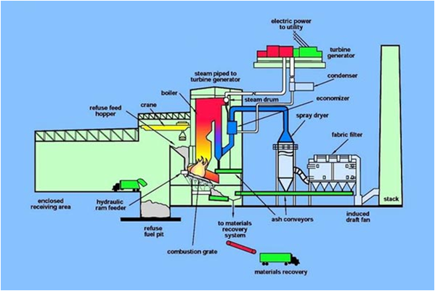

Slide 95
Advantages of Incineration:----
This is most hygienic method, since it ensures the complete destructions of pathogens.
ii) There is no odour trouble or dust nuisance.
The heat generated can be used for raising the
steam power.
iv) Clinkers produce can be used for the road purpose.

Slide 96
Disadvantages of Incineration:
i) Large initial expenditure.
ii) Improper operation results air pollution problems and incomplete reduction of waste materials.
iii) Disposal of remaining residue is required,
iv) High stacks are needed for the natural draft chimneys present safety problems.

Slide 97
Pyrolysis of waste :--
Pyrolysis can be defined as the thermal decomposition of organic material through the application of heat without the addition of extra air or oxygen.
*In this process thermal decomposition of organic matter at high temperature take place. Pyrolysis is an endothermic process which requires heat for an external source.
*In this method solid waste material is heated in specially designed chamber which is called as pyrolysis reactor.
*In pyrolysis reactor, heating is carried out in closed environment which is almost oxygen free at an average temperature above 650o c which may rise to 1000o c. The end products are Hydrogen, methane, carbon mono-oxide, tar or oil, char, inert material.

Slide 98
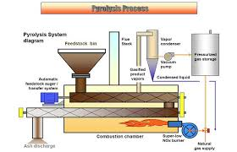

Slide 99
Methods of Pyrolysis:
1. Dry pyrolysis
Process of thermal decomposition without access of oxygen (O₂)
Products of dry pyrolysis are gas with high heat of combustion, liquid
and solid carbon residue.
Type of dry pyrolysis depend on the temperature of the process i.e.
Low Temperature Analysis ,Medium Temperature Analysis ,High
Temperature Analysis

Slide 100
2. Oxidizing pyrolysis :----
➢ It’s impossible to achieve a completely oxygen-free atmosphere.
➢ Thus, a small amount of oxidation occurs. If volatile or semi-volatile materials
are present in the waste, thermal desorption will also occur.
➢ Thermal decomposition of industrial waste by its partial burning or direct contact with end product of fuel combustion
This method is used for neutralization of most wastes including “inconvenient” ones for burning are present in the waste, thermal desorption will also occur.
➢ Thermal decomposition of industrial waste by its partial burning or direct contact with end product of fuel combustion
➢ This method is used for neutralization of most wastes including “inconvenient” ones for burning

Slide 102
Topic 4: Special Types of Solid wastes
1)List various types of special waste.
2)Describe method of collection and disposal of biomedical waste, E- waste and industrial waste.
.

Slide 103
Content:
4.1 Biomedical Waste ………………….. 06
Definition of Biomedical Waste
Sources and generation of Biomedical
Waste
Classification of Biomedical Waste
Management technologies.
4.2 E-waste ………………………………..06
Definition of E- waste
Varieties of E- waste
Dangers of E- waste
Disposal of E- waste
Recycling of E- waste
4.3 Industrial waste ……………………….06
Variety of industrial waste
Collection of disposal of industrial waste
Control measures of industrial waste.
Recycling of industrial waste.
4.4 Biomedical waste ……………………..06
Biomedical waste management & handling as per rule 1998.

Slide 104
Biomedical waste.
This is medical waste and includes all infectious waste, hazardous (including low-level radioactive wastes), and any other wastes that are generated from all types of health care institutions, including hospitals, clinics, doctor’s (including dental and veterinary) offices and medical laboratories.
Bio-medical waste means any solid and or liquid waste including its
container and any intermediate product, which is generated during the diagnosis, treatment of human beings or animals or in research and testing.

Slide 105
Sources and generation of bio-medical waste
1) Waste generated by hospitals.
2) Waste generated by nursing homes.
3) Waste generated by funeral homes.
4) Waste generated by clinics.
5) Waste generated by dentist clinic.
6) Waste generated by blood bank.
7 ) Waste generated by pathological laboratory.
8) Waste generated by pharmacies

Slide 106
Components of biomedical waste
Following are the components of biomedical waste:
1) Human anatomical waste (tissues, organ, body parts etc)
2) Animal waste ( as above, generated during research/ experimentation, from veterinary hospital etc)
3) Microbiological and biotechnological waste such as laboratory cultures, microorganisms, human and animal cell cultures, toxins etc.
4) Waste sharps, such as hypodermic needles, syringes, scalpels, broken glass etc.
5) Discarded medicines and cyto-toxic drugs.
6) Soiled waste such as dressing, bandages, plaster casts, material contaminated with blood etc.
7) Solid waste ( disposal items like tubes, catheters etc excluding sharps)
8) Liquid waste generated from any of the infected area.
9) Incineration ash
10) Chemical waste

Slide 107
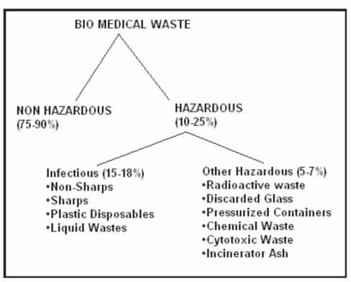
Classification of Biomedical Waste Management technologies.

Slide 108
Objectives of Biomedical waste management.
1) Define Medical Waste, Regulated Medical Waste and
Infectious Waste.
2) Discuss the Regulations Applicable to Medical Waste.
3) Discuss the Components of an Infectious Waste
Management Plan.
4) Outline an Exposure Control Plan.
5) Discuss Steps to take if exposed to Infectious Waste.
6) Discuss the Problem of Mercury.
7) Discuss Records to Maintain.
8) Recommend Inspection Items.
9) Discuss Use of Contractors.

Slide 109
Biomedical waste management and handling as per rule 1998
Rules for BMW:
1. Rules for duty of occupier.
2. Rules for treatment and disposal.
3. Rules for segregation, packaging, transportation and storage.
4. Rules for prescribed authority.
5. Rules for authorization.
6. Rules for advisory committee.
7. Rules for annual report.
8. Rules for maintenance of records.
9. Rules for accident reporting.
10. Rules for appeal.etc

Slide 110
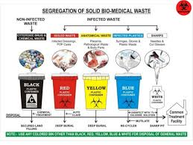

Slide 111
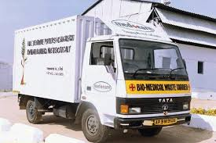

Slide 112


Slide 113
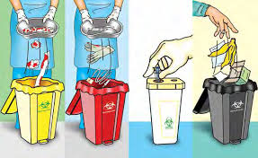
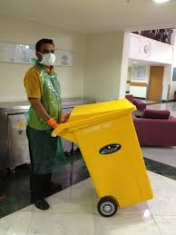

Slide 114
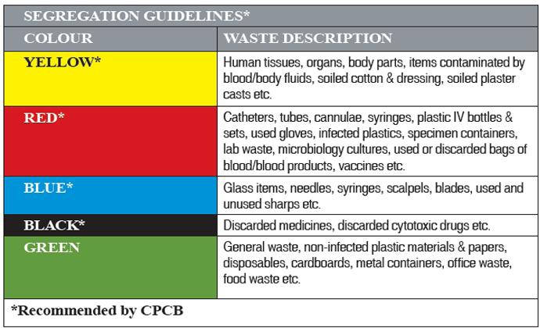
Color coding used for sorting of biomedical waste.

Slide 115
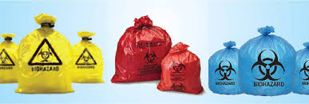

Slide 116
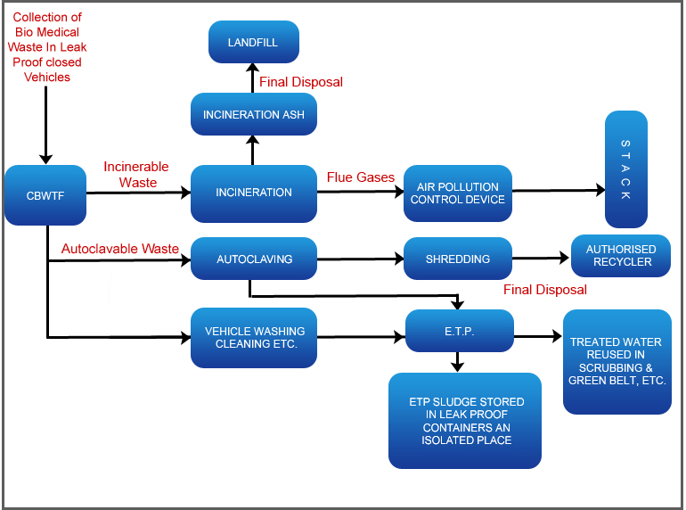

Slide 117
Provisions in the law for safe disposal of biomedical waste.
**Disposal of biomedical waste is now a legal requirement in India. The ministry of environment and forests notified the bio medical waste rules, 1998 in July1998. In accordance with these rules following provisions are made:
It is the duty of every occupier i.e. a person who has the control over the institution or its premises, to take all steps to ensure that waste generated is handled without any adverse effect to human health and environment.
2) The hospitals, nursing homes, clinics, dispensaries, pathological
laboratories etc. are therefore required to set in places the
biological waste treatment facilities.
3) Bio medical waste rules have six schedules as briefed in table.

Slide 118
Schedule | Contents
Schedule I | Classification of biological waste in various categories
ScheduleII | Color coding ant types of containers to be used for each category of biomedical waste
ScheduleIII | Proforma of the label to be used on container/bag
ScheduleIV | Proforma of label for transport of waste container/ bag
Schedule V | Standards for treatment and disposal of waste
Schedule VI | Deadline for creation of waste treatment facilities

Slide 119
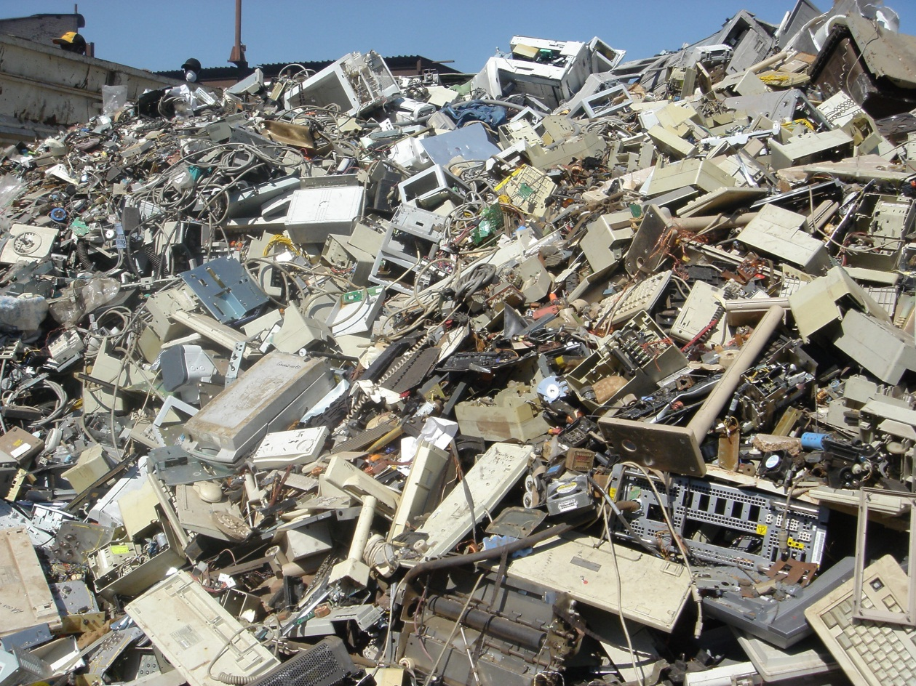
4.2 E-waste ………………………………..06
Definition of E- waste
Varieties of E- waste
Dangers of E- waste
Disposal of E- waste
Recycling of E- waste

Slide 120
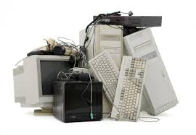
E-waste
E-waste is any refuse created by discarded electronic devices and
components as well as substances involved in their manufacture or use.
ii) Examples-: computers, office electronic equipment, entertainment
device electronics, mobile phones, television sets, and refrigerators.

Slide 121
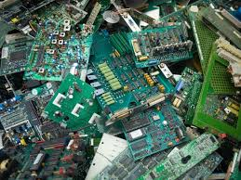
The various variety of E-waste.
1) Telecommunication Waste:
Mobile phones , Telephones
Telephone exchanges Wireless Equipment cables and related scrap
material , PC and TV
2) Electrical Waste:----
Switches , Relays , Connectors and related Scrap Material.
3) Electronic Waste:-----
Electronic –metal waste , Printed Circuit Boards , E –Equipment and Machinery
IC , Sockets Connectors.
4) Cable waste.
PVC ,Pre Insulated Copper and Aluminium waste

Slide 122
Dangerous constituents of E-waste
E-waste-connected health risks may result from direct contact with harmful materials such as lead, cadmium, chromium, brominated flame retardants or polychlorinatedbiphenyls (PCBs), from inhalation of toxic fumes, as well as from accumulation of chemicals in soil, water and food
Ill effects of hazardous substances that come out of E- Waste
1) Mercury causes chronic damage to the brain, memory loss, and muscle
weakness.
2) Sulphur causes liver damage, kidney damage, heart damage, and eye and throat
irritation.
3) Cadmium causes neutral damage, toxic irreversible effects on human health.
4) BFRs disrupt endocrine system function.
5) Lead damage to central and peripheral nervous systems, blood systems and
kidney damage.
6) Lead affects the brain development of children.
7) Cadmium also accumulates in kidney and liver, teratogenic.
8) The inhalation of cadmium can cause severe damage to the lungs and also
causes kidney damage.

Slide 123
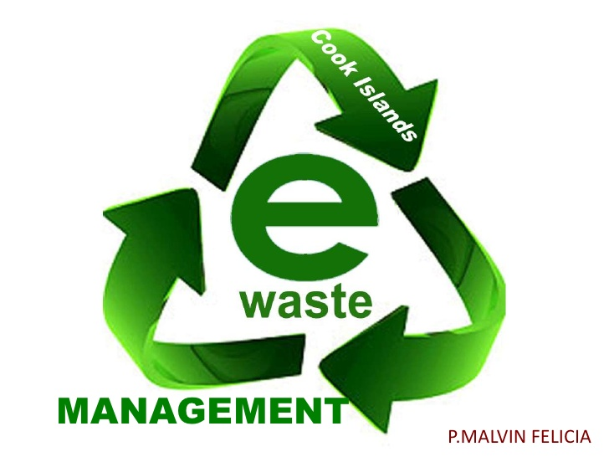

Slide 124
Methods of collection and disposal of E-Waste.
1) Land filling: In land filling, trenches are made on the flat surfaces. Soil is
excavated from the trenches and waste material is buried in it, which is covered
by thick layer of soil. Now a day’s secure land filling are provided with some
facilities like impervious liner made up of plastic or clay, leachate collection
basin that collect and transfer the leachate to wastewater treatment plant.
Environmental risk from land filling of e-waste cannot be neglected because the
condition of land filling site are different from a native soil, particularly
concerning the leaching behavior of metals.
2) Incineration: It is controlled and complete combustion process, in which the
waste material is burned in specially designed incinerators at a high
temperature. Advantage of incineration of e-waste are the reduction of waste
volume and utilization of the energy content of combustible materials.
Disadvantages of incineration are the emission to air of substances escaping
flue gas cleaning and the large amount of residue from gas cleaning and
combustion.

Slide 125
3) Recycling of e-waste: Monitors and CRT, keyboards, laptops, modems, telephone bards, hard drives, floppy drives, compact disk, mobiles, fax machines, printers, CPUs, memory chips, connecting wires and cables can be recycled. Recycling involves dismantling and recovery of valuable materials. Recycling is the best possible option for the management of e- waste because the existing dumping grounds in India are full and overflowing beyond capacity and it is difficult to get new dumping sites due to Scarcity of land.
4) Re-use: It is commonly used for electronic equipment's like computers, cell phones etc. It constitutes direct second hand use or use after slight modification to the original functioning equipment. This method also reduces the volume of e-waste generation

Slide 126
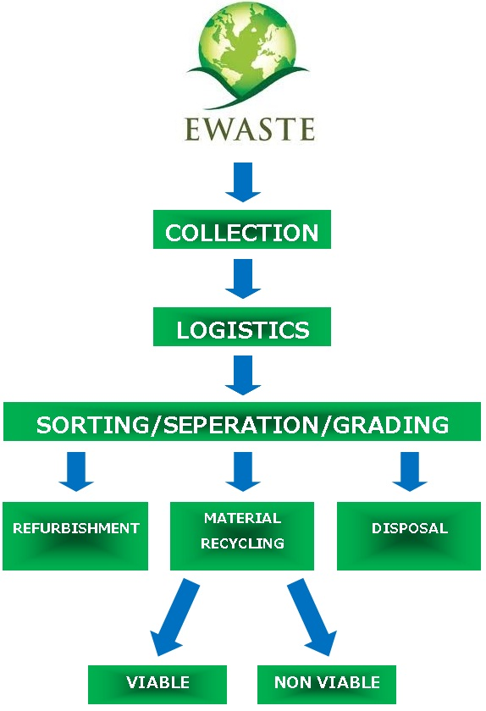

Slide 128


Slide 129
Ill effects of hazardous substances that come out of E- Waste
Following are ill effect of hazardous substances that come out of E-waste:
1) Mercury causes chronic damage to the brain, memory loss, and muscle
weakness.
2) Sulphur causes liver damage, kidney damage, heart damage, and eye and throat
irritation.
3) Cadmium causes neutral damage, toxic irreversible effects on human health.
4) BFRs disrupt endocrine system function.
5) Lead damage to central and peripheral nervous systems, blood systems and
kidney damage.
6) Lead affects the brain development of children.
7) Cadmium also accumulates in kidney and liver, teratogenic.
8) The inhalation of cadmium can cause severe damage to the lungs and also
causes kidney damage

Slide 130
Disposal of E-waste is done by following four method:--
1) Land filling: In land filling, trenches are made on the flat surfaces. Soil is
excavated from the trenches and waste material is buried in it, which is covered
by thick layer of soil. Now a day’s secure land filling are provided with some
facilities like impervious liner made up of plastic or clay, leachate collection
basin that collect and transfer the leachate t wastewater treatment plant.
Environmental risk from land filling of e-waste cannot be neglected because the condition of land filling site are different from a native soil, particularly
concerning the leaching behavior of metals.
2) Incineration: It is controlled and complete combustion process, in which the waste material is burned in specially designed incinerators at a hightemperature. Advantage of incineration of e-waste are the reduction of wastevolume and utilization of the energy content of combustible materials.
Disadvantages of incineration are the emission to air of substances escaping flue gas cleaning and the large amount of residue from gas cleaning and
combustion

Slide 131

3)Recycling of e-waste: Monitors and CRT, keyboards, laptops, modems,
telephone bards, hard drives, floppy drives, compact disk, mobiles, fax
machines, printers, CPUs, memory chips, connecting wires and cables can be recycled. Recycling involves dismantling and recovery of valuable materials. Recycling is the best possible option for the management of e- waste because the existing dumping grounds in India are full and overflowing beyond capacity and it is difficult to get new dumping sites due to Scarcity of land.

Slide 132
4) Re-use: It is commonly used for electronic equipment's like computers, cell phones etc. It constitutes direct second hand use or use after slight modification to the original functioning equipment. This method also reduces the volume of e-waste generation.

Slide 133


Slide 134
4.3 Industrial waste …………….06
Variety of industrial waste
Collection of disposal of industrial waste
Control measures of industrial waste.
Recycling of industrial waste.

Slide 135

Industrial waste :---
Industrial waste is the waste produced by industrial activity which includes any material that is rendered useless during a manufacturing process such as that of factories, mills, and mining operations. It has existed since the start of the Industrial Revolution

Slide 136
Variety of industrial waste
1) Chemical solvents,
2) Paints
3) Sandpaper
4) Paper products
5) Industrial by-products
6) Metals
7) Radioactive wastes

Slide 137
Collection and disposal of Industrial waste
Sr No. | Industry | Disposal Method
01 | Thermal Power Station Industry | Fly ash waste can be recycled for 1)Cement 2) Raw material in ordinary Portland cement 3) Cellular concrete bricks and blocks lime and cement fly ash concrete. 4) Precast fly ash concrete building units. 5) As a plasticizers
02 | Sugar Industry | Converting waste into manure by composting treatment. And the bagasse is used as fuel for boiler.
03 | Blast Furnace Slags from Metal Industry | 1) As a aggregate in concrete 2) Non- Portland cement 3) Manufacture of slag cement, super sulphated cement, metallurgical cement 4) As a structural fill ( air- cooled slag)

Slide 138
04 | Paper and Pulp Industry . | Paper cutting Waste is recycled for either same industry or it is send to cardboard industry as raw material
05 | Food Industry | Waste is treated either by Vermi-composting (For small quantity) and Bio-methenation process (For large quantity)

Slide 139
Control measures of industrial waste.
Treatment before disposal of waste materials.
1) Using alternative source such as petrol.
2) Awareness and educational program.
3) Managing and treating industrial waste by using modern technology such as electrostatic convertor.
4) Control use of pesticides and fertilizers.
5) Law, regulation and enforcement.
6) Manufacturing and use of ozone depleting chemicals should be stopped.
7) Toxic gases should be treated before they released into the air.

Slide 140
Recycling of industrial waste.
1) Reduces the amount of waste sent to landfills and incinerators.
2) Conserves natural resources such as timber, water and minerals.
3) Saves energy.
4) Prevents pollution by reducing the need to collect new raw materials.
5) Helps sustain the environment for future generations.
6) Reduce greenhouse gas emissions that contribute to global climate
change.

Slide 141
Recycling of industrial waste.
1) Reduces the amount of waste sent to landfills and incinerators.
2) Conserves natural resources such as timber, water and minerals.
3) Saves energy.
4) Prevents pollution by reducing the need to collect new raw materials.
5) Helps sustain the environment for future generations.
6) Reduce greenhouse gas emissions that contribute to global climate
change.

Slide 142
Waste minimization approach measures of industrial waste.
1) Optimization of resources: waste reduction at individual and institutional level goes side by side with the utilization of raw materials.
2) Using again the Scrap Material: this is the process in which individual and Industry reuses the waste material as soon as it is produced. This keeps it frombecoming a waste material.
3) Quality control improvement and process monitoring: this technique is to ensure that products produced are kept from rejection and this is increased by the inspection of frequency and monitoring point’s inspection.
4) Exchanging Waste: this is the technique in which the waste product, which comes out of a process, becomes a raw material for another process. This is another way for reducing waste.
5) Point of use from ship: to maintain and making deliveries for the raw materials to be used with the manufacturing process, at the point of assembly with fewer packages and wrappings can save from the waste production.
6) Zero waste: this is a whole systems approach that aims to eliminate waste at
the source and at all points down the supply chain, with the intention of
producing no waste. It is a design philosophy which emphasizes waste
prevention as opposed to end of pipe waste management.

Slide 143
Topic 5: Health aspect and public Involvement in solid waste management
Specific Objectives:
Know health aspect during handling and processing.
State stages for public involvement
Content :
Health aspect during handling and processing
Health problem during time of segregation, reuse, recovery,
recycling of solid waste.
Public Involvement and participation in Solid waste management.

Slide 144
Health aspect during handling and processing
There is potential risk to environment and health from improper handling of solid wastes. Direct health risks concern mainly the workers in this field, who need to be protected, as far as possible, from contact with waste.
1) Traffic accidents can result from toxic spilled wastes.
2) Air pollution can be caused from the inefficient burning of wastes, either in open air, or in plants that lack effective treatment facilities from the gaseous effluents.
3) Uncontrolled hazardous wastes from industries mixing up with municipal wastes create potential risk to human health.
4) The most obvious environmental damage caused by municipal solid wastes is aesthetic, the ugliness of street litter and degradation of urban environment and beauty of city.
5) There is specific danger of concentration of heavy metals in the food chain, a problem that illustrates the relationship between municipal solid wastes and liquid industrial effluents containing heavy metals discharged to a drainage/ sewerage system and/ or open dumping sites of municipal solid wastes and the wastes discharged thereby maintains a vicious cycle.

Slide 145
Health problem during time of segregation, reuse, recovery, recycling of solid waste.
Health problem during the time of segregation
1. Workers and rag pickers can be infected during picking of biodegradable and Non biodegradable waste.
2. If biodegradable and non biodegradables or wet and dry wastes are not put separately, it can creates bad odour.
3. Possible health hazard include raised level of infant mortality, non communicable disease such as hand/leg injury by sharp edge material, respirational infections, eye infection,.
4. Comunicable diseases such as Diarrhoea & dysentery(due to flies), skin disease etc.

Slide 146
Health problem during reuse
1. Health risk can be arises from transportation and handling of organic waste, processing application of organics from mixed municipal waste to soil, cultivation on old dumps and feeding of animal with waste and hence many factor are involved over the risk of human –animal disease links.

Slide 147
Health problem during recovery recycling
1. During the recovery and recycling process of the solid waste, it creates the various health problems because in production of electricity, there is the generation of gas evolved in the environment in which some toxic gases are present, which affects on the respiration system of the surrounding peoples and working people there on.
2. Recovery and recycling process creates bad odour, particulate matter emissions that lead to air pollution and also creates metal illness to the humans

Slide 148
Public Involvement and participation in Solid waste management.
1) To increase the awareness of solid waste management among the
people.
2. To increase the efficiency and effectiveness of planning process and
Implementation of solid waste management.
3. To understand the planning importance and significance.
4. To play an important role in the permitting process in case of
hazardous waste as well as municipal waste facilities.
5. To improve the waste management strategies, negotiations with
municipal authorities for better involvement in decision making.
6. To achieve the 3R principles.
7. To reduce littering of waste on streets and into drains, open spaces,
etc.
8. To encourage and assists the local composting and recycling
initiatives.

Slide 149
Municipal Solid Wastes Management Systems involves various activities like
storage, collection, transportation, disposal etc. These activities even if properly
controlled and with proper precautionary measures adopted, may have adverse
impact on land, water and air environment, human and environmental health
aesthetics and quality of life.
➢ The main risk to health is indirect and arises from the breeding of disease
vectors, primarily files and rats.

