Slide 1
Rail fixtures & fastening
All the fitting which is used for linking of rail end to end & also for fixing rails to the sleeper in track are known as fixture & fastening

Slide 2
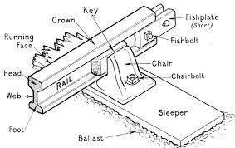
Rail fixtures & fastening

Slide 3
Types of fixtures & fastening
Fish plate
Bearing plate
Chairs
Spikes
Bolts
Keys & cotters
Anchors & anticreepers

Slide 4
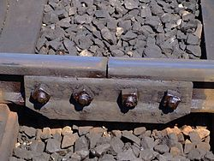
Fish plate
Used to maintain the continuity of rail in a track
Made of mild steel 20mm thick 456cm long provided with 4no. Of 32mm dia. Hole at 114mm c/c

Slide 5
Function of fish plate
To maintain continuity of rail in track
To allow expansion & contraction of rail due to temp.
To maintain correct alignment at each rail joint

Slide 6
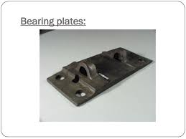
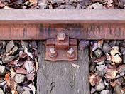
Bearing plate
The placed between flat footed rails & wooden sleeper
Type
Flat bearing plates
Canted bearing plate

Slide 7
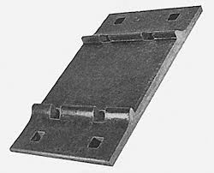
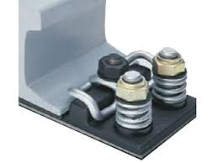
Flat bearing plates
Canted bearing plate

Slide 8
Function of bearing plate
To prevent sinking of rail in wooden sleeper
To distribute the load uniformly
To enable the spike to be held tight
To prevent shifting of rail
To eliminate adding of wooden sleeper
To maintain gauge when bearing plate are used
To achieve economy

Slide 9
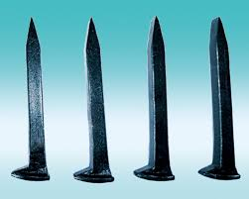
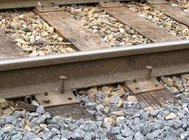
Spike
It is require to fix the rail, bearing plates or chairs to woooden sleeper

Slide 10
Requirement of good spike
They should be strong enough to hold the rail, bearing plate and chair in proper position
They should be easy in fixing and removing
They should not come out due to vibrations
They should be cheap

Slide 11
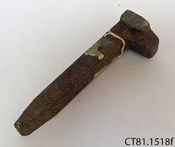
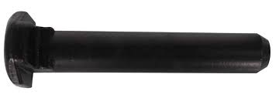
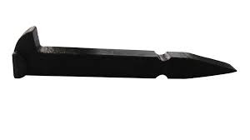
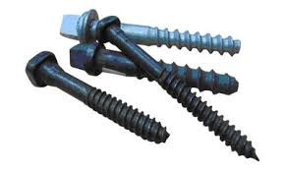
types
Round spike
Dog spike
Screw spike
Round spike
Standard spike
Standard spike
Screw spike

Slide 12
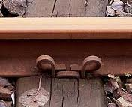
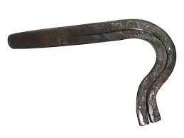
Elastic spike

Slide 13
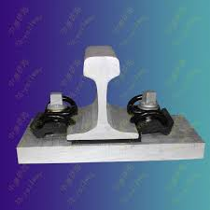
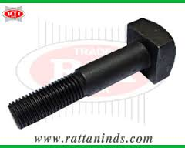
Bolt
To connect various joint in track

Slide 14
Function
To connect fish plate to rail
To connect chair or bearing plate to timber sleeper
To connect sleeper to bridge girdeer

Slide 15
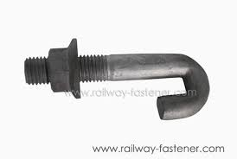
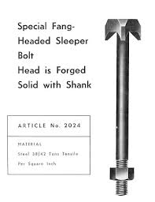
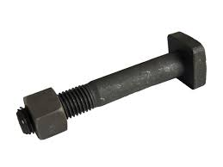
Types
Fang bolt
Hook bolt
FISH BOLT

Slide 16
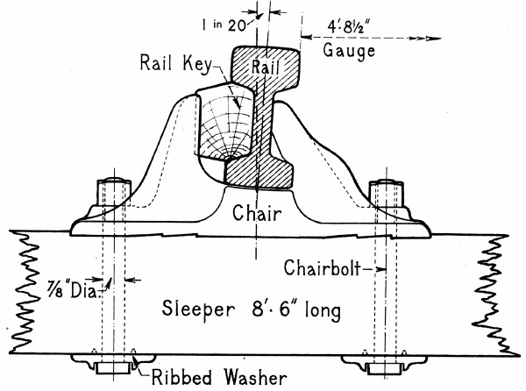
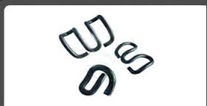
keys
It is require to keep the rail in proper position

Slide 17
Type
Timber keys
Metal key
Stewart key
Spring coiled key
Morgan key

Slide 18
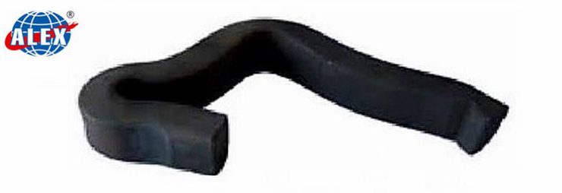
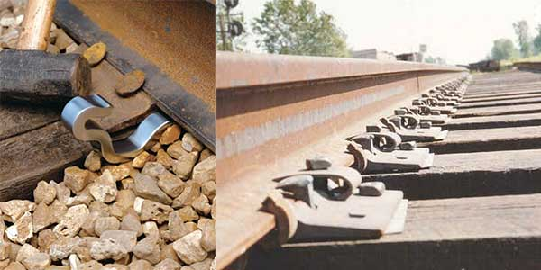
Anchor or Anti creeper
It is used to prevent the creep in rail
They are available in different shape
The no of anti creeper depend upon amount of creep occurring in the track

