Slide 1
FLOOR SPACE INDEX
By
Mrs. A.A. AVASTHI
Visit for more Learning Resources

Slide 2
Table of Contents
  Background
  Computation of FSI
  Incentive FSI
  Versatile tool
  Constraints
  Conclusions
  Green Initiatives

Slide 3
Background

Slide 4
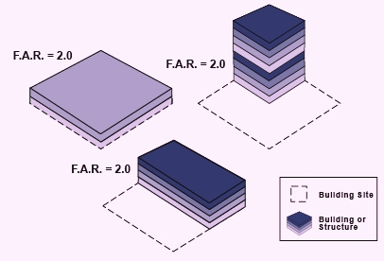
The meaning- Concept- Origin – FAR
FSI => Floor Space Index
FAR => Floor Area Ratio’ (term particularly followed in North Indian States)
Definition:
Floor area ratio is the ratio of a building's total built up area on all floors to the area of plot upon which it is built.
plot
Gr. coverage
FSI : 1

Slide 5
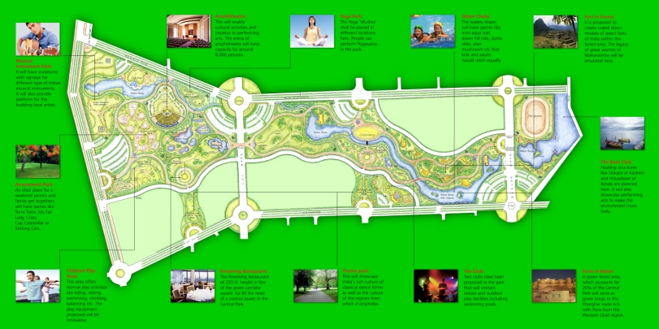
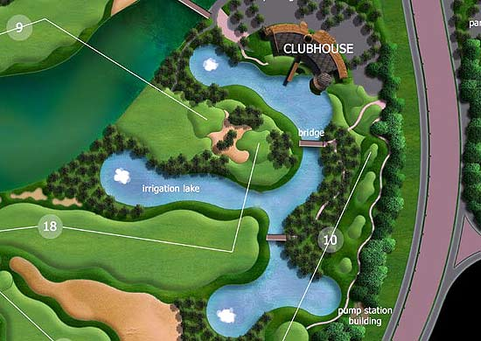
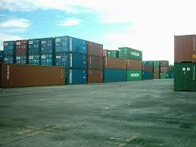
FSI is of little concern
Land extensive uses - Golf Course
Paramilitary forces campuses
Educational campuses
Holiday resorts
Container Yards
Warehouses
Manufacturing plants/Industries
Freight stations
Outdoor Studios
Theme parks
Due to handling of heavy goods, availability of large open spaces
is required.

Slide 6
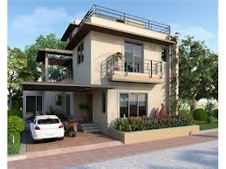
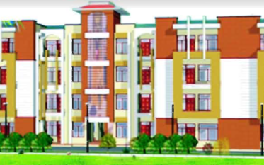
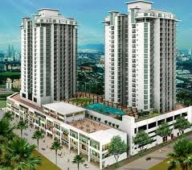
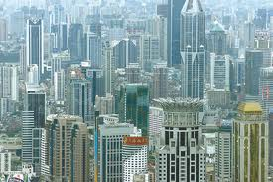
Built form
The built form can be developed in either of the following density patterns
1. Low rise low density
2. Low rise high density
3. High rise low density
4. High rise High Density

Slide 7
  Computation of FSI

Slide 8
Features covered in computation of FSI
Without paying premium FSI exemptions granted for the following:
(upto certain limits)
I. Building features
(Basement or cellars, Balcony, Flower bed, Cup boards of limited size, Stilts used for parking where there are no side walls on three or more sides, Architectural features)
II. Amenities
(Parks, Swimming pools, Society Office, Fitness centre, Club House)
III. Utilities
(Roads, Electrical, Gas Supply, Water, Sewage, Communication, Parking, Staircase, Watchman’s booth, lifts, fire lifts, fire staircase)
Excess area is counted in FSI.

Slide 9
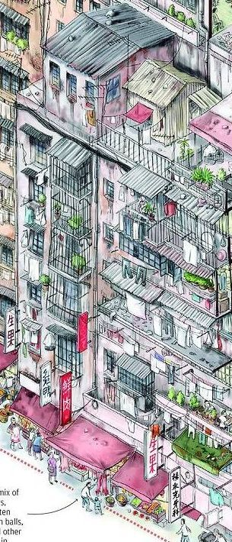
Typical violations:
Covering balconies, terraces, flower beds.
Cupboards made part of habitable room
Privatizing common passages etc.
Basement area misused. Parking area used for office and other services

Slide 10
Fungible FSI (MCGM SRA)
Compensatory floor space index
- Interplay of/Mutually interchangeable building features.
Upto 35% (0.35) FSI for Balcony, staircase, Terrace, Cupboards, Flower beds are availed as fungible FSI in case of residential use on payment of premium to the authority.
20% fungible FSI can be availed for commercial and industrial development
Fungible FSI is usable as regular FSI
Manipulations and violation in provision and use of free of FSI components avoided due to concept of Fungible FSI
Fungible FSI' would pave way for better transparency in the sector and would also reduce corruption.

Slide 11
FSI prescriptions
R ……………1.0
R+C…………1.0 (for plots of area below 1000 sqm.), 1.5 (for plots of area above 1000 sqm.)
C ……………1.5 (starred category residential hotels in any zones other than RPZ)
SF……………1.0
Industrial…….0.5 -1.0
Assembly……1.0 (0.1- 0.15 for assembly in RPZ, 0.05 for cremetoria /burial grounds)
Other uses in RPZ…….(0.1 to 0.15)
Airport & allied activities…..max. permissible FSI 1.0
FSI for Gaothans
Village settlements …….0.75

Slide 12
Granting additional FSI on premium payment
i. IT Parks, Religious buildings, Biotechnological Industrial Units
(100% additional FSI may be permitted) (50% of religious)
ii. Residential use to Residential + Commercial
(plot size >1000sq.m.) leased earlier with lower FSI in zones other than predominantly Commercial Zone and provided further GDCR including parking are fulfilled. (50%)
iii. Star category Residential Hotels
100% in zone other than RPZ
iv. Change of Land use Commercial to R+C or vice-a-versa
(min. Plot area 1000sq.m., deriving access from 15m or more wide road-
FSI remains 1.5 in both the cases)
v. Medical, Educational, Government buildings – 100%

Slide 13
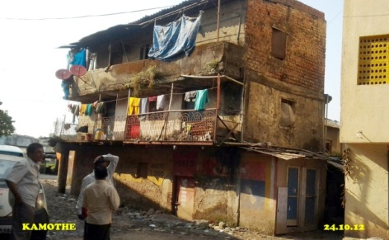
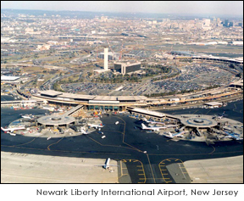
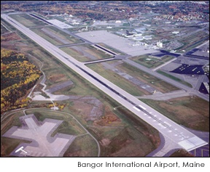
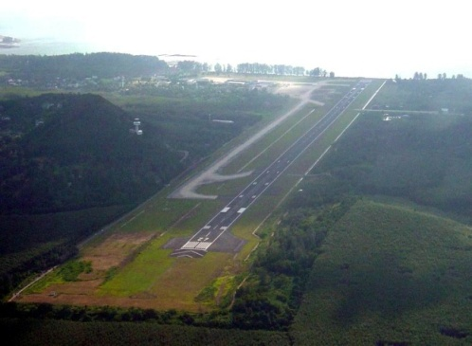
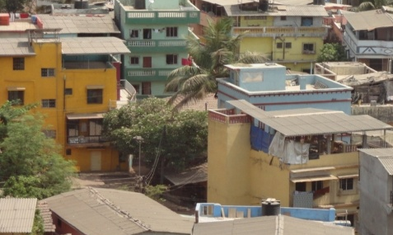
Relaxation in marginal open spaces for FSI consumption
        For smaller plots
          Hardship cases- FSI cannot be fully consumed due to odd/ narrow plot shape and size
        Airport influence areas
          Height restriction as per the obstacle limitation map for area around airport, hence FSI cannot be fully consumed.(low rise, high density)

Slide 14
  Incentive FSI

Slide 15
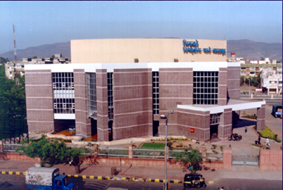
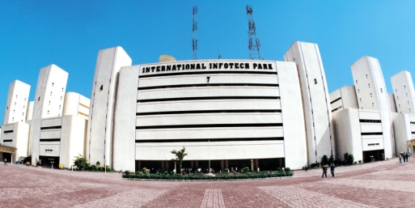
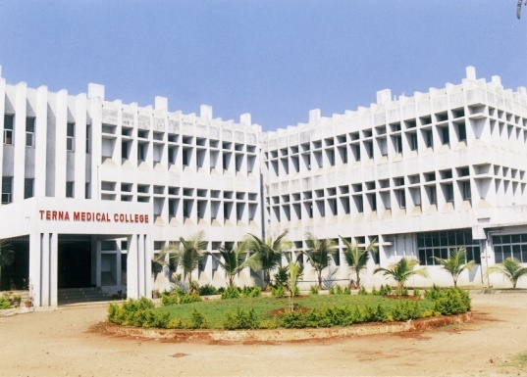
Inducement / Incentive with a purpose
Compensation towards land acquisition
Road widening
Scenic Easements
Promoting Growth Centre activities like IT parks, business parks, facilities like health, education, hotels, religious, commercial etc.
Land Pooling – Eligibility on gross plot area but incentive on net plot area
Heritage conservation

Slide 16
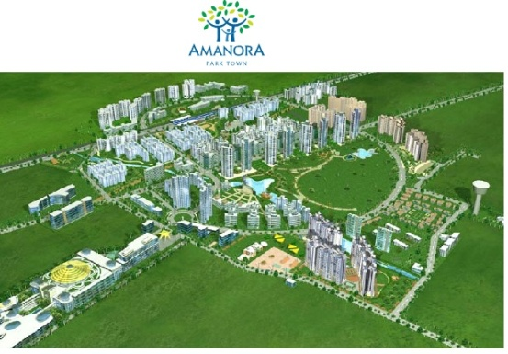
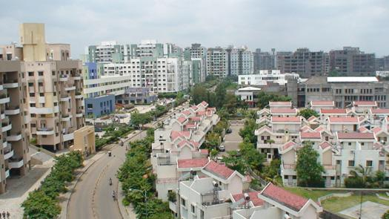
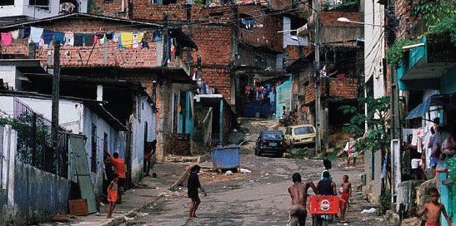
Inducement / Incentive with a purpose
Urban Redevelopment / Renewal / Slum Redevelopment
Cluster Development for intensification, (organised development with facilities)
Promoting / subsidising affordable housing
Special Townships
Rental Housing
In lieu of sharing social / physical infrastructure providing responsibility

Slide 17
  Versatile tool

Slide 18
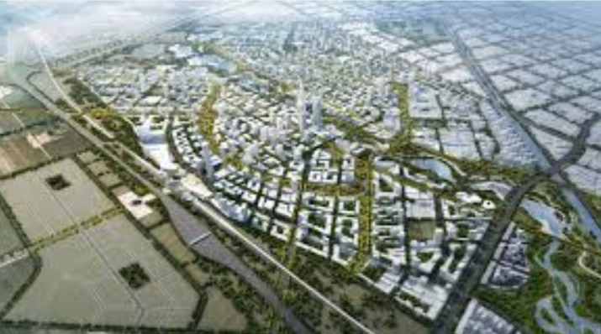
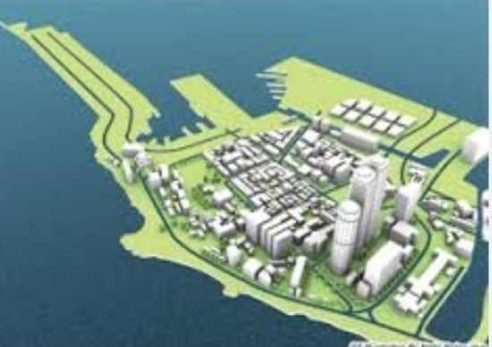
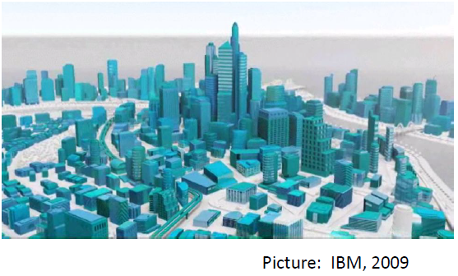
Tapering FSI towards periphery
Suitable for metropolitan areas
Concept is to have variable FSI.
Higher FSI in the city centre and progressive reduction / tapering for area away from it.
It means-
Higher densities in Central Business District and Residential area adjacent to it and tapering of densities as we move towards suburbs.
Taller buildings near commercial area/transit places (TOD) and gradual tapering towards residential areas

Slide 19
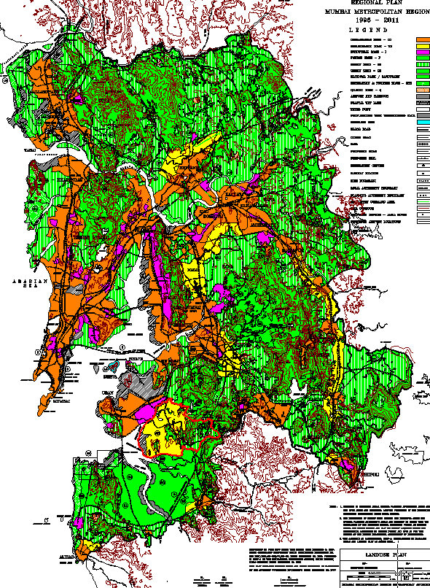
Variable FSI across the city pockets
Based on City vision, assignment of specific land uses/promoting/ restricting certain activities.

Slide 20
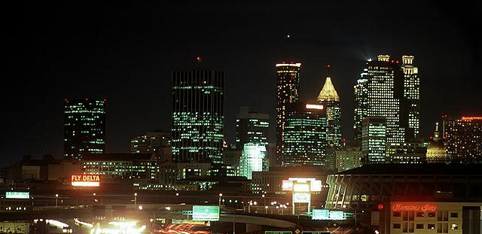
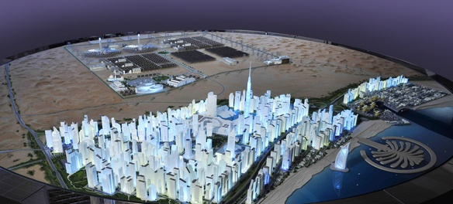

Global FSI
FSI reckoned on large land holding with variations across sub sets (Special Townships)
High FSI zones
Certain areas are earmarked with high FSI …..3 to 5
Leads to intensification of land utilization for precious and scarce urban land.
Prescribed at vantage locations.

Slide 21
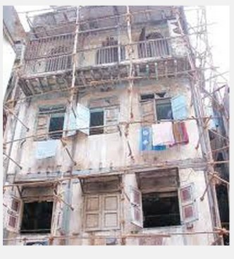
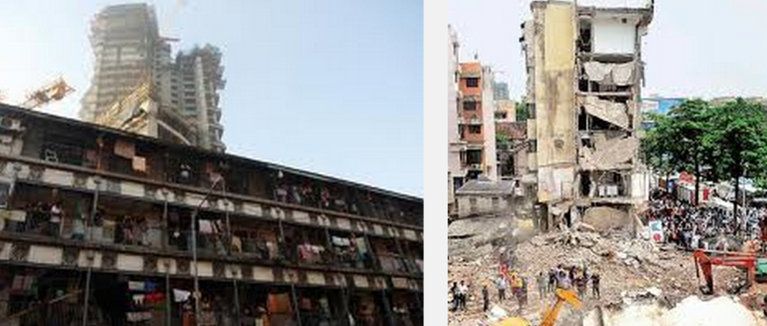
FSI for dilapidated/unsafe buildings
  Residents in smaller tenements apparently unable to afford repair, leading to dilapidation.
  Faced natural calamity, fire hazard.
MCGM provision
For the Redevelopment or Reconstruction of Old Cessed Buildings, the Government of Maharashtra has already approved a Floor Space Index (FSI) of 3
MHADA provision:
The generated BUA with FSI 3 is shared by three interests, namely the existing tenement holders, MHADA and the CHS/developer
CIDCO is contemplating 3 FSI for redevelopment of CIDCO constructed dilapidated buildings in Navi Mumbai through private participation.

Slide 22
Urban Renewal / Redevelopment.
Land use lost relevance with time
Run down condition
Declining manufacturing activity.

Slide 23
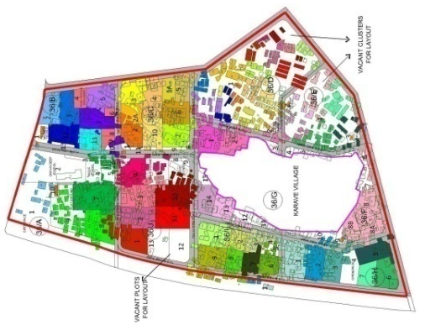
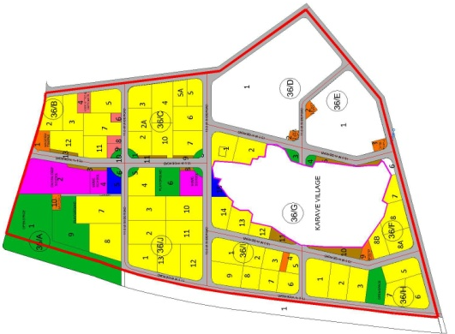
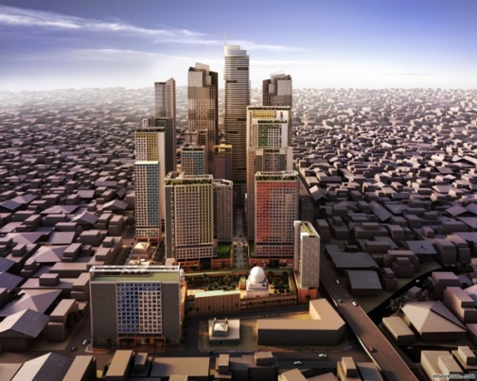
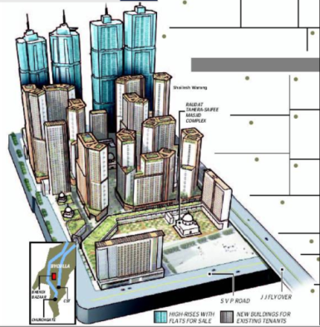
FSI for cluster development to regularize unauthorized constructions
To cope up with urban sprawl.
Cluster carved out of Neighborhoods.
Comprehensive and integrated development to be proposed with FSI 2.5 for organised development.

Slide 24
FSI for rental housing (MMR)
Based on the Maharashtra State Housing Policy of 2007, Government of Maharashtra (GoM) initiated the Rental Housing Scheme (RHS) with the participation of private sector.
Act as a Slum prevention measure.
Make affordable housing stock available to Economically weaker section and Lower income group
3 to 4 FSI
Targeted at new migrants

Slide 25
DR /TDR FSI (MCGM)
Development rights –
Potential to be used on remaining plot on surrender of public purpose reservation land.
Transfer of Development Rights (TDR) –
Transfer of Development Rights from one plot to another.
Development rights certificate (DRC)-
TDR in terms of FSI is issued in form of DRC which is transferable to any other person on payment
Generation zone and Utilization zone -
Defined for utilization of FSI by TDR

Slide 26
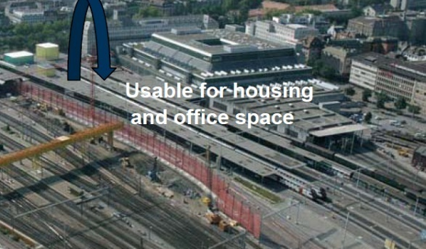
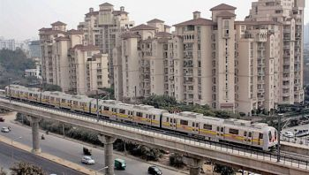
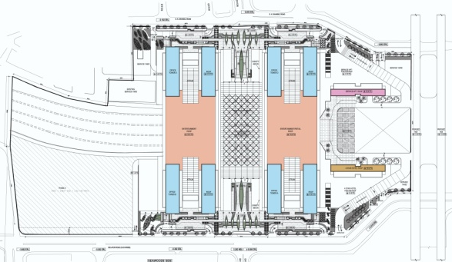
High FSI impact zones and collection of premium due to transit oriented development (TOD)
Transit-oriented development (TOD) – intense, comprehensive
development around transit stations
Value of land in vicinity of the transit projects captured by development agencies to finance the infrastructure projects
In vicinity of metro rail projects /MRTS /railway stations
Impact fee
Examples:
BRTS in Ahmadabad , Surat
Metro Delhi
Seawoods stn commercial complex
JLL has undertaken study for metro corridor in Navi Mumbai.

Slide 27
  Constraints

Slide 28
Marginal open spaces around the building for High Rise Buildings
Sr. no. | Building height | Open space around buildings
a. | Upto 10m | Minimum 3.0m
b. | 10 to 25m | Increase @1m per every 3m increase in height
c. | 25 to 30m | min. 10m
d. | 30m | @1m per 5m increase, max upto 16m

Slide 29
Fire fighting provisions to be incorporated in a high rise building (more than 24 M height)
Max. travel distance from farthest exit on floor to the staircase/Lift 22.5m
(30m in case of commercial buildings).
- Provision of fire lift mandatory for buildings with height more than 24m.
Fire equipments as per IS Code
Max. height permissible in Navi Mumbai 90m.
Lift compulsory for >15 m. height.
2nd lift for height > 24 m.
2nd staircase must for height > 22 m.
(In Mumbai for height > 70 m.)

Slide 30
No limit to FSI
It is dependent on certain constraints such as
  Fire Fighting preparedness
  Construction Technology
  Soil Bearing Capacity
  Earthquake-proneness
  Airport, Metrological department restrictions (e.g. Doppler radars)

Slide 31
Considerations
- Loss of Privacy, Light/ ventilation,
- Doubly loaded corridor (public housing)
- Lack of parking, Open spaces
- Requires advance Firefighting equipments (Sky lifts, Snorkel lifts etc.)
- Strain on social and physical infrastructure
- Built form dictated by parking needs

Slide 32
FSI not the panacea for all urbanization ills.

Slide 33
Optimal FSI
0.375 for low intensity users
0.75 for public assembly buildings
1.0 for residential on smaller plots- less than 500 sq.m.
1.5 for residential + commercial use
2.5 for redevelopment cases
3.5 for business parks, growth centres, commercial hubs, etc.
5.0 for hotels.

Slide 34
Thank You!
For more detail contact us

