Slide 1
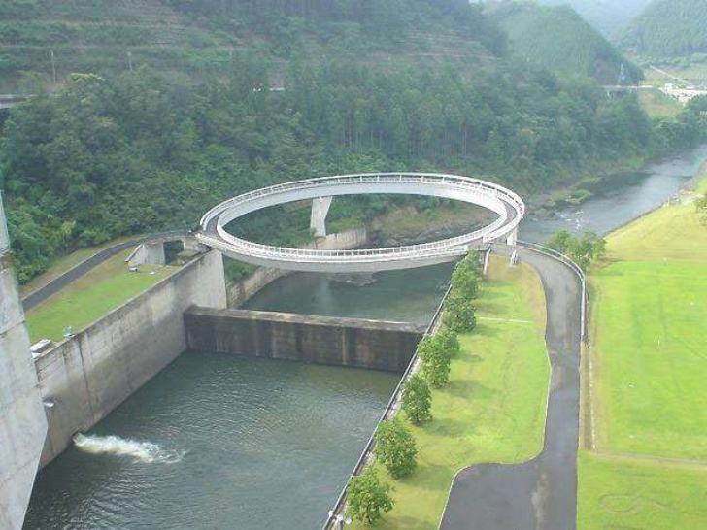
Bridge engineering

Slide 2
Factor affecting selection of site of a bridge
Sub soil condition of the bed of the river
Nature of the river
Grades & alignment
Approaches
Banks of stream
Scouring & silting
Obstruction to waterway
River training work
Construction work inside water
Availability of free board
Workers & construction materials

Slide 3
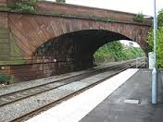
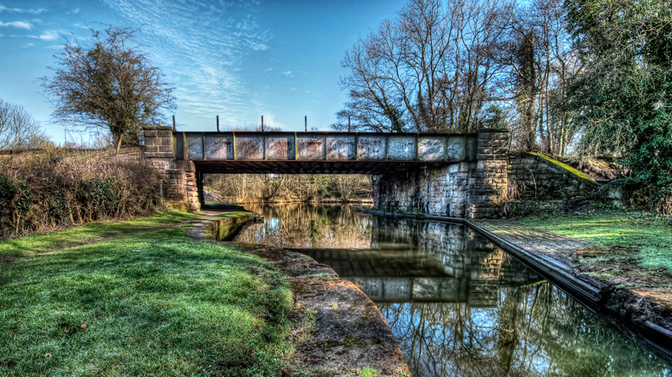
Bridge alignment
The locating the center line of communication route to be carried by the bridge at the selected site is called bridge alignment
Types of bridge alignment
Square alignment
Skew alignment

Slide 4
Collection of design data for a bridge
1.General data
a) index map
b)contour survey plan
c)site plan
d)cross- section
e)longitudinal section
f) catchment area map
g) soil profile
2. Geological data
3. Hydraulic data
4. Climatic data
5. Loading & other data

Slide 5
Classification Of Bridge
1. ACCORDING TO FUNCTION
a)Aqueducts: an artificial channel for conveying water, typically in the form of a bridge across a valley or other gap.
b)Viaduct
c)foot bridge
d) highway bridge
e)Railway bridge
2. According to material
a) Timber bridge
b)Masonary bridge
c) steel bridge
d) R.C.C. bridge
e) Prestressed concrete bridge

Slide 6
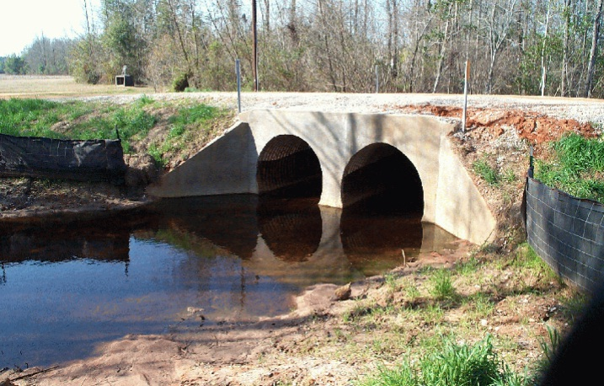
3. According to span
a) culverts
b) Minor bridge
c) Major bridge
d) Long span bridge
4. According to loading
a)Class AA bridge
b) Class A bridge
c) Class B bridge

Slide 7
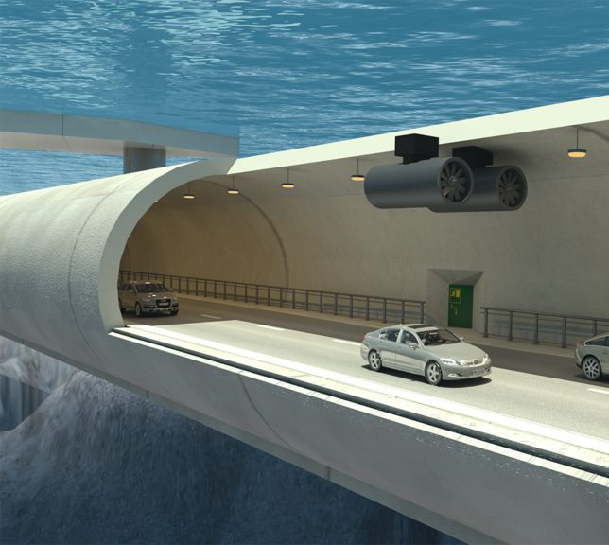
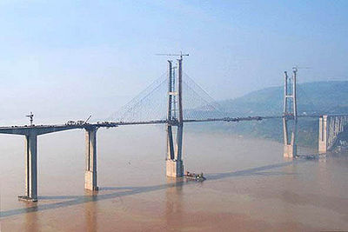
5. ACCORDING TO ALIGNMENT
a) Straight bridge
b)skew bridge
6. According to position of H.F.L.
A) Submersible bridge
b) non-submersible bridge
7. According to life
a) temporary bridge
b) permanent bridge

Slide 8
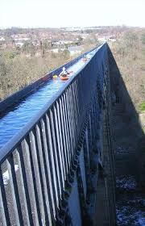

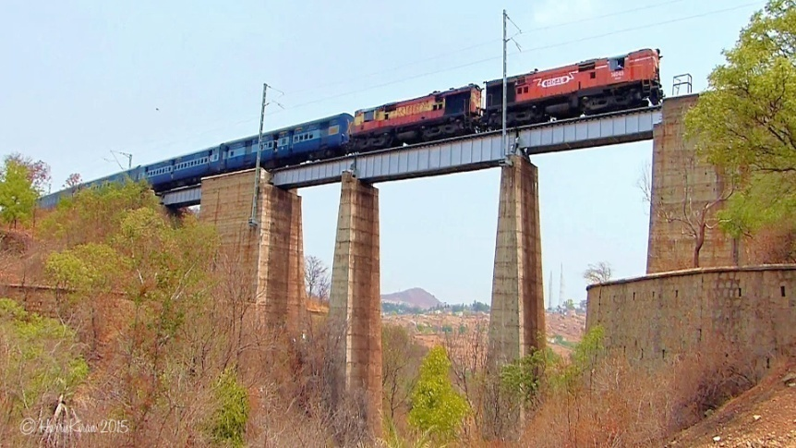
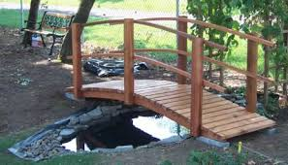
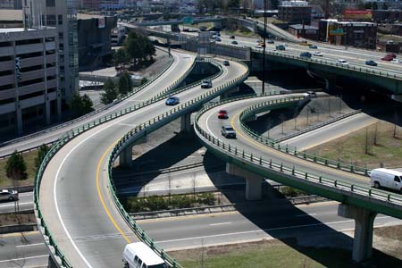
ACCORDING TO FUNCTION
Aqueducts
Viaduct
Railway bridge
foot bridge
Highway bridge

Slide 9
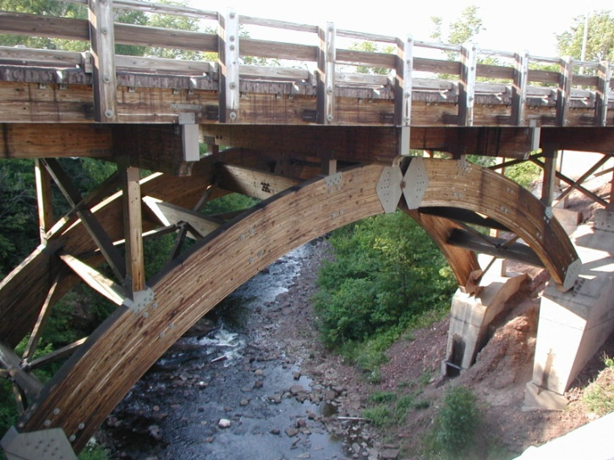
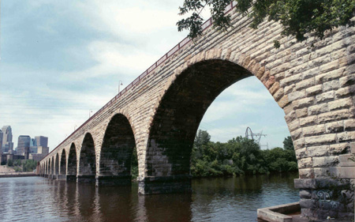
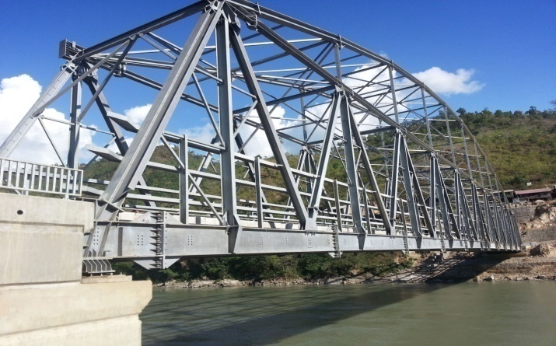
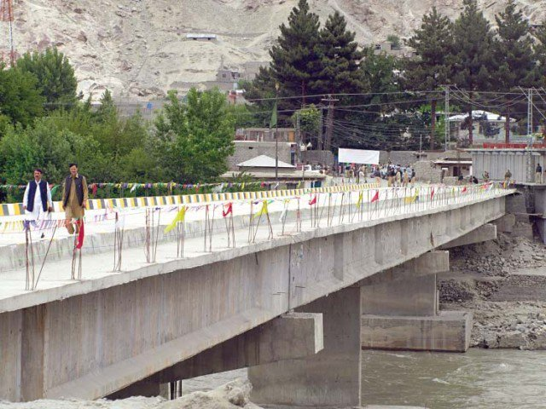
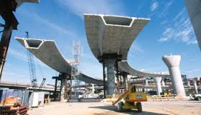
According to material

