Slide 1
Emission Control Diagnosis and Service

Slide 2
Objectives
Diagnose engine performance problems caused by improper EGR operation.
Diagnose and service the various types of EGR valves.
Diagnose EGR vacuum regulator (EVR) solenoids.
Describe the inspection and replacement of PCV system parts.

Slide 3
Objectives
Diagnose engine performance problems caused by improper EGR operation.
Diagnose and service the various types of EGR valves.
Diagnose EGR vacuum regulator (EVR) solenoids.
Describe the inspection and replacement of PCV system parts.

Slide 4
Objectives
Diagnose and service the various intake heat control systems.
Check the efficiency of a catalytic converter.
Diagnose and service secondary air injection systems.
Diagnose and service evaporative (EVAP) systems.

Slide 5
Objectives
Describe oxygen (O₂) emissions in relation to air/fuel ratio.
Describe how carbon dioxide (CO₂) is formed in the combustion chamber.
Describe how oxides of nitrogen (NO_{X}) are formed in the combustion chamber.

Slide 6
Emission Diagnosis
Hydrocarbons (HC)
A product of incomplete combustion
Carbon monoxide (CO)
A result of an overly rich mixture
Oxides of nitrogen (NO_{X})
A result of combustion temperatures above 1375°C

Slide 7
Emission Testing
Exhaust Analyzers
An exhaust analyzer has a sample hose equipped with a probe.
The probe is inserted in the vehicle’s tailpipe.
An internal pump moves an exhaust sample from the tailpipe through the analyzer.
The two-gas analyzer determines the quantities of HC and CO, a four-gas measures HC, CO, CO₂, and O₂ and a five-gas additionally measures NO_{X}.

Slide 8
Emission Testing
A five-gas exhaust analyzer

Slide 9
Drive Cycle Modes
Idle, no load at 0 km/h
Acceleration from 0 to 55 km/h
Acceleration from 55 to 90 km/h
Steady 55 km/h cruise
Steady 90 km/h cruise
Deceleration from 55 to 0 km/h
Deceleration from 90 to 0 km/h

Slide 10
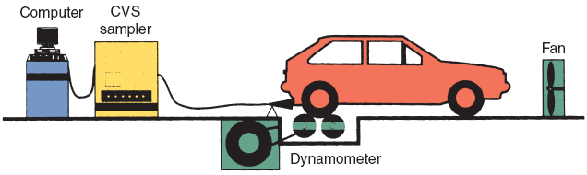
Test Station

Slide 11
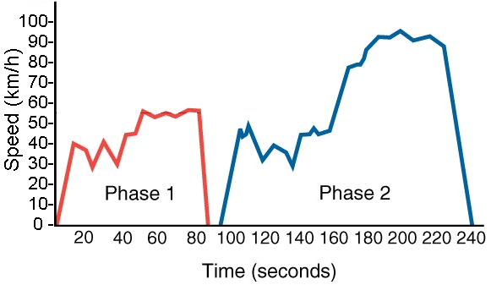
Drive Trace

Slide 12
PCV Valve Conditions and Symptoms
PCV valve stuck open can cause:
Lean air/fuel mixture.
Rough idle.
Stalling.
PCV valve stuck closed can cause:
Oil in the air cleaner.
Moisture or sludge in the oil.
Oil leaks.

Slide 13
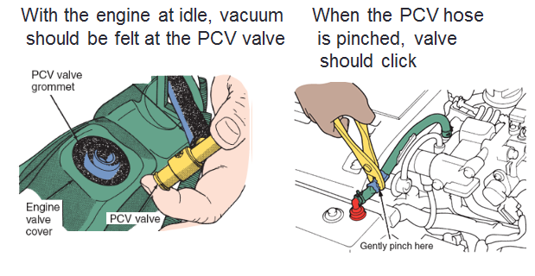
PCV Quick Checks

Slide 14
EGR System Conditions and Symptoms
EGR stuck open can cause:
Rough idle.
No-start, surging, or stalling.
EGR stuck closed (or system inoperative) can cause:
Detonation (spark knock).
Excessive NO_{X} emissions.
Poor fuel economy.

Slide 15
EGR Valve Testing
To check an EGR valve with a vacuum pump, remove the vacuum supply hose from the EGR valve port.
Connect the vacuum pump to the port and supply 457 mm Hg of vacuum and observe the EGR diaphragm movement.
If the diaphragm does not move or does not hold vacuum, replace the valve.

Slide 16
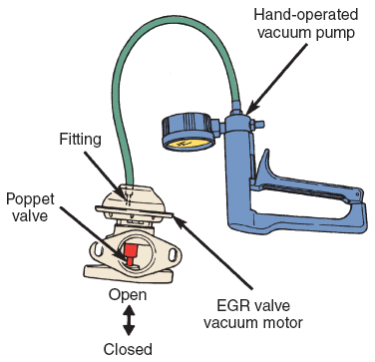
EGR Valve Testing
Watch the action of the valve when vacuum is applied to it and released

Slide 17
Digital EGR Valve Testing
A digital EGR valve may be diagnosed with a scan tool.
With the scan tool, energize the solenoids, one at a time.
Engine speed should drop slightly as each EGR solenoid is energized.
If the EGR valve does not operate properly, make sure 12 V is applied to the power supply terminal and the resistance of the valve should also be checked with an ohmmeter.

Slide 18
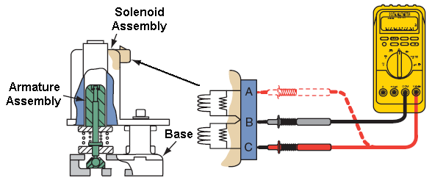
Digital EGR Valve Testing
Ohmmeter connections for checking a digital EGR valve

Slide 19
Knock Sensor Diagnostic Tips
To check sensor operation, tap on engine block while observing knock sensor output with a voltmeter, lab scope, or scan tool.
Check wiring for damage, corrosion, and incorrect routing.
Always tighten sensor to the proper torque specification.

Slide 20
Catalytic Converter Tests
A plugged or partially plugged catalytic converter can cause power loss as well as higher than normal emissions.
One simple test is to simply rap the converter with a rubber mallet.
If the converter rattles (loose catalyst substrate), it needs to be replaced.
Testing with a vacuum gauge during acceleration and with an exhaust back pressure gauge can also show blockage.

Slide 21
Catalytic Converter Tests
Checking exhaust system back pressure

Slide 22
Catalytic Converter Tests
Delta temperature test
Use a pyrometer to compare converter inlet and outlet temperatures. (Outlet should be 38°C [100°F] hotter than inlet.)
0₂ storage test
Use exhaust analyzer to check 0₂ content (should be about 0.5 to 1 percent).
Converter efficiency test
Use exhaust analyzer to check CO₂ content (should be greater than 11 percent).

Slide 23
Evaporative System Conditions and Symptoms
System purging at idle can cause:
Rough idle.
Cracks in hose or canister can cause:
Gasoline odor around vehicle.
Trouble codes on OBD II systems.
A loose fuel filler cap can cause:
Trouble codes on OBD II systems.

Slide 24
Summary
Testing the quality of the exhaust is both a procedure for testing emission levels and a diagnostic routine.
The test is a 240-second test of a vehicle’s emissions.
A PCV valve that is stuck open typically causes rough idle operation or engine stalling.

Slide 25
Summary
A PCV valve that is restricted may result in the accumulation of moisture and sludge in the engine and engine oil; oil leaks may also result.
With too little EGR flow, the engine can overheat, detonate, and emit excessive amounts of NO_{X}.

Slide 26
Summary
Problems with the knock sensor system include excessive detonation and loss of power.
AIR system concerns include an overheated exhaust manifold or catalytic converter and increased engine emissions.

Slide 27
Thank You !

Slide 29
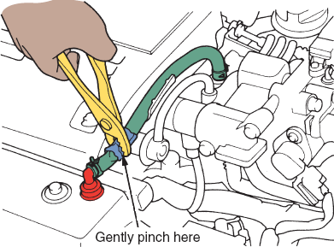
PCV Quick Checks
With the engine at idle, vacuum When the PCV hose should be felt at the PCV valve is pinched, valve should click

