Slide 1
AAE 17521 Chapter 1 Theory of Combustion
Prepared by S. D. Gandhi

Slide 2
1.1 Combustion in S.I. engines
Ignition Limits
Ignition Limit corresponds approximately to that mixture ratio, at lean & rich ends of the scale, where the heat released by spark is no longer sufficient to initiate combustion in the neighbouring UN burnt mixture. The flame will propagate only if the temperature of the burnt gases exceeds approximately 1250⁰ C in the case of hydrocarbon-air mixture.
The lower & upper ignition limits of the mixture depend upon mixture ratio & flame temperature. The ignition limits are wider at increased temperature because of higher rates of reaction.

Slide 3
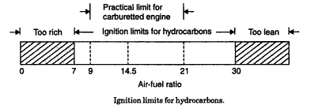
1.1 Combustion in S.I. engines
Ignition Limits

Slide 4
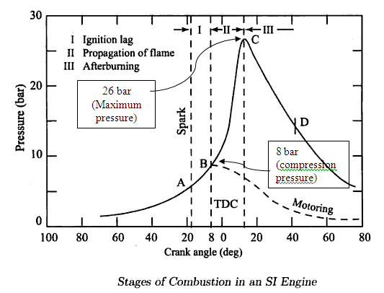
1.1 Combustion in S.I. engines
Stages of combustion in S.I. Engine

Slide 5
1.1 Combustion in S.I. engines
Stages of combustion in S.I. Engine
Stage I:-Ignition Lag or Preparation Phase.
It is a chemical process which depends on-nature of fuel, temperature & pressure, proportion of exhaust gas, rate of burning and temperature .It is the growth and development of a semi propagating nucleus of flame.(At the moment of spark discharge, the temperature exceeds 10,000⁰ c)
At the end of this stage, the first rise of pressure (on indicator diagram) can be detected. It is the point where the line of combustion departs from the compression line.

Slide 6
1.1 Combustion in S.I. engines
Stages of combustion in S.I. Engine
Stage II: - Propagation of flame
-It is a simple, pure and mechanical process. The starting point of the second stage is where first measurable rise of pressure can be seen on the indicator diagram. i.e. the point where the line of the combustion departs from the compression line. During second stage, the flame spreads throughout the combustion chamber. The second stage ends as maximum pressure (on indicator diagram) is reached.

Slide 7
1.1 Combustion in S.I. engines
Stages of combustion in S.I. Engine
Stage III →after burning
End of second stage means completion of flame travel. But it does not result in complete heat release (burning of fuel).
Even after the passage of flame, some chemical adjustments continue throughout the expansion stroke- near the walls and behind the turbulent flame front. The rate of combustion reduces due to surface of the flame front becoming smaller and reduction in turbulence.

Slide 8
Effect of engine variables on Ignition Lag
Ignition lag is a chemical process. The ignition lag in term of crank angle is 10º to 20º& in terms of second, 0.0015 second. The duration of ignition lag depend on
Fuel- it is depend on chemical nature of fuel. The higher, the self ignition temp of fuel, the longer, the ignition lag
Mixture Ratio-The ignition lag is smallest for the mixture ratio which gives the maximum temperature this mixture ratio is some what richer than the stoichiometric ratio.
Initial pressure and temperature –increasing the intake temp, pressure, compression ratio and retarding spark, all reduce the ignition lag.

Slide 9
Effect of engine variables on Ignition Lag
Electrode gap- It affects establishment of the nucleus of flame. If the gap is too small, quenching of the flame nucleus may occur & rang of fuel –air ratio for the development of a flame nucleus is reduced.
Turbulence- measured in degree of crank-rotation the ignition lag increases almost linearly with engine speed. For this reason. It becomes necessary to advance the spark timing at higher speed.
Excessive turbulence of the mixture in the area of the spark plug is harmful, since it increases the heat transfer from the combustion zone & leads to unstable development of the nucleus of flame. That is way the spark plug is usually arranged in a small recess in the wall of the combustion chamber.

Slide 10
Effect of engine variables on Flame Propagation
Fuel –Air ratio:- With hydrocarbon fuels the maximum flame velocities occur when mixture strength is 110% of stoichiometric . Lean mixtures release less thermal energy resulting in lower flame temperature & flame speed. Very rich mixtures have incomplete combustion (Some carbon only burns to CO & not to CO₂), which results in production of less thermal energy & hence flame speed is again low.
Compression ratio-A higher compression ratio increases the pressure & temperature of the working mixture & decrease the concentration of residual gases. High pressures & temperature of the compressed mixture also speed up the second phase of combustion. Total ignition angle is reduced. Maximum pressure are increased
Intake temp & pressure-increase in the intake temp & pr. Increase the flame speed.

Slide 11
Effect of engine variables on Flame Propagation
Engine load:-With increases in the engine load the cycle pressures increase. Hence the flame speed increases.
Turbulence:-The flame speed is very low in non-turbulent mixtures. A turbulent motion of the mixture intensifies the processes of heat transfer & mixing of the burned & unburned portions in the flame front (diffusion). These two factors cause the velocity of turbulent flame to increase practically in proportion to the turbulence velocity. However, excessive turbulence is also undesirable.

Slide 12
Effect of engine variables on Flame Propagation
Engine speed – the higher the engine speed the greater the turbulence inside the cylinder. For this reason the flame speed increases almost linearly with engine speed. The crank angle required for the flame propagation, which is the main phase of combustion, will remain almost constant at all speed.
Engine size- engine of similar design generally run at the same piston speed. This is achieved by smaller engine having larger RPM & larger engines having smaller RPM. Due to the same piston speed. The inlet velocity, the degree of turbulence & the flame speed are nearly same in similar engines regardless of the size.
i.e. the number of crank degrees required for flame travel will be about the same irrespective of engine size, provided the engine are similar.

Slide 13
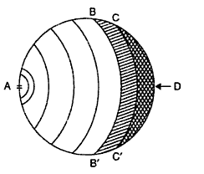
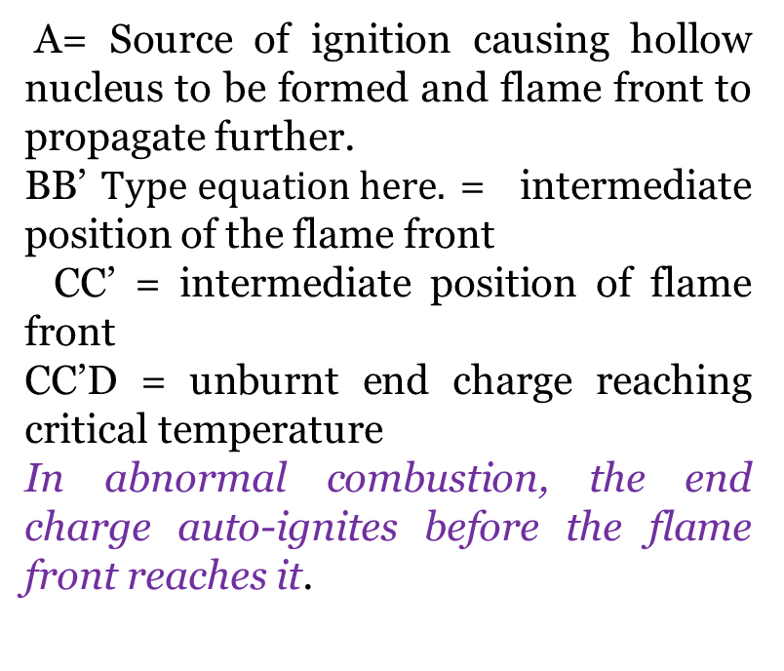
1.2 Abnormal Combustion
Detonation type of abnormal combustion.
A= Source of ignition causing hollow nucleus to be formed and flame front to propagate further.
BB’= intermediate position of the flame front
CC’ = intermediate position of flame front
CC’D = unburnt end charge reaching critical temperature
In abnormal combustion, the end charge auto-ignites before the flame front reaches it.

Slide 14
1.2 Abnormal Combustion
Detonation type of abnormal combustion.
Figure shows combustion with detonation. The flame front has reached BB’ and the unburnt charge BB’D has reached the critical conditions for auto-ignition. In this case there is a possibility of detonation. If the flame front can proceed from BB’ to D and consume the unburnt charge in a normal manner, prior to completion of the Ignition delay period, there will be no detonation.
If, however, the flame front is able to proceed only as far as, say CC’, during the ignition delay period, then the remaining portion of the unburnt charge CC’D will auto-ignite and cause extreme pressure fluctuations from about 50 bar to 150-200 bar.

Slide 15
Effects of detonation
Noise and vibration: the presence of vibratory motion causes crankshaft vibrations and the engine runs rough.
Mechanical damage: the cylinder head and valves may be pitted, increased rate of wear may occur.
Carbon Deposits: detonation results in increased carbon deposits.
Increase in heat transfer: occurs due to scouring away of protective layer of inactive stagnant gas on the cylinder walls due to pressure waves.
Decrease in power output and efficiency: due to increase in the rate of heat transfer the power output as well as efficiency of a detonating engine decreases.
Pre-ignition: The increased rate of heat transfer to walls causes local overheating of spark plug, which ignites charge before the spark, thus causing Pre- ignition.

Slide 16
Control of detonation
Methods of controlling detonation:
By controlling following engine variables, detonation can be controlled.
Increasing engine rpm.
Retarding spark timing
Reducing pressure in inlet manifold by throttling. In supercharged engines reducing supercharging pressures reduces detonation.
Making the ratio too lean or too rich, preferably latter.
Water injection.

Slide 17
Control of detonation
By design features, detonation can be reduced.
Use of low compression ratio.
Increasing turbulence
Relocating spark plugs or use of two or more spark plugs.
Suitable combustion chamber design to reduce flame length and to reduce temperature of end gas.
It can be eliminated by using High octane fuels, or by adding additives known as dopes to petrol.

Slide 18
What is Ignition delay? How it affects the combustion process in S.I. Engine?
In abnormal combustion, called detonation, end charge auto-ignites before the flame front reaches it. To auto-ignite, the last unburnt charge must reach above critical temperature and remain at this temperature for certain length of time. This time required in the chemical preparation phase is called “Ignition Delay”.
If ignition delay period is longer than the time required for the flame front to burn through the unburnt charge, there will be no detonation in S.I Engine.
Only when the critical temperature is reached and maintained, and the ignition delay is shorter than the time it takes for the flame front to burn through the unburnt charge, there will be detonation.

Slide 19
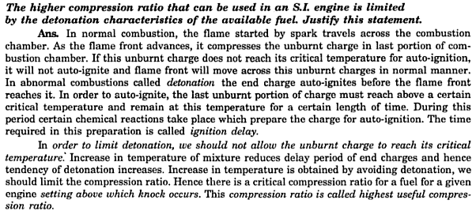

Slide 20
1.2 Abnormal Combustion
Pre-ignition
The increase in the rate of heat transfer to the walls may cause local overheating specially of the spark plug, which may reach a temperature high enough to ignite the charge before the passage of spark. This phenomenon is called Pre-ignition.
Pre-ignition may also be caused by overheated exhaust valves or glowing carbon deposits in the combustion chamber.

Slide 21
Some part of the cylinder surface may be hot enough (nearly 1100°) to ignite the charge before the spark does so. This is equivalent to advancing the ignition, but since the hot spot surface is larger than the spark, the combustion rate would be faster than that of normal combustion. Creating very high cylinder pressures and temperatures and thus resulting in excessive negative compression work and increased heat loss to the walls. The overall effect will be the loss in power.
Additional Information

Slide 22
Pre-ignition will also cause higher temperatures and pressures in the end-gas than those caused by normal ignition because of its earlier occurrence on the compression stroke. Thus pre-ignition leads to auto-ignition and hence knock. And auto-ignition encourages pre-ignition. Knock and pre-ignition are different phenomena. Knock is due to the rapid combustion of the last part of the mixture following the initiation of flame by the spark, whereas pre-ignition is the ignition of the charge by a hot body before the spark occurs.
Additional Information

Slide 23
The result of pre-ignition are to increase the work of the compression stroke, decrease the net work of the cycle, increase the engine pressures, increase the heat loss from the engine and decrease the efficiency. Pre-ignition if not checked gets progressively worse, culminating in severe engine damage. Pre-ignition can be detected by switching off the ignition when irregular firing might occur for a few strokes before the engine speed drops. The sudden loss of power with no evidence of mechanical malfunctioning may also indicate pre-ignition.
Additional Information

Slide 24
1.2 Abnormal Combustion
Surface ignition
Under certain conditions, air-fuel mixture is ignited by a hot spot in the cylinder.
Initiation of a flame front by a hot surface other than the spark is called surface ignition. The hot surface may be the spark plug insulator or electrode, the exhaust valve head, the combustion deposits on the combustion chamber surfaces etc.
Surface ignition occurring before the spark is called pre-ignition and that occurring after the spark is called post-ignition.
Run-on, run-away, wild ping and rumble are caused by surface ignition which are harmful.

Slide 25
1.3 SI engine combustion chambers
Basic requirements of a good combustion chamber
1. High power output
2. High thermal efficiency and low specific fuel consumption
3. Smooth engine operation
4. Reduced exhaust pollution
5. High volumetric efficiency
6. Minimum length of flame travel
7. Provision of suitable quench region

Slide 26
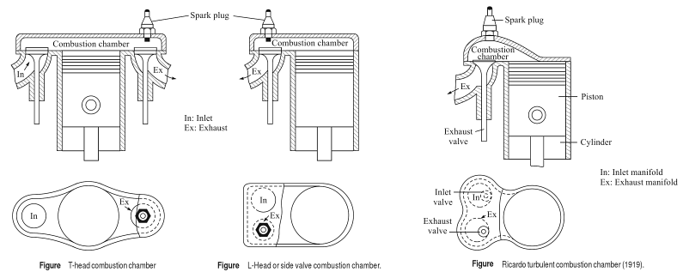
1.3 SI engine combustion chambers

Slide 27
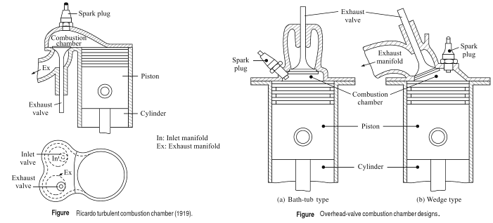
1.3 SI engine combustion chambers

Slide 28
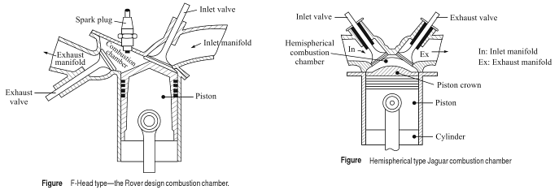
1.3 SI engine combustion chambers

Slide 29
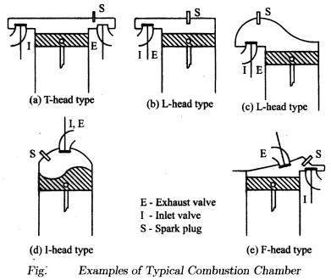
1.3 SI engine combustion chambers

Slide 30
1.3 S.I. engine Combustion Chambers
1. Wedge Type: It has the spark plug positioned off-center in the widest part of the wedge. The intake and exhaust valves are usually positioned next to each other. The air-fuel mixture is compressed into an area called the quench area as the piston travels through the compression stroke to TDC. The quench area helps in mixing of the air and fuel before combustion. This also causes a turbulence or movement of the mixture within the cylinder, causing a more complete burn at lower and mid-cruise speeds. The high-swirl combustion chambers are the result of raised surfaces on the cylinder head surface of the wedge design that creates a specific amount of combustion turbulence.

Slide 31
1.3 S.I. engine Combustion Chambers
2. Hemispherical: The main characteristic of the hemispherical combustion chamber is that it is rounded. When the piston is at TDC, the combustion chamber resembles a half- ball, hence the name.
This design allows the intake and exhaust valves typically located across from each other with the spark plug placed between them, to be angled in the cylinder head. This cross-flow arrangement provides better scavenging, lower pumping loss and better fuel efficiency.

Slide 32
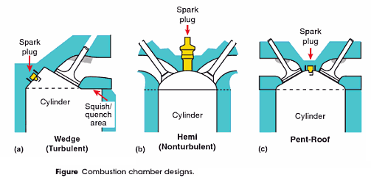
1.3 S.I. engine Combustion Chambers

Slide 33
1.3 S.I. Engine Combustion Chambers
Advantages and drawbacks of S I Engine combustion chambers
Sr. no. | Combustion Chamber Type | Advantages | Drawbacks
1 | T- head combustion chamber | 1. Easy to manufacture flat cylinder head, 2. Lower height of engine and front hood for better frontal visibility of vehicle . | 1. Longer length of flame travel. 2. Increased detonation tendency.

Slide 34
1.3 S.I. Engine Combustion Chambers
Advantages and drawbacks of S I Engine combustion chambers
Sr. no. | Combustion Chamber Type | Advantages | Drawbacks
2 | L- head or side head combustion chamber | 1. Neat and compact layout 2. Easy to lubricate valves, easy to decarbonize engine. | 1. Lack of turbulence 2. Extremely prone to detonation 3. Extremely sensitive to ignition timing slow combustion.

Slide 35
1.3 S.I. Engine Combustion Chambers
Advantages and drawbacks of S I Engine combustion chambers
Sr. no. | Combustion Chamber Type | Advantages | Drawbacks
3 | Ricardo Turbulent head side valve combustion chamber | 1. Faster flame speed, 2. Reduced detonation 3. Homogeneous air: fuel mixture formation. | 1. Inefficient operation as compared to latest engines with compression ratio of 10:1

Slide 36
1.3 S.I. Engine Combustion Chambers
Advantages and drawbacks of S I Engine combustion chambers
Sr. no. | Combustion Chamber Type | Advantages | Drawbacks
4 | F- head combustion chamber | 1. Flat roof allows use of an inlet valve bigger than exhaust valve. 2. Valve and plug cooling is efficient. | Complex valve operating mechanism.

Slide 37
Advantages and drawbacks of S I Engine combustion chambers
Sr. no. | Chamber Type | Advantages | Drawbacks
5 | I – head combustion chamber (Wedge form and Bath tub form of combustion chamber) | 1. Lower pumping losses and higher volumetric efficiency. 2. Lesser distance of flame travel. Therefore low octane requirement. 3. More uniform cooling of cylinder and piston. 4. Lower surface to volume ratio and therefore less heat loss. 5. Easier to cast and hence lower casting cost. | 1. Large sized valves cannot be accommodated. 2. Valve operating mechanism gets disturbed while decarbonizing combustion chamber.

Slide 38
1.4 Combustion in CI engine
Air fuel ratio in Diesel engines
In CI engines, for a given speed, irrespective of load, an approximately constant supply of air enters the cylinder.
With change in load, the quantity of fuel is changed, which changes the air: fuel ratio. The overall air: fuel ratio may thus vary from about 100:1 at no load to 20: 1 at full load.
The poor distribution of fuel and its limited intermixing with air results in objectionable smoke if operated near chemically correct air: fuel ratio (14.5: 1) for diesel.
Hence CI engines are operated with excess air (air: fuel ratio 20:1 to 23: 1 i.e. excess air 35 to 50%). So, diesel engines are also termed as lean burn engines.

Slide 39
Stages of combustion in C.I. engine.
First Stage: Ignition Delay period during which some fuel has been admitted but has not yet been ignited. The ignition delay is counted from the start of injection to the point where P-θ curve separates from the pure air compression curve.
Second Stage: Rapid or Uncontrolled combustion: In this second stage, the pressure rise is rapid because during the delay period the fuel droplet have had time to spread themselves over a wide area and they have fresh air all around them. It is counted from the end of Delay period to the Point of Maximum pressure on the P-θ diagram.
About one-third of the heat is evolved during this period.

Slide 40
Stages of combustion in C.I. engine.
Third Stage: Controlled Combustion: At the end of second stage, the temperature and pressure are so high that the fuel droplets injected during the last stage burn almost as they enter and any further pressure rise can be controlled by Injection rate. It is counted from the point of maximum pressure to maximum cycle temperature.
About 70 to 80 % of the total heat of the fuel is evolved during this period.

Slide 41
Stages of combustion in C.I. engine.
Fourth Stage: Afterburning: Because of poor distribution of the fuel particles, combustion continues during part of the remainder of the expansion stroke. This after-burning can be called the fourth stage of combustion. The duration of after-burning phase may correspond to 70-80 degrees of crank travel from TDC.
Total heat evolved by the end of the combustion process is
95 to 97 % and 3 to 5% of heat goes as unburnt fuel in
exhaust.

Slide 42
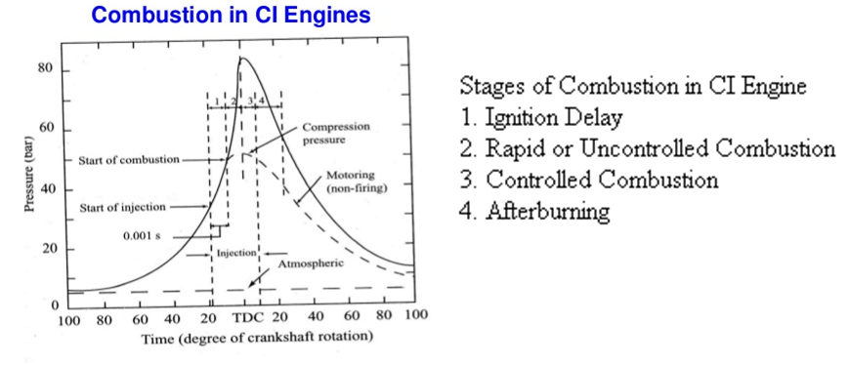
P- θ diagram showing stages of combustion in C.I. engine.

Slide 43
Ignition Delay period in C.I. Engine
Ignition delay is the period during which some fuel has been admitted but has not yet been ignited. It is counted from the start of injection to the point where P-θ curve separates from pure air compression curve. The ignition delay can be roughly divided into two parts: Physical delay and chemical delay.
Physical Delay: The period of physical delay is the time between the beginning of injection and the attainment of chemical reaction conditions. In the physical delay period, the fuel is atomized, vaporized, mixed with air , and raised in temperature.
Chemical Delay: in this period, pre-flame reactions start slowly and then accelerate until local inflammation or ignition takes place. At high temperatures, chemical reaction is quicker and physical delay is longer than chemical delay.

Slide 44
Factors affecting Ignition Delay period
Fuel: Lower self ignition temperature means a lower delay period. Higher Cetane number means a lower delay period and smooth engine operation.
Intake Temperature: Increase in intake temperature would result in increase in compressed air temperature which would reduce the delay period.
Compression ratio: Increase in compression ratio reduces delay period as it raises both temperature and density.
Type of combustion chamber: A pre-combustion chamber gives shorter delay compared to an open type of combustion chamber.
Injection advance: Delay period increases with increase in injection advance angle. (with increase in injection angle, pressure and temperature are lower when injection begins)

Slide 45
Diesel Knock
If the Ignition delay period is long, a large amount of fuel will be injected and accumulated in the chamber. The auto-ignition of this large amount of fuel may cause high rate of pressure rise and high maximum pressure which may cause Knocking in diesel engines.
A long delay period not only increases the amount of fuel injected by the moment of ignition, but also improves the homogeneity of the fuel- air mixture and its chemical preparedness for explosion type of self-ignition similar to detonation in SI engines.

Slide 46
Methods of controlling Diesel Knock
The diesel knock can be controlled by reducing delay period. The delay is reduced by the following.
1. High charge temperature
2. High fuel temperature.
3. Good turbulence.
4. A fuel with short induction period.
5. By using Ignition accelerators like Amyl
Nitrate.

Slide 47
Detonation and Knocking Comparison
Sr. No. | Detonation in S I Engine | Knock in C I Engine
1 | Detonation occurs near the end of combustion | Knocking occurs near the beginning of combustion. i.e. at the end of first stage of combustion.
2 | Detonation in S I Engine is of a homogeneous charge causing very heavy rate of pressure rise and high maximum pressure. | Knocking in C I engine is of imperfectly mixed charged and hence the rate of pressure rise is normally lower than that in the detonation in S I Engine.
3 | Pre-ignition may occur. | Fuel is injected into the cylinder only at the end of the compression stroke and there is no question of pre- ignition or premature ignition.

Slide 48
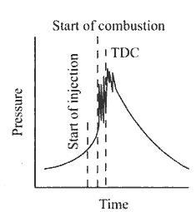
Detonation and Knocking Comparison
Sr. No. | Detonation in S I Engine | Knock in C I Engine
4 | Detonation is easily distinguished from normal combustion. | Knocking is not easy to distinguish from normal combustion.
5 | Larger cylinder promotes detonation | Diesel knock is reduced with increase in size of cylinder.
6 | Compression ratio in S.I. engine is limited by Detonation | In C.I. engines, higher compression ratio causes lesser ignition delay and hence lesser possibility of diesel knock.
7

Slide 49
C.I. Engine Combustion Chambers
C.I. Engines are classified on the basis of method of generating swirl. There are four types of combustion chambers.
Open Combustion chambers
Divided or turbulent swirl chambers
Pre-combustion chambers
Air cell combustion chambers.

Slide 50
C.I. Engine Combustion Chambers
Open combustion chambers: The method of swirl used in this type of combustion chamber is induction swirl. In induction swirl, flow of air is directed towards the cylinders during its entry.
An open combustion chamber is one in which combustion space is essentially a simple cavity with little restriction and there are no large differences in pressure between different parts of chamber during the combustion process.

Slide 51
C.I. Engine Combustion Chambers
Divided or Turbulent swirl chambers: The method of generating swirl in the divided chamber is by compression.
Compression swirl is one in which air is forced through a tangential passage into a separate swirl chamber during compression stroke. A divided combustion chamber is defined as one in which the combustion space is divided into two or more distinct compartments between which there are restrictions or throats small enough so that considerable pressure difference occurs between them during combustion process.

Slide 52
C.I. Engine Combustion Chambers
Pre-combustion chamber: The type of swirl used is combustion induced swirl. A pre-combustion chamber consist s of pre-combustion chamber or anti-chamber connected to the main chamber through a number of very small holes. Pre-combustion chamber contains 20 to 30 % of clearance volume. Pre-combustion chamber has multi-fuel capability without any modification in the injection system in the type of swirl used. i.e. combustion inducted swirl, swirl turbulence is created by use of initial pressure rise due to partial combustion.

Slide 53
C.I. Engine Combustion Chambers
Air cell combustion chamber: The type of swirl used in this combustion chamber is combustion induced swirl. Here there is no organized air swirl. The advantage for this type of combustion chamber are
The maximum pressure on the main chamber is fairly low and hence it gives smooth running and easy starting.
This type of combustion chamber is most suitable for comparatively small engines of medium duty where a relatively high fuel consumption can be tolerated.

Slide 54
Classification of C.I. engine Combustion chambers
C.I. Engine Combustion Chambers
Direct Injection or
Open Chamber
Low Swirl
High Swirl
M Type
Indirect Injection or Divided Chamber
Compression Swirl
Medium Swirl
Pre-combustion Chamber
Air Cell
Energy Cell

Slide 55
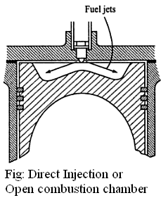
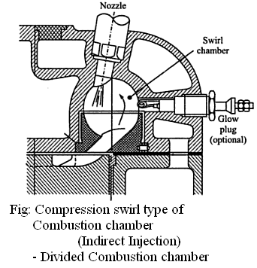
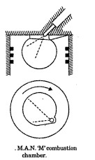
C.I. Engine Combustion Chambers

Slide 56
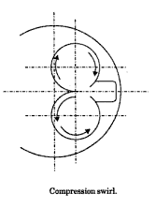
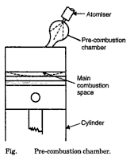
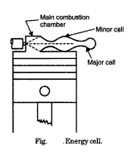
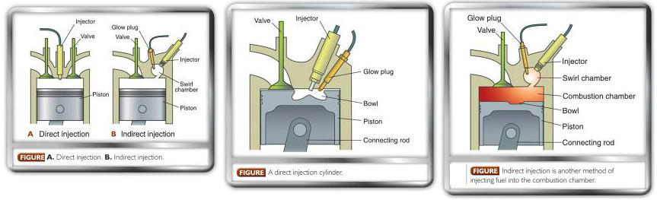
C.I. Engine Combustion Chambers

Slide 57
Advantages and drawbacks of C. I. Engine combustion chambers
Combustion Chamber Type | Advantages | Drawbacks
1. Direct injection (DI) or Open combustion chamber | 1. Good supply of oxygen to the combustion chamber. 2. Lower surface area/ volume reduce heat losses. 3. higher efficiency (efficient combustion) 4. lower fuel consumption 5. Good cold starting ability (glow plug is not required.) | 1. Inaccurate setting of valves can damage piston crown 2. Engine runs rough at low speeds. 3. injector nozzle holes may get blocked by carbon deposits(multi-hole nozzle) 4. High injection pressures are necessary.

Slide 58
Advantages and drawbacks of C. I. Engine combustion chambers
Combustion Chamber Type | Advantages | Drawbacks
2. Ricardo (Compression) swirl combustion chamber | 1. Minimized exhaust gas odour. 2. Relatively low injection pressure can be used. 3. Reduced delay period. | 1. Cold weather starting problems occurs. 2. Inefficient scavenging. 3. Slightly more fuel consumption than DI engines.

Slide 59
Advantages and drawbacks of C. I. Engine combustion chambers
Combustion Chamber Type | Advantages | Drawbacks
3. Pre-combustion chamber | 1. Blockage due to carbon deposit of Pintle type nozzle is eliminated 2. Lower injection pressure is required 3. Low quality fuel can be used 4. Smooth engine operation | 1. Heater plug is required for cold starting. 2. Low thermal efficiency. 3. High fuel consumption

Slide 60
Advantages and drawbacks of C. I. Engine combustion chambers
Combustion Chamber Type | Advantages | Drawbacks
4. Air cell or Energy cell combustion chamber | 1. Minimum shock loading of working components due to high degree of controlled combustion. 2. Reduced exhaust gas pollution 3. Relatively low injection pressure may be used. | 1. Starting difficulty when cold. Hence glow plug is needed. 2. Inefficient scavenging of the energy cell. 3. costly cylinder head (complicated moulding and machining involved in manufacturing.)

Slide 61
Advantages and drawbacks of C. I. Engine combustion chambers
Combustion Chamber Type | Advantages | Drawbacks
5. M- combustion chamber | 1. Low peak pressure 2. Low rate of pressure rise. 3. Low smoke level 4. Multi-fuel capability | 1. Low volumetric efficiency 2. Cold starting requires glow plug 3. At starting and idling conditions hydrocarbon emissions may occur.

Slide 62
Comparison of S.I. and C.I. Engines
S.I. Engine
Otto Cycle
Theoretically more efficient
C.I. Engine
Diesel Cycle
Theoretically less efficient
Thermodynamic Cycle
Actual efficiency is less
Actual efficiency is more

Slide 63
Comparison of S.I. and C.I. Engines
S.I. Engine
Homogeneous Mixture
C.I. Engine
Heterogeneous Mixture
A: F Ratio varies considerably with load
Combustion Phenomenon
Quantity Governing
Quality Governing
A: F ratio is nearly constant for all loads

Slide 64
Comparison of S.I. and C.I. Engines
S.I. Engine
Compression ratio is low, about 10:1 limited by Detonation
C.I. Engine
Compression Ratio is higher, about 15:1 to 18:1
Compression Ratio

Slide 65
Comparison of S.I. and C.I. Engines
S.I. Engine
Compression Pressure is 7 bar to 15 bar
C.I. Engine
Compression Pressure is 30 bar to 50 bar
Maximum pressure is 60 bar to 70 bar
Operating Pressure
Maximum pressure is 45 bar to 50 bar

Slide 66
Comparison of S.I. and C.I. Engines
S.I. Engine
High speed engine
(5000 rpm)
C.I. Engine
Low speed engine (3000 rpm)
Operating Speed

Slide 67
Comparison of S.I. and C.I. Engines
S.I. Engine
Poor mixture distribution because of wall-wetting effect
C.I. Engine
Excellent mixture distribution (calibrated F.I.P.)
Distribution of fuel between cylinders

Slide 68
Comparison of S.I. and C.I. Engines
S.I. Engine
Supercharging of S.I. Engine is limited by detonation
C.I. Engine
In C.I. Engine, super charging tends to prevent knocking it is limited by thermal & mechanical stresses
Supercharging
Supercharging is used in air craft engines.
Turbo-charging is used in generation plant, commercial & army vehicles

Slide 69
Comparison of S.I. and C.I. Engines
S.I. Engine
Higher exhaust Gas temperature (low thermal efficiency )
C.I. Engine
Lower exhaust Gas temp.
Exhaust Gas Temperature

Slide 70
Comparison of S.I. and C.I. Engines
S.I. Engine
Easier starting due to lesser cranking effort
Cold starting circuit in carburetor provides cold starting
C.I. Engine
Difficult to start due to requirement of greater cranking effort to over come higher compression
Glow plug is required in cold weather (for IDI engines)
Starting

Slide 71
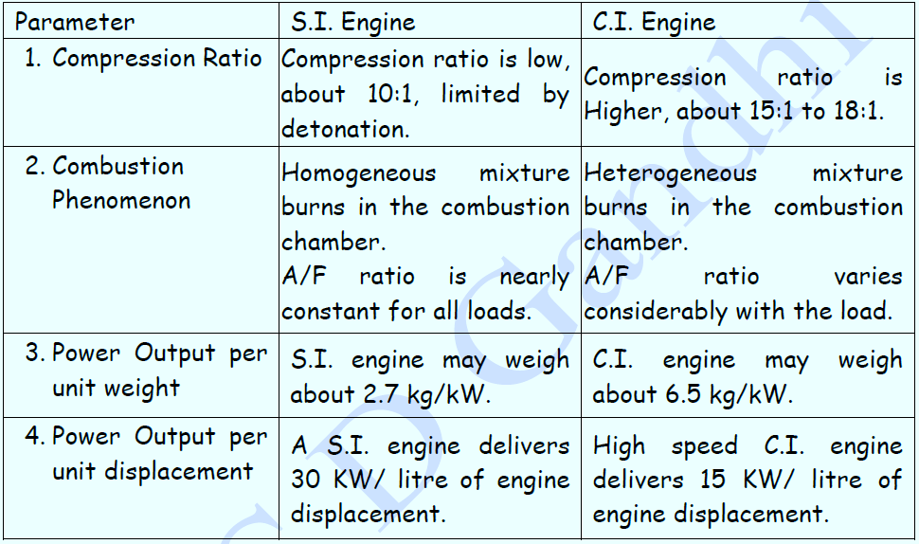
Comparison of S.I. and C.I. Engines

