Slide 1
ELECTRONIC MEASUREMENT AND INSTRUMENTATION
EMI
22333
ESE:70 + PA:30+ ESE@50+PA:50=200

Slide 2
Course: Electronics Measurement and Instruments (22333) Programme: EJ3I
CO statement no. | CO statements
22333.a | Interpret the characteristics of measuring instrument
22333.b | Calibrate different electronic instrument.
22333.c | Use the relevant instrument to measure specified parameters.
22333.d | Interpret working of various types of sensors and transducers.
22333.e | Use various types of transducers and sensors to measure quantities.
22333.f | Maintain signal conditioning and data acquisition system.

Slide 3
UNIT-1
FUNDAMENTAL OF ELECTRONIC MEASUREMENT
8 MARKS

Slide 4
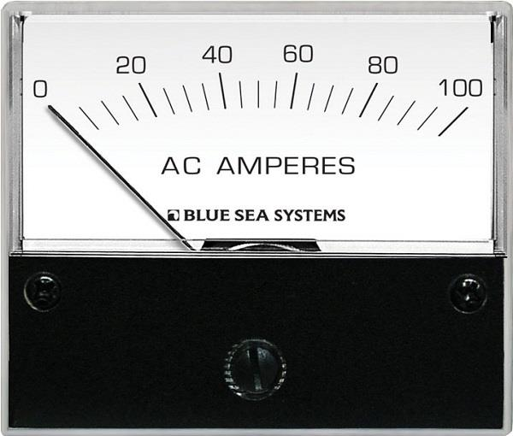
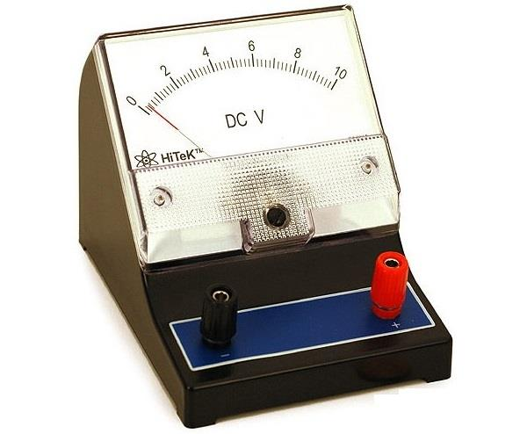

Slide 5
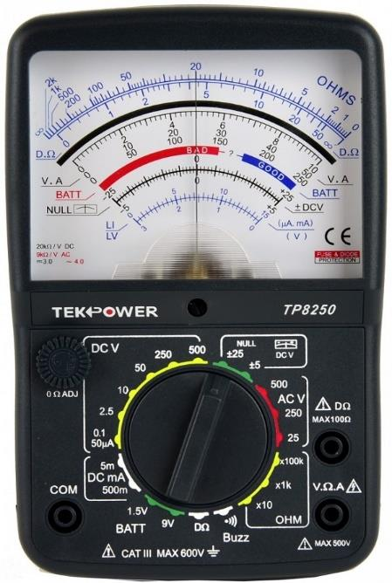

Slide 6
STATIC & DYNAMICCHARACTERISTICS OF MEASUREMENT SYSTEM
The performance characteristics of an instrument are mainly divided into two
categories:
i) Static characteristics
ii) Dynamic characteristics

Slide 7
Static characteristics:
The set of criteria defined for the instruments, which are used to measure the
quantities which are slowly varying with time or mostly constant, i.e., do not vary
with time, is called ‘static characteristics’.
The various static characteristics are:
Accuracy
ii) Precision
iii) Sensitivity
iv) Linearity
v) Reproducibility
vi) Repeatability

Slide 8
vii) Resolution
viii) Threshold
ix) Drift
x) Stability
xi) Tolerance
xii) Range or span

Slide 9
Accuracy
It is the degree of closeness with which the reading approaches the true value of
the quantity to be measured. The accuracy can be expressed in following ways:

Slide 10
Sensitivity:
The sensitivity denotes the smallest change in the measured variable to which the
instrument responds. It is defined as the ratio of the changes in the output of an
instrument to a change in the value of the quantity to be measured. Mathematically
it is expressed as,

Slide 11
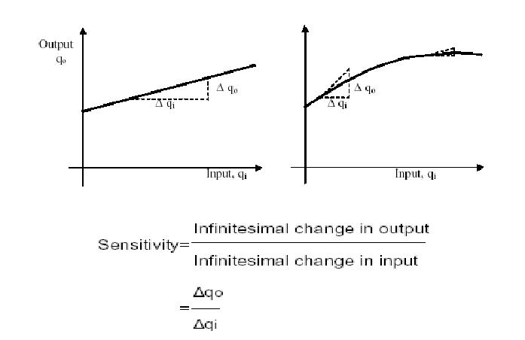

Slide 12
