Slide 1
HISTORY OF
MICROPROCESSORS
1

Slide 2
CONTENTS
Introduction
4-Bit Microprocessors
8-Bit Microprocessors
16-Bit Microprocessors
32-Bit Microprocessors
64-Bit Microprocessors
2

Slide 3
INTRODUCTION
Fairchild Semiconductors (founded in 1957)
invented the first IC in 1959.
In 1968, Robert Noyce, Gordan Moore, Andrew
Grove resigned from Fairchild Semiconductors.
They founded their own company Intel (Integrated Electronics).
Intel grown from 3 man start-up in 1968
3

Slide 4
4-BIT MICROPROCESSORS
4

Slide 5
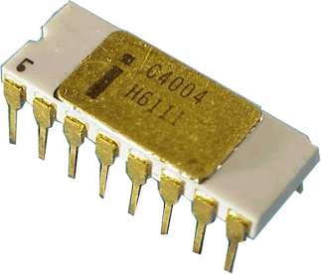
INTEL 4004
Introduced in 1971.
It was the first microprocessor by Intel.
It was a 4-bit µP.
Its clock speed was 740KHz.
It had 2,300 transistors.
It could execute around 60,000 instructions per second.
5

Slide 6
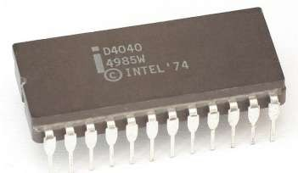
INTEL 4040
Introduced in 1974.
It was also 4-bit µP.
6

Slide 7
8-BIT MICROPROCESSORS
7

Slide 8
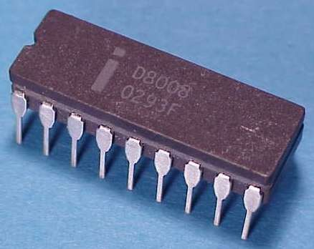
INTEL 8008
Introduced in 1972.
It was first 8-bit µP.
Its clock speed was 500 KHz.
Could execute 50,000 instructions per second.
8

Slide 9
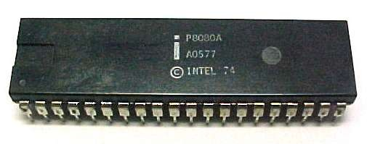
INTEL 8080
Introduced in 1974.
It was also 8-bit µP.
Its clock speed was 2 MHz.
It had 6,000 transistors.
Was 10 times faster than
8008.
Could execute 5,00,000 instructions per second.
9

Slide 10
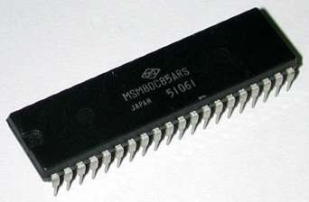
INTEL 8085
Introduced in 1976.
It was also 8-bit µP.
Its clock speed was 3 MHz.
Its data bus is 8-bit and address bus is 16-bit.
It had 6,500 transistors.
Could execute 7,69,230 instructions per second.
It could access 64 KB of
memory.
It had 246 instructions.
10

Slide 11
16-BIT MICROPROCESSORS
11

Slide 12
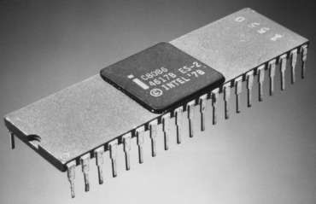
Introduced in 1978.
INTEL 8086
It was first 16-bit µP.
Its clock speed is 4.77 MHz, 8 MHz and 10 MHz, depending on the version.
Its data bus is 16-bit and address bus is 20-bit.
It had 29,000 transistors.
Could execute 2.5 million instructions per second.
It could access 1 MB of memory.
It had 22,000 instructions.
It had Multiply and Divide
instructions.
12

Slide 13
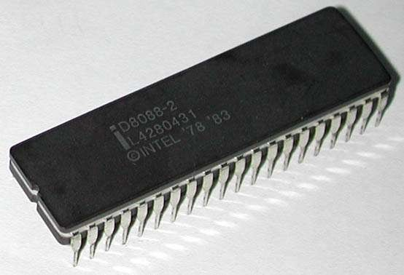
INTEL 8088
Introduced in 1979.
It was also 16-bit µP.
It was created as a cheaper
version of Intel’s 8086.
It was a 16-bit processor with an 8-bit external bus.
13

Slide 14
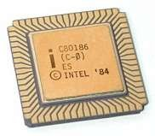
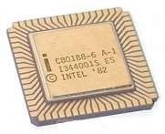
INTEL 80186 & 80188
Introduced in 1982.
They were 16-bit µPs.
Clock speed was 6 MHz.
14

Slide 15
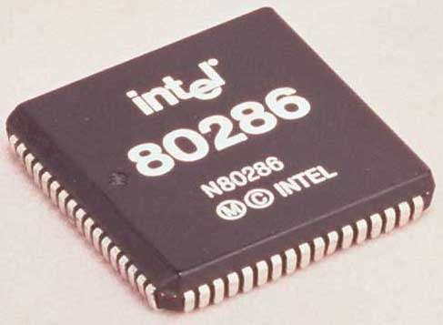
INTEL 80286
Introduced in 1982.
It was 16-bit µP.
Its clock speed was 8 MHz.
15

Slide 16
32-BIT MICROPROCESSORS
16

Slide 17
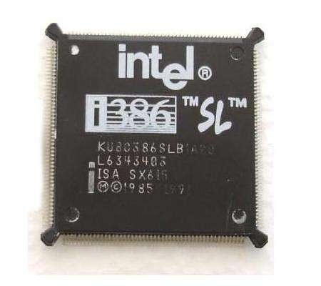
Introduced in 1986.
INTEL 80386
It was first 32-bit µP.
Its data bus is 32-bit and address bus is 32-bit.
It could address 4 GB of memory.
17

Slide 18
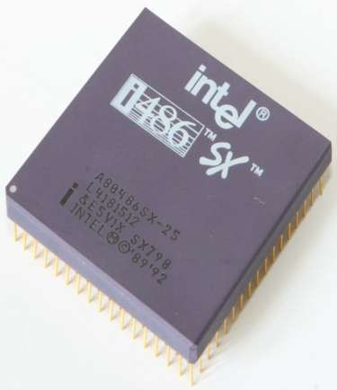
Introduced in 1989.
INTEL 80486
It was also 32-bit µP.
It had 1.2 million transistors.
Its clock speed varied from 16 MHz to 100 MHz depending upon the various versions.
18

Slide 19
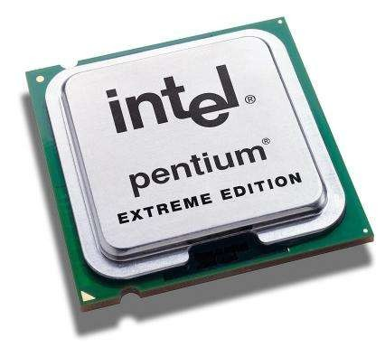
Introduced in 1993.
INTEL PENTIUM
It was also 32-bit µP.
It was originally named 80586.
Its clock speed was 66 MHz.
19

Slide 20
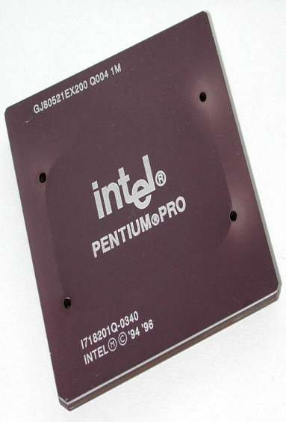
INTEL PENTIUM PRO
Introduced in 1995.
It was also 32-bit µP.

Slide 21
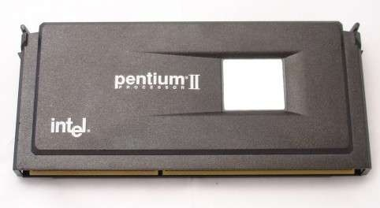
INTEL PENTIUM II
Introduced in 1997.
It was also 32-bit µP.
21

Slide 22
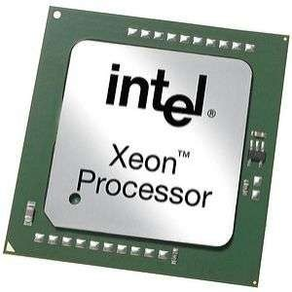
INTEL PENTIUM II XEON
Introduced in 1998.
It was also 32-bit µP.
22

Slide 23
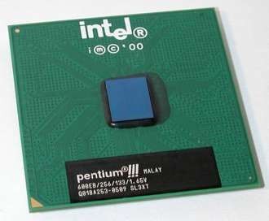
INTEL PENTIUM III
Introduced in 1999.
It was also 32-bit µP.
23

Slide 24
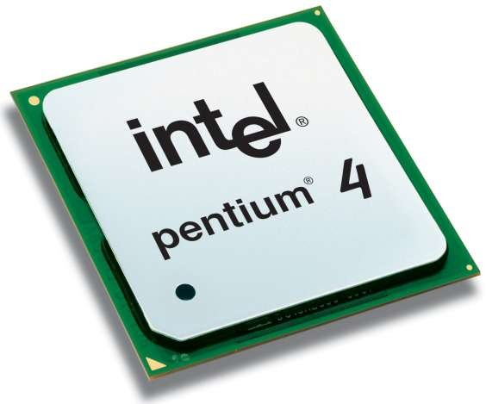
INTEL PENTIUM IV
Introduced in 2000.
It was also 32-bit µP.
24

Slide 25
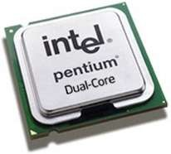
INTEL DUAL CORE
Introduced in 2006.
It is 32-bit or 64-bit µP.
It has two cores.
Both the cores have there own internal bus and L1 cache, but share the external bus and L2 cache
25

Slide 26
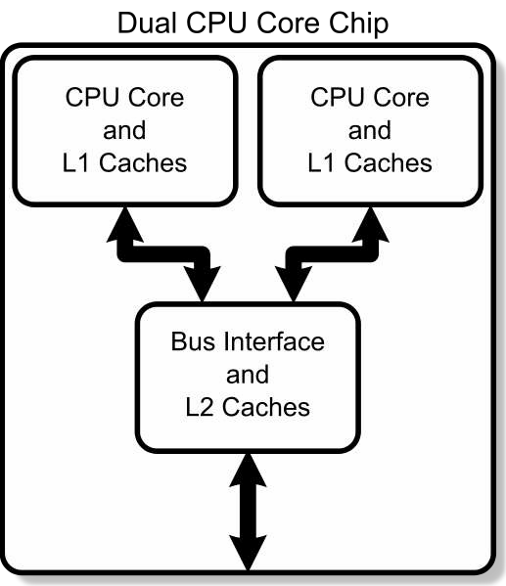
26

Slide 27
64-BIT MICROPROCESSORS
27

Slide 28
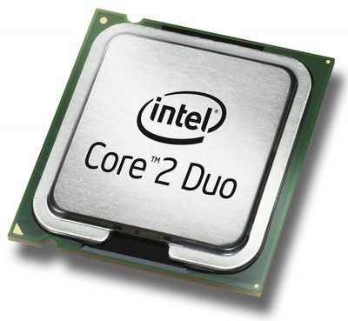
INTEL CORE 2
Introduced in 2006.
It is a 64-bit µP.
28

Slide 29
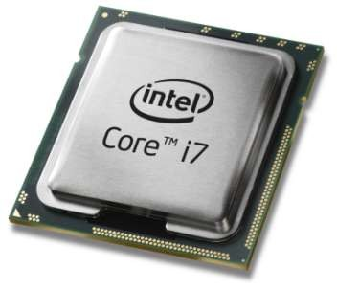
INTEL CORE I7
Introduced in 2008.
It is a 64-bit µP.
29

Slide 30
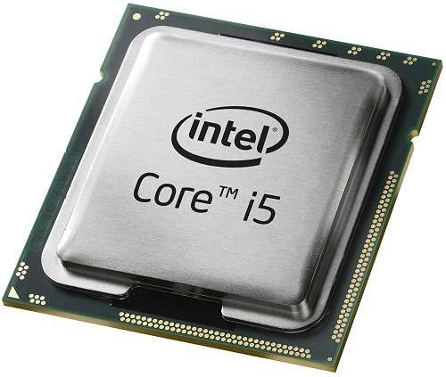
INTEL CORE I5
Introduced in 2009.
It is a 64-bit µP.
30

Slide 31
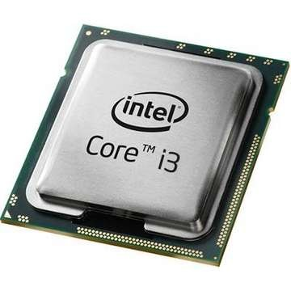
INTEL CORE I3
Introduced in 2010.
It is a 64-bit µP.
31

Slide 32
The salient features of 8085 microprocessor.

Slide 33
8085 Microprocessor
The salient features of 8085 μp are :
It is a 8 bit microprocessor.
It has 16 bit address bus and hence can address up to 2¹⁶ = 65536 bytes (64KB) memory locations through A0-A15.
The first 8 lines of address bus and 8 lines of data bus are multiplexed AD0 – AD7.
Data bus is a group of 8 lines D0 – D7.
It supports 5 hardware interrupt and 8 software interrupt.

Slide 34
8085 Microprocessor
A 16 bit program counter (PC)
A 16 bit stack pointer (SP)
Six 8-bit general purpose register arranged in pairs: BC,DE, HL.
It requires a signal +5V power supply
Maximum Clock Frequency is 3MHz and Minimum Clock Frequency is 500kHz

Slide 35
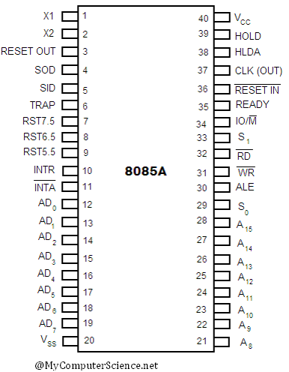
Pin Diagram of 8085

Slide 36
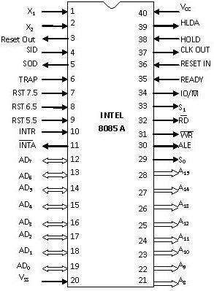
X₁ & X₂
Pin 1 and Pin 2 (Input)
These are also called
Crystal Input Pins.
8085 can generate clock signals internally.
To generate clock signals internally, 8085 requires external inputs from X₁ and X₂.

Slide 37
RESET IN and RESET OUT
Pin 36 (Input) and Pin 3 (Output)
RESET IN:
It is used to reset the microprocessor.
It is active low signal.
When the signal on this pin is low for at least 3 clocking cycles, it forces the microprocessor to reset itself.

Slide 38
RESET IN and RESET OUT
Pin 36 (Input) and Pin 3 (Output)
Resetting the microprocessor means:
Clearing the PC and IR.
Disabling all interrupts
(except TRAP).
Disabling the SOD pin.
All the buses (data, address, control) are tri- stated.
Gives HIGH output to RESET OUT pin.

Slide 39
RESET IN and RESET OUT
Pin 36 (Input) and Pin 3 (Output)
RESET OUT:
It is used to reset the peripheral devices and other ICs on the circuit.
It is an output signal.
It is an active high signal.
The output on this pin goes high whenever RESET IN is given low signal.
The output remains high as long as RESET IN is kept low.

Slide 40
SID and SOD
Pin 4 (Input) and Pin 5 (Output)
SID (Serial Input
Data):
It takes 1 bit input from serial port of 8085.
Stores the bit at the 8th position (MSB) of the Accumulator.
RIM (Read Interrupt Mask) instruction is used to transfer the bit.

Slide 41
SID and SOD
Pin 4 (Input) and Pin 5 (Output)
SOD (Serial Output Data):
It takes 1 bit from Accumulator to serial port of 8085.
Takes the bit from the 8th position (MSB) of the Accumulator.
SIM (Set Interrupt Mask) instruction is used to transfer the bit.

Slide 42
Interrupt Pins
Interrupt:
It means interrupting the normal execution of the
microprocessor.
When microprocessor receives interrupt signal, it discontinues whatever it was executing.
It starts executing new program indicated by the interrupt signal.
Interrupt signals are generated by external peripheral
devices.
After execution of the new program, microprocessor goes back to the previous program.

Slide 43
Sequence of Steps Whenever There
is an Interrupt
Microprocessor completes execution of current instruction of the program.
PC contents are stored in stack.
PC is loaded with address of the new program.
After executing the new program, the microprocessor returns back to the previous program.
It goes to the previous program by reading the top value of stack.

Slide 44
Five Hardware Interrupts in 8085
TRAP
RST 7.5
RST 6.5
RST 5.5
INTR

